Slide 1

Catholic Education Week 2022
Communion, Participation &
Mission
Pupil Resources Pr1-4
Notes:
During Catholic Education week, we will concentrate on the themes of the Synod communion (we come together as a unified Church). Participation (we are not passive-we take an active part in our faith, especially at Mass) and Mission ( all baptized Catholics have a mission to bring the Good News to others and to make new disciples .

Slide 2
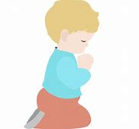


What are we learning about this week?
I am learning :
About journeying together with others who love God
About ways to join in at Mass
About ways to share God’s Word with others
To thank God for our Community of Faith
. I can :
Tell others about the journey of faith we are on
Tell others about how we can join in at Mass
Tell others about God’s Word
Thank God for our Community of Faith
2

Slide 3

We travel towards God together!
People who love God want to know more about Him and to be with Him
It is good to be with other people who want to know about God too
Look at the picture>>>>
What can you see? Who can you see? Are they all the same? Why do you think they are all going in the same direction?
Draw and cut out a figure of yourself and add to your class/school display
Notes:
(Click)Explain to the children that God made everyone and he wants us to love Him and get to know Him better. All through our life, there will be times when we learn more about Him or want to be closer to him. Some examples of this are when we receive the sacraments, go to Mass or learn more about God in RE lessons. We can call this our journey of faith. Like any journey, it might be a bit lonely to travel by yourself so it is good to travel alongside others who also want to know more about God and to love Him more. (Click)We can call this our community of faith. Our school and our parish are our community of faith but we also join together with people who love God from all over the world. How lovely that we are all on this wonderful journey together! (click) Look at this special picture. This is a picture that you might have seen before. Over the past year or so, Pope Francis and all his bishops and priests are asking the whole community of faith, (that is all Catholic people, all over the world) about how they think our journey towards God is going-what is going well and what we could do better. These special discussions are called a Synod. Let’s look at the picture representing the synod: What can you see (sun, tree, people walking). Talk about the variety of people who are walking together- they are not the same but they are all going the same way. This is because they all love God and want to get closer to him by learning more about Him. Notice that the children are at the front. This is because children have a special place in God’s family-He loves them so much! Notice that the bishop, priest and nun are in the group with everyone else. No one is more important than anyone else-God wants us all to travel to be closer to Him. The tree in the picture looks a bit like Jesus ‘ outstretched hands to us on the cross- he is reaching out to each and every one of us. The sun in the picture reminds us that God’s love shines down on us all, wherever we are in the world. You may wish to print the Synod logo worksheet and use to record what the children discuss and tthink. (click) If desired, create your own class/school display, based on this Synod logo. Invite the children to draw and cut out figures of themselves from a variety of coloured paper and display them in a group, walking together in the same direction.

Slide 4
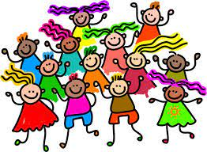
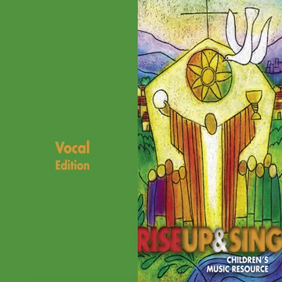

We belong to God’s Family song
‘We belong to God’s family,
brothers and sisters are we.
Singing together in unity
About one Lord and one faith
-one family’
Notes:
This song can be used to remind the children that we are one family of God and that we are in unity with people of faith all over the world. The children can join in the chorus as shown. Click on the picture to start)

Slide 5
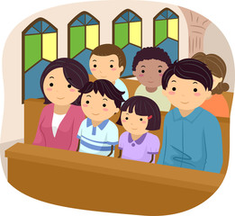
We take part!
It is good to go to Mass often with our school and family
It’s very important we join in!
Can you think of some ways to take part in the Mass?
Work with your partner to make a poster with some of your ideas
Try to remember your ideas next time you are at Mass and join in!
Notes:
During this activity, pupils are helped to realise we should be passive whilst at Mass-we are all expected to participate. Some ways we actively participate are: joining in with prayers, singing, making correct gestures, ministries (offertory/readings/passkeeping), going for a blessing if too young to receive communion. A simple proforma is available to make a poster with a partner.

Slide 6
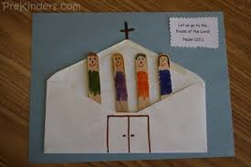
Make an envelope church
Open an envelope and stick this to some coloured paper
Decorate this to look like a church
Use a lolly stick/strips of card to make some of the people who help in our parish and put them into the envelope
Put yourself in too!
Make a sign with the name of our parish
Notes:
This craft activity is designed to impress on the children that they belong in the Church and they are an important part of their parish.
You will need: coloured backing paper, small envelopes, lollysticks/strips of card, glue and felt pens.

Slide 7
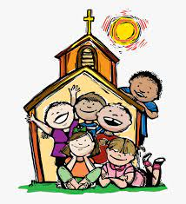
We tell others!
Everybody is welcome to come to Mass
It’s our job to encourage others
Make a list with your class of ways to encourage others to come to Mass
Make an invitation for your family to come to Mass at your parish this Sunday
Notes:
Jesus told his disciples, “be my witnesses, telling people about me everywhere—in Jerusalem, throughout Judea, in Samaria, and to the ends of the earth” (Acts 1:8,). This is the mission of all baptised Christians. We can share the Good News with others through our actions and by how we treat them. Equally important is actually telling others about God and welcoming them to share in the liturgy. In this activity, the children are encouraged to think of ways to encourage others to attend Mass i.e. by example, by telling others about Mass, by asking them to go. For the puposes of this activity, help the children to make an invitation to give their family for the next Sunday Mass at the parish. You will need to help them with the details such as Mass time etc. A simple proforma is included but invitations can be designed and decorated any way you wish. If your school is having a special Catholic Education week Mass at the local parish, this would be the ideal opportunity to invte families to attend with their children.

Slide 8

Time for prayer
Sign of the cross
We light the candle to remind us God is with us when we pray
Father in Heaven, we love to take time each day to be with you in prayer and we know that you are always ready to listen to us
We thank you, Father for helping us to know and love you more. We love to hear about your love for us and we want to tell other people about how much you love them too.
Thank you, Lord for our community of faith who are with us at Mass
Teacher: Lord hear us Children :Lord graciously hear us
Thank you, Lord for opportunities to learn more about you at home, in school and at Mass
Teacher: Lord hear us Children :Lord graciously hear us
Thank you God for our priests, teachers and families who help us to know and love you
Teacher: Lord hear us Children :Lord graciously hear us
Thank you God for being with us every time we go to Mass
Teacher: Lord hear us Children :Lord graciously hear us
We sing our song to end our time of prayer

Slide 9
What have we learned about this week?
I learned :
About journeying together with others who love God
About ways to journey together
About ways to share God’s Word with others
To thank God for our Community of Faith
. I can :
Tell others about the journey of faith we are on
Tell others about how we can join in on this journey
Tell others about God’s Word
Thank God for our Community of Faith
9

