Slide 1

Catholic Education Week 2023
Pilgrims of Faith
Notes:
Each year in our parish and school communities we stop and take some time to reflect on Catholic education and to celebrate the great work that is achieved in our schools . During Catholic Education Week, Catholic schools all over Scotland reflect on the same theme and this year our theme is Pilgrims of Faith.

Slide 2
Pilgrims of Faith
Notes:
We are going to explore this theme further in today’s lesson. Think Pair and Share: What do the children already know about the words ‘pilgrim’ and ‘faith’? Have they heard these words before? Perhaps they know someone who has been on a pilgrimage. What does it mean to have faith in something or someone?
Take responses from the pupils.
Explain to the pupils that A journey to a holy place is called a pilgrimage. A person who makes such a journey is a pilgrim. Pilgrimages have been a part of the world’s major religions since ancient times. Can they think of some Catholic places that people might go on pilgrimage to? Lourdes, Fatima, Rome, Assisi etc.
To have Faith means to have belief and trust in God. Faith is a gift from God.

Slide 3
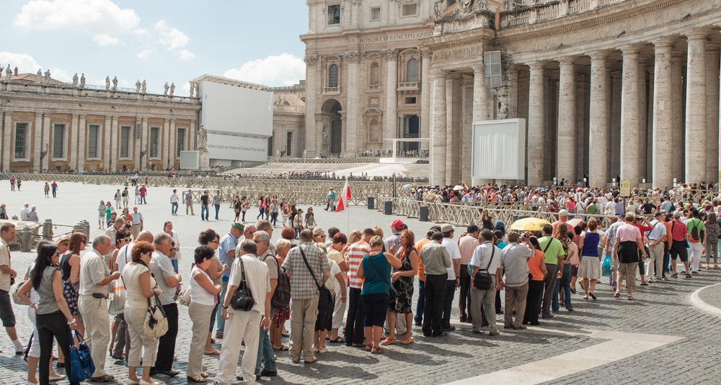
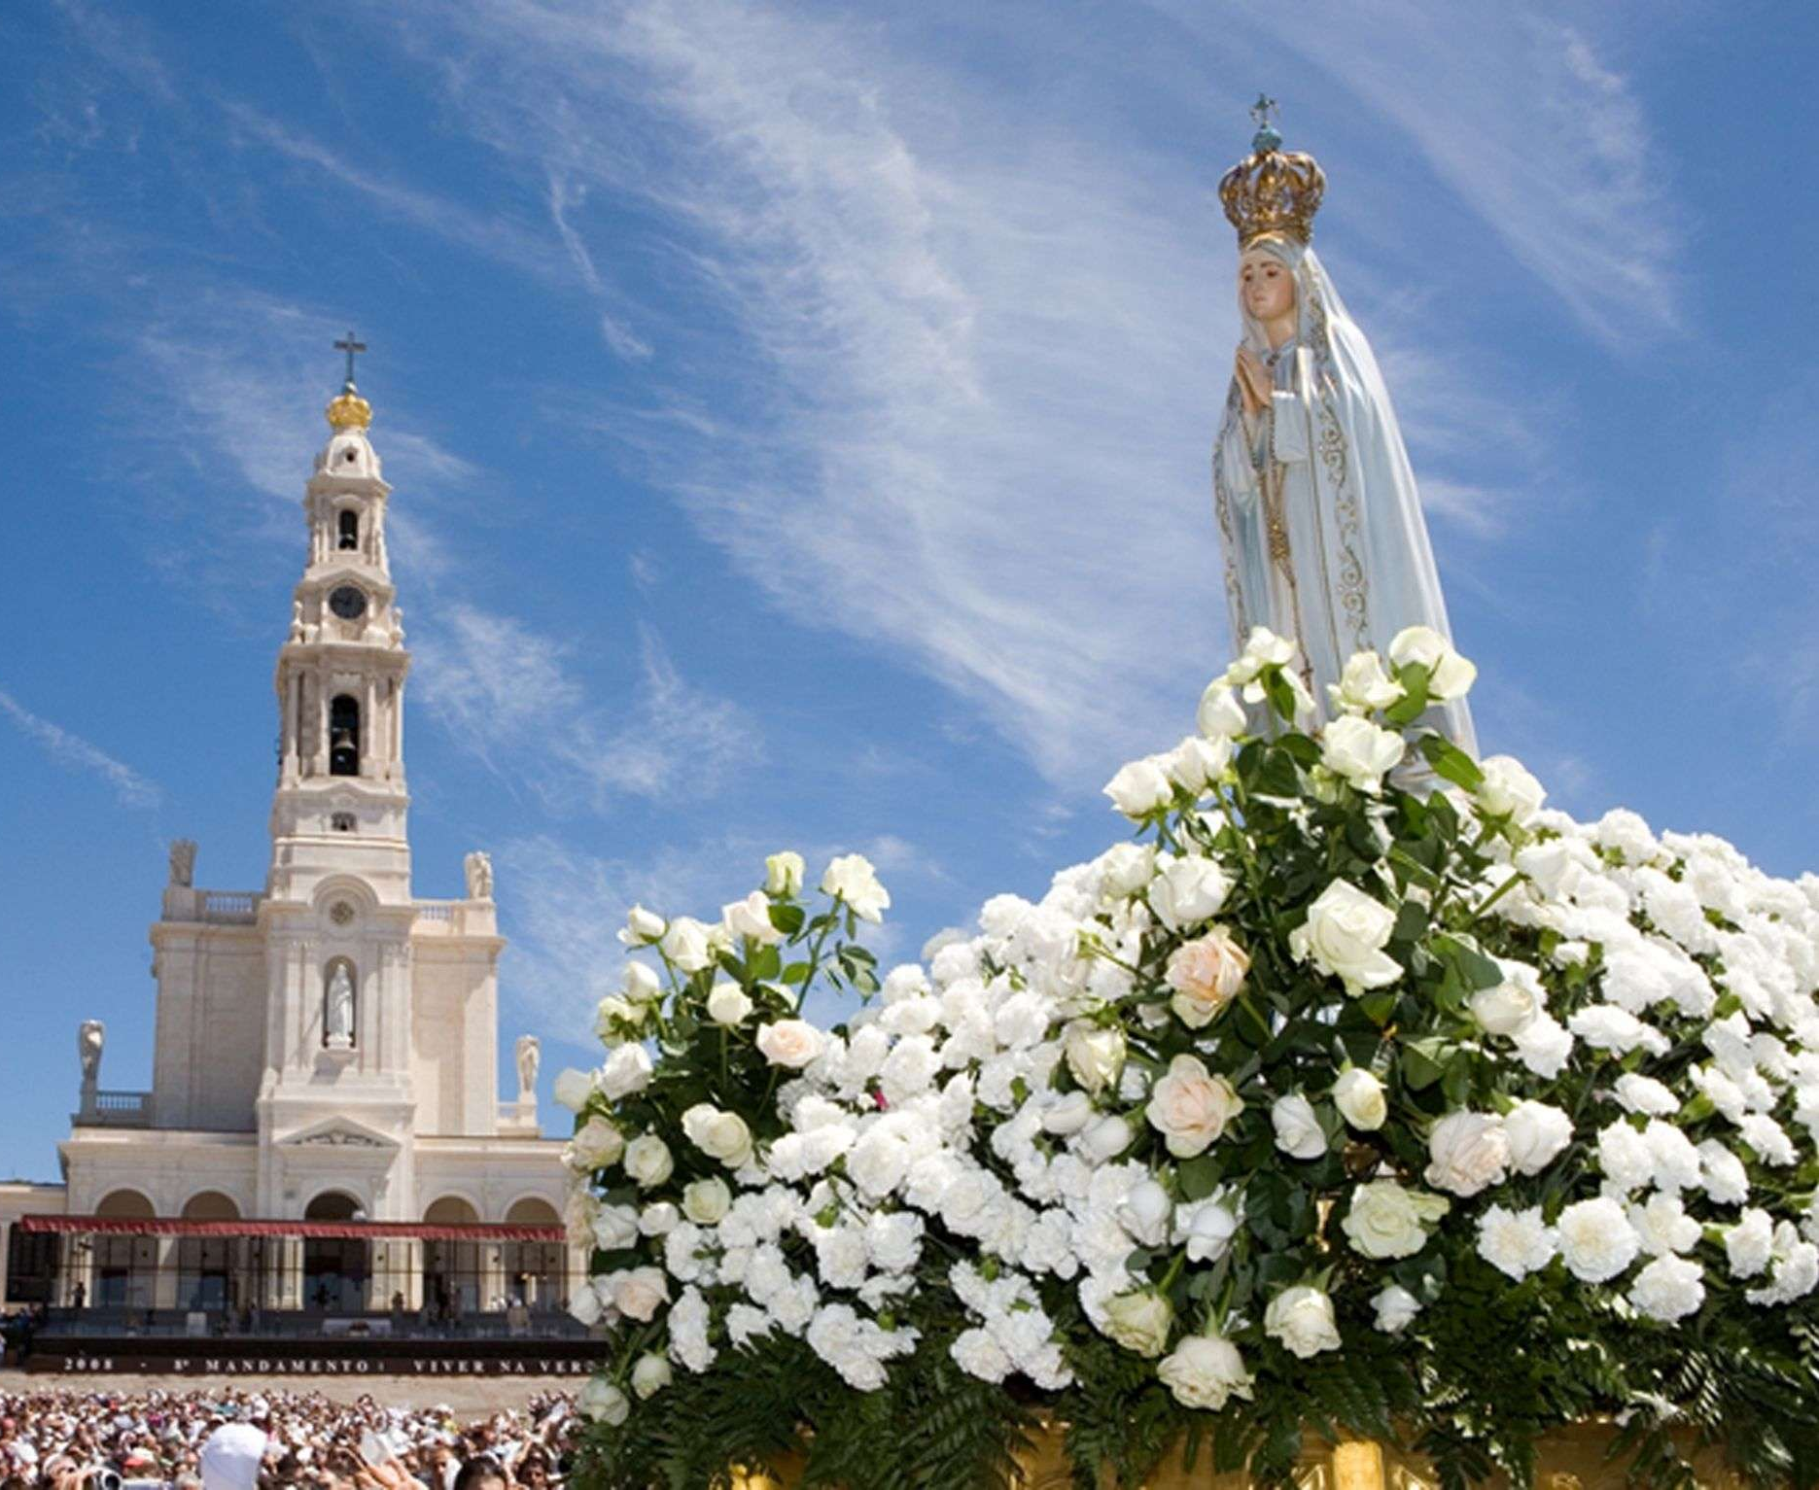
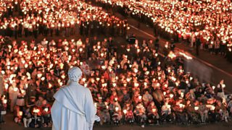
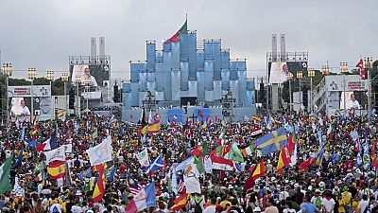
Notes:
Every year Catholics travel all over the world on pilgrimage. Pictures on the screen include: Rome, Fatima, Lisbon World Youth Day 2023, Lourdes Candlelight procession).
They go on a physical journey (take a plane, train, travel by some other means) but they are also on a journey of faith. As Catholics, we are all on a journey of faith. We hope one day to be with God in heaven and we spend our time here on earth praying, participating in the Sacraments and doing our best to live as Jesus taught us. By doing this we are growing and journeying in faith.

Slide 4
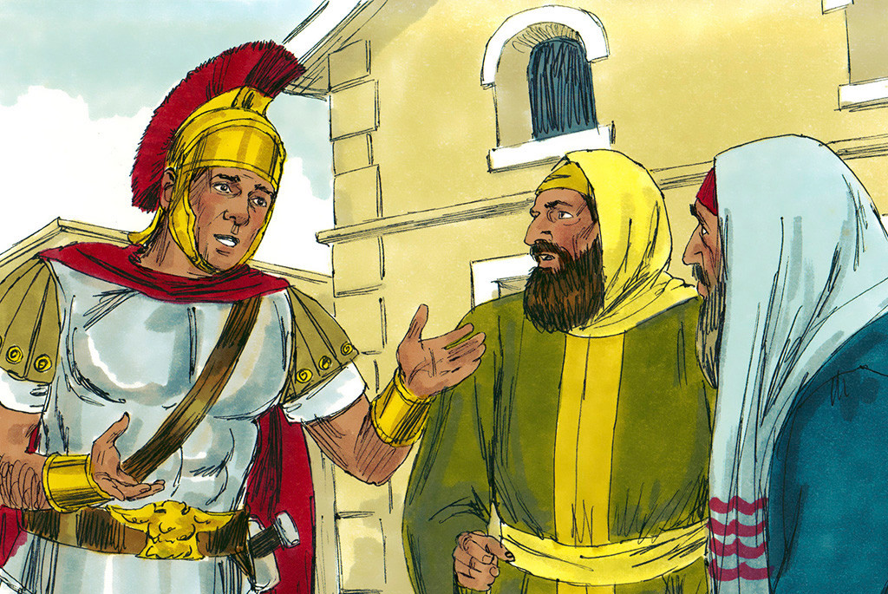
Notes:
Let’s look at an example of Faith from Matthew’s Gospel:
A pupil or the teacher should read the passage aloud.
Matthew 8:5-10, 13
Jesus Heals a Soldier’s Servant
⁵ Jesus went to the city of Capernaum. When he entered the city, an army officer came to Jesus and begged for help. ⁶ The officer said, “Lord, my servant is at home in bed. He can’t move his body and is in much pain.”
⁷ Jesus said to the officer, “I will go and heal him.”
⁸ The officer answered, “Lord, I am not good enough for you to come into my house. All you need to do is command that my servant be healed, and he will be healed. ⁹ I myself am a man under the authority of other men. And I have soldiers under my command. I tell one soldier, ‘Go,’ and he goes. I tell another soldier, ‘Come,’ and he comes. I say to my servant, ‘Do this,’ and my servant obeys me.
¹⁰ When Jesus heard this, he was amazed. He said to those who were with him, “I tell you the truth. This man has more faith than any other person I have found, even in Israel. ¹¹ Many people will come from the east and from the west.
¹³ Then Jesus said to the officer, “Go home. Your servant will be healed just as you believed he would.” And at that same time his servant was healed.
Discuss the passage with the pupils. Explain the role and authority that a Roman Centurion would have had. How did the Roman Centurion demonstrate his faith in Jesus? He didn’t only have faith he acted on that faith and sought out Jesus.
Ask the pupils to think of a time that someone demonstrated their faith in God. This could be another scripture passage, a saint, someone they know personally.

Slide 5
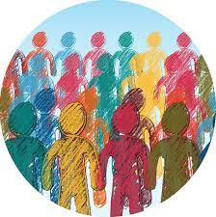
Community of Faith
Notes:
In our school we often use the phrase Community of Faith. As a Community of Faith we gather together to pray, celebrate Mass, we learn about our faith and we try to live out our faith in the way that we treat and care for others in our community and beyond.
A person of faith believes in God and all that God has done. But faith is not simply a belief that something is true, it is a way of living. We are called not only to keep the faith but to live a faithful life filled with hope and love.
Ask the pupils to make a list of all of the ways that they can or do demonstrate their faith in God.

