Slide 1

Catholic Education Week 2023
Pilgrims of Faith
Notes:
In our previous learning we have explored what it means to be a Pilgrim of Faith, we have reflected on the lives of the saints and the ways in which they demonstrated their faith in God.

Slide 2
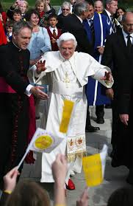
Pilgrims of Faith: Called to be Saints
Notes:
We have an opportunity in our Catholic schools to learn more about Jesus, His teachings and to grow in our faith. We also have the example of the saints to help, guide and inspire us.
13 years ago (In September 2010), Pope Emeritus Benedict XVI (Pope Francis’ predecessor) visited the UK and spent some time in Scotland.

Slide 3
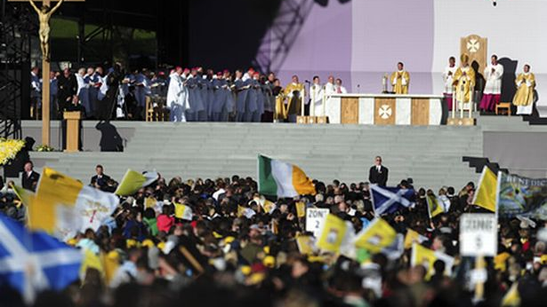
Mass at Bellahouston Park
September 2010
Notes:
He even celebrated Mass in Bellahouston Park with around 70,000 people. People lined the streets, waving papal flags, in the hope of catching sight of him as he passed by.
Perhaps you could ask your relatives if they have any fond memories of this day?

Slide 4
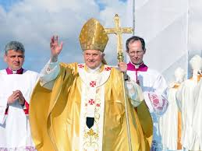
“I hope that among those of you listening to me today there are some of the future saints of the twenty-first century.”
Pope Benedict XVI
Notes:
As part of his visit to the UK, Pope Emeritus Benedict XVI also visited St Mary’s University Twickenham (London) where he spoke to school pupils from all over the UK.
While speaking to the students he invited them to become saints. This may sound a little strange at first but he explained that we are all called to be saints and to grow in holiness.
As Pilgrims of Faith we are on a journey. Recap previous day’s learning: We hope one day to be with God in heaven and we spend our time here on earth praying, participating in the Sacraments and doing our best to live as Jesus taught us. By doing this we are growing and journeying in faith.
We will now watch a short clip of Pope Emeritus Benedict XVIs visit before exploring what he said in more detail.

Slide 5
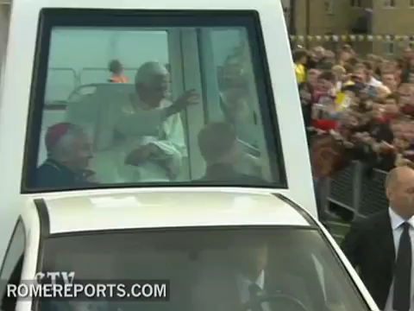
Notes:
Play short clip of visit to St Mary’s Twickenham.
Throughout this week we will look at extracts from his speech and think about the lessons that we can learn from his words.

