Slide 1


Catholic
Education
Week
2022-2023

Slide 2


Holy Spirit, we gather together in Your name.
You alone guide us, come into our hearts;
Teach us the way we must go and how we can get there.
We are sinful; sometimes we do not make loving choices.
Do not let us become confused.
Do not let anything lead us down the wrong path.
Help us to think before we act.
Let us find our unity in you so that we can
journey together to eternal life
and always know the way of truth and what is right.
All this we ask of You, who are everywhere, all the time,
in the communion of the Father and the Son, forever and ever.
Amen.
Notes:
Opening Prayer

Slide 3
Communion
Participation
Mission
Notes:
Think, Pair and Share: definitions of the three words we learned about last lesson.
Check their answers with the next slide.

Slide 4



Communion: We come together as Children of God
Participation: We serve one another
Mission: We witness to the love of God
Notes:
Today we are going to think about how we do each of these things in our Catholic school. Across Scotland there are over 300 Catholic schools. Within each school there are pupils and staff who each day are trying their best to live as Jesus called us to. This not only has an impact on our own school communities but on the wider society and the world too. Just think of all of the prayers, fundraising and good work that is done in your school community and multiply that by 300!
Over these last few lessons, we have been learning about the Synod and it’s theme: Communion, Participation, Mission. As part of the Synod, we are asked to reflect on how we are as a Church. Today we are going to reflect on how we are as a Catholic school within the Church community.

Slide 5
Communion
Participation
Mission
Notes:
With the three words on the board, take suggestions from the pupils as to how we do each of these things as a school community e.g. Communion: how often do we gather together as Children of God (prayer, Mass, rosary, assembly etc.) Is there anything we could improve?
Once you have gathered a number of suggestions for each ask the pupils to choose one thing that they personally would like to improve on this year.

Slide 6
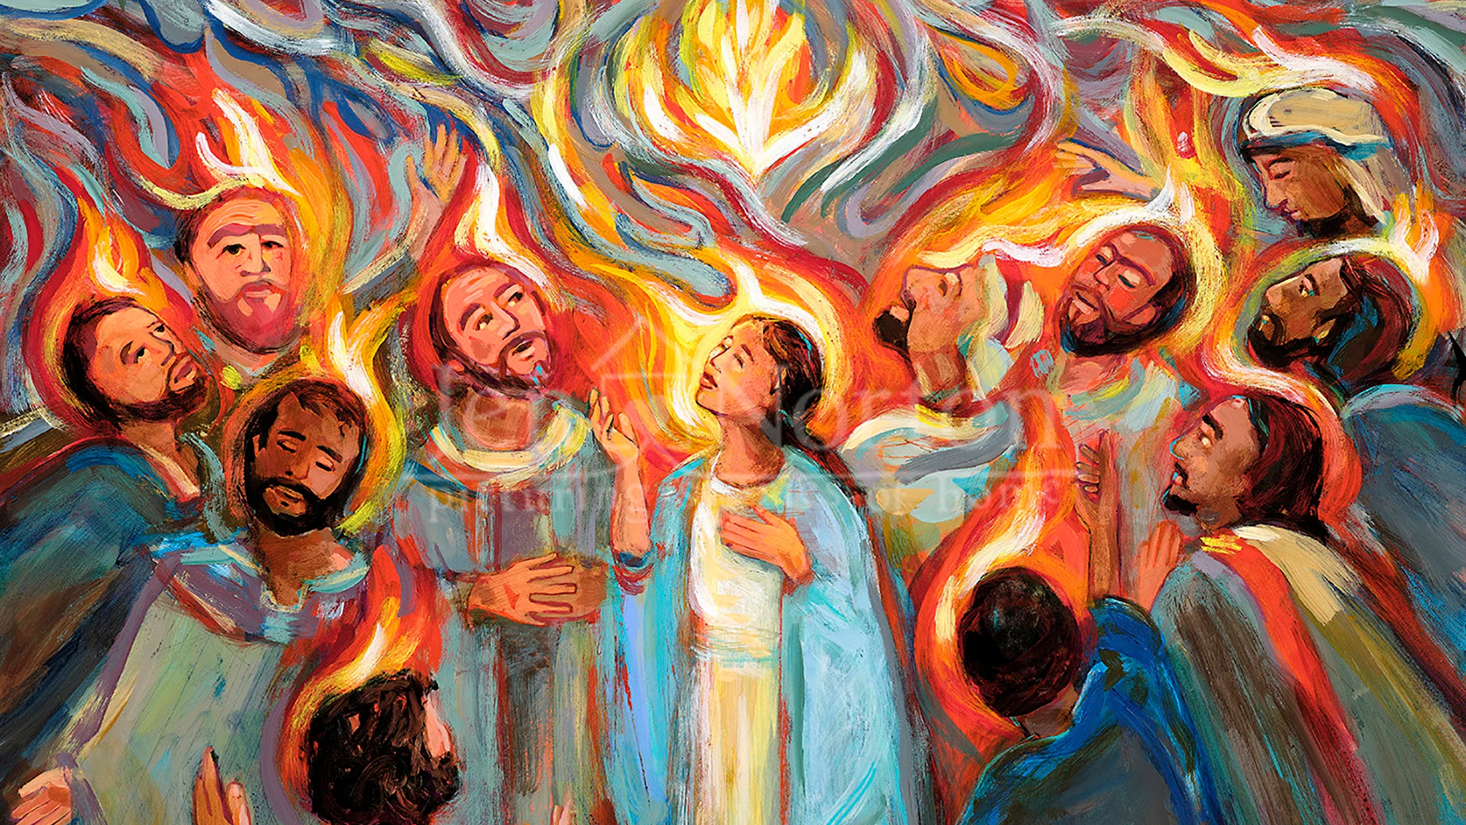
Notes:
Explain to the Pupils that the Holy Spirit will guide and support us with whatever we would like to get better at: prayer, relationship with God, how you treat others, being a courageous witness etc. We only have to ask.
Ask the pupils to write a short prayer to the Holy Spirit asking that they are given the gifts, strength, confidence to improve/do this important task.

