Slide 1


Catholic
Education
Week
2022-2023

Slide 2
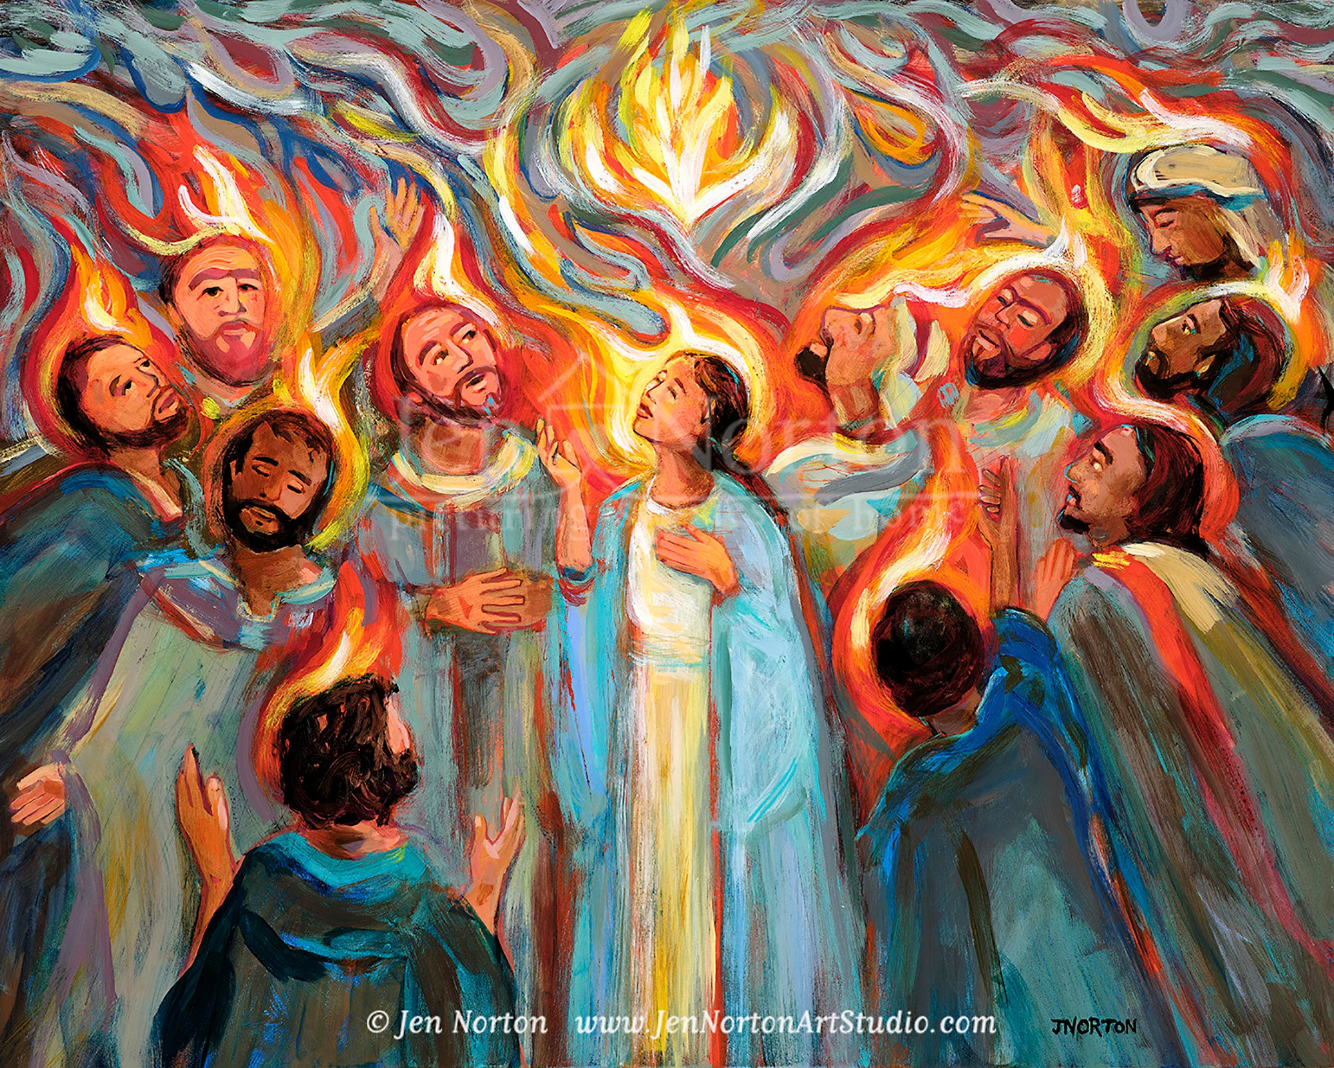
Notes:
In the Name of the Father, and of the Son, and of the Holy Spirit. Amen.
Gathering Prayer Leader: Come Holy Spirit, fill the hearts of your faithful and kindle in them the fire of your love. Leader: Send forth your Spirit and they shall be re-created. And You shall renew the face of the earth. O God, who by the light of the Holy Spirit, did instruct the hearts of the faithful, grant that by the same Spirit we may be truly wise and ever rejoice in His consolation, through Jesus Christ Our Lord, Amen.
The Word of God | Acts 2: 1-11, 14-19
Reader: A reading from the Acts of the Apostles
When the time for Pentecost was fulfilled, they were all in one place together And suddenly there came from the sky a noise like a strong driving wind, and it filled the entire house in which they were.
Then there appeared to them tongues as of fire, which parted and came to rest on each one of them. And they were all filled with the Holy Spirit and began to speak in different tongues, as the Spirit enabled them to proclaim.
Now there were devout Jews from every nation under heaven staying in Jerusalem. At this sound, they gathered in a large crowd, but they were confused because each one heard them speaking in his own language. They were astounded, and in amazement they asked, “Are not all these people who are speaking Galileans Then how does each of us hear them in his native language? We are Parthians, Medes, and Elamites, inhabitants of Mesopotamia, Judea and Cappadocia, Pontus and Asia, Phrygia and Pamphylia, Egypt and the districts of Libya near Cyrene, as well as travelers from Rome, both Jews and converts to Judaism, Cretans and Arabs, yet we hear them speaking in our own tongues of the mighty acts of God.”
The Word of the Lord ALL: Thanks be to God
In the Name of the Father, and of the Son, and of the Holy Spirit. Amen.
Explain to the pupils that they are going to explore this year’s Catholic Education Week theme in more detail. Can they remember it? Click for next slide.

Slide 3

Communion
Participation
Mission

Slide 4

God gathers us together as His children.
We are untied in our love of God.
It is Christ who reconciles us to the Father and unites us with each other in the Holy Spirit.
Communion: We come together as Children of God

Slide 5

All of us are called to serve one another through the gifts we have each received.
We are guided by the Holy Spirit.
We are involved in our Church communities.
Participation: We serve one another

Slide 6

The Church exists to evangelize.
We can never be centered on ourselves.
Our mission is to witness to the love of God in the midst of the whole human family.
Mission: We witness to the love of God

Slide 7
Communion
Participation
Mission
Notes:
Can they identify the themes of communion, participation and mission in the scripture passage they heard earlier? If required you could read this again.

Slide 8
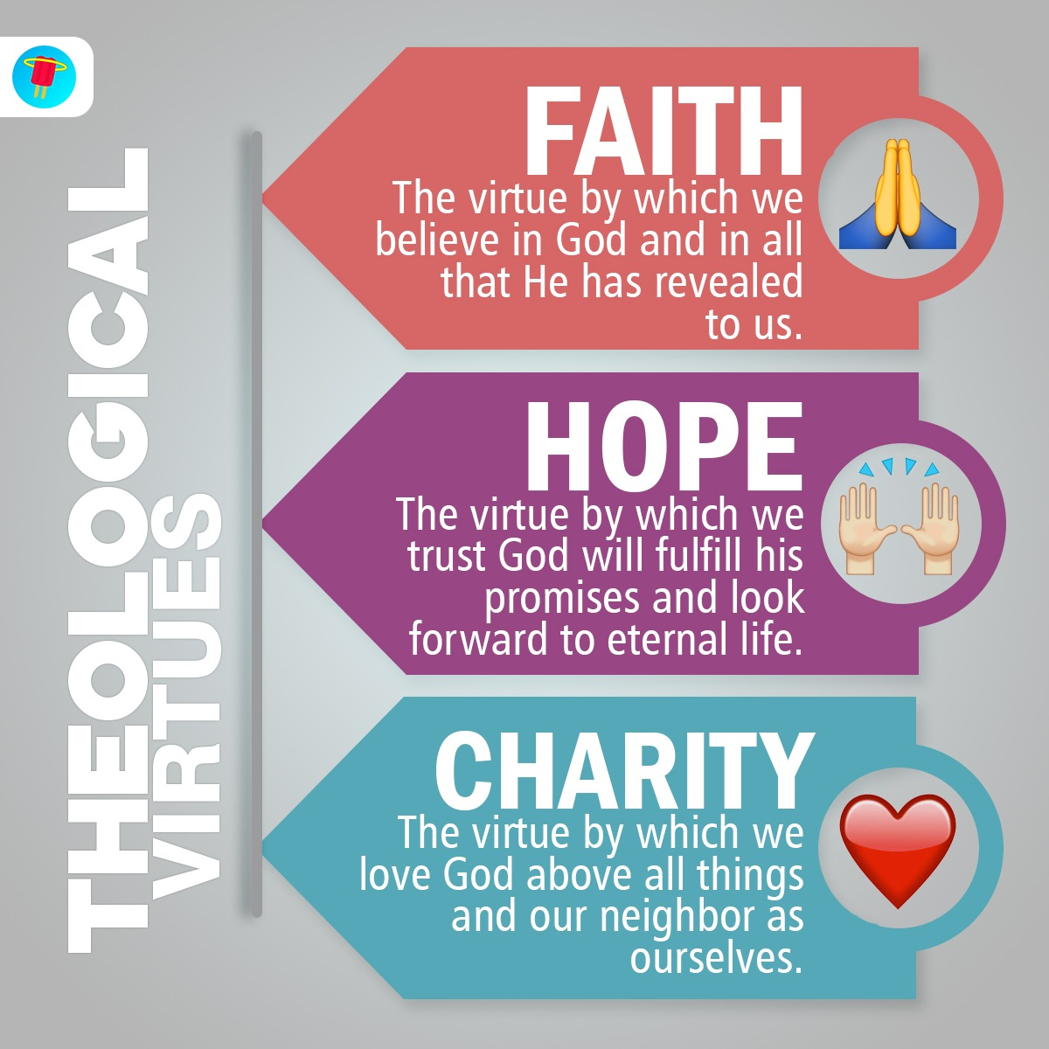
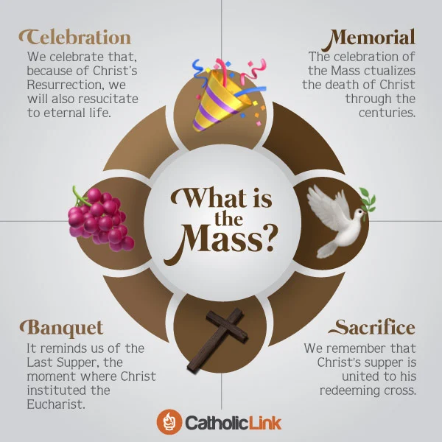
Notes:
On the screen are two examples of infographics. Infographics give an easy to understand overview of a topic/theme. Today we are going to design an infographic explaining the theme: Communion, Participation, Mission. It can take any format but should include the three words, a short definition and some images.

Slide 9

Holy Spirit, we gather together in Your name.
You alone guide us, come into our hearts;
Teach us the way we must go and how we can get there.
We are sinful; sometimes we do not make loving choices.
Do not let us become confused.
Do not let anything lead us down the wrong path.
Help us to think before we act.
Let us find our unity in you so that we can
journey together to eternal life
and always know the way of truth and what is right.
All this we ask of You, who are everywhere, all the time,
in the communion of the Father and the Son, forever and ever.
Amen.
Notes:
Closing prayer

