Slide 1

Catholic Education Week 2022
Communion
Participation
Mission

Slide 2
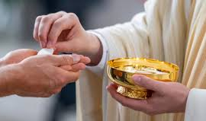
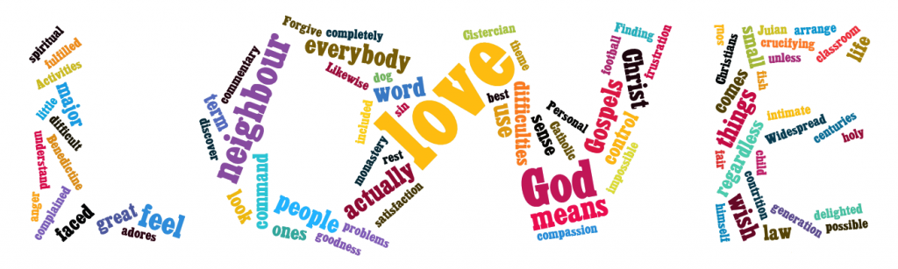
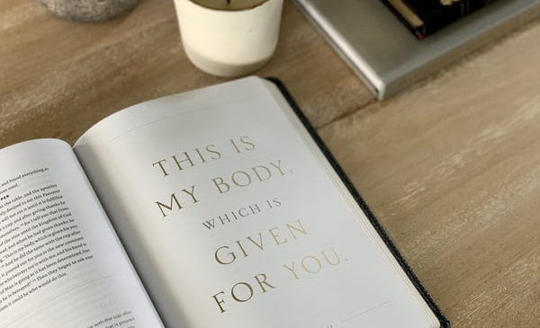
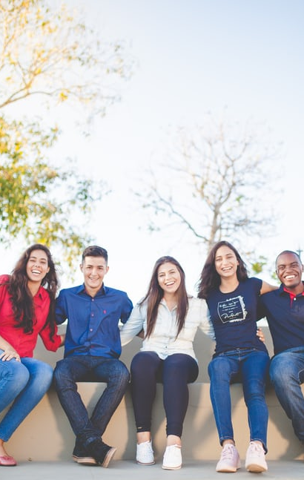
What does the word
‘communion’ mean to you?
Communion

Slide 3
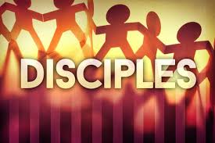
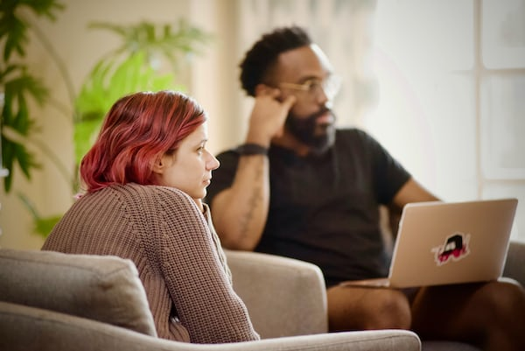
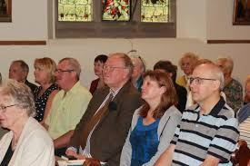
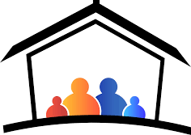
What does the word ‘participation’ mean to you?
Participation

Slide 4

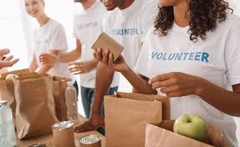
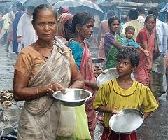
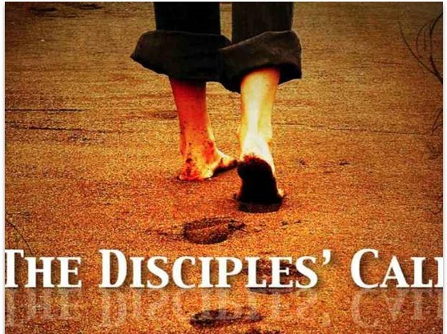
What does the word ‘mission’ mean to you?
Mission

Slide 5

Synod
These words are very important as they are the themes for the Synod meeting next year in Rome. You can see them in the baseline of the Synod logo.
You might have completed some lessons on the questions being asked in each diocese in preparation for the Synod. If you did, think back to the questions and your responses.

Slide 6
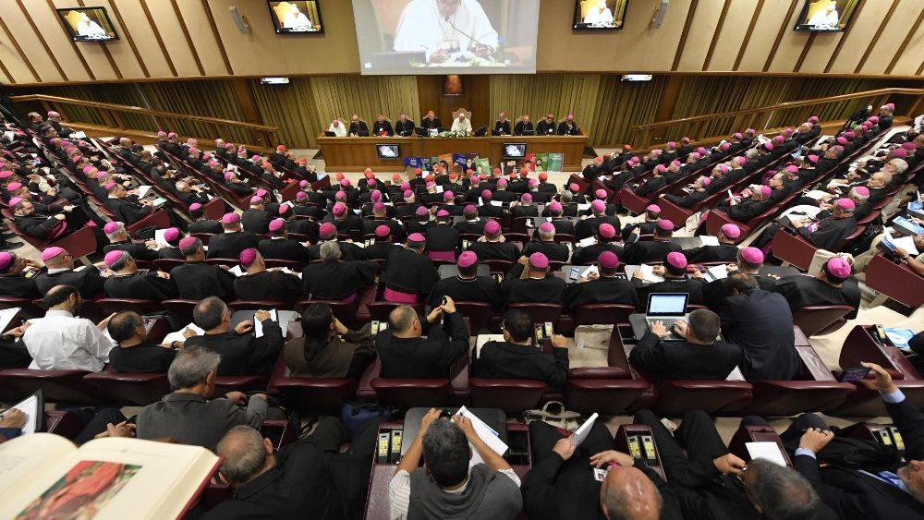
Why is there a Synod meeting in Rome next year?
Pope Francis announced that there would be a Synod in October 2023 so the entire worldwide Church could reflect on these themes of communion, participation and mission.

Slide 7
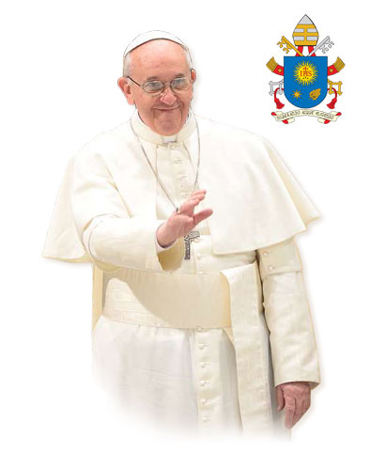
The Church is the People of God – we are pilgrims journeying together
Pope Francis wants us, the Church, to reflect on where we have journeyed until now and where we are headed in the future. Through such intense reflection Pope Francis wants the Church to learn through Her experience, and consider which processes can help Her to:
live communion
achieve participation, and
open Herself to mission

Slide 8

This clip helps explain the words Communion, Participation & Mission
After watching this clip discuss again what is meant by communion, participation and mission

Slide 10
Activity 1 – The Synod Logo
Look carefully at the Synod logo.
Write down all the things that you can see depicted in the logo
Share your list with your shoulder partner
Choose 5 images from your list – why do you think they have been included in the logo?
Share your thoughts with your shoulder partner
Have a class discussion about the logo – in what ways does this logo explain the Synodal journey that the Church is on right now?

Slide 11
Ask yourself:
What do you think the tree represents?
What is the tree reaching up to?
Why are these 15 silhouettes depicted?

Slide 12
The tree is reaching for the sky. It is a sign of deep vitality and hope which expresses the cross of Christ. It carries the Eucharist, which shines like the sun. The horizontal branches, opened like hands or wings, suggest, at the same time, the Holy Spirit.
The People of God are not stationary: they are on the move, in direct reference to the word synod, which means "walking together". The people are united by the same common dynamic that this Tree of Life breathes into them, and there they begin their walk together.

Slide 13
The 15 silhouettes sum up all humanity in all its diversity of life situations of generations and origins. This aspect is reinforced by the multiplicity of bright colours which are themselves signs of joy. There is no hierarchy between these people who are all on the same footing: young, old, men, women, teenagers, children, lay people, religious, parents, couples, singles, the disabled; the bishop and the nun are not in front of them, but among them. The group are all journeying together. Did you identify these different people in the image?
The horizontal baseline runs from left to right in the same direction the group is marching, underlining and strengthening it. It ends with the title "Synod 2021 - 2023", which is the high point that synthesises the whole.

Slide 14
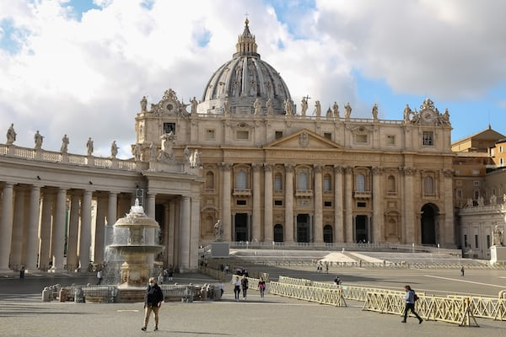
Having read the description of the logo in what ways does it help express the purpose of the Synod?
Which element of the logo has the most meaning for you? Why?
What are your hopes for the discussions at the Synod? Why?

Slide 15
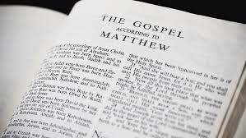
Part 2: Scripture and our Synodal Journey
How can reading the Bible help us on our Synodal journey?
As the People of God journey together, the Word of God in scripture is our food for the journey. As we read it and pray it, we encounter Christ in our midst and see ourselves, our Church, and our world through the eyes of faith.

Slide 16
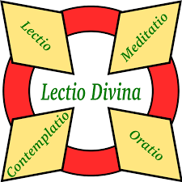
Lectio Divina
The Synod 2021-2023 emphasizes listening attentively to the Word of God.
The practice of Lectio Divina remains a long-standing tradition in the Christian Church. Lectio Divina is a form of prayer where you contemplate on a passage of scripture.

Slide 17
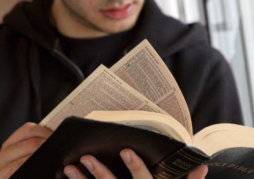
Believing that the Scriptures contain God’s Word to us, engaging in this practice teaches us to pray by the inspiration of the Holy Spirit.
What you do:
First, you read the text slowly and deliberately;
Second you meditate or reflect on what you have just read, focusing on what touched your heart, stopped you in your reading;
Third, you pray from what inspired or touched you in the text, drawing from your life experiences, your hopes, your relationship with God; and
Fourth, you contemplate further from what you read, pondered, and prayed in an environment of silence.

Slide 18
Lectio Divina Mark 2:1 -12
Jesus Forgives and Heals a Paralysed Man
Read this passage following the 4 stages of Lectio Divina – Read, Meditate, Pray, Contemplate
A few days later, when Jesus again entered Capernaum, the people heard that he had come home.
They gathered in such large numbers that there was no room left, not even outside the door, and he preached the word to them. Some men came, bringing to him a paralysed man, carried by four of them.
Since they could not get him to Jesus because of the crowd, they made an opening in the roof above Jesus by digging through it and then lowered the mat the man was lying on. When Jesus saw their faith, he said to the paralysed man, “Son, your sins are forgiven.”
Now some teachers of the law were sitting there, thinking to themselves, “Why does this fellow talk like that? He’s blaspheming! Who can forgive sins but God alone?” Immediately Jesus knew in his spirit that this was what they were thinking in their hearts, and he said to them, “Why are you thinking these things? Which is easier: to say to this paralysed man, ‘Your sins are forgiven,’ or to say, ‘Get up, take up your mat and walk’? But I want you to know that the Son of Man has authority on earth to forgive sins.” So, he said to the man, “I tell you, get up, take your mat and go home.” He got up, took his mat and walked out in full view of them all. This amazed everyone and they praised God, saying, “We have never seen anything like this!”

Slide 19
Some background to this scripture passage:
This passage in Mark’s Gospel stands within a series of narratives about Jesus’ healing miracles and his confrontations with those who oppose his teaching and example. The language that Jesus uses carries a strong sense of authority, and the people respond to it. The point of conflict here centres around Jesus’ authority to forgive sin (2:6-7). His opponents’ comment, “Who can forgive sins but God alone.”
Jesus then moves from words to action, by healing the paralytic. This leads to a joyful response of the people: “This amazed everyone, and they praised God, saying, ‘We have never seen anything like this!’” They praise God who has acted in this context; this is followed by the wonder of those who have witnessed this miracle.

Slide 20
Key points:
Jesus speaks, and his words become reality.
Initially, Jesus tells the man his sins are forgiven. Remember, in biblical times, illness was considered as a punishment for sin. We can see a connection here between forgiveness and healing.
Jesus ‘knew in his spirit’ that some were opposed to his actions. Jesus responded to their doubts and his words came into being.
We can consider the faith of the people who gathered to hear Jesus, the faith of the friends who carried the paralysed man and the faith of the paralytic himself. When your faith is blessed, as in this miracle, it can build up your trusting relationship with God.

Slide 21
How does this scripture passage help us focus on our synodal journey?
Working for the Service of Others:
The 4 friends were determined that, despite the crowds, their sick companion should be in the presence of Jesus. They united to both carry him to, and make extraordinary efforts to get him into, the house where Jesus was preaching. Synodality means that we work together, for the sake of each other, to contribute positively to the common good.
Working for Unity:
As Jesus preached, some responded with great faith and others chose to criticise Jesus for his words. Jesus remained true and good in his response to this division. As we journey together, we need to keep our minds and hearts focused on what is true and good. In the face of division, listen with an open heart, be honest, and strive for a positive outcome.

Slide 22
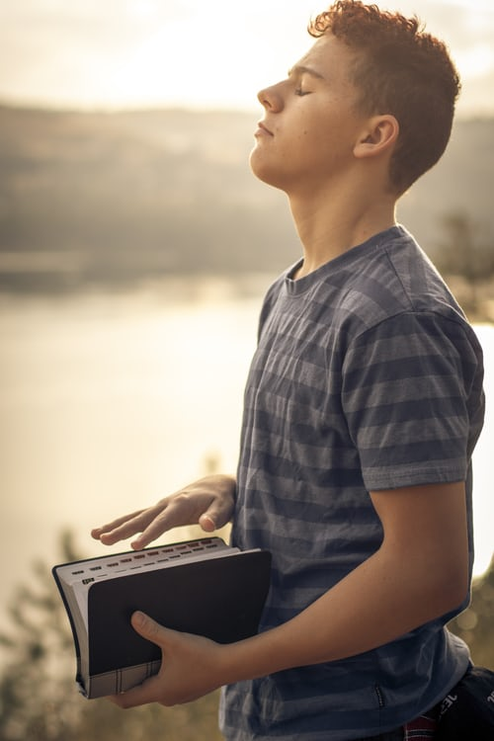
Questions for Prayerful Reflection
In what ways can synodality help us to:
Be healed?
Feel whole?
Find the truth?
Feel blessed?
Change our perspective on life?
Unite with others?
Work against division?
Always be honest and good?

Slide 23
Questions for Prayerful Reflection
Is there anyone you wish to bring to Christ?
Are there friends who have carried you?
Are there times when you regret not carrying someone?
What is it that you wish to say to Christ or ask of him?
What is the grace or gift that you desire?

Slide 24

“One must avoid the risk of an individualistic approach and remember, that God’s word is given to us precisely to build communion, to unite us in the Truth along our path to God.
Verbum Domini, 86

Slide 25
Part 3: Communion, Participation, Mission
The Synodal process invited us:
To gather as people of faith in order to listen to each other and discuss the ways we can best live out the call to love God and our neighbour.
As the People of God, to consider and give feedback about our aspirations for the future of the Church based on God’s will for us.
To act and give witness to God’s love in the way we treat others.

Slide 26
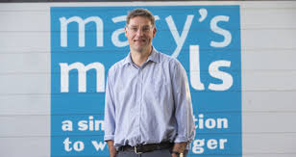
Mary’s Meals
Many individuals have been inspired by the teachings of the Gospels to reach out and help those in need. Mary's Meals is a charity which supports children in many countries to get a daily meal and an education. The founder of this charity says:
'Mary's Meals is a series of lots of little acts of love. If you put all those acts of sacrifice together, it creates a beautiful thing. '
Magnus MacFarlane-Barrow, Mary’s Meals founder and Chief Executive

Slide 27
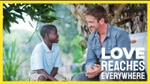
Watch this clip about Mary’s Meals

Slide 28
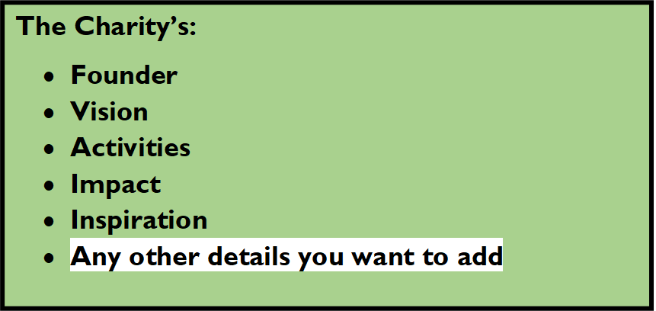
ACTIVITY – MISSION – SERVICE TO OTHERS
As the earlier clip said, synodality is the path by which the Church can witness to the love of God through service to others. You will now learn more about the work of different charities.
Complete the placemat activity. Use the websites listed to gather information about each charity regarding:
Charities:
Mary’s Meals: https://www.marysmeals.org.uk/
Society of St. Vincent de Paul: https://www.ssvpscotland.com/
SCIAF: https://www.sciaf.org.uk/

Slide 29
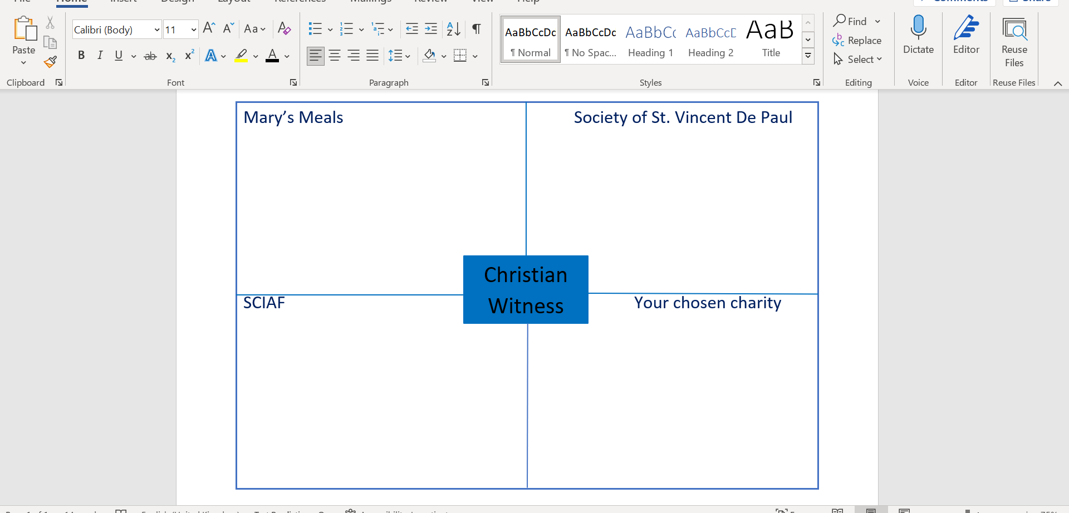

Slide 30
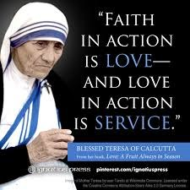
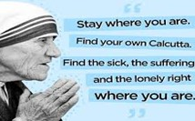
Reflect on these words of the Saints.
In what ways do their words encourage you to fulfil your mission to act and give witness to God’s love in the way we treat others?
Share your reflections with your shoulder partner.

Slide 31
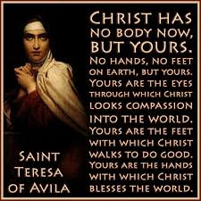

Slide 32
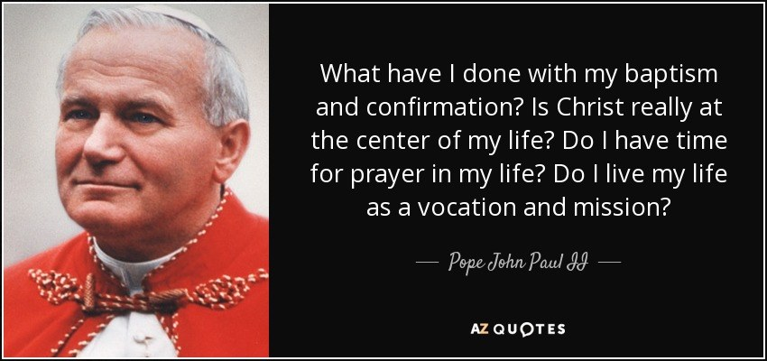

Slide 33
Recite the Mary's Meals prayer:
Our Father,
give us this day our daily bread and forgive us for the times when we take more than our share of the bread that belongs to all.
Let us help You fill the starving with good things, not with scraps from our table.
Teach us how to share what is not ours to keep.
Clothe us with Your love that we may complete each good work You created us to do.
Place in our hearts Your compassion for each starving child and use our little acts of love so that they starve no more. Amen

