Slide 1


Pilgrims of Faith
Catholic Education Week 2023
Junior Phase

Slide 2
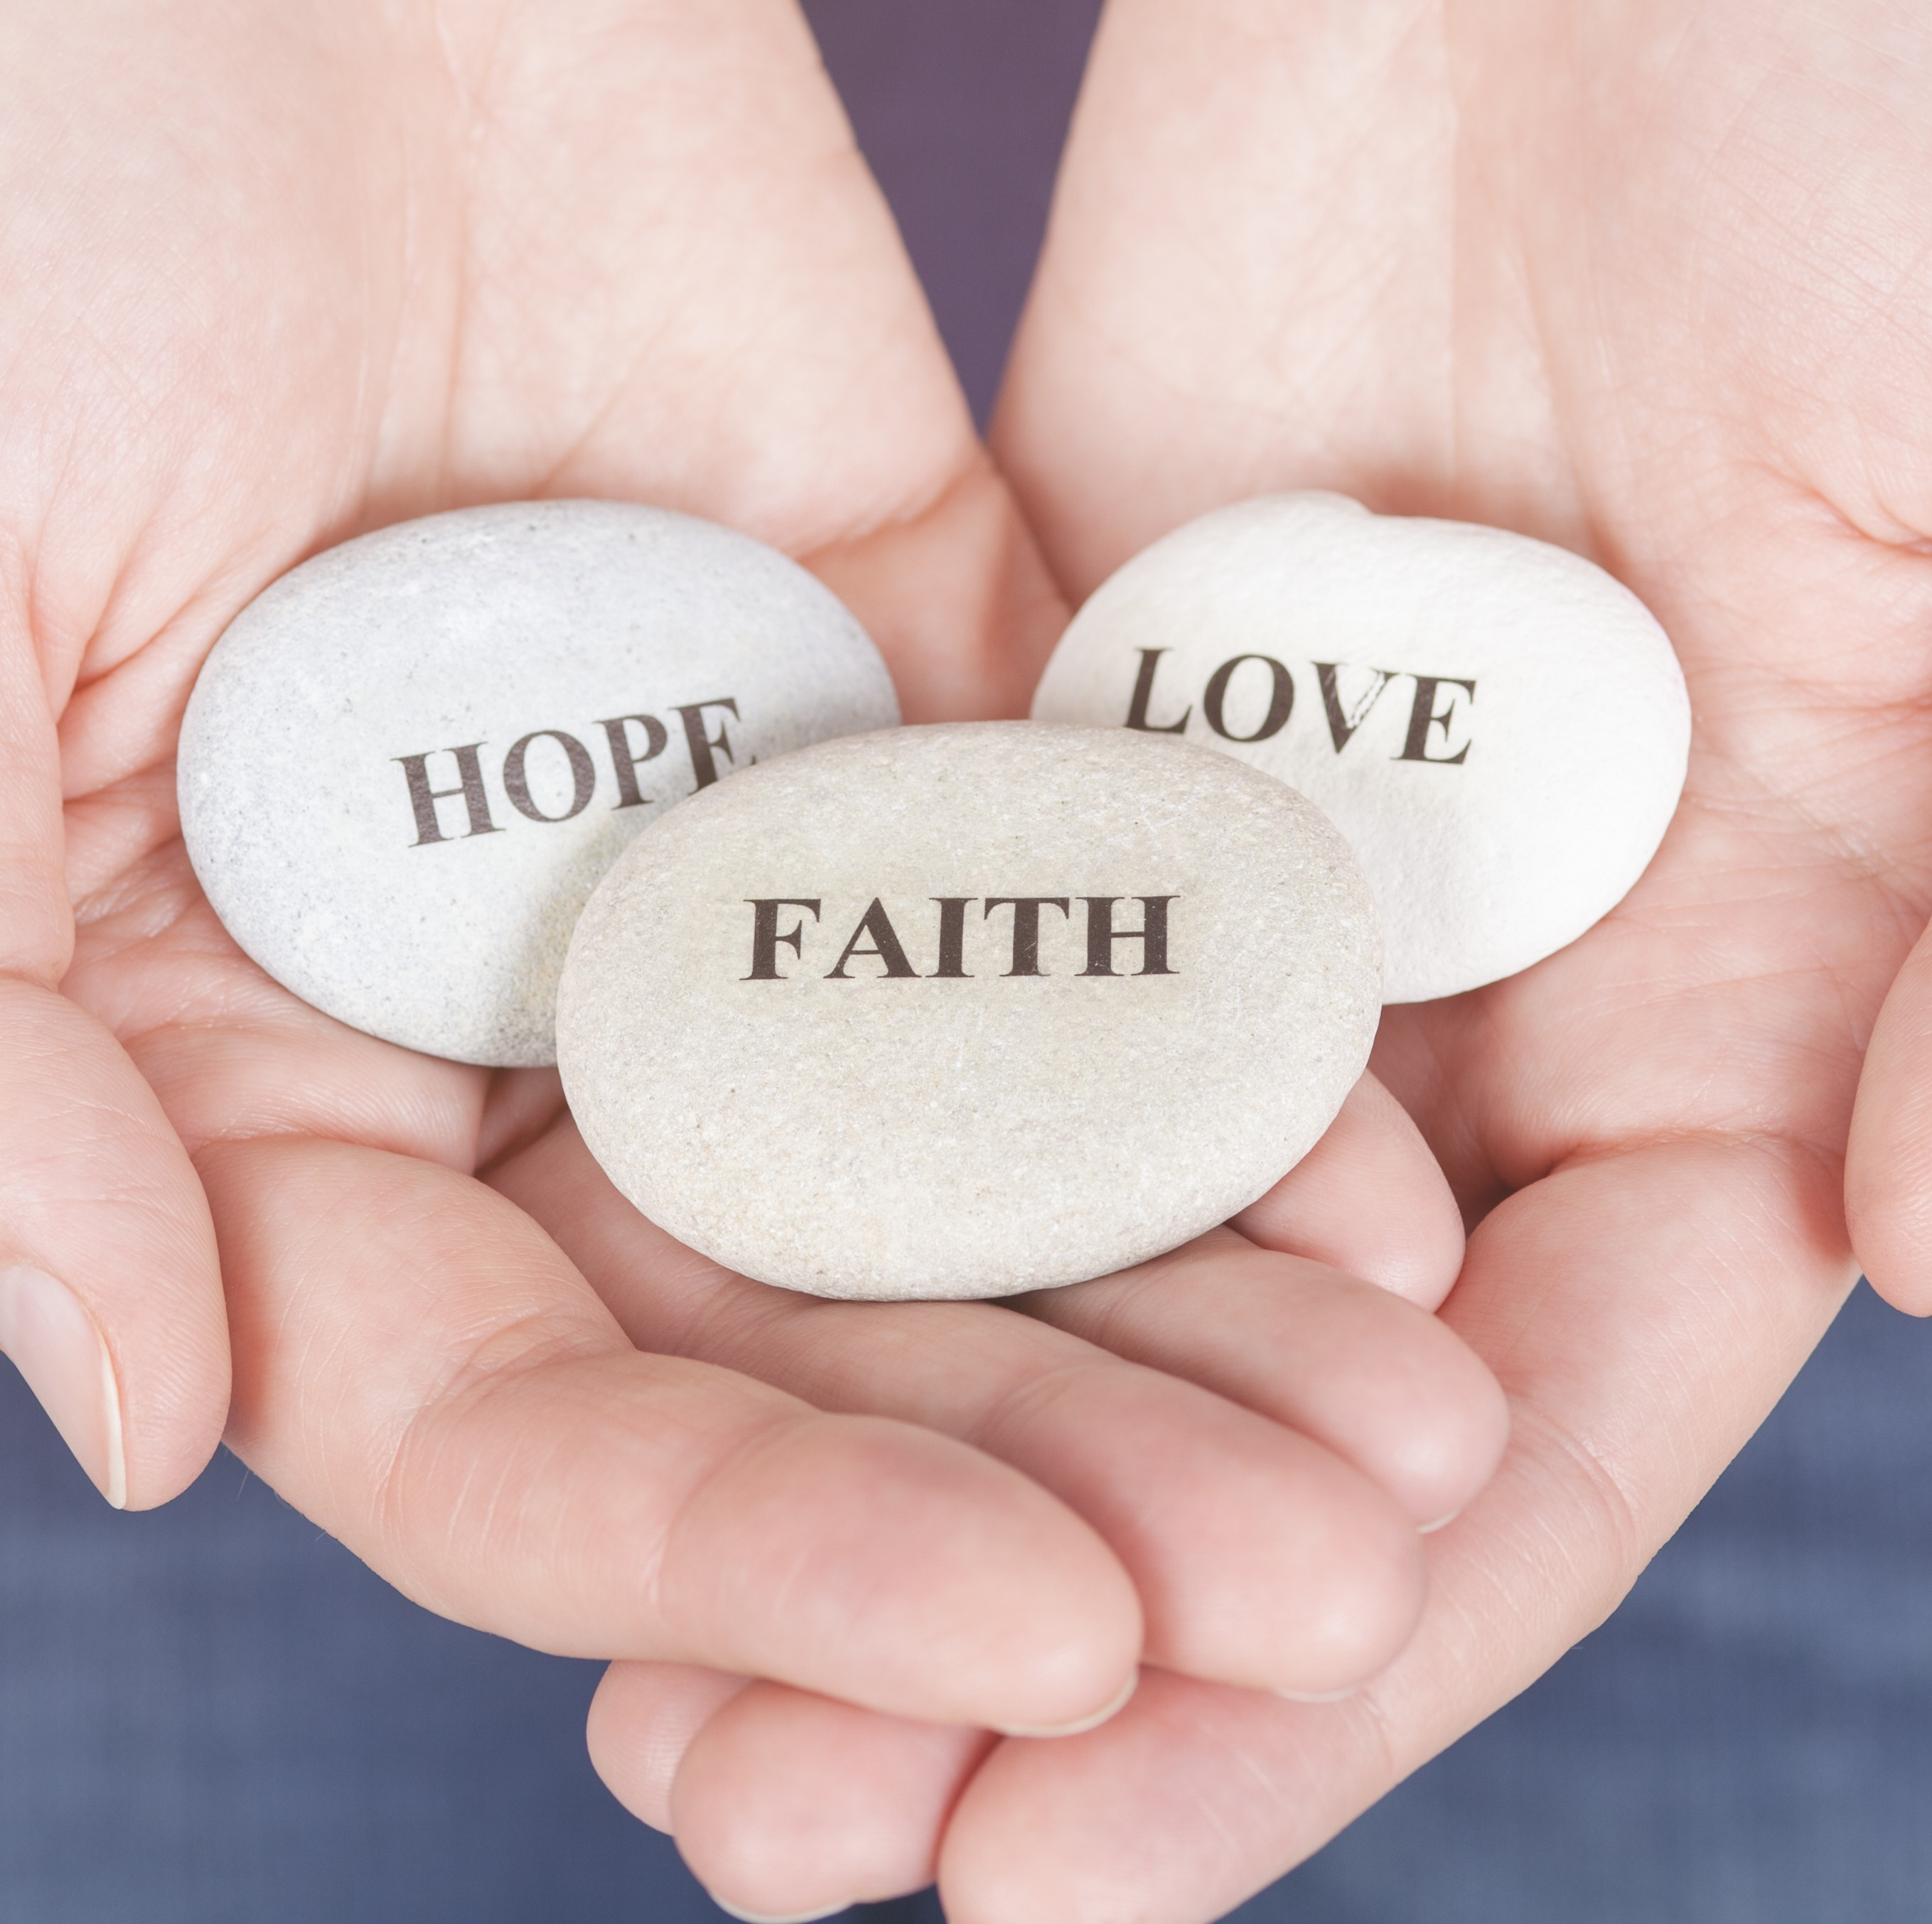
Learning Intentions
To understand what is meant by the theological virtue of faith
To consider biblical teachings about faith

Slide 3
Starter
Do you believe that any of the following statements are true?
Crisps are tastier than chocolate
There are at least 118 pyramids in Egypt
It is cruel to keep animals in captivity
October is usually the rainiest month in the UK
In 2040, the Olympic Games will be held in Dublin
Are there any statements on the list by which you are absolutely convinced? If your life depended on one of the statements being true, which would you pick?
Why?

Slide 4
What is faith?
"Faith is the assurance of what we hope for and the certainty of what we do not see." Hebrews 1:11
What does this mean? Can you use different words to explain this quotation?

Slide 5
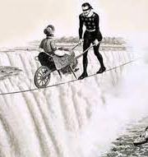
What is faith?
The Church teaches that faith is an invitation from God to enter into His friendship.
Faith is more than hope. If I buy a lottery ticket, I might hope to win. However, if I have genuine faith in my lucky numbers, I will be so convinced that I will win, that I will resign from my job and start spending!
Faith is also stronger than belief. Imagine that you were watching a tightrope walker push a wheelbarrow across a rope suspended over Niagara Falls. He manages to do it successfully three times, and then he asks for a volunteer to sit in the wheelbarrow for the next trip. You might believe that he is capable of delivering you safely to the other side, but you would only be demonstrating true faith in him if you got in!
Similarly, to have religious faith is to be truly, adamantly convinced that God loves us and has great plans for us.

Slide 6

One sentence summary
On a post-it note, write one sentence to explain what the word “faith” means.

Slide 7
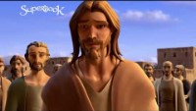
Faith in the Bible
This is a clip from Mark’s Gospel, in which Jesus restores the sight of a beggar.
What does this story teach us about faith?

Slide 8
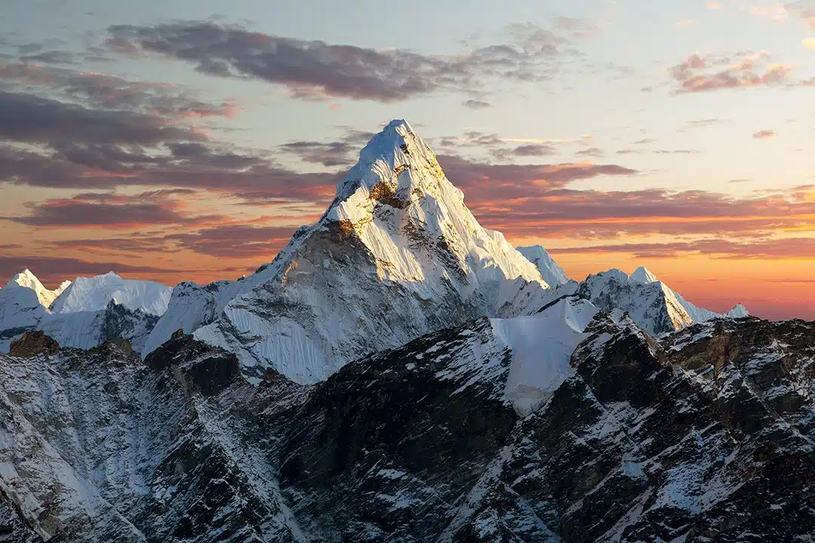
Faith in the Bible
The story of Jesus and Bartimaeus shows us that having faith can have a transformative impact on our lives!
You will receive one biblical quotation about faith.
Explain your teaching in your own words in your jotter
Find someone who has a different quotation to you. Take turns to explain the meaning of each quote to each other

Slide 9
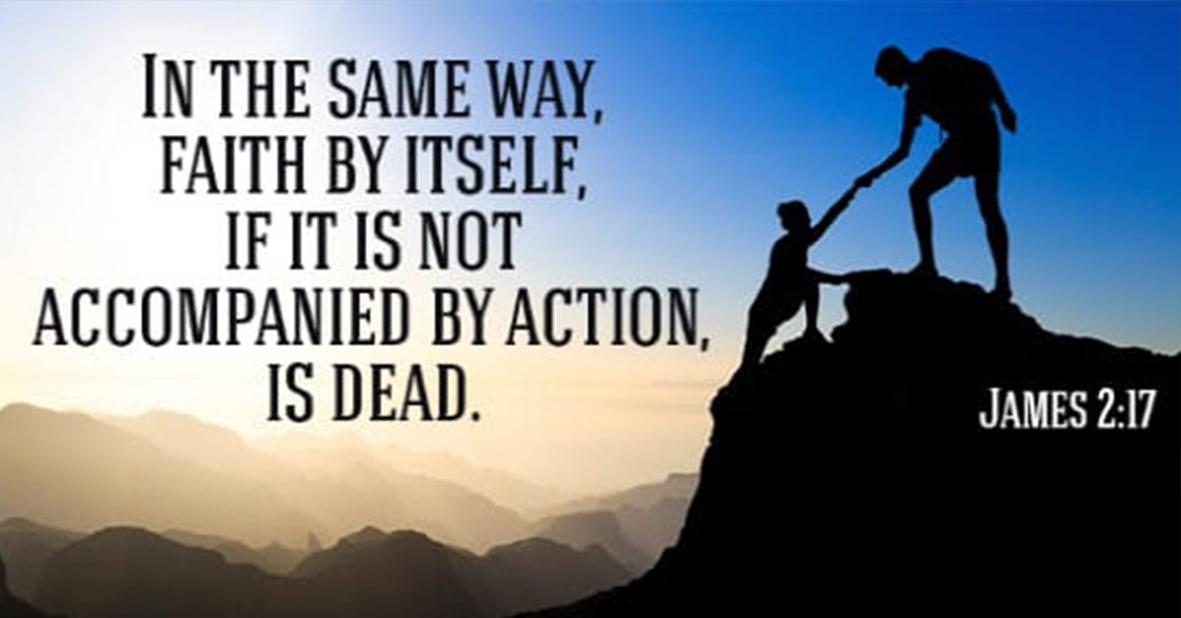
What does faith demand of us?
In the Epistle of James it is written:
“What good is it, my brothers and sisters, if someone claims to have faith but has no deeds? Can such faith save them? Suppose a brother or a sister is without clothes and daily food. If one of you says to them, “Go in peace; keep warm and well fed,” but does nothing about their physical needs, what good is it? In the same way, faith by itself, if it is not accompanied by action, is dead.”
What does this tell us about faith?

Slide 10
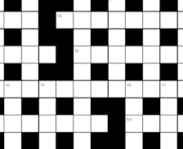
Crossword Challenge
Complete the crossword to demonstrate how much you have learned about faith during this lesson!

Slide 11
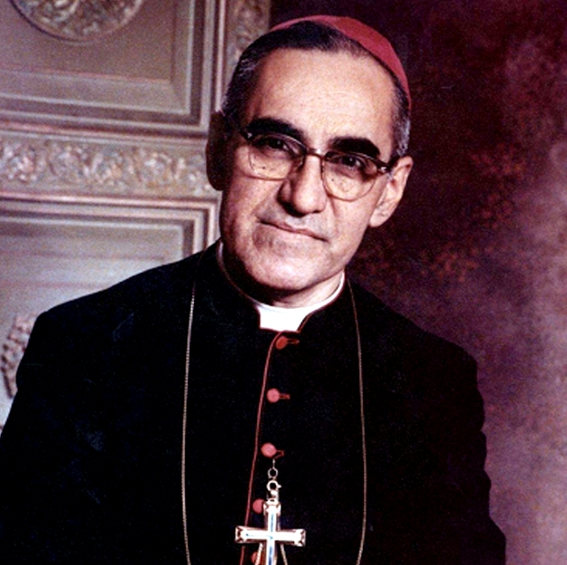
Lesson Two
Faithful people

Slide 12
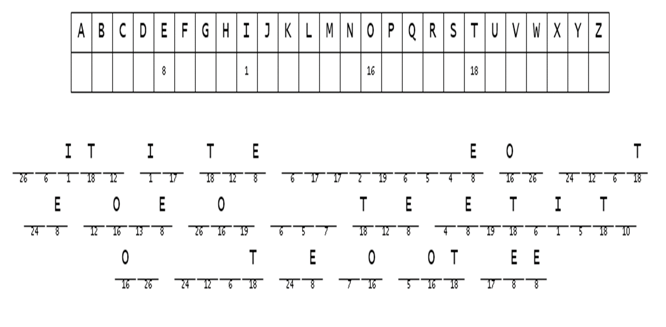
Starter
Complete the cryptogram to remind yourself of an important definition from our last lesson.
Who will be first to crack the code?

Slide 13
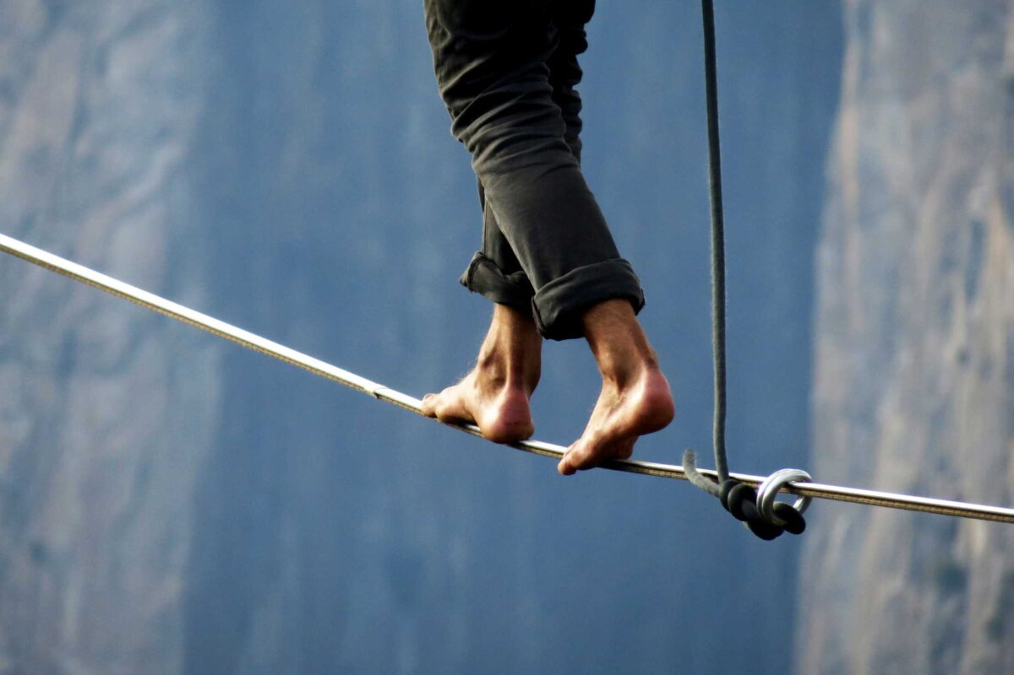
Learning Intentions
To understand the role that faith has played in the life of an inspirational person
To consider how we can nurture our own faith

Slide 14
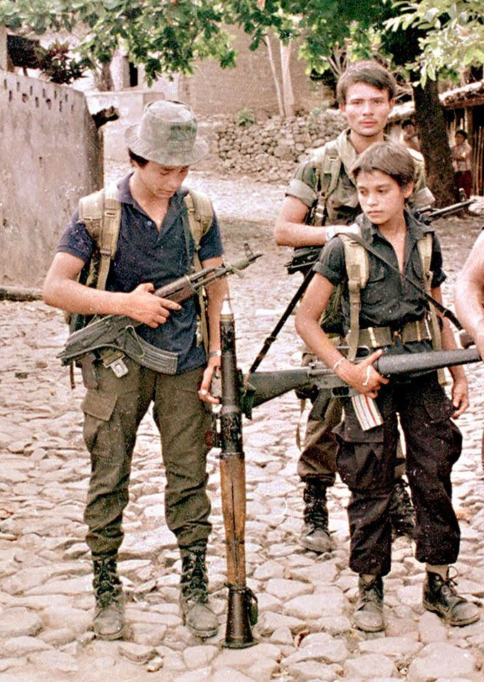
Oscar Romero
Saint Oscar Romero became Archbishop of San Salvador in El Salvador in 1977, during a time of civil war in the country. He repeatedly spoke out against human rights violations and atrocities that were happening in his country, and made weekly radio broadcasts during a time of censorship.

Slide 15
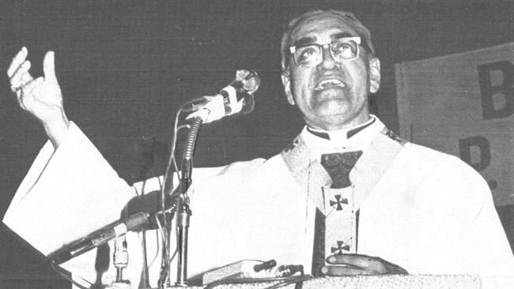
Oscar Romero
He spoke out on behalf of the poor and urged soldiers and the police not to follow orders to kill civilians, saying:
“You are killing your own brothers. Any human order to kill must be subordinate to the law of God, which says, 'Thou shalt not kill'. No soldier is obliged to obey an order contrary to the law of God. No one has to obey an immoral law. It is high time you obeyed your consciences rather than sinful orders. The church cannot remain silent before such an abomination. ...In the name of God, in the name of this suffering people whose cry rises to heaven more loudly each day, I implore you, I beg you, I order you: stop the repression.”
Romero was shot dead on 24th March 1980, while celebrating Mass.

Slide 16
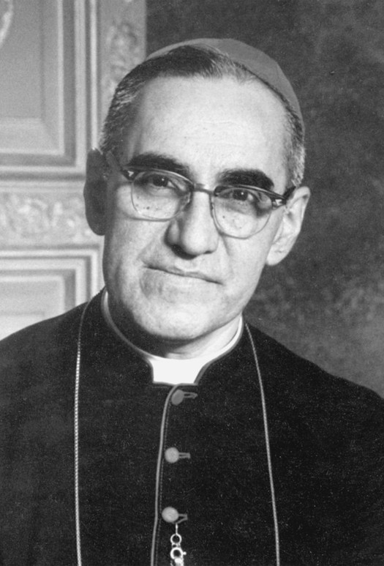
Oscar Romero
Answer the following question in your jotters, giving as much detail as possible:
What role did faith play in the life of St Oscar Romero?

Slide 17

How can we nurture our faith?
Work with a partner to produce a mind map showing anything that people can do to grow in faith.

Slide 18
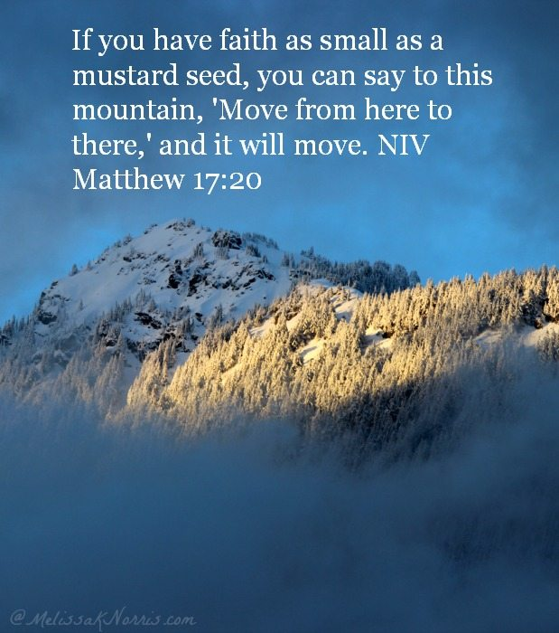
How can we nurture our faith?
Here are some ideas:
Spend time in prayer/ meditation
Read the Bible
Participate in the Sacraments, such as reconciliation
Ask God to help us develop in faith
Practise trusting God more and worrying less
Do kind things for others- remember that having faith should lead to action!

Slide 19
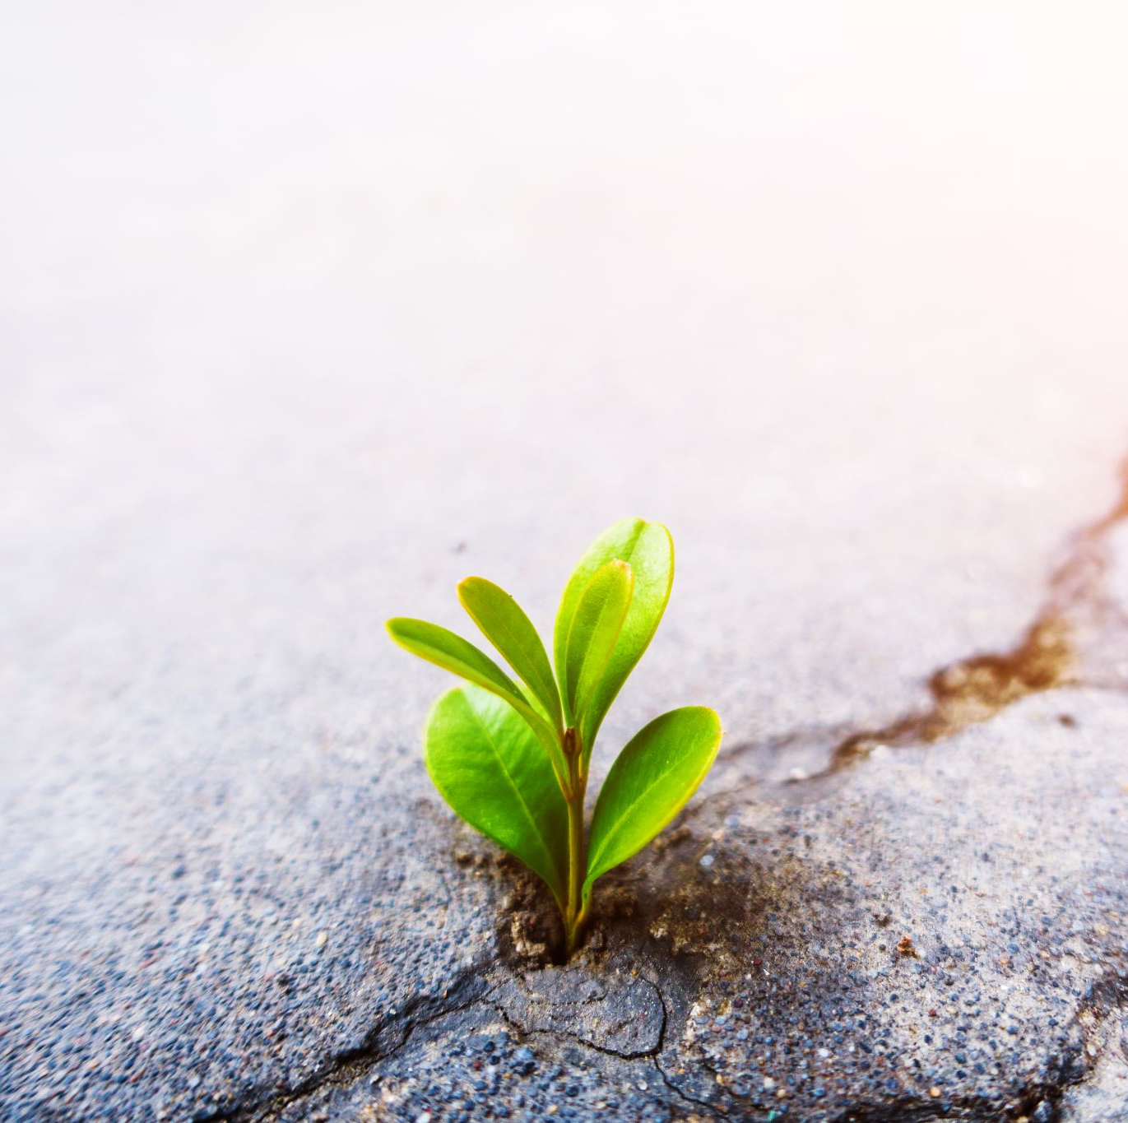
Extension Task
Research the life of one other person who has demonstrated great faith in God.
Produce a PowerPoint, poster or information leaflet to inform others about their life and how they can inspire others to grow in faith.

