Slide 1







Our Journey

Slide 2



Slide 3
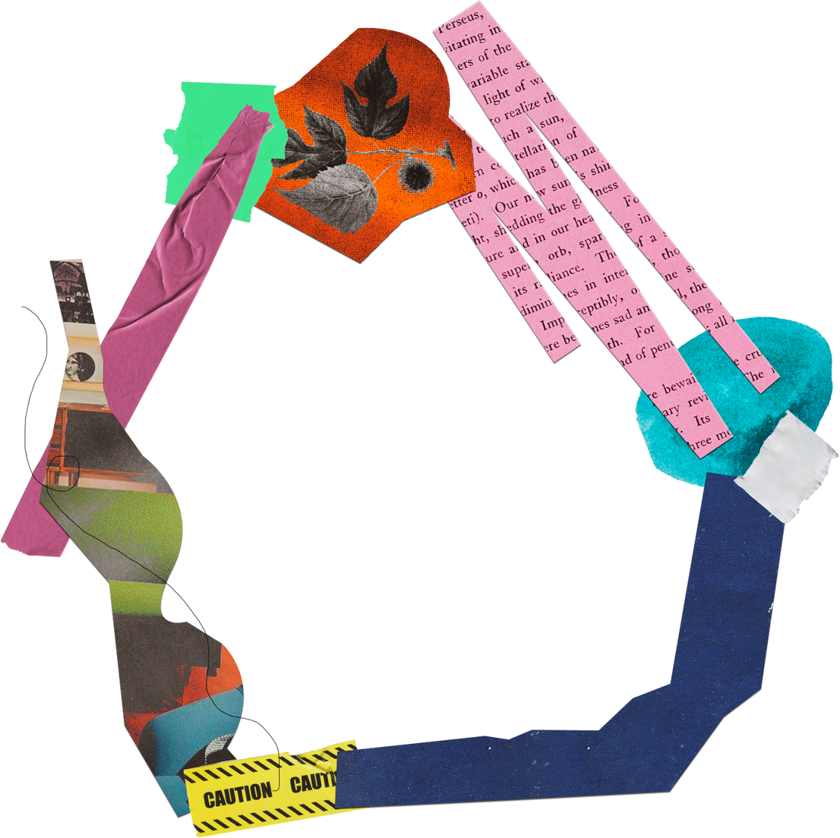

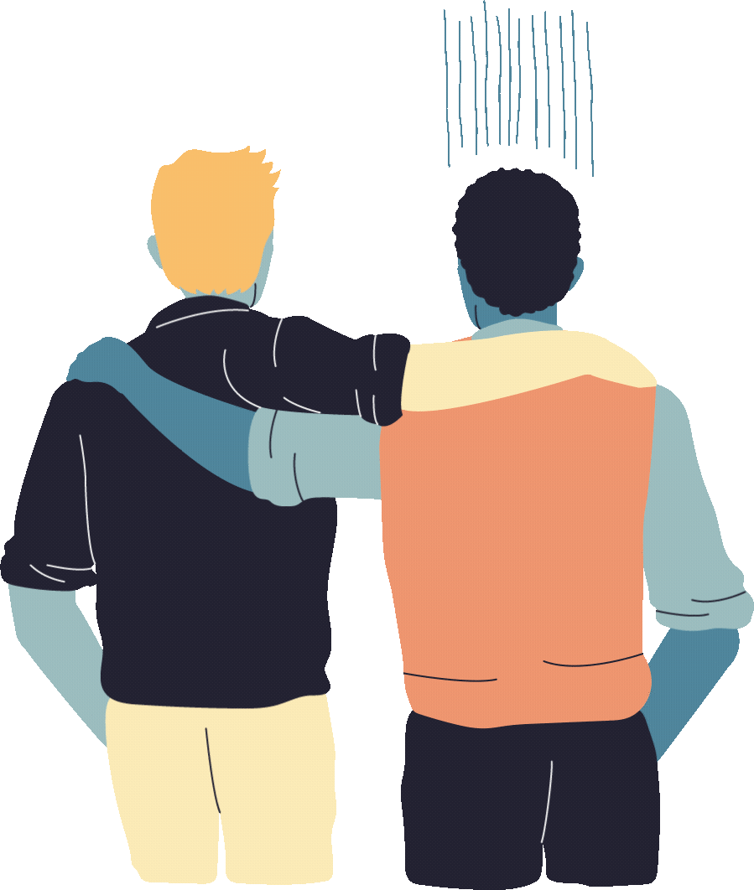

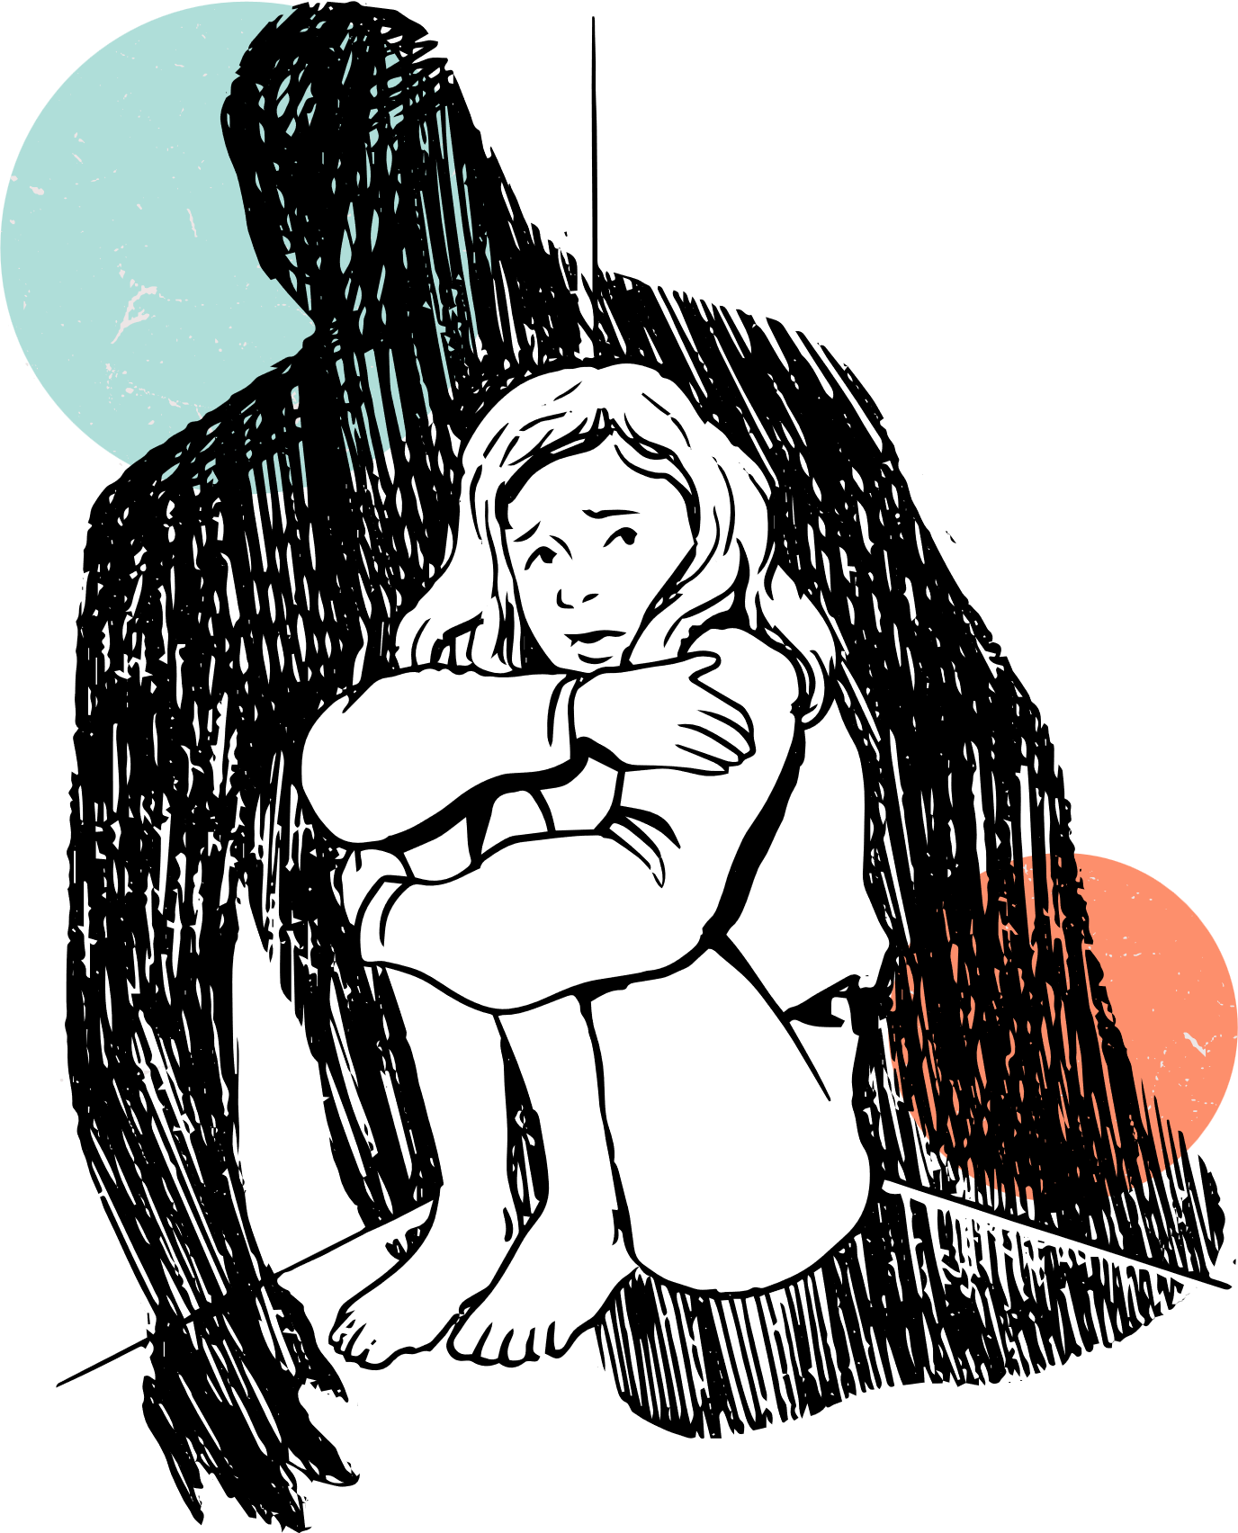

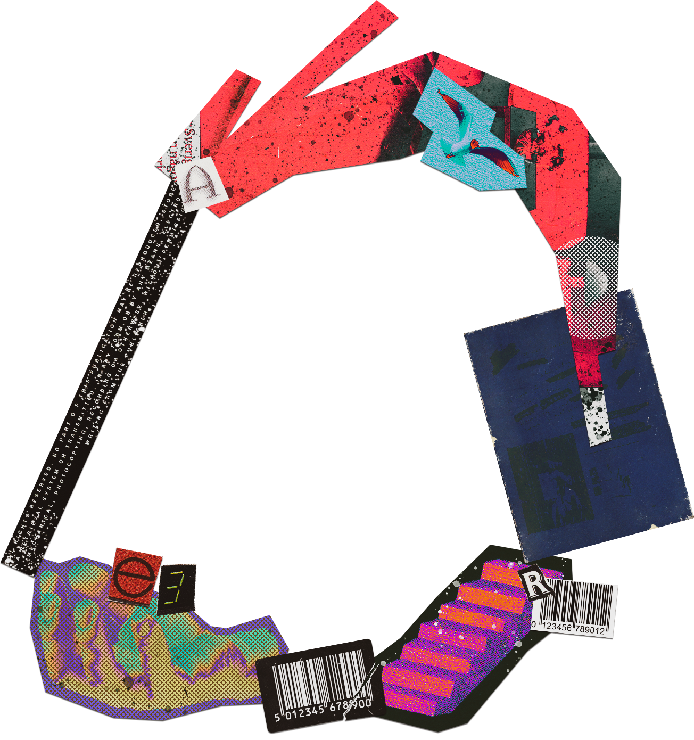

Pilgrims of Faith
I have explored the Christian belief that in Jesus, God enters and transforms human nature, and exists at the centre of all creation. RERC 4-05a

Slide 4


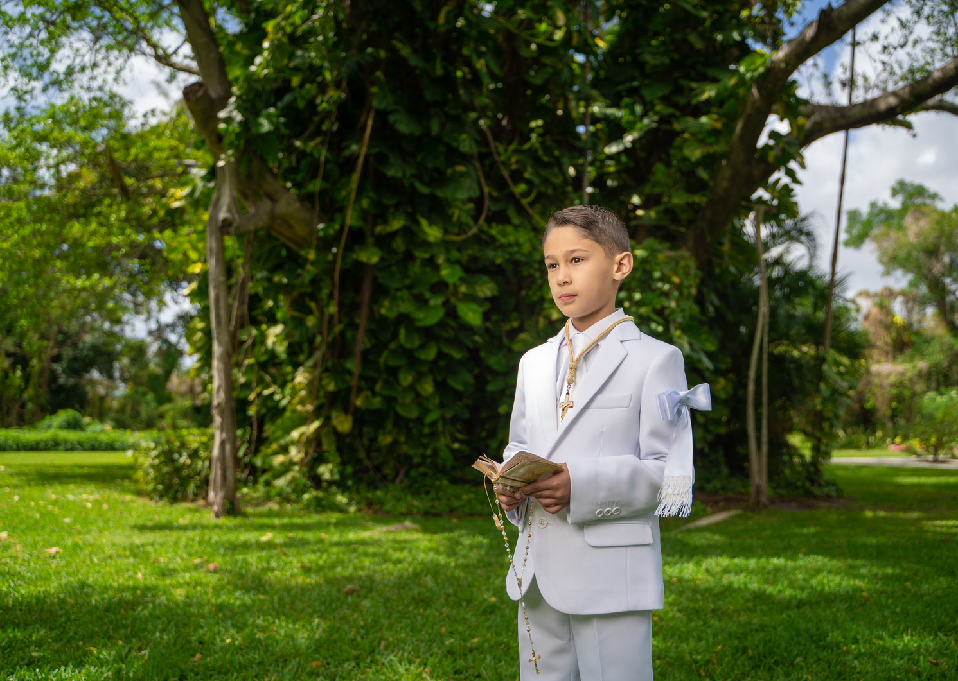




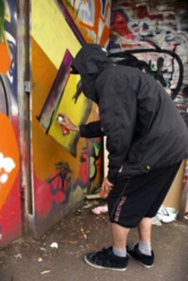


My Journey

Slide 5
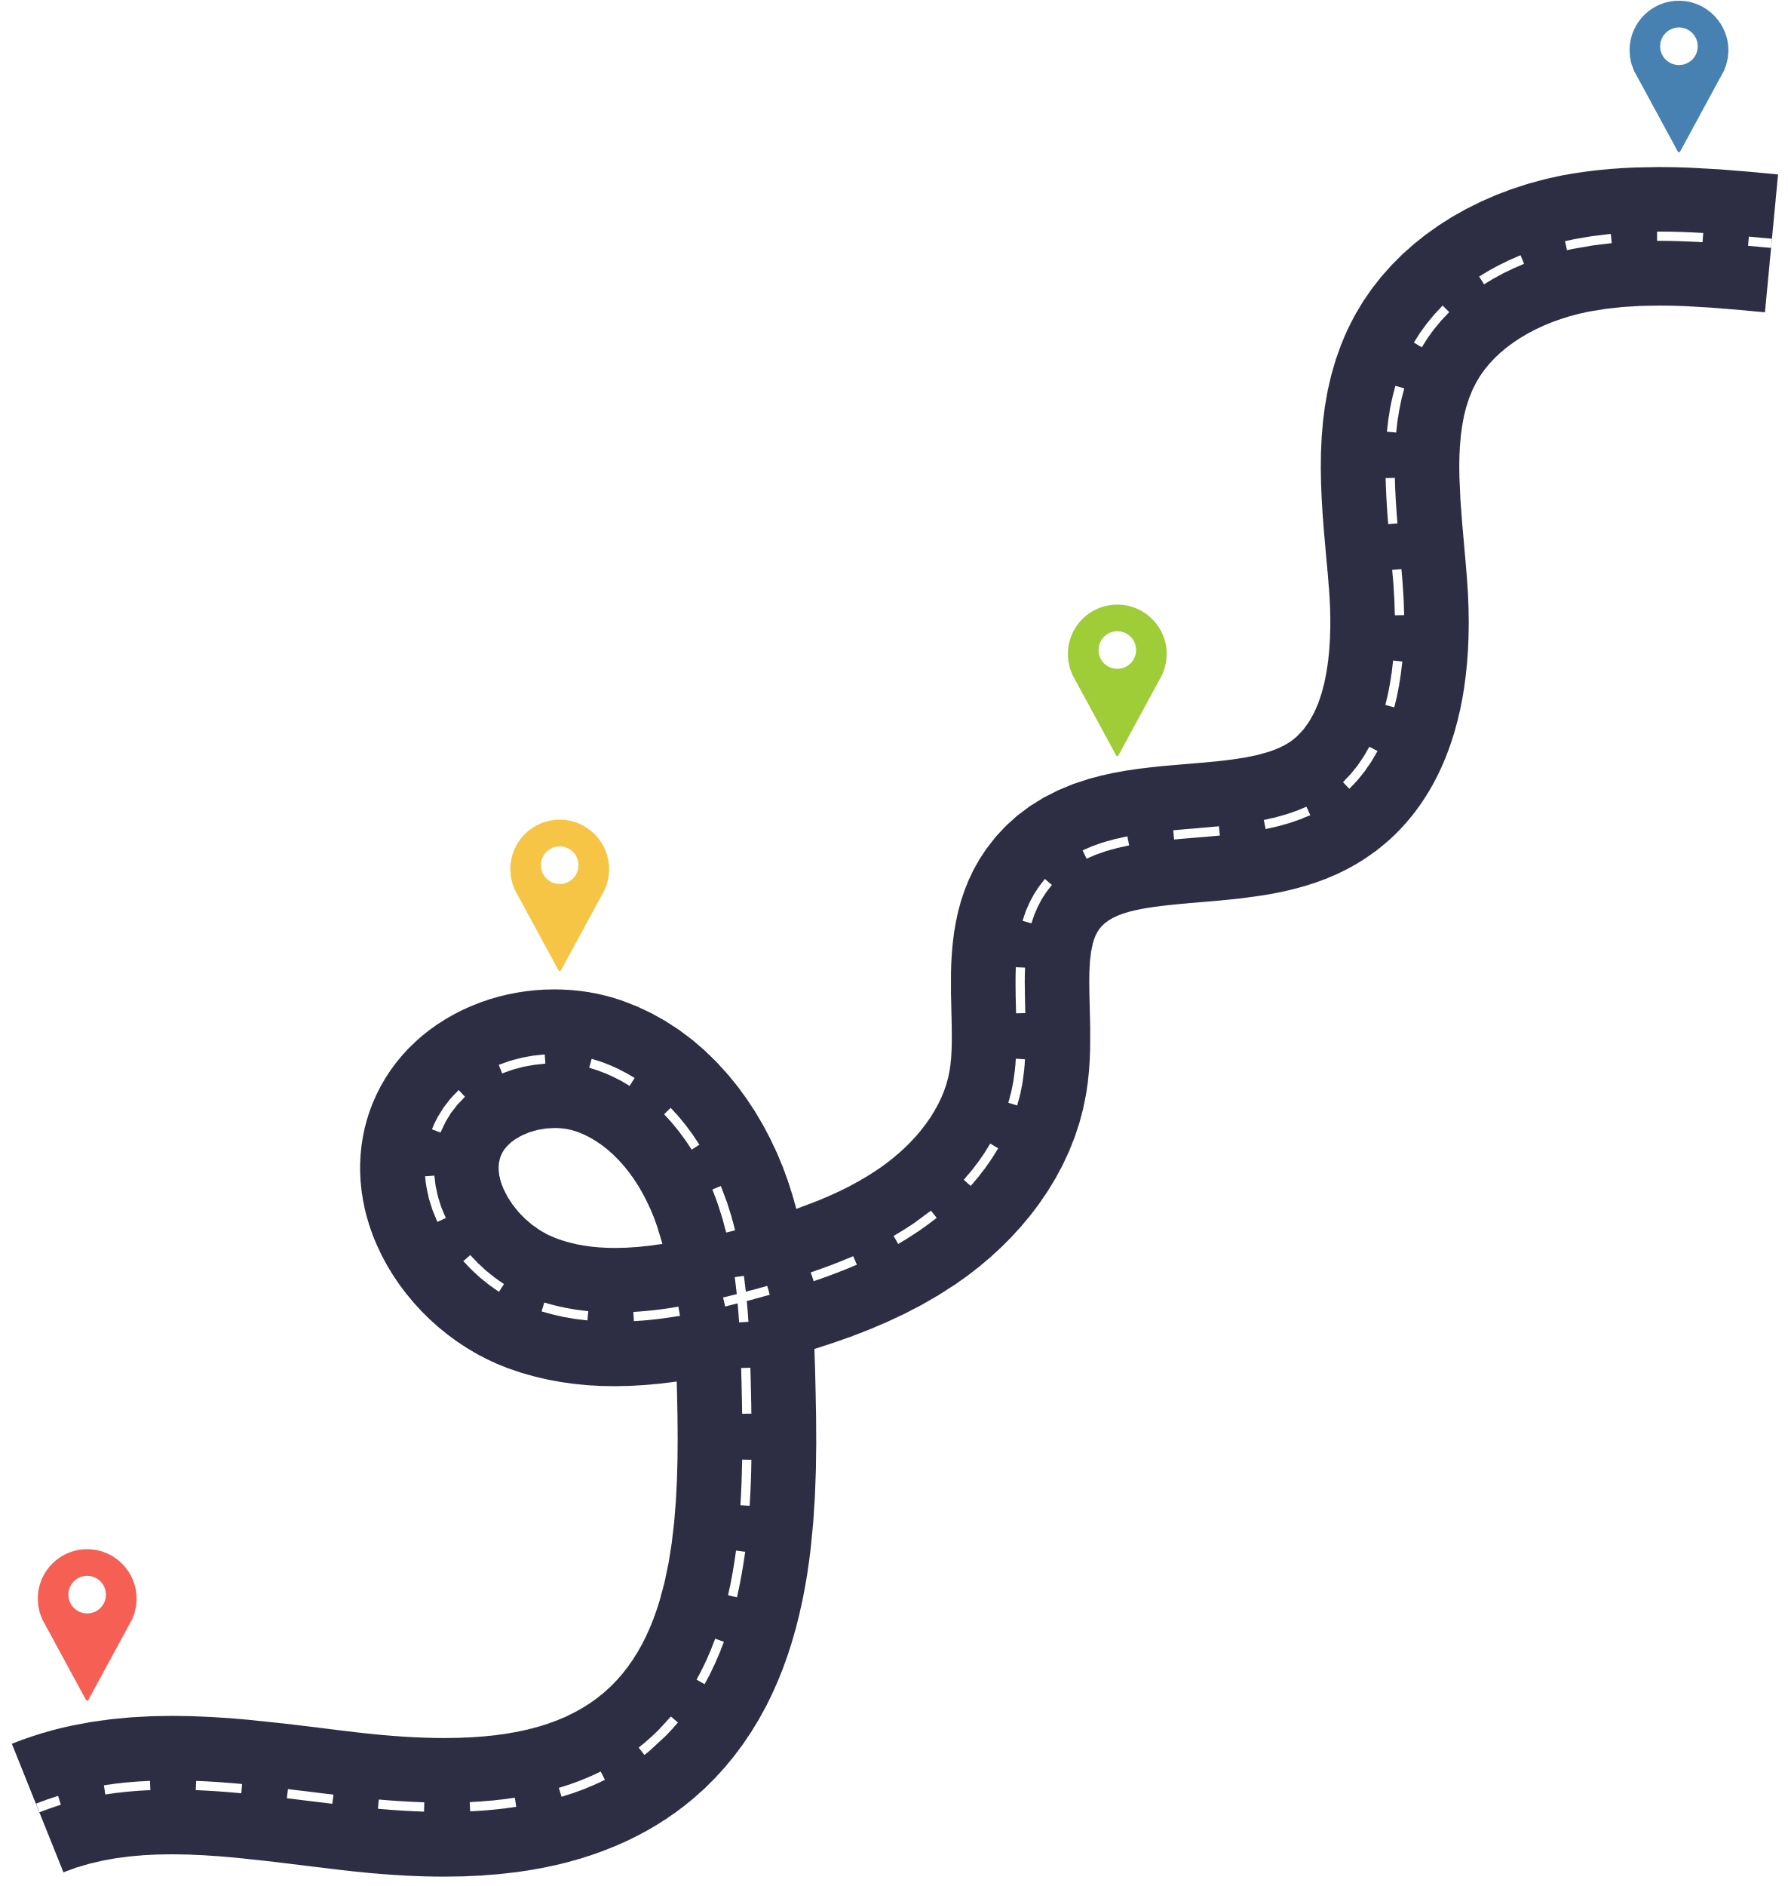

Activity 1 a
Plot your timeline; add turning points and any 'uphill' struggles, as well as any exciting detours.
My Journey

Slide 6


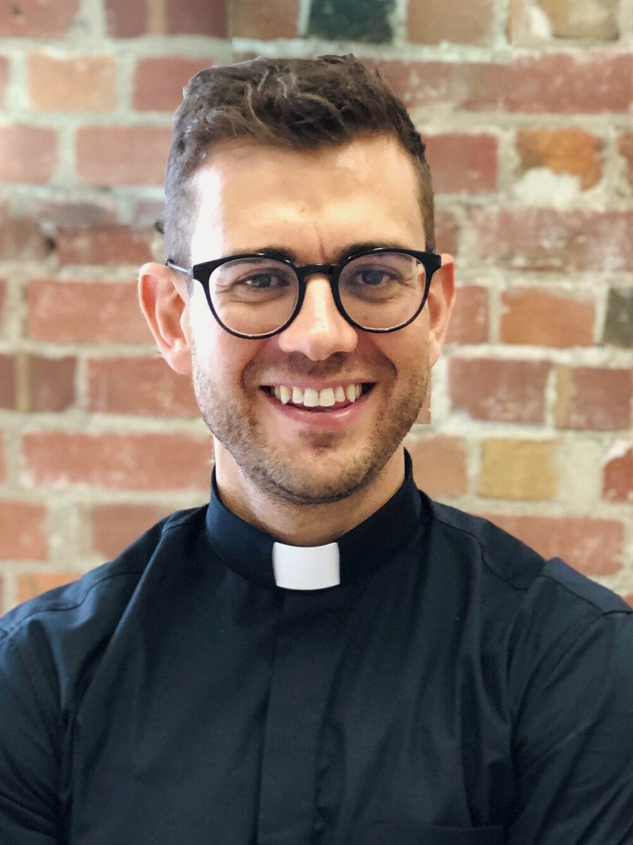

Fr Rob
'God can take your brokeness, your mistakes and weaknesses and make something beautiful out of it. All you need to do is surrender. He will turn your mess into a message.'

Slide 7


Notes:
https://youtu.be/JnUAeJ02ENk

Slide 8
Activity 1b
Add a line parallell to your journey; representing your faith during these key events. For example, when something good and exciting happened, was it easier, or more difficult, to recognise God's presence? Has God been beside you throughout your entire journey, or have you been 'disconnected' at times?
Who am I?

Slide 9
Pilgrims of Faith
I have explored the Christian belief that in Jesus, God enters and transforms human nature, and exists at the centre of all creation. RERC 4-05a

Slide 10
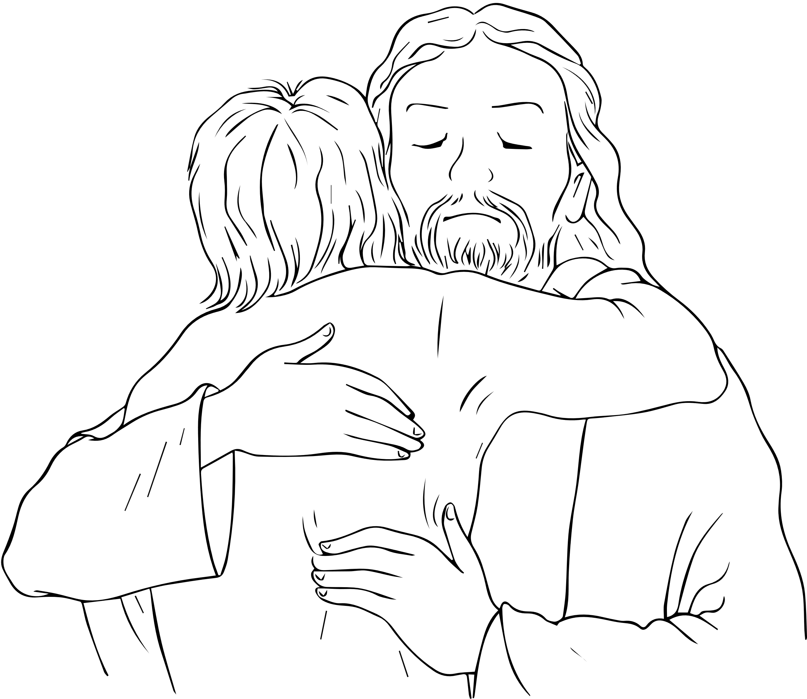
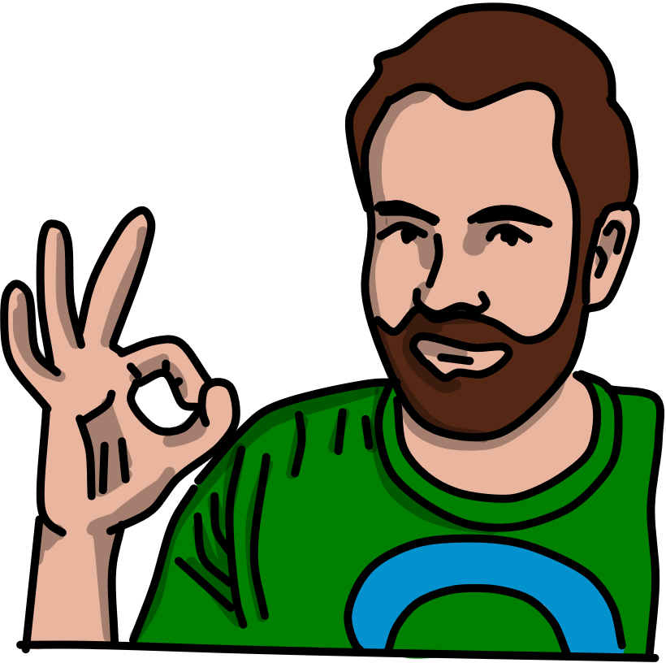
Pilgrims of Faith
I have explored the Christian belief that in Jesus, God enters and transforms human nature, and exists at the centre of all creation. RERC 4-05a

Slide 11


How Can I Live My Best Life Now?

Slide 12




Activity 2a
4 things to make life better ....
My Journey

Slide 13
Notes:
https://youtube.com/shorts/ZDLq-fAgiN4?feature=share

Slide 14

Activity 2b
Spend time in 'heaven'
Rest
Exercise
You
My Journey

Slide 15
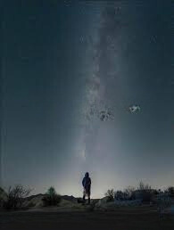

God created heaven and earth in six days; He can changeyour life in one. Stay faithful.

Slide 16




Activity 2c
Spend time in 'heaven'
Rest
Exercise
You
My Journey

Slide 17
Pilgrims of Faith
I have explored the Christian belief that in Jesus, God enters and transforms human nature, and exists at the centre of all creation. RERC 4-05a

Slide 18
Self directed learning
After assessing options and the consequences of my decisions, I can identify safe and unsafe behaviours and actions. HWB 4-41a
I reflect on how my attitudes, beliefs, values, and morality can influence my decisions about friendships, relationships, and sexual behaviour. HWB 4-46a
I know that popular culture, the media, and peer pressure can influence how I feel about myself and the impact this may have on my actions. HWB 4-46b

Slide 19

Starter
Make a list of interview questions that you could ask a Catholic influencer on your school podcast.
Think about 'hot topics' in the media just now; the interview should be punchy and relevant to the people in your school.

Slide 20
Activity 3
Challenge Questions
  What could I do to live a more virtuous life?
  What impact could I have on my future by living a life of faith?
  What impact could I have on the world by living a life of faith?

Slide 21

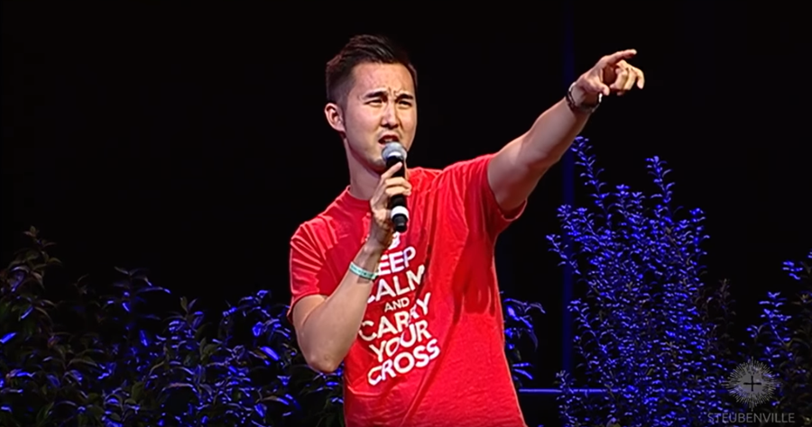
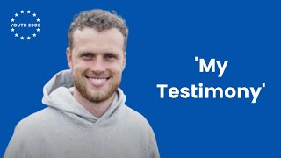
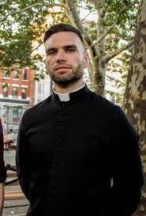

PAUL. J
GERARD
NIALL
KIM
HANLEY
MCDONAGH
Notes:
https://youtu.be/e1c_hONzlx0

Slide 22
Notes:
https://youtu.be/u-L-7bouVGs

Slide 23
Notes:
https://youtu.be/e1c_hONzlx0

Slide 24
Notes:
https://youtu.be/v-ymrebSX6Q

Slide 25
Activity 3
Challenge Questions
  What could I do to live a more virtuous life?
  What impact could I have on my future by living a life of faith?
  What impact could I have on the world by living a life of faith?

Slide 26
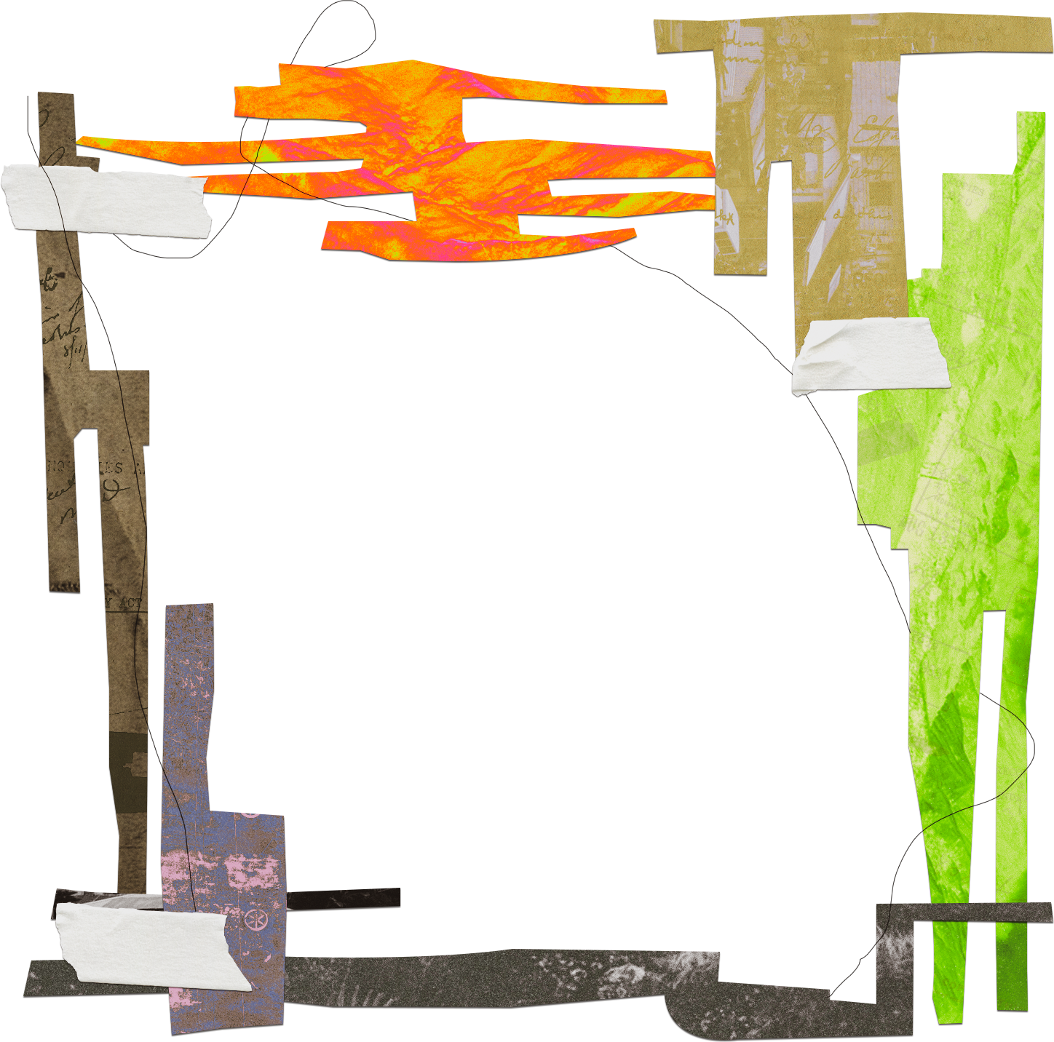
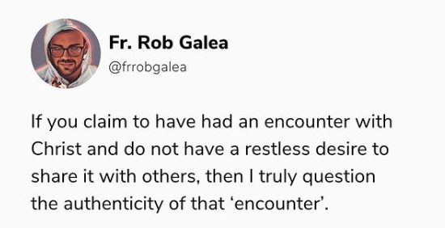

Slide 27
Self directed learning
After assessing options and the consequences of my decisions, I can identify safe and unsafe behaviours and actions. HWB 4-41a
I reflect on how my attitudes, beliefs, values, and morality can influence my decisions about friendships, relationships, and sexual behaviour. HWB 4-46a
I know that popular culture, the media, and peer pressure can influence how I feel about myself and the impact this may have on my actions. HWB 4-46b

Slide 28
Our Journey

Slide 29
Starter
Use your starter questions from lesson 3 to interview the person next to you; remember to pause to listen to their responses.

Slide 30
Pilgrims of Faith
I can describe how the Christian vision of the human person has affected our understanding of the experience of life as a journey towards fulfilment in God. I have reflected on and can describe my sense of vocation in life. RERC 4-02a

Slide 31


School
VALUES

Slide 32
CATHOLIC EDUCATION WEEK
Pilgrims of Faith
“The beauty of the Christian faith lies not in its theological explanations but in the lives of people who dedicate themselves to prayer, charity and sharing the Gospel. Be discoverers of beauty, seekers of the treasures of faith…because faith cannot remain a memory of the past, something ‘museum-like.’ No, it always lives again in the joy of the Gospel, in the community made up of people, in the assembly of those who experience mercy and recognize themselves as brothers and sisters loved by God by grace…
Always remember: the witness of life communicates the beauty of faith,”
Pope Francis

Slide 33
'Be discoverers of beauty, seekers of the treasures of faith.'

Slide 34
Pilgrims of Faith
I can describe how the Christian vision of the human person has affected our understanding of the experience of life as a journey towards fulfilment in God. I have reflected on and can describe my sense of vocation in life. RERC 4-02a
I have explored the Christian belief that in Jesus, God enters and transforms human nature, and exists at the centre of all creation. RERC 4-05a
After assessing options and the consequences of my decisions, I can identify safe and unsafe behaviours and actions. HWB 4-41a
I reflect on how my attitudes, beliefs, values, and morality can influence my decisions about friendships, relationships, and sexual behaviour. HWB 4-46a
I know that popular culture, the media, and peer pressure can influence how I feel about myself and the impact this may have on my actions. HWB 4-46b

