Slide 1

Catholic Education Week 2024
Pilgrims of Hope
Early Level Classroom Resources

Slide 2
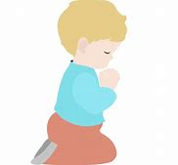


What are we learning about this week?
I am learning :
What a Jubilee Year is
About following others to learn about Jesus
About the ‘Holy Door’ during a Jubilee Year
To be thankful to God who welcomes me to be close to Him
. I can :
Tell others what a Jubilee Year is
Tell others about some ways I can be a follower of Jesus
Tell others about the ‘Holy Door’
Thank God for always making me welcome to be close to Him
2
Notes:
Share with the children prior to the lesson

Slide 3

A Special Year
Every 25 years, the Pope makes a special time of celebration called a ‘Jubilee Year’
In 2025, Pope Francis has said the Jubliee Year will be called’ Pilgrims of Hope’
Pilgrims are people who want to be closer to God and to find out more about Him
What can you see in the logo of the Jubilee?
Notes:
Tell the children that Pope Francis is a very important person to Catholic people. He is our leader and it is good to listen to what he tells us about God. Our Pope is called Pope Francis and he is a very good and holy man. ‘Click’ Every 25 years, the Pope makes a special time for Catholics to pray and learn more about God, It is a special time of celebration and we call this a Jubliee Year. 2025 will be a Jubilee year and it will be called ‘Pilgrims of Hope’. ‘Click’ Pilgrims are people who want to be close to god and to find out more about Him. ‘Click’ Ask the children to look at the logo for the Jubilee (either on the screen on a copy of resource sheet 1 can be give be given to each group/trio to look at more closely. What can they see? Elicit: The four figures are travelling towards the cross. This represents people from the 4 corners of the world , travelling towards God. They are holding on to one another so they can support each other and not get lost- like follw my leader. The figure at the front is holding tightly to the cross which represents keeping as close to God as we can, Notice the water below the people. Ask the children if they have ever been in a boat. It can rock about and it can make us feel a bit scared and unsteady. During our life, things can happen to make us feel abit like this too and that’s when we should look towards God and try toi keep close to him. Ask the children if they can see the anchor. On a boat, the sailors put an anchor down to the bottom of the seabed to stop the boat from drifting away and getting lost. The image is remindind us that Jesus is our anchor. If we know and love him, he will be there for us in difficult times. This is why the people in the picture are holding on to the cross.

Slide 4

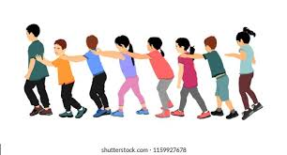
Foll0w my leader
Pope Francis wants us all to be Pilgrims of hope
We can travel together to learn more about God in school, at home and at Mass
When we are together, we are stronger and can all go the same way without getting lost
Let’s play ‘Follow my leader’!
How did it make you feel?
How can we travel together to know and love God?
Notes:
*Explain to the children that our lives are like a journey and God wants us all to make good choices which bring us closer to Him. We are all pilgrims. ‘click’ Tell the children that Pope Francis encourages us all to be on a journey to find out more about God and to love Him more. ‘click’ it is good to do this together as we are stronger and we are less likely to stray away from God and get lost ‘click’ To demonstrate this, play a game of ‘follow my leader’ with the children. This can be played in the classroom, gymhall or ideally outside in the glayground. If possible, the teacher can be the ‘leader’, leding the children around obstacles etc but not going too fast so the children can keep together in a long chain. ‘click’ after the game, ask the children to think how it feels to follow- elicit- makes you happy, feel safe, trust the leader etc. ‘click’ Elicit ways we can travel together to know and love God- prayers in class and at home, sing hymns, go to Mass with school and with my family, listen to stories about God from the bible, etc.

Slide 5
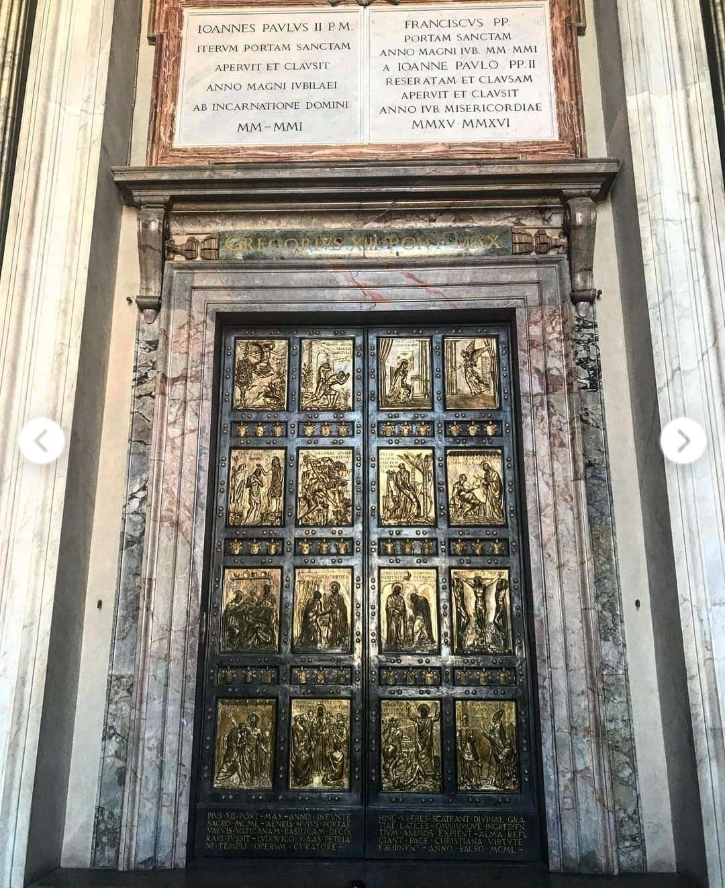
The Holy Door
At the beginning of a Jubilee Year, the Pope opens a special door in St Peter’s Basilica in Rome.
This is called the Holy door
People can go through this door as a sign they are a pilgrim who wants to love God more
Other churches throughout the world also have a Holy Door so lots of people can show they want to come closer to God
Everybody is welcome to go through the Holy Door to show they want to know and love God
Notes:
Tell the children that Pope Francis is a very important person to Catholic people. He is our leader and it is good to listen to what he tells us about God. Our Pope is called Pope Francis and he is a very good and holy man. ‘Click’ Every 25 years, the Pope makes a special time for Catholics to pray and learn more about God, It is a special time of celebration and we call this a Jubliee Year. 2025 will be a Jubilee year and it will be called ‘Pilgrims of Hope’. ‘Click’ Pilgrims are people who want to be close to god and to find out more about Him. ‘Click’ Ask the children to look at the logo for the Jubilee (either on the screen on a copy of resource sheet 1 can be give be given to each group/trio to look at more closely. What can they see? Elicit: The four figures are travelling towards the cross. This represents people from the 4 corners of the world , travelling towards God. They are holding on to one another so they can support each other and not get lost- like follw my leader. The figure at the front is holding tightly to the cross which represents keeping as close to God as we can, Notice the water below the people. Ask the children if they have ever been in a boat. It can rock about and it can make us feel a bit scared and unsteady. During our life, things can happen to make us feel abit like this too and that’s when we should look towards God and try toi keep close to him. Ask the children if they can see the anchor. On a boat, the sailors put an anchor down to the bottom of the seabed to stop the boat from drifting away and getting lost. The image is remindind us that Jesus is our anchor. If we know and love him, he will be there for us in difficult times. This is why the people in the picture are holding on to the cross.

Slide 6
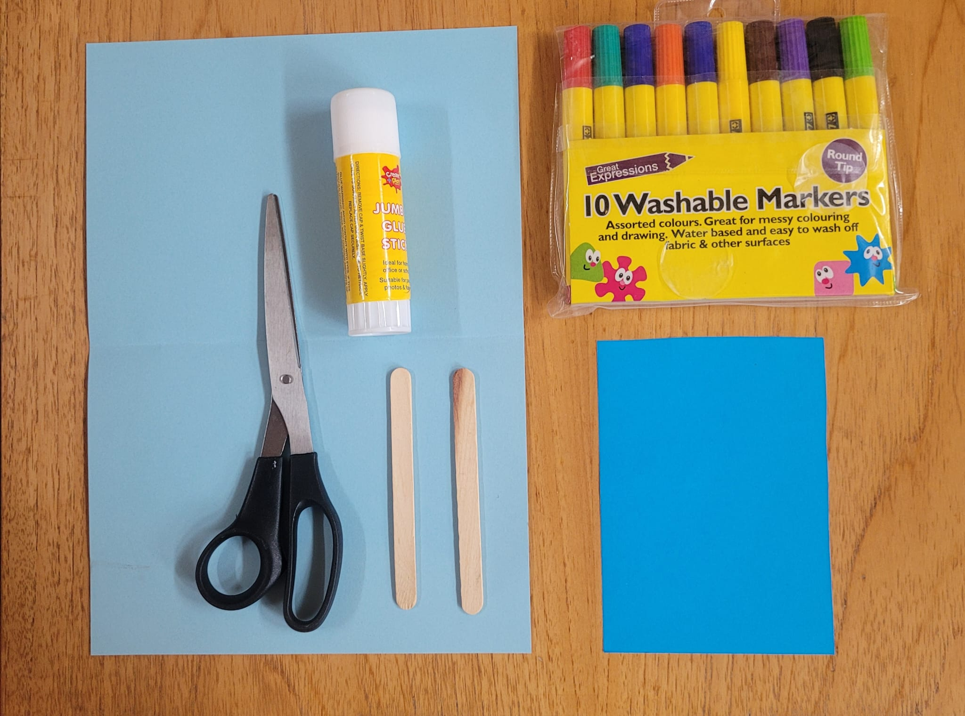



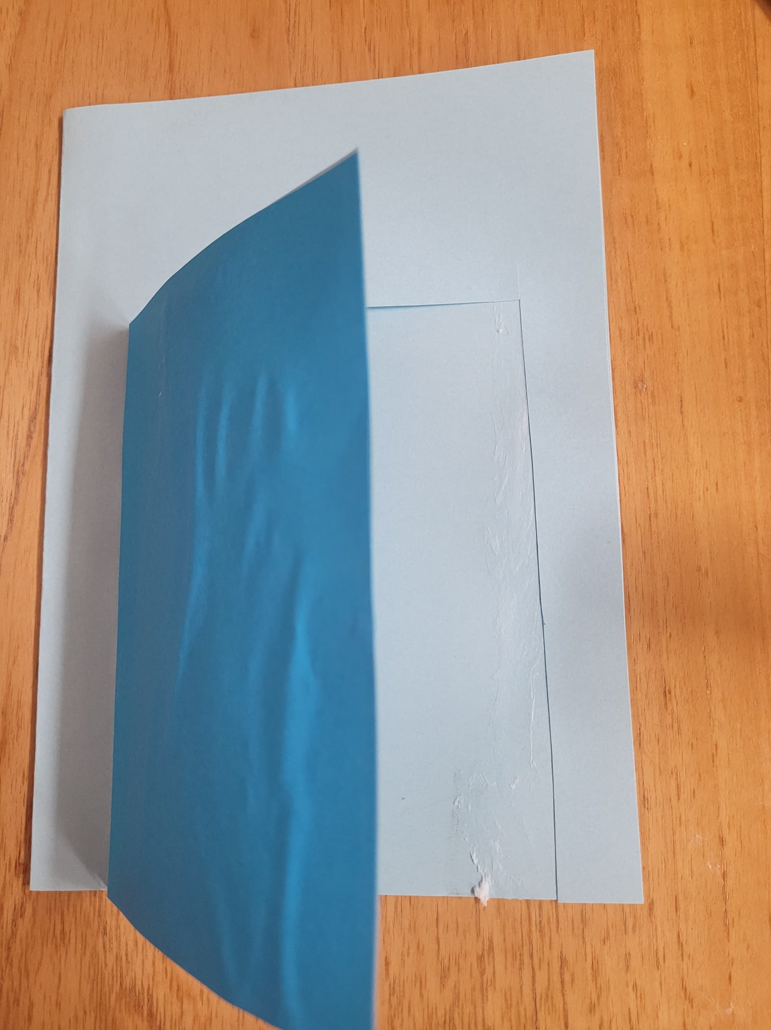

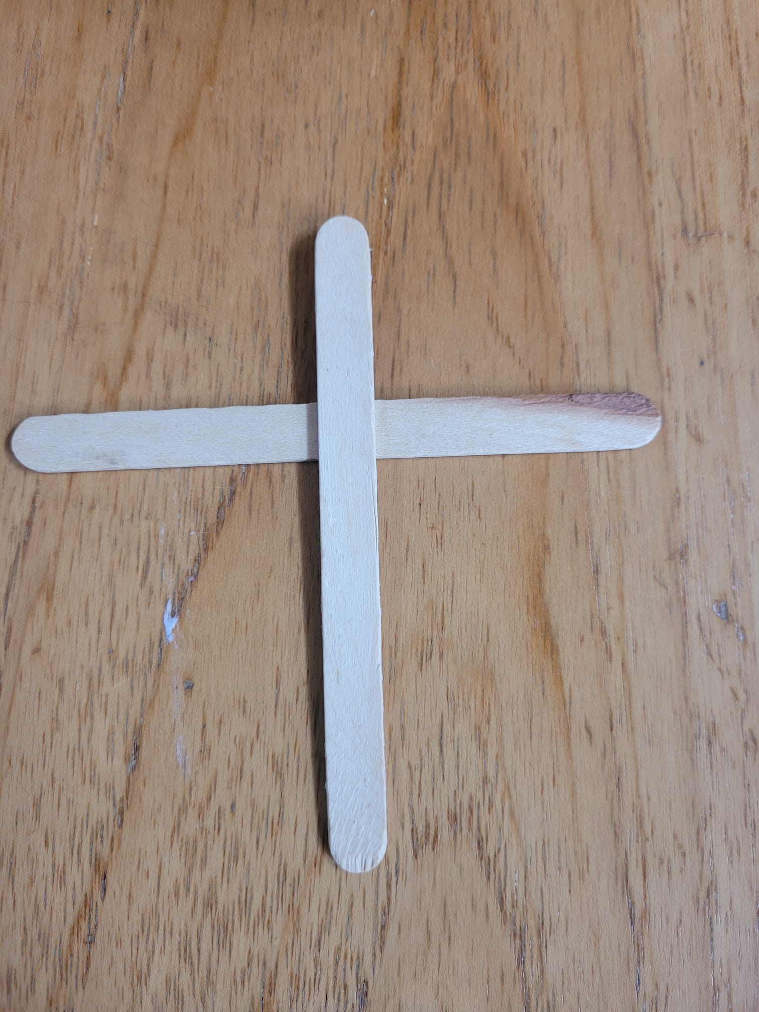
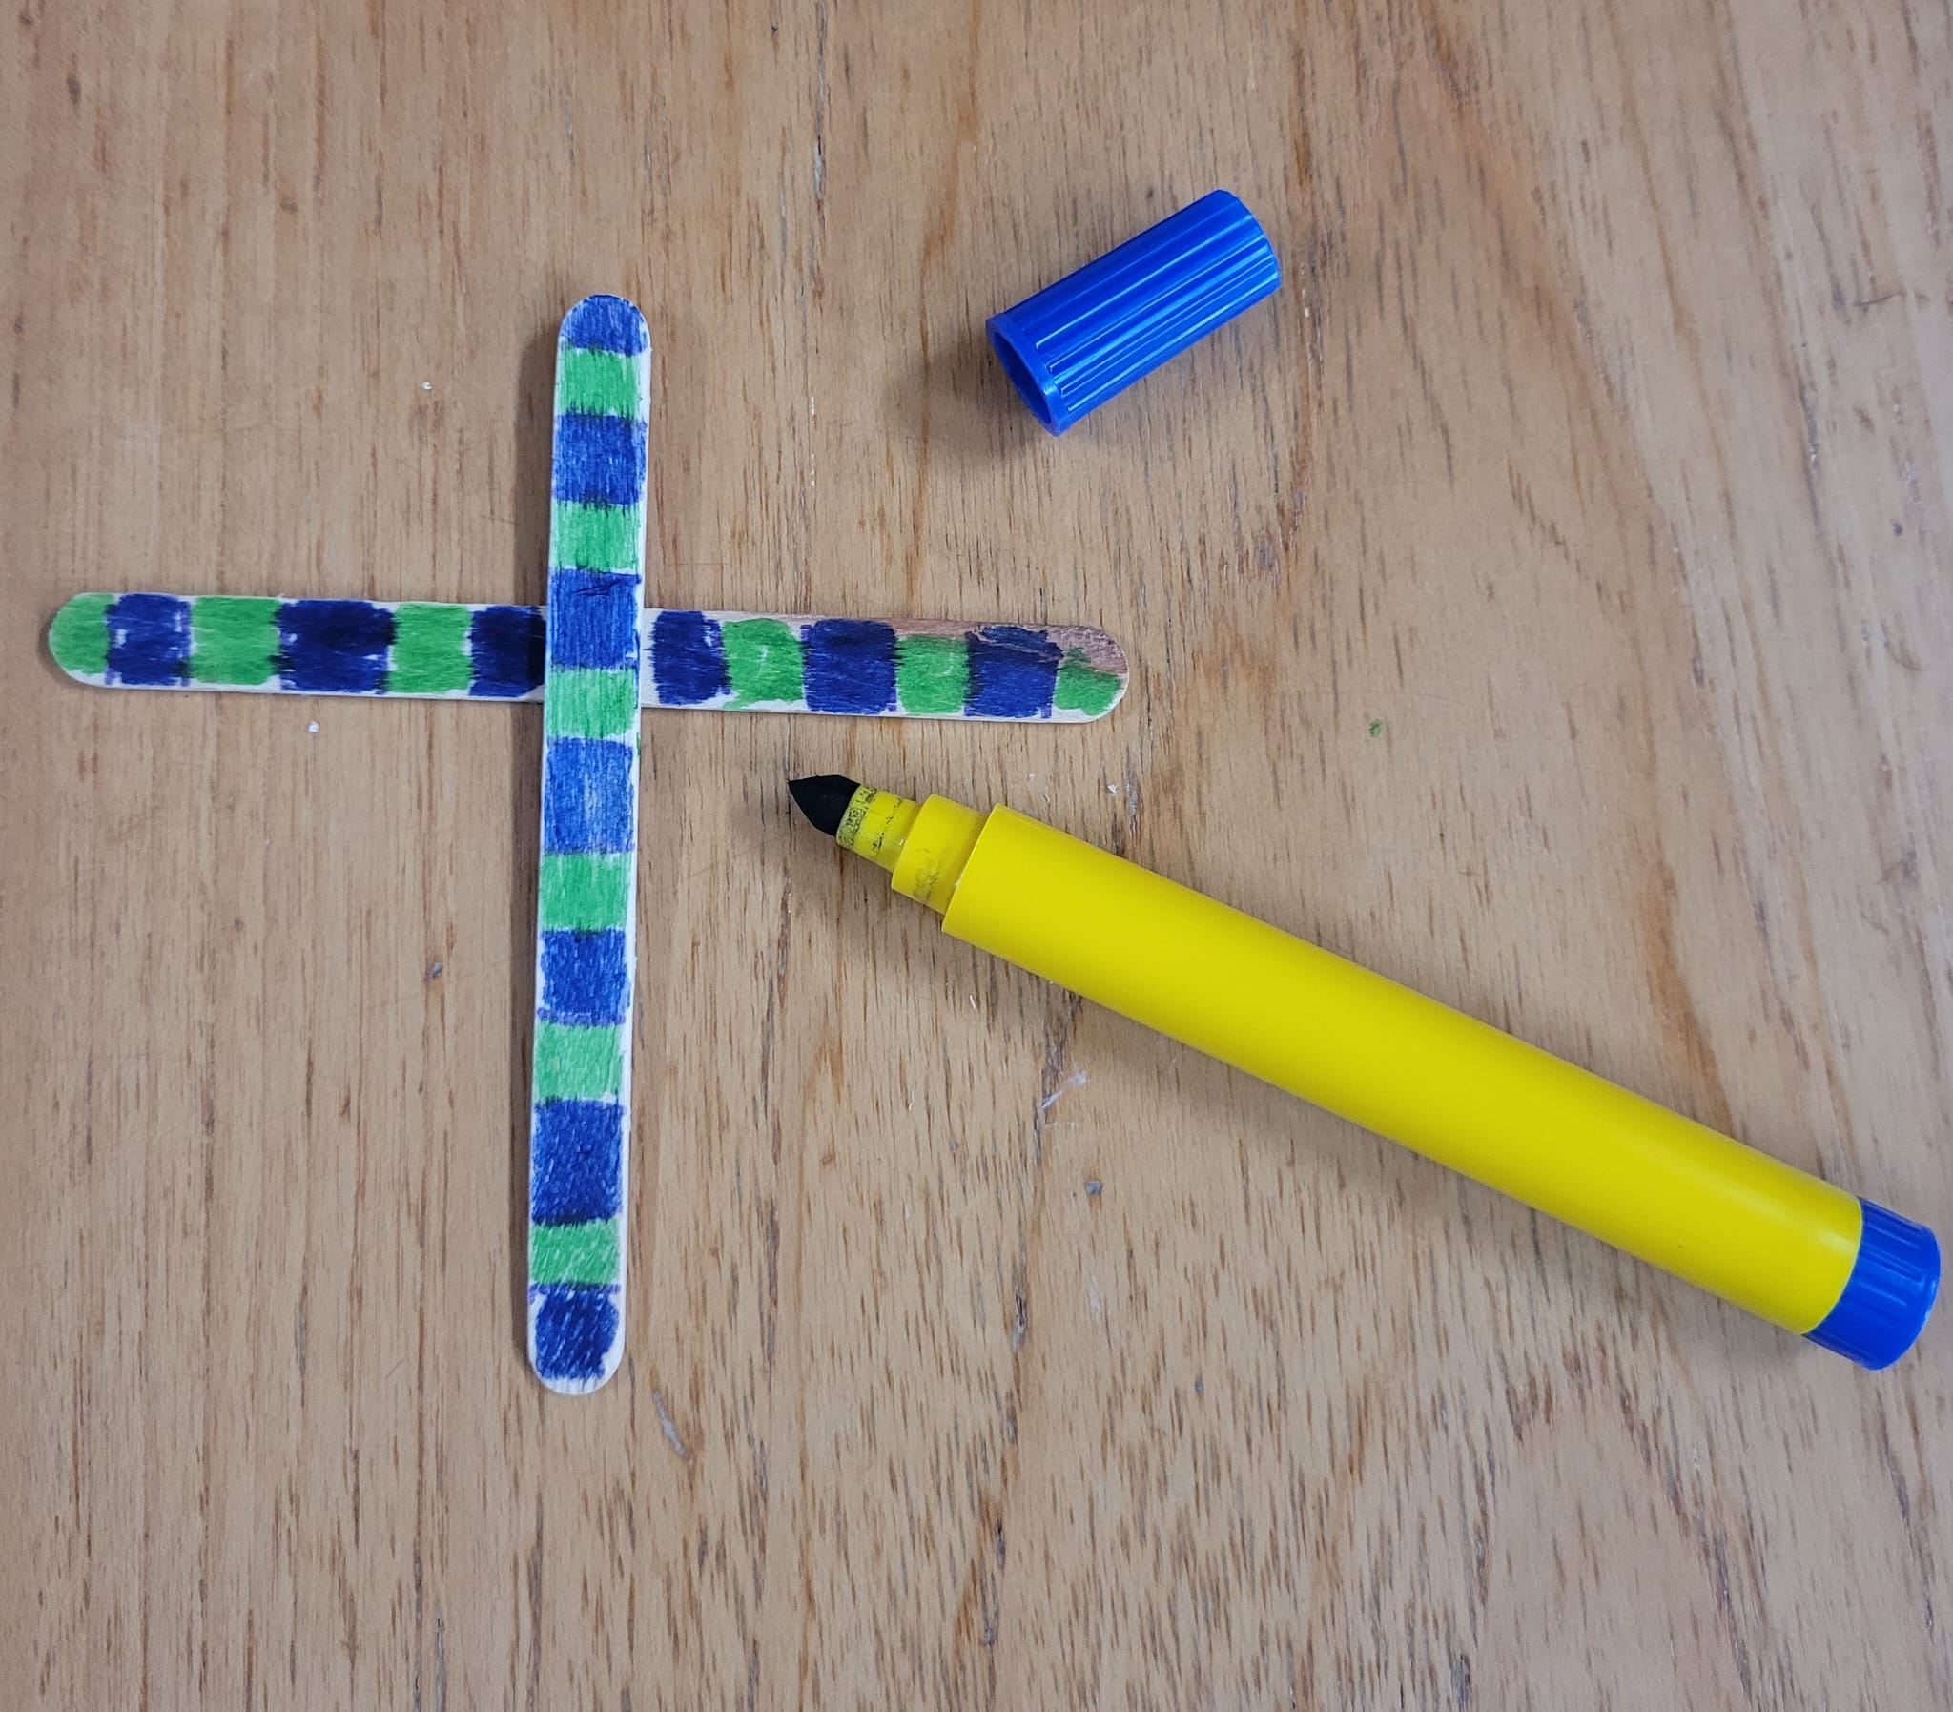
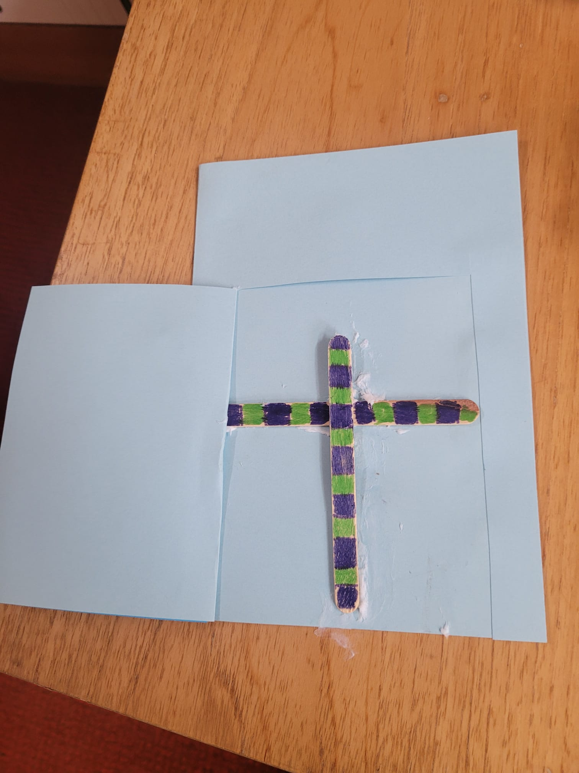
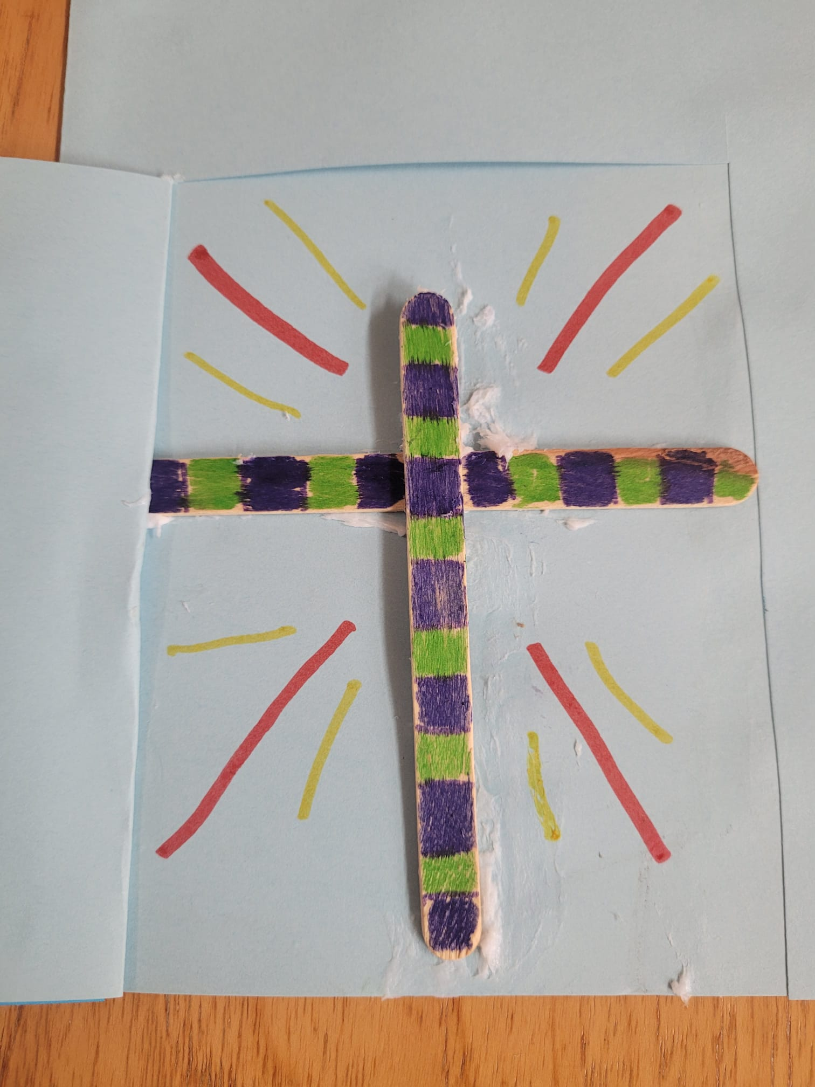
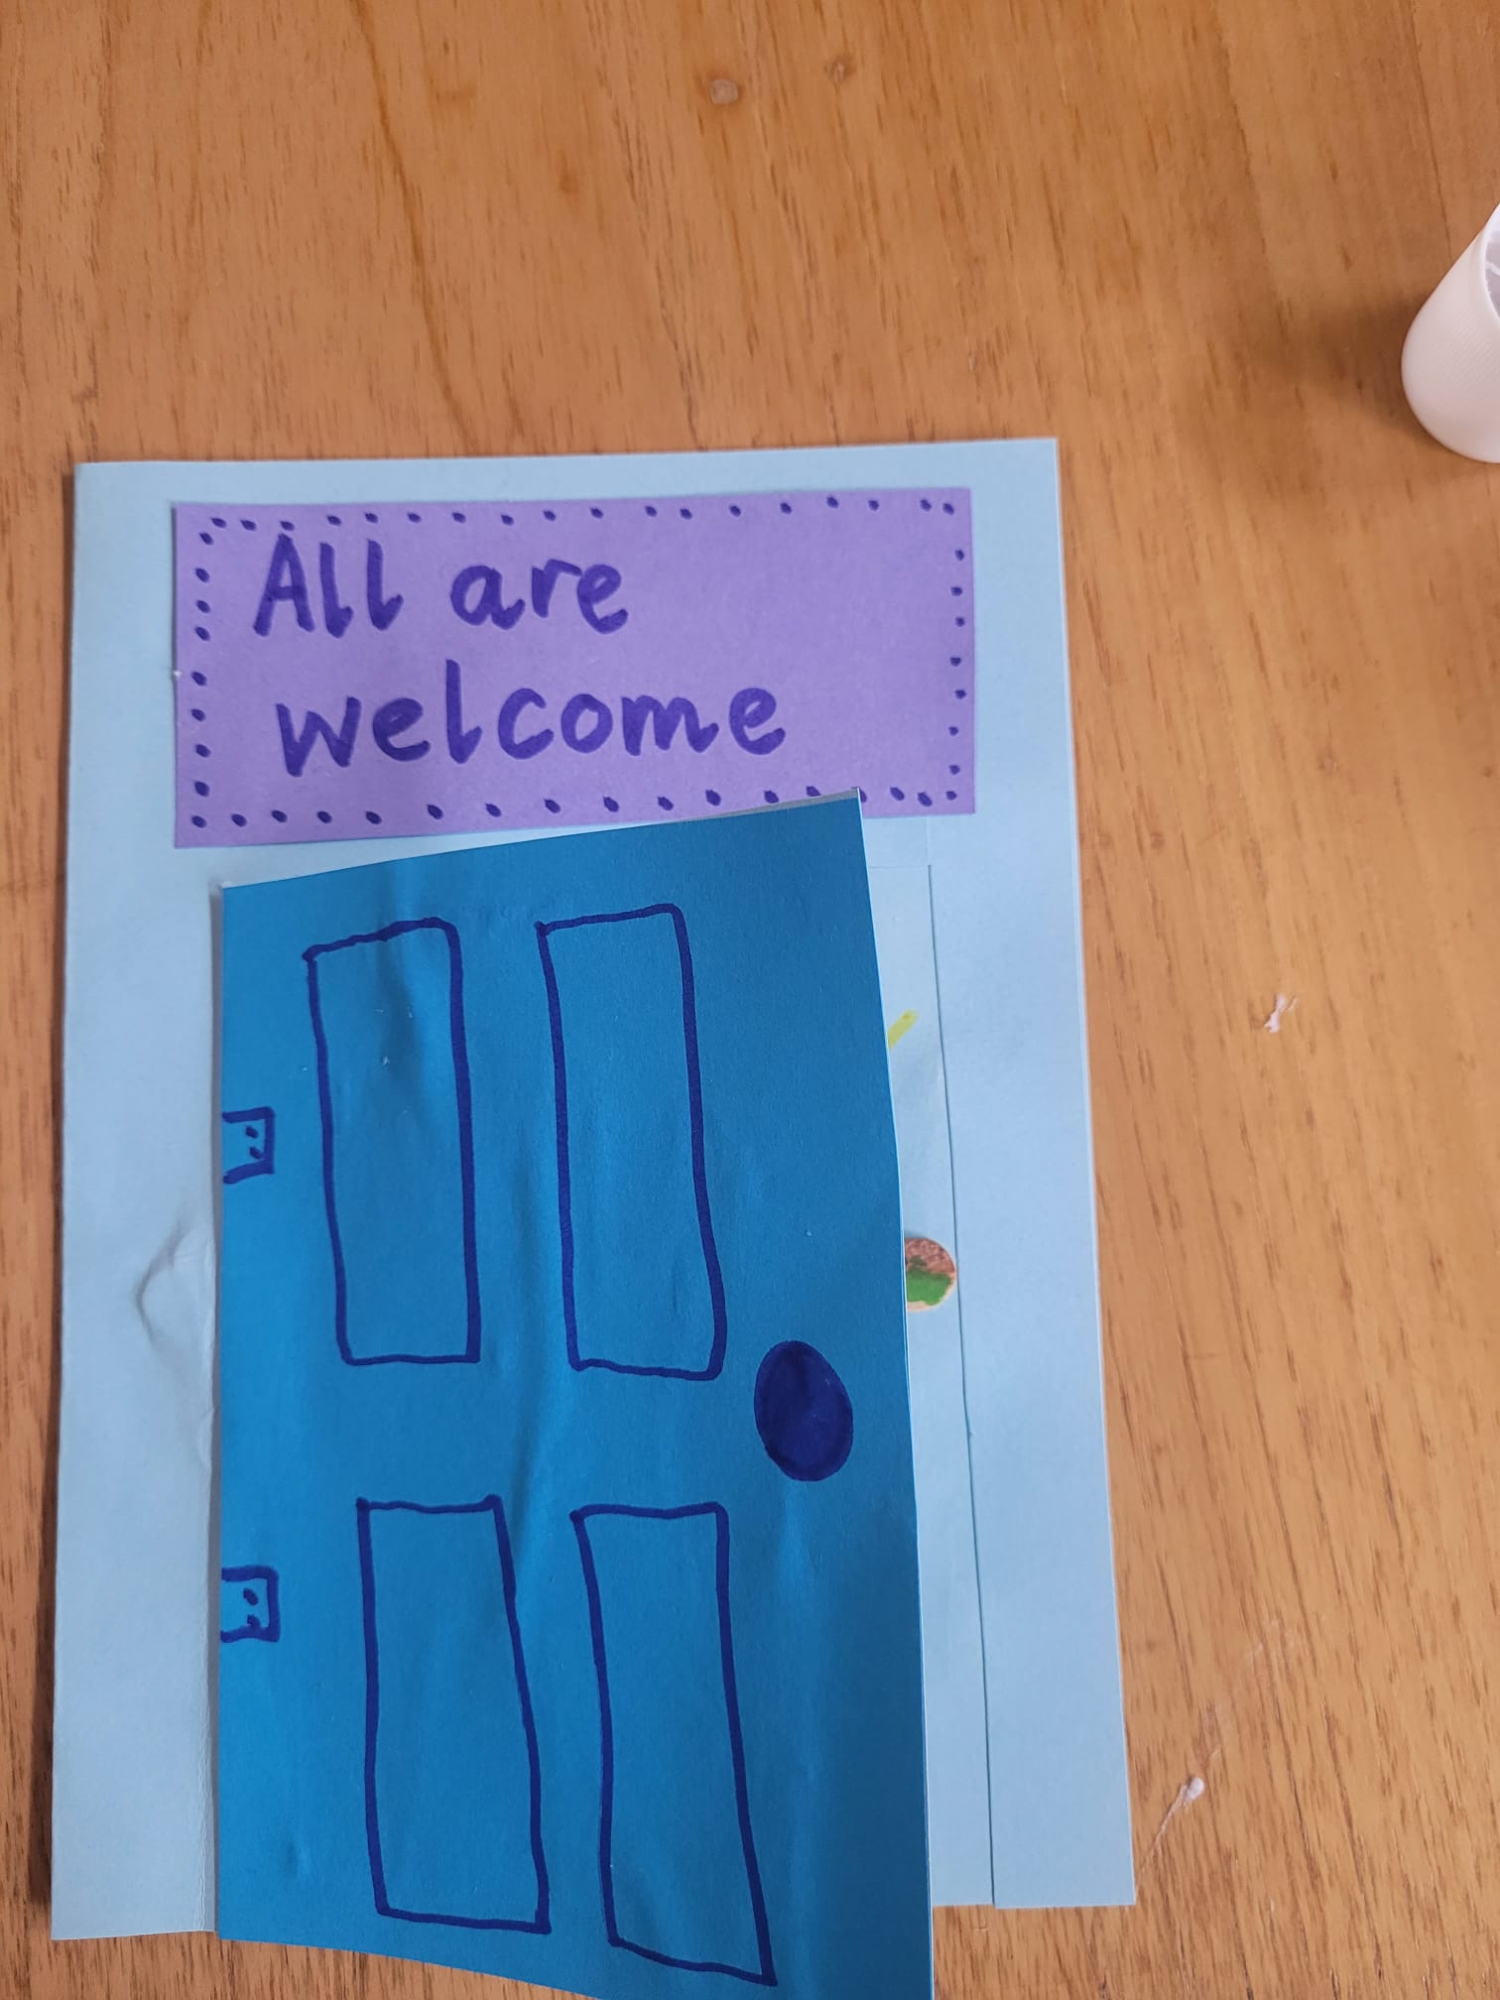
Make your own Holy Door
Notes:
Please use resource sheet 2 for instructions to make ‘Holy Door’. Teachers may find that steps 1-4 are better done by an adult helper in advance if this is to tricky for the children. Theses can all be displayed together with some information about the Holy door in St Peter’s being opened by Pope Francis to mark the beginning of the Jubliee year.

Slide 7


Welcome to God’s House song
‘We will dance we will sing
We will welcome you in
Welcome to God’s House today’
Notes:
This song can be used to remind the children that God welcomes everyone and wants us all to be close to Him. Click the image to place the song from you tube.

Slide 8

Time for prayer
Sign of the cross
We light the candle to remind us God is with us when we pray
Father in Heaven, we love to take time each day to be with you in prayer and we know that you are always ready to listen to us
We thank you, Father for the Jubliee Year which helps us to remember to try to know and love you more.
Thank you, Lord for Pope Francis who leads us closer to you.
Teacher: Lord hear us Children :Lord graciously hear us
Thank you, Lord for our priest and teachers who tell us about you.
Teacher: Lord hear us Children :Lord graciously hear us
Thank you God for our friends and family who pray with us.
Teacher: Lord hear us Children :Lord graciously hear us
Thank you God for welcoming us to come close to you.
Teacher: Lord hear us Children :Lord graciously hear us
We sing our song to end our time of prayer
Notes:
Click the image to play the song via you tube.

Slide 9
What have we learned about this week?
I have learned :
What a Jubilee Year is
About following others to learn about Jesus
About the ‘Holy Door’ during a Jubilee Year
To be thankful to God who welcomes me to be close to Him
. I can :
Tell others what a Jubilee Year is
Tell others about some ways I can be a follower of Jesus
Tell others about the ‘Holy Door’
Thank God for always making me welcome to be close to Him
9
Notes:
May be used as part od plenary session to review learning.

