Slide 1

Catholic Education Week 2024
Pilgrims of Hope

Slide 2
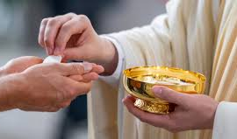
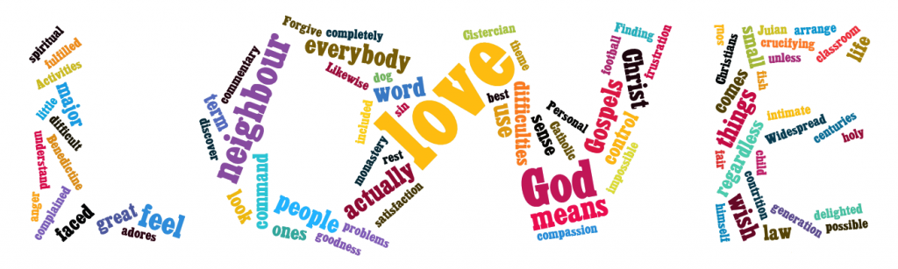
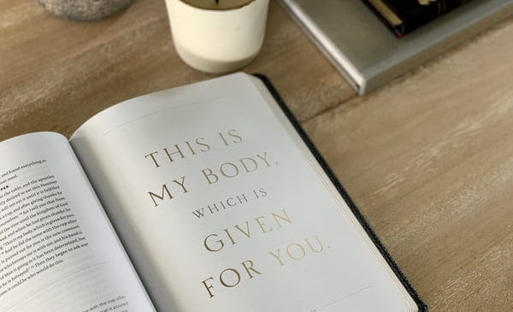

What does the word
‘Pilgrim’ mean to you?
Pilgrim

Slide 3
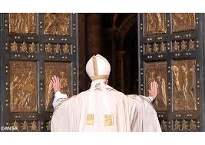
Why is there a Jubilee next year?
Watch this video to learn more about the jubilee tradition in the Roman Catholic Church

Slide 4


Slide 5


Slide 6
Activity 1 – The Jubilee Year Logo
Look carefully at the Synod logo.
Write down all the things that you can see depicted in the logo
Share your list with your shoulder partner
Choose 5 images from your list – why do you think they have been included in the logo?
Share your thoughts with your shoulder partner
Have a class discussion about the logo – in what ways does this logo explain that we are Pilgrims of Hope?

Slide 7
Having watched the video:
What do you think the colours represents?
Why is the Cross not straight?
Why is there an anchor at the bottom of the cross?

Slide 8
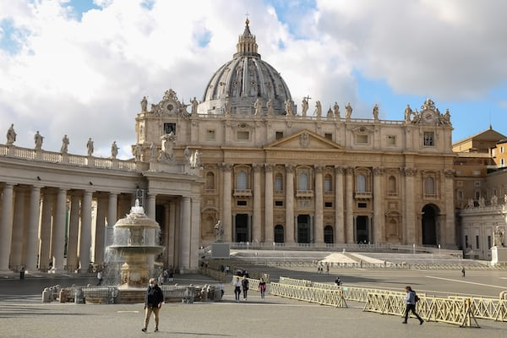
We have been asked to focus on 4 Vatican documents to prepare for the Jubilee Year.
Watch this 12 minute video for a summary of the documents

Slide 9


Slide 10
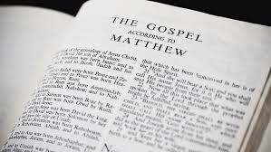
Part 2: Scripture and our Pilgrim Journey
How can reading the Bible help us on our pilgrim journey?
As the People of God journey together, the Word of God in scripture is our food for the journey. As we read it and pray it, we encounter Christ in our midst and see ourselves, our Church, and our world through the eyes of faith.

Slide 11
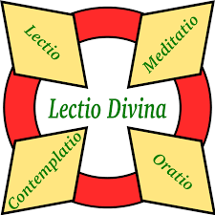
Lectio Divina
The jubilee year emphasizes listening attentively to the Word of God, in particular we are asked to reflect on the Our Father.
The practice of Lectio Divina remains a long-standing tradition in the Christian Church. Lectio Divina is a form of prayer where you contemplate on a passage of scripture.

Slide 12
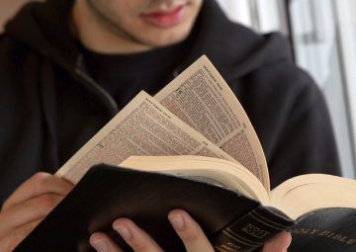
Believing that the Scriptures contain God’s Word to us, engaging in this practice teaches us to pray by the inspiration of the Holy Spirit.
What you do:
First, you read the text slowly and deliberately;
Second you meditate or reflect on what you have just read, focusing on what touched your heart, stopped you in your reading;
Third, you pray from what inspired or touched you in the text, drawing from your life experiences, your hopes, your relationship with God; and
Fourth, you contemplate further from what you read, pondered, and prayed in an environment of silence.

Slide 13
Lectio Divina: Gospel of Luke
“Teach us to pray”
Read this passage following the 4 stages of Lectio Divina – Read, Meditate, Pray, Contemplate
11 Now Jesus^{[a]} was praying in a certain place, and when he finished, one of his disciples said to him, “Lord, teach us to pray, as John taught his disciples.” ² And he said to them, “When you pray, say:
“Father, hallowed be your name.
Your kingdom come.
³ Give us each day our daily bread,^{[b]}
⁴ and forgive us our sins,
for we ourselves forgive everyone who is indebted to us.
And lead us not into temptation.”

Slide 14
Some background to this scripture passage:
The “Our Father,” also known as the “Lord’s Prayer,” is a central prayer in Christianity. It is recorded in the Gospels of Matthew and Luke.
In the Gospel of Matthew, Jesus teaches this prayer during the Sermon on the Mount (Matthew 6:9-13). In the Gospel of Luke, it is presented in response to a disciple’s request to teach them how to pray (Luke 11:2-4)¹². The prayer is a model for how Christians should pray, emphasizing themes of reverence, dependence on God, forgiveness, and seeking divine guidance.
The prayer’s wording varies slightly between the two Gospels, but it generally includes the following elements:
Addressing God as Father: Signifying a close, personal relationship with God.
Hallowing God’s Name: Acknowledging God’s holiness.
Seeking God’s Kingdom and Will: Expressing a desire for God’s rule and purposes to be fulfilled.
Requesting Daily Needs: Asking for provision of daily sustenance.
Seeking Forgiveness: Asking for forgiveness of sins and committing to forgive others.
Asking for Guidance and Protection: Requesting help to avoid temptation and deliverance from evil¹².
The “Our Father” is recited by Christians of various denominations around the world and is considered a universal Christian prayer

Slide 15
Key points:
Pope Francis has chosen the “Our Father” as a central focus for the 2025 Jubilee Year to emphasize themes of hope, reconciliation, and divine guidance. The Jubilee Year, officially proclaimed with the papal bull “Spes Non Confundit” (“Hope Does Not Disappoint”), aims to renew the faith and hope of Catholics worldwide¹².
The “Our Father” prayer encapsulates these themes, making it a fitting focal point. It calls for:
Reverence for God: Acknowledging God’s holiness and sovereignty.
Dependence on Divine Provision: Trusting God for daily needs.
Forgiveness and Reconciliation: Seeking and offering forgiveness.
Guidance and Protection: Asking for help to avoid temptation and evil¹².
By focusing on this prayer, Pope Francis hopes to inspire a deeper spiritual renewal and a tangible expression of hope and mercy in the lives of believers

Slide 16
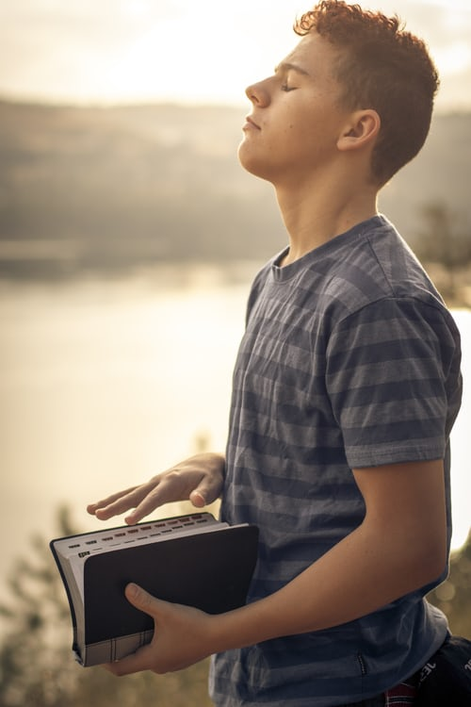
Questions for Prayerful Reflection
Reflective questions can deepen your understanding and experience of the “Our Father” prayer. Here are some questions to consider for each part of the prayer:
Our Father, Who art in heaven
How do I perceive my relationship with God as a loving Father?
In what ways do I acknowledge God’s presence in my daily life?
Hallowed be Thy Name
How do I honour and respect God’s name in my actions and words?
What does it mean to me to keep God’s name holy?
Thy Kingdom come
How can I contribute to bringing God’s kingdom to earth through my actions?
What areas of my life need to align more with God’s will?

Slide 17
Questions for Prayerful Reflection
Thy Will be done, on earth as it is in heaven
Am I open to accepting God’s will, even when it differs from my own desires?
How can I better discern and follow God’s will in my daily decisions?
Give us this day our daily bread
What are my true needs versus my wants?
How do I express gratitude for the daily provisions I receive?
And forgive us our trespasses, as we forgive those who trespass against us
Is there anyone I need to forgive or seek forgiveness from?
How do I practice forgiveness in my relationships?
And lead us not into temptation, but deliver us from evil
What are the temptations I struggle with the most?
How can I seek God’s help to overcome these temptations and avoid evil?

Slide 18
Part 3: Pilgrims of Hope: Daily Prayer
Incorporating the “Our Father” into your daily routine can be a meaningful way to deepen your spiritual life. Here are some practical suggestions:
Morning Prayer
Start Your Day: Begin each morning by reciting the “Our Father” to set a positive and reflective tone for the day.
Reflect on the Day Ahead: As you pray, think about how you can live out the values expressed in the prayer throughout your day.
Mealtime Prayers
Before Meals: Use the “Our Father” as a grace before meals to express gratitude for your daily bread and to seek God’s blessings on your food and fellowship.

Slide 19
Part 3: Communion, Participation, Mission
Midday Prayer
Pause and Reflect: Take a moment during your lunch break or another quiet time in the middle of the day to recite the prayer and reflect on its meaning.
Check-In with God: Use this time to assess how your day is going and to seek guidance for the remainder of the day.
Evening Prayer
End Your Day: Conclude your day with the “Our Father” as part of your evening prayer routine.
Reflect on Your Day: Think about how you lived out the prayer’s teachings and where you might need to seek forgiveness or make changes.

Slide 20
Part 3: Communion, Participation, Mission
Integrate with Other Prayers
Combine with Other Prayers: Incorporate the “Our Father” into other prayer practices, such as the Rosary or personal prayer time, to enrich your spiritual routine.
Use Visual Reminders
Prayer Cards or Posters: Place a card or poster with the “Our Father” in a visible spot, like your bedside table, desk, or kitchen, to remind you to pray throughout the day.
Group Prayer
Family or Community Prayer: Recite the “Our Father” together with your family or prayer group to foster a sense of community and shared faith.
Mindful Moments
During Daily Activities: Recite the prayer during routine activities, like walking, commuting, or doing household chores, to keep your mind focused on spiritual matters.
By integrating the “Our Father” into various parts of your day, you can create a rhythm of prayer that helps you stay connected to your faith and the values it represents.

