Slide 1


Pilgrims of Hope
Catholic Education Week 2024
BGE Assembly

Slide 2

Jesus our Teacher, in your love for us, help us to develop our own talents so that we may become like you and lead lives of goodness.
Bless all learners and all teachers. May our Catholic schools continue to serve our families, our communities and our country.
Help us, through our learning, to believe in you and to celebrate the life of your Church. Help us to grow in holiness as we grow in friendship with you and try to become saints.
We make this prayer in the name of Jesus, our Lord. Amen
Prayer for Catholic Education Week
Notes:
Begin the Assembly saying the Catholic Education Week prayer together.

Slide 3

Pilgrims of Hope
This is the theme of the Jubilee Year in 2025.
In the Church, a Jubilee, or Holy Year, is a great religious event.

Slide 4
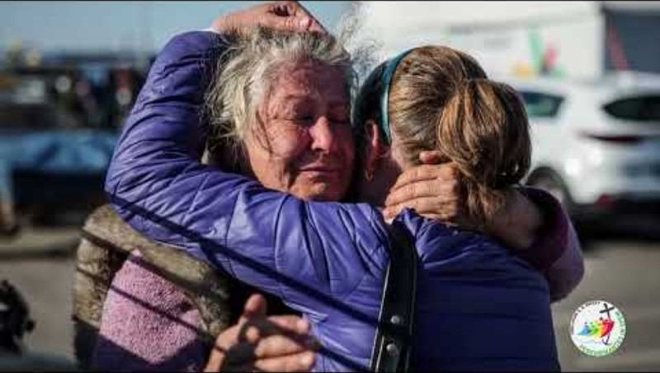
Notes:
Play the clip. Then ask the students to reflect on what is meant by a Jubilee Year.

Slide 5
What do you see when you look at the logo for the Jubilee Year?
Notes:
Allow a few minutes for the students to reflect on the Jubilee logo.

Slide 6
The Cross – the reassurance of hope
All humanity
Holding the Cross
Choppy waters
The Cross is an anchor
Peregrinantes in Spem
Notes:
Explain the logo:
All humanity - The Logo shows four stylized figures to indicate all of humanity from the four corners of the earth. They each embrace one another, indicating the solidarity and fraternity that must unite peoples.
Holding the Cross - The first figure clings to the cross. It is not only the sign of the faith which this lead figure embraces, but also of hope, which can never be abandoned, because we are always in need of hope, especially in our moments of greatest need.
Choppy Waters - The underlying waves are choppy to indicate that the pilgrimage of life is not always lived on calm waters.
The Cross is an Anchor - Because often personal circumstances and world events call for a greater sense of hope, the lower part of the Cross is elongated turning into an anchor, which dominates the movement of the waves. Anchors often have been used as metaphors for hope.
The Cross – the reassurance of hope - The Cross is not static, but dynamic, bending toward and meeting humanity as if not to leave it alone. The cross is offering the certainty of its presence and the reassurance of hope.
At the bottom of the logo is the motto of the 2025 Jubilee Year: Peregrinantes in Spem (Pilgrims in hope), represented in green letters.
Overall, the image shows how the pilgrim's journey is not individual, but rather communal, with the signs of a growing dynamism that moves more and more toward the Cross of hope.
Ask the students to look again at the Logo and reflect on what it is saying about being a Pilgrim of Hope.

Slide 7

So, is hope…
An optimistic state of mind that is based on the expectation of positive outcomes or the belief that things will get better in the future. It is the feeling of desire and anticipation for something good to happen, even when the odds may seem unfavourable. Hope may provide motivation, comfort and resilience during difficult times and can inspire people to take action to achieve their goals.
Notes:
This is a definition of hope taken from a dictionary. Does this reflect what the Jubilee logo is trying to tell us about hope? No. While this is very positive about hope, it is a definition which does not reflect the richness and spiritual dimension of life as a Pilgrim of Hope.

Slide 8
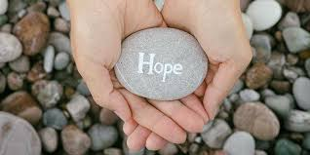

For Christians, hope is greater and more powerful than this definition.
It is an unshakable trust and assurance that the promises of God will be fulfilled.
It is placing our trust in God, based on what He has already done for us in the life, death, and resurrection of Jesus.
Hope is an absolute certainty that God’s promises will come true.
Hope =
Trust in God
Notes:
After reading to ‘…promises will come true.’ : Read the following:
Having hope in God does not necessarily mean that our current circumstances will immediately change, but that God will support us throughout them and that we will one day experience eternal happiness.
Then display ‘Hope =…’

Slide 9
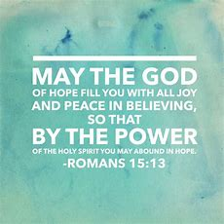

Reflect on Christian hope
Notes:
Reflect on these statements about hope – what are they saying about the importance of hope?

Slide 10
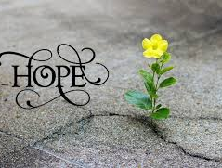

Reflect on Christian hope

Slide 11

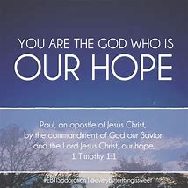
Reflect on Christian hope

Slide 12

Hope is trusting in what God has promised us in creation, in the prophets, but especially in Jesus Christ, even though we do not yet see it. God’s Holy Spirit is given to us so that we can patiently hope for the truth.
YOUCAT 308

Slide 13
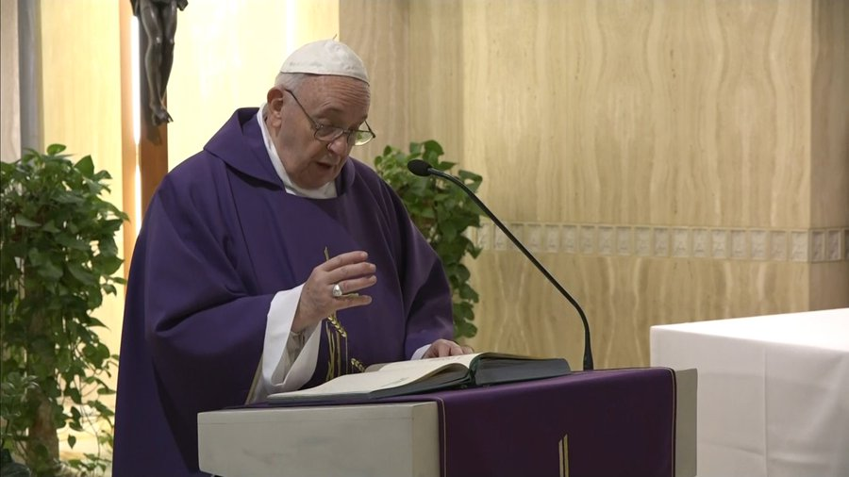
Pope Francis says Pilgrims of Hope should:
Welcome our God-given vocation to serve Him
Make room for God, so that you might find happiness in His call
Let Jesus draw you to Himself and guide you
Read and reflect on the Gospels
Be guided by the Holy Spirit
Listen to one another and journey together
Engage daily in prayer that listens for the voice of God and helps us become “pilgrims of hope and builders of peace”
Be on Christian pilgrimage which means keeping our eyes, minds, and hearts fixed on our goal — Christ
Become “men and women of hope,” bearing the Gospel message of hope
How can you be a Pilgrim of Hope?
Notes:
Read the statements. Let the students read them again.
Let them reflect on the question, ‘How can you be a Pilgrim of Hope’?

Slide 14
Pope Francis said:
That in the Jubilee year, hope be offered to those in prison, the sick, to the young and to the elderly – especially grandparents, to migrants and to the poor.
That during the Holy Year, “the light of Christian hope might illumine every man and woman, as a message of God’s love addressed to all,” and that “the Church might bear faithful witness to this message in every part of the world.”
How can we offer this hope to others in need? How can we bear witness to this message of hope?

Slide 15

Notes:
Reflect on these questions as you watch this clip – do small things with love and you can bring hope and make a difference to many people.

Slide 16

Notes:
How can you respond to the Summons of the Lord and bring hope to others?

Slide 17
Father in heaven, may the faith you have given us in your son, Jesus Christ, and the flame of charity enkindled in our hearts by the Holy Spirit, reawaken in us the blessed hope for the coming of your Kingdom.
May your grace transform us into Pilgrims of Hope, walking a path focused on Gospel values.
May the grace of the Jubilee reawaken in us, Pilgrims of Hope, a yearning for the treasures of heaven. May that same grace spread the joy and peace of our Redeemer throughout the earth.
To you our God, eternally blessed, be glory and praise for ever. Amen.
Notes:
Say the final prayer together.

Slide 18
