Slide 1

Catholic Education Week 2022

Slide 2
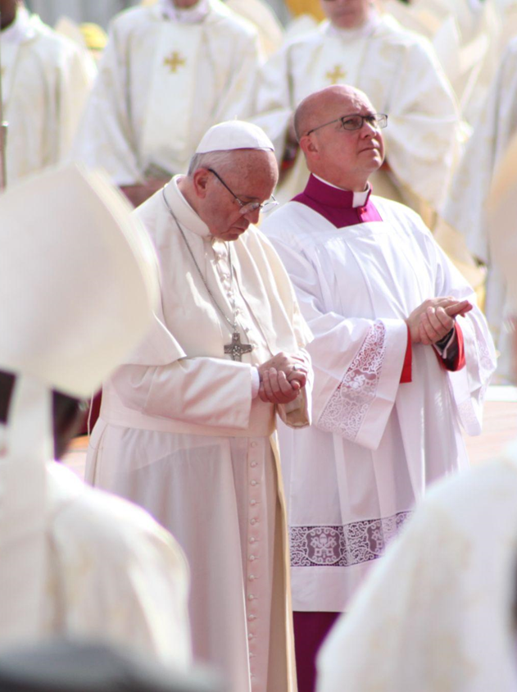
Catholic Education Week 2022
We stand before You, Holy Spirit,
as we gather together in Your name.
With You alone to guide us,
make Yourself at home in our hearts; Teach us the way we must go
and how we are to pursue it.
We are weak and sinful;
do not let us promote disorder.
Do not let ignorance
lead us down the wrong path
nor partiality influence our actions.
Let us find in You our unity
so that we may journey together
to eternal life and not stray
from the way of truth and what is right.
All this we ask of You, who are at work in every place and time, in the communion of the Father and the Son, forever and ever. Amen.
Communion, Participation and Mission
Notes:
Introduction:
Explain that Catholic Education Week is a period of time set apart in the year for us to consider the unique role of Catholic Education in the life and mission of the wider Church. Each year has a theme that allows us to explore and deepen our knowledge of a particular aspect of Catholic Education.
Introduce pupils to the theme of this year’s Catholic Education Week: Communion, Participation and Mission, which is taken from the Synod currently happening all over the world. The word “synod” comes from the Greek synodos, meaning “an assembly.” but also means “journeying together”.
Opening Prayer
To begin this learning, we’ll use the same prayer that has been used throughout the synod process in every parish and every diocese across the word. Click to reveal prayer
Prior Learning:
Ask students what their knowledge of the synod is? Did they take part in the synod activity through school or in their parish? What do they think the purpose of the synod is?

Slide 3
Notes:
Notes: Take some time to allow students to look at the above image.
What do they see? Who is included in the image?
In addition to class feedback, draw out the points made below about the image:
A large, majestic tree, full of wisdom and light, reaches for the sky. A sign of deep vitality and hope which expresses the cross of Christ, it carries the Eucharist, which shines like the sun.
The horizontal branches, opened like hands or wings, suggest, at the same time, the Holy Spirit.
The people of God are on the move, in direct reference to the word synod, which means “walking together”. These 15 silhouettes sum up our entire humanity in its diversity of life situations, of generations and origins. This aspect is reinforced by the multiplicity of bright colours which are themselves signs of joy.
There is no hierarchy between these people who are all on the same footing: young, old, men, women, teenagers, children, lay people, religious, parents, couples, singles; the bishop and the nun are not in front of them, but among them.
Quite naturally, children and then adolescents open their walk, in reference to these words of Jesus in the Gospel: “I praise you, Father, Lord of heaven and earth, because you have hidden these things from the wise and learned and revealed them to little children”. (Mt 11:25)
With all the observations of this image in mind, let's explore the three themes of the synod: Communion, Participation and Mission.

Slide 4
Communion
Notes:
Ask students what they understand by the word “Communion”. Comments may include reference to First Holy Communion, receiving communion at Mass, or a sense of being in communion with each other. Draw out the following points:

Slide 5
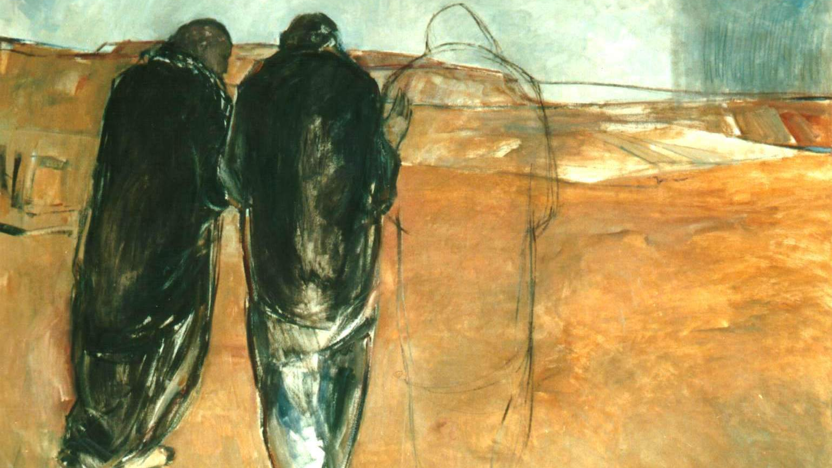
Communion
Notes:
Notes: Use the following scripture passage to explore what being in communion with the person of Jesus means.
Luke 24:13-35
The Walk to Emmaus
Now on that same day two of them were going to a village called Emmaus, about seven miles from Jerusalem, and talking with each other about all these things that had happened. While they were talking and discussing, Jesus himself came near and went with them, but their eyes were kept from recognizing him. And he said to them, “What are you discussing with each other while you walk along?” They stood still, looking sad. Then one of them, whose name was Cleopas, answered him, “Are you the only stranger in Jerusalem who does not know the things that have taken place there in these days?” He asked them, “What things?” They replied, “The things about Jesus of Nazareth, who was a prophet mighty in deed and word before God and all the people, and how our chief priests and leaders handed him over to be condemned to death and crucified him. But we had hoped that he was the one to redeem Israel. Yes, and besides all this, it is now the third day since these things took place. Moreover, some women of our group astounded us. They were at the tomb early this morning, and when they did not find his body there, they came back and told us that they had indeed seen a vision of angels who said that he was alive. Some of those who were with us went to the tomb and found it just as the women had said; but they did not see him.” Then he said to them, “Oh, how foolish you are, and how slow of heart to believe all that the prophets have declared! Was it not necessary that the Messiah should suffer these things and then enter into his glory?” Then beginning with Moses and all the prophets, he interpreted to them the things about himself in all the scriptures.
As they came near the village to which they were going, he walked ahead as if he were going on. But they urged him strongly, saying, “Stay with us, because it is almost evening and the day is now nearly over.” So he went in to stay with them. When he was at the table with them, he took bread, blessed and broke it, and gave it to them. Then their eyes were opened, and they recognized him; and he vanished from their sight. They said to each other, “Were not our hearts burning within us while he was talking to us on the road, while he was opening the scriptures to us?” That same hour they got up and returned to Jerusalem; and they found the eleven and their companions gathered together. They were saying, “The Lord has risen indeed, and he has appeared to Simon!” Then they told what had happened on the road, and how he had been made known to them in the breaking of the bread.
Notes:
Ask for comments and observations on the passage that has just been heard. Especially focusing on what communion might mean in this passage.
Points to draw out:
Communion is about common sharing, fellowship. For a Christian, it has a much more powerful meaning: the courage to ‘break bread’, to recognise Jesus in the breaking of bread and to share it with others. The two disciples with whom Jesus journeys with, on the road to Emmaus are able to recognise him only in the ‘breaking of the bread’. Once the bread is broken it needs to be shared with others. At the Last Supper, Jesus also gives communion to Judas – whom he knows is about to betray him. Communion is the grace to transcend our narrowness, bigotedness, selfishness, exclusiveness – to reach out to others particularly the lost, least and last. It is the openness to realise that all are my sisters and brothers.

Slide 6
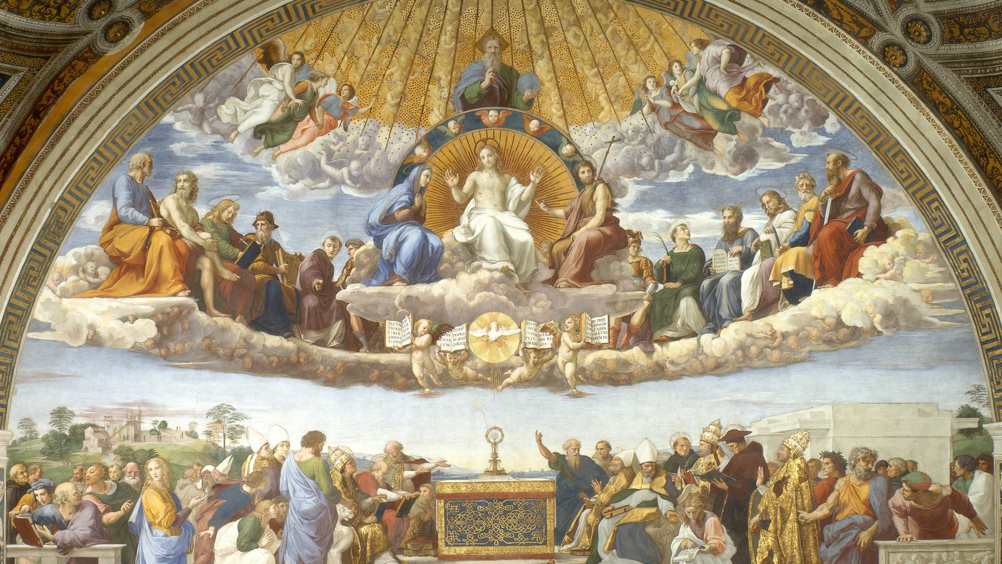
Notes:
Note: Give your students a few minutes to observe and consider the image on the screen (The Disputation of the Holy Sacrament by Raphael). The following questions could be used to direct discussion around the image, or certain questions could be selected for written reflection on the image. Whichever way you choose to engage, the emphasis here is on the communion of the Church i.e. that the Trinity, the angels and saints, and every Christian both living and dead forms the communion of the Church.
How does this painting make you feel?
Describe what you see in this painting?
What do you think this an image of? (Heaven, the Communion of Saints, or all of the angels)and saints in Heaven.
Where is Jesus in this painting? Why do you think the artist placed Him where He is? Who else is with Him? (He is in the centre of the circle (Heaven). The artist probably placed Him there because He is the king of the universe and reigns over Heaven. He is with God the Father (above Him)and the Holy Spirit (as a dove beneath them) with Mary and Joseph to His sides.)
Where do you see angels in this painting? How do you know they are angels? (At the top and on either side of Jesus, the Father, and the Holy Spirit. We know they are angels because they are depicted with wings.)
Who are all of the other people depicted in Heaven with Jesus? The saints.
What does Jesus (and the saints in Heaven) have around his head? What do you think this means? (A halo. A halo is an artistic representation of a person’s holiness. Jesus (and often the angels and saints) are usually depicted with halos to show that they are holy. Jesus and Mary are also usually shown with halos.)
Who are the people at the bottom of the painting beneath Heaven? What are they doing? (All of the people still alive on earth working out their salvation. They appear to be worshiping Jesus in the Eucharist which is on the altar. (The priests and bishops shown with them are directing the worship of the people towards Jesus in Heaven.)

Slide 7
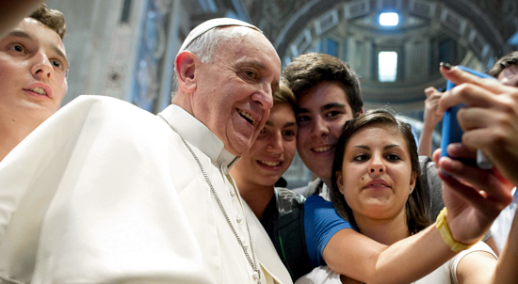
Participation
“Each of us has a part to play, a gift to
share, a service to offer, for building up
the Body of Christ in love.” Pope Francis, June 19, 2013
Notes:
Notes:
Participation is about realising that you are an indispensable piece of a jigsaw puzzle. The picture is never complete without ‘me’ and ‘you’. From the time Jesus opens the scroll in the Synagogue and reads from the Prophet Isaiah, he makes clear what his mission is and invites us to participate in it. Everyone is called to participate.
Promoting participation means recognising we each have something unique and important to contribute to the Church and to society.
As human beings we live in community with others, growing together. We are called to be active members of our local, national and global communities to improve the well-being of all people.
We have a responsibility to be inclusive in our churches, our workplaces, our neighbourhoods and our decision-making processes. As communities we can work creatively to provide opportunities for all people to participate.

Slide 8
• ‘So we, who are many, are one body in Christ, and individually we are members one of another.’​
Romans 12:5
• ‘And let us consider how to provoke one another to love and good deeds, not neglecting to meet together, as is the habit of some, but encouraging one another, and all the more as you see the Day approaching.’ Hebrews 10:24-25
“Participation is a duty to be fulfilled consciously by all, with responsibility and with a view to the common good...it becomes absolutely necessary to encourage participation above all of the most disadvantaged...” Compendium of the Social Doctrine of the Church (#189)
‘Little children, let us love, not in word or speech, but in truth and action.’ 1 John 3:18
Notes:
Notes:
The quotes on the slide, from scripture and from the Compendium of the Social Doctrine of the Church explore what participation means in the Church.
Is this different from how we understand participation in a secular (wordly) sense? Or is it similar?
Points to draw out:
Importance of doing good for others
Christians are united in their mission to serve others – co-responsibility as one body
We are called to provoke and encourage one another to do good
We are called to live in love and truth
Participation is not a choice, but rather a duty

Slide 9
How do I participate?
What is the significance of being ‘one body in Christ’ and ‘members one of another’?
Why is participation an obligation, rather than a choice for Christians?
What do I need to change to ensure that I can exercise my responsibility to actively participate in society?
How can I become more conscious of people's needs in my own life?
Notes:
Notes:
You may wish to explore these questions in the style of an examen with a more reflective nature, or ask students to produce written responses to all/some of the questions.

Slide 10
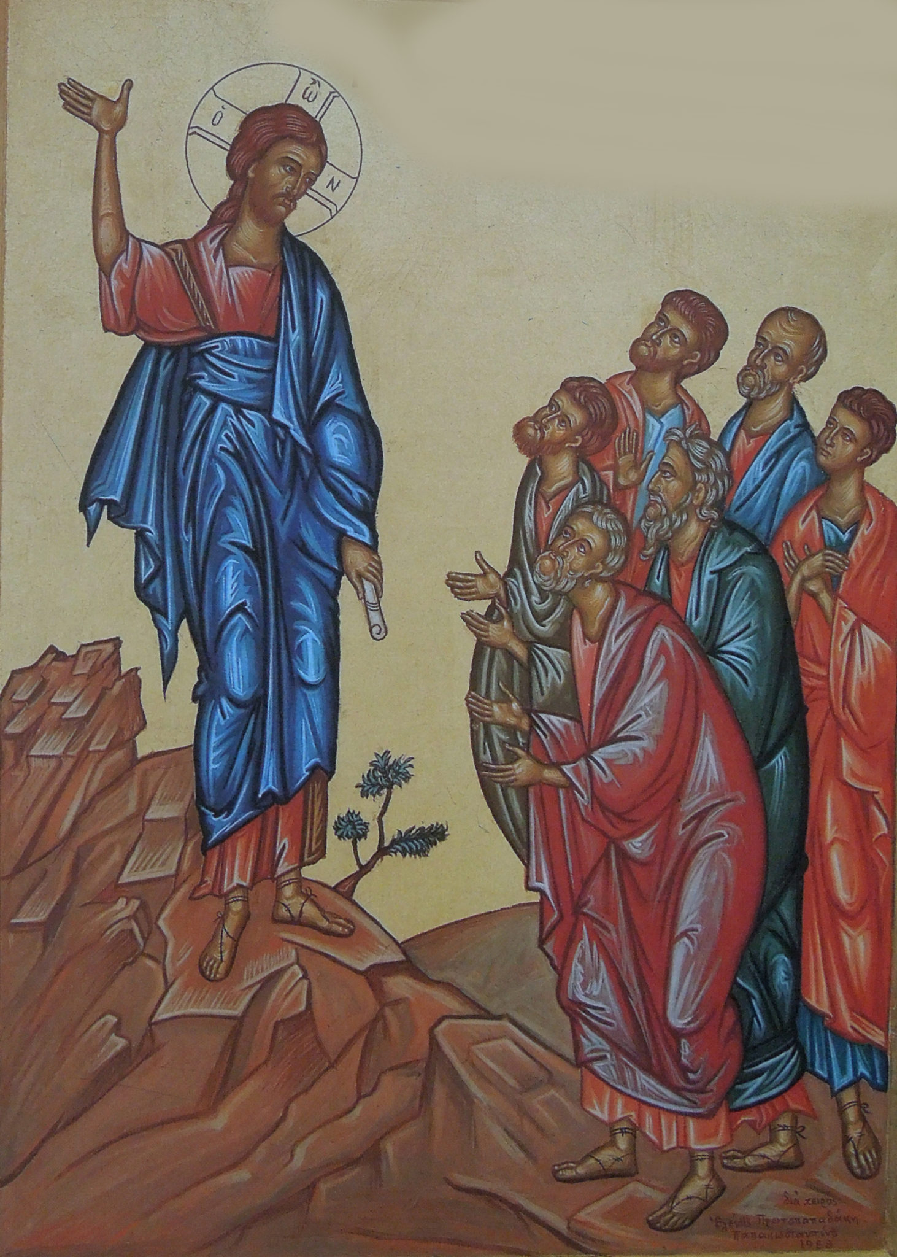
Mission
https://www.youtube.com/watch?v=bJxyiGmTT3w
Notes:
Notes:
Ask students what mission means? Do they have a sense of mission in their own lives?
Mission means going forth but also to send. Mission is a journey we are all called to undertake -to go out of ourselves: We are called to go forth: to build bridges rather than walls, to heal and not to wound, to love and not to hate. In Catholicism, mission is being sent out by Jesus to make him known and loved by every person in everything that we do and say.
Let's consider Jesus' last words to his disciples, often referred to as "The Great Commision (image on the slide above). Think about that word "co-mission". It means that in sending the disciples out, they become partners in Jesus' mission.
Matthew 28:16-20
The Commissioning of the Disciples
Now the eleven disciples went to Galilee, to the mountain to which Jesus had directed them. And when they saw him they worshiped him; but some doubted. And Jesus came and said to them, “All authority in heaven and on earth has been given to me. Go therefore and make disciples of all nations, baptizing them in the name of the Father and of the Son and of the Holy Spirit, teaching them to observe all that I have commanded you; and lo, I am with you always, to the close of the age.”
Notes:
What does Jesus commission the Disciples to do?
Make the link between Jesus' commissioning or sending out of the disciples, and what happens at the end of every Mass – we are sent out by Jesus in the same way with the same mission. Click on the hyperlink on the screen for a short video exploring this (https://www.youtube.com/watch?v=bJxyiGmTT3w)
Ask for comments or observations after the clip.

Slide 11
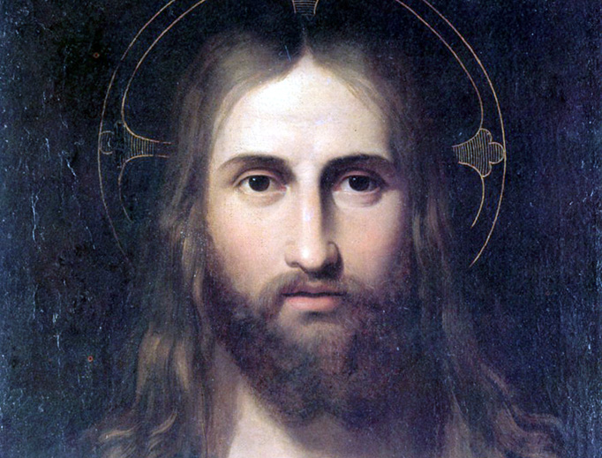
How are we Christ for others?
School
Home
Parish
Those in need
Notes:
Notes:
Collaborative activity:
Our mission is to be Christ for others. How do we demonstrate this:
In our school
In our homes
In our parishes or places of worship
To those in need?

