Slide 1

Catholic Education Week 2022
Communion, Participation and Mission
Notes:
Open the assembly in whatever way is usual for you and then introduce today’s theme:
Welcome to our special assembly for Catholic Education Week 2022. This week is Catholic Education Week across Scotland. Some of you may remember that we celebrate this week in our school every year. For our new Primary one children, this will be their first year celebrating Catholic Education Week in school.
Catholic Education Week is when we celebrate our faith, being Catholic and having our faith as part of our learning journey at school.
During this week we remember and celebrate all that is special about our Catholic School life and this year, in particular, we think about what is going on in our local Parishes and Churches and in our communities, as well as all around the world.

Slide 2

Every year, there is a special theme and this year it is ~ Communion, Participation and Mission
Theme
Notes:
Read the slide.
These are three very, big and tricky words. Words which you may have heard before and understand or words that you may not have heard before and don’t really understand. During this assembly, you will hear those words again and again and hopefully by the end of it, you will know what they mean and understand them a little more.
Let’s say those words together as they are very important…Communication, Participation and Mission.

Slide 3
Synod
What can we do better to make our Parish a better place for everyone?
What are we doing well in our Parishes?
Notes:
Provide a reminder of what the Synod is:
Our Pope, Pope Francis decided that he would like to know what is happening in our Churches and how we feel about what is happening. Last year, in 2021, he launched a big process, called ‘Synod’ where he asked all Catholics around the world (not just here where we live or in the country where we are, but all around the world) to talk and listen to each other and discuss what is good about our Church/Parish and what we think could be better. He will then take all the answers and try to make some changes to make sure everyone is happy and that we are doing our best to please God and live our lives as He has asked us to.
You will see the synod logo at the corner of each slide today, and we will talk about the logo at the end of this assembly before going back to class to do some work with your teacher and classmates.

Slide 4

Synod Prayer
Holy Spirit, we come together in your Name,
Guide us and come into our hearts;
Show us the right path and how to get there.
Sometimes we do not make loving choices;
Do not let us be confused.
Do not let anyone lead us down the wrong path.
Let us be one with you,
so that we may walk together to heaven
and always know the truth and what is right.
We ask this of you,
You are everywhere, all the time,
together with the Father and the Son, forever and ever.
Amen.
Notes:
Pope Francis gave us a special prayer to use during this time of Synod and this one has been changed a little so that you can understand the words and use them to pray to the Holy Spirit. (May be used in classrooms during regular prayer time with the children)
Let’s join our hands and pray together. (One line may be read by adult and repeated by the children)

Slide 5

Can you remember the theme?
Notes:
So, let’s talk about the theme for this year. There were three big words mentioned at the beginning, can anyone remember them? Ask for suggestions.

Slide 6
Communion
Notes:
The first word was Communion.
Discuss the word ‘Communion’. Where have you heard this word before? (Most will suggest the Sacrament of Holy Communion)

Slide 7
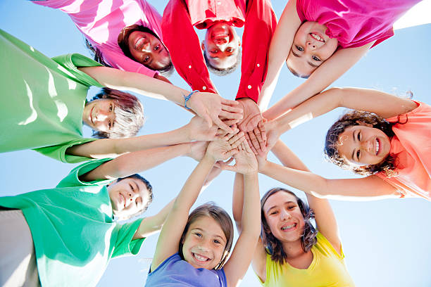
Communion
What does this word mean?
Sharing
Joining together
Asking others to join in with you
Thinking more about others rather than yourself
Being ‘in Communion’ is joining together in our hearts and minds
Notes:
Read through the slide and discuss. Provide examples of when we share, join together, include, are selfless.
You might suggest the children talk to their shoulder partner about times when they have shared/thought more of others.
Before turning to slide 8, ask what happens when we are ‘in Communion’ with one another?

Slide 8
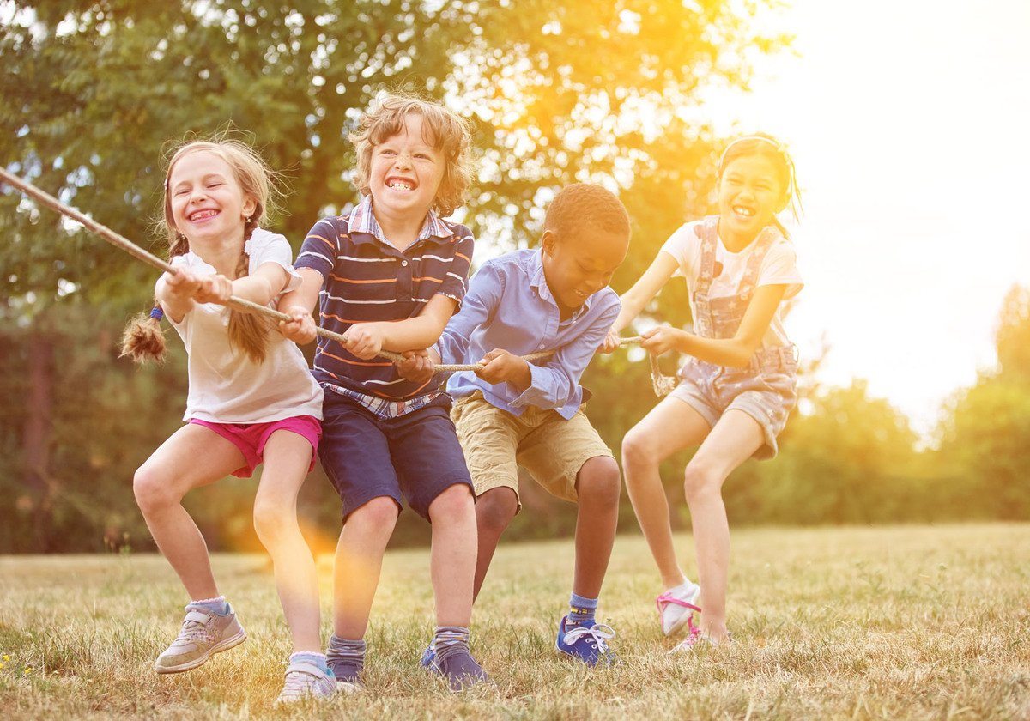
Communion
What happens when we are ‘in Communion’?
Things are a little easier
We can help each other
We feel included
We can solve problems
We can do better
Notes:
Discuss answers given by the children and those on the slide. (e.g. If you join together to solve a Number problem, it can be a little easier if you work together, sharing ideas and using each other’s skills to solve the problem instead of trying to do it on your own)
Explain these things happen in our life when we are in Communion with God – when we are praying to God/speaking to God and trying to be the best we can be then we live our lives with and for Him, joining together to share His stories, His joy and His love and things become easier, we feel part of something, and we can live our lives in a better way.

Slide 9
Participation
Notes:
The second word we will discuss is Participation.
What does this word mean to you? What can you ‘participate’ in?

Slide 10
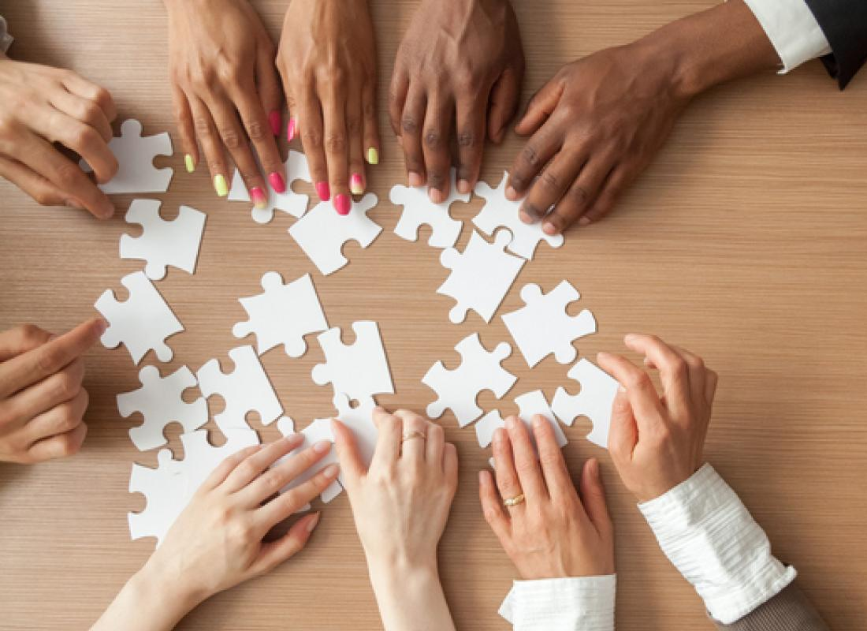
Participation
What does this word mean?
    Taking part
    Joining in
    Doing something with and for others
What do we participate in when in school What do we participate in within our communities
Mass
Lessons
Prayer
Events
(festivals, fayres, shopping)
Clubs
Games
Notes:
Read through the slide and discuss things that we all participate in. The children might want to share clubs/groups they attend, things they participate in within their classrooms/the playground and at home.
How does it feel to participate? Imagine you didn’t have anything to participate in, how would you feel then? We are very lucky to have an education, a school to come to and be part of, lessons to be involved in, clubs to be offered to us, events taking place in our communities and a Church that is open for us to go to and pray together.

Slide 11
Participation
How can we make Jesus happy by ‘participating’?
Going to Mass
Listening to one another when we speak
Being a good friend
Loving one another
Pope Francis has asked us to ‘participate’ by talking and listening to one another. He says,
“Listening. Before speaking, listen."
Notes:
Discuss each point.
Going to Mass – actively participating, not just being present but listening carefully and joining in when you can –Children’s Liturgy, listening to the Priest, responses and prayers
Listening to one another – Not being selfish and instead listening to one another and trying to make others happy
Being a good friend – kindness, including others, sharing
Loving one another – treating others with respect and care, showing kindness by sharing

Slide 12
Mission
Notes:
Introduce the third and final word from the CEW theme. Where have we heard this word before and what does it mean?

Slide 13


Mission
What does this word mean?
Starting something new and working on it until it is finished
An adventure that can be tricky along the way but that must be completed
Notes:
After taking suggestions from the children about the meaning of the word, ‘mission’, explain some more definitions from this slide.

Slide 14
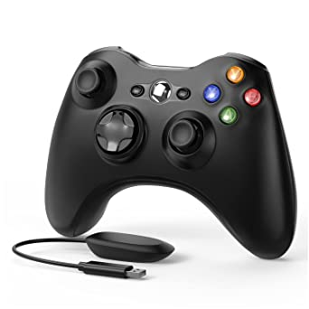
Mission
Have you ever been on a mission?
What was your end goal?
How did it feel during the mission?
How did you feel when you completed your mission?
Notes:
Examples could be Scout/Brownie camp, school project, learning something new, such as swimming.
Encourage children to express feelings of excitement but also of difficulty - wanting to give up, becoming bored, feeling afraid but then experiencing sense of achievement in the end. Some children might not have reached their end goal and solutions could be offered for this too, such as trying again, asking for help, changing mindset.

Slide 15
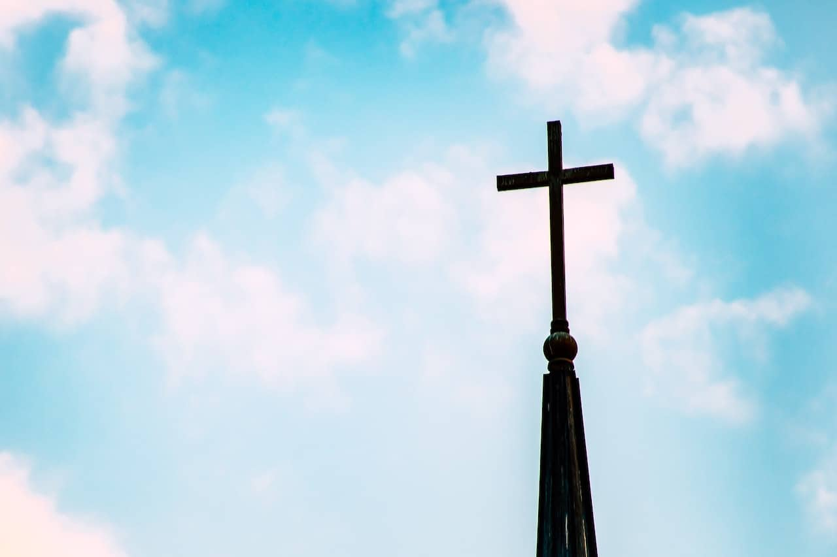
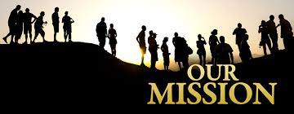
Mission
“All the Baptised are called to take part in the Church’s life and mission.” ~ Pope Francis
Notes:
Discuss the words from Pope Francis. We have all been chosen to do a special job by God. To be as good as we can be, make the right choices and love one another.
Take suggestions of what we might need to make this journey easier in our school and our communities – Prayer groups, Rights Respecting Schools, Class/school rules, Children’s Liturgy, friendship groups, lessons in class, playground games which encourage love, joy, friendship, fairness.

Slide 16
Communion, Participation and Mission
What can you see in this logo?
Think of the 3 words we have been talking about…
Notes:
During the week ahead, we will think carefully about the three, very important words that we have discussed today, in our classes and think of how they affect our daily lives and how we can help the Mission of the Church together through Communion (joining together and sharing) and Participation (taking part). We will also be exploring the logo that you can see now and discussing what is in the logo and what it means.
As we come to the end of our special assembly, we thank God for all that we have in our lives and for allowing us to be part of the Mission of the Church. We are thankful that we are able to participate in so many things each day (prayer, friendship, family, community life, education, fun, joy, play) and we thankful for the opportunity to be ‘in Communion’ with one another and for having one another to share our lives and experiences with.

Slide 17



Let’s give thanks…
Give Thanks ( With A Grateful Heart ) - YouTube
Notes:
We end our special assembly by listening to the words of this song, giving thanks to God.
When you click on the link, extend it to a full screen to avoid the children reading around the page and instead they can view the words/images displayed.
(This may be played as the children leave or they may close their eyes and listen/reflect before leaving)

