Slide 1

Catholic Education Week 2022
Communion, Participation and Mission
Notes:
Open the assembly in whatever way is usual for you and then introduce today’s theme:
Welcome to our special assembly for Catholic Education Week 2022. This week is Catholic Education Week; you may remember that we celebrate this every year. During this week we remember and celebrate all that is special about our Catholic School life and this year, in particular, we think about what is going on in our local Parishes and communities as well as around the world.

Slide 2

Every year, there is a special theme and this year it is ~ Communion, Participation and Mission
Theme
Notes:
Read the slide.
These are three very, big and tricky words. Words which you may have heard before and understand or words that you may not have heard before and don’t really understand. During this assembly, you will hear those words and hopefully by the end of it, you will know what they mean and understand them more.

Slide 3
Synod
Notes:
Provide a reminder of what the Synod is:
Pope Francis launched a 2-year worldwide Synod process on 10th October 2021 entitled: For a Synodal Church: Communion, Participation and Mission.
Pope Francis wants to hear from the whole Church about what is happening in local parishes. He and the Bishops would like to know what individuals think we should all be doing to help make our parishes better. The way he has decided to do this is using a synodal process. Synod means “journeying together” and it involves listening to the Holy Spirit and to each other in order to discern the path we are called to walk together.
You will see the synod logo at the corner of each slide, and we will talk about the logo at the end of this assembly before going back to class to do some work with your teacher and classmates using the logo as a stimulus.

Slide 4

Synod Prayer
Holy Spirit, we come together in your Name,
Guide us and come into our hearts;
Show us the right path and how to get there.
Sometimes we do not make loving choices;
Do not let us be confused.
Do not let anyone lead us down the wrong path.
Let us be one with you,
so that we may walk together to heaven
and always know the truth and what is right.
We ask this of you,
You are everywhere, all the time,
together with the Father and the Son, forever and ever.
Amen.
Notes:
Pope Francis gave us a special prayer to use during this time of Synod (Adsumus, Sancte Spiritus) and this one has been adapted for your age group so that you can understand the words and pray to the Holy Spirit using them. (May be used in classrooms during regular prayer time with the children)
Let’s join our hands and pray together. (One line may be read by adult and repeated by the children)

Slide 5

Can you remember the theme?
Notes:
So, let’s talk about the theme for this year. There were three big words mentioned at the beginning, can anyone remember them? Ask for suggestions.

Slide 6
Communion
Notes:
The first word was Communion.
Discuss the word ‘Communion’. Where have you heard this word before? (Most will suggest the Sacrament of Holy Communion) What do you think it means? (Encourage suggestions and praise right or wrong) Can you hear any words or parts of words within this word? (Come, Communal, Community)

Slide 7
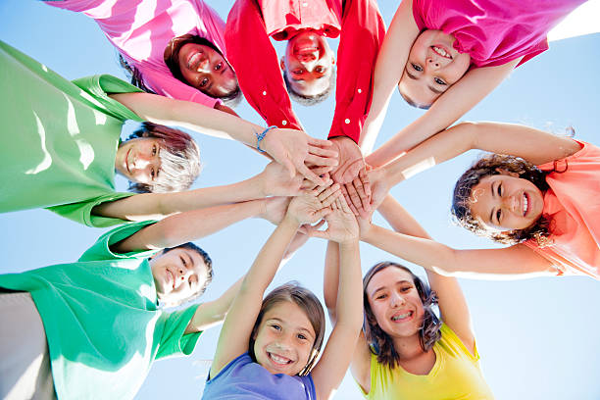
Communion
What does this word mean?
Sharing
Joining together
Including others
Being selfless
Reaching out to others
Being ‘in Communion’ is joining together in our hearts and minds
Notes:
Read through the slide and discuss. Provide examples of when we share, join together, include, are selfless and reach out.
You might suggest the children talk to their shoulder partner about times when they
Before turning to slide 8, ask what happens when we are ‘in Communion’ with one another?

Slide 8
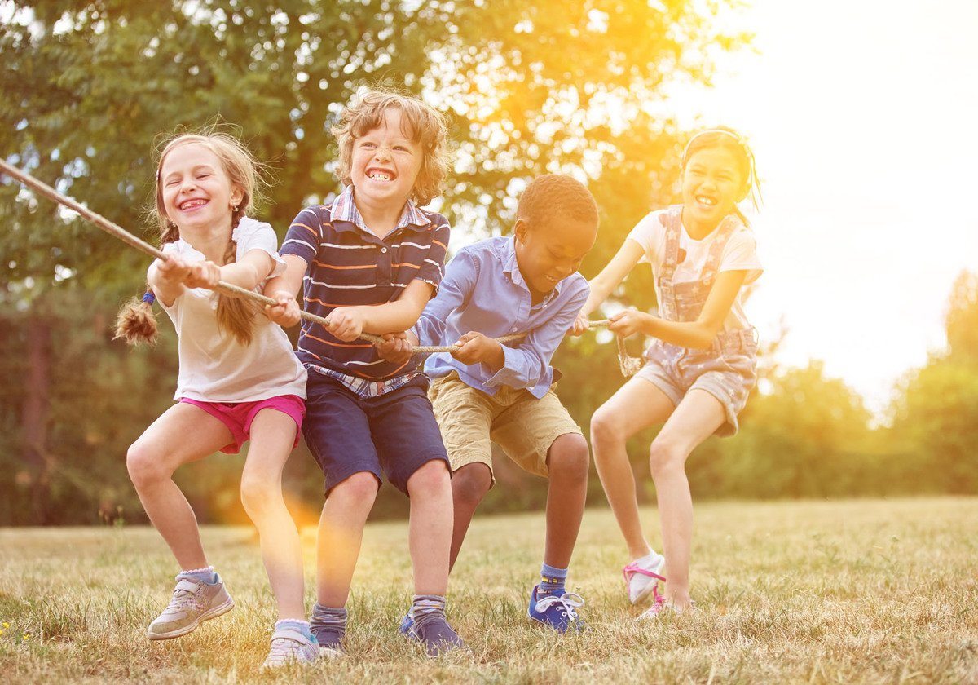
Communion
What happens when we are ‘in Communion’?
Things become less difficult
We can help each other
We feel included
We can solve problems
We can do better
Notes:
Discuss answers given by the children and those on the slide.
Explain these things happen in our life when we are in Communion with God – we live our lives with and for Him, joining together to share His word, His joy and His love and things become easier, we feel part of something, and we can live our lives in a better way.

Slide 9
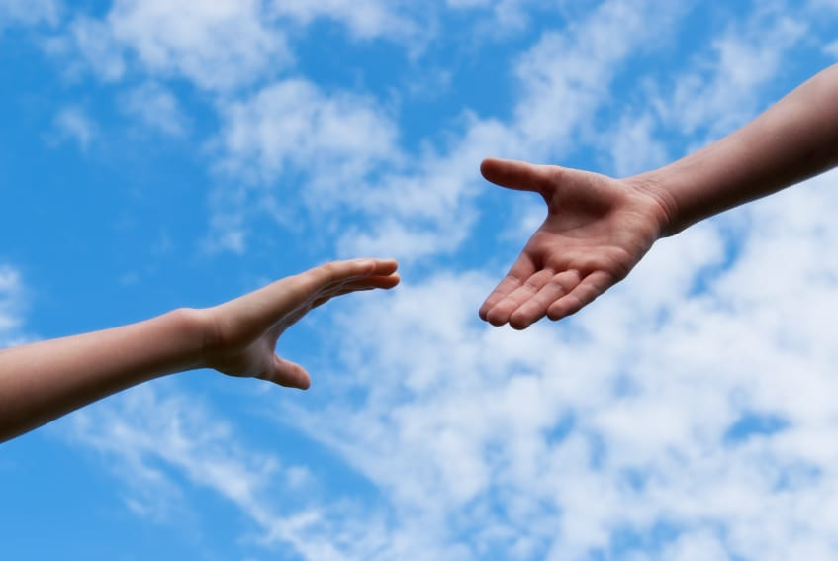
Communion
In Matthew’s Gospel, we hear about the “last, the least and the lost”.
Let’s reach out and join with them; the last the least and the lost
Notes:
Who are the last, least and lost.
Last – those who are never chosen to be part of a game, those who might not be the best at…Spelling, running, using manners?
Least – the poor, the vulnerable, those who don’t have the most (skills, collection of football cards)
Lost – Those who are making wrong choices, aren’t living as Jesus asked us to by being kind, showing love
Let’s make a conscious effort to join with the last, least and lost and reach out to them for a change.

Slide 10
Participation
Notes:
The second word we will discuss is Participation.
What does this word mean to you? What can you ‘participate’ in?

Slide 11
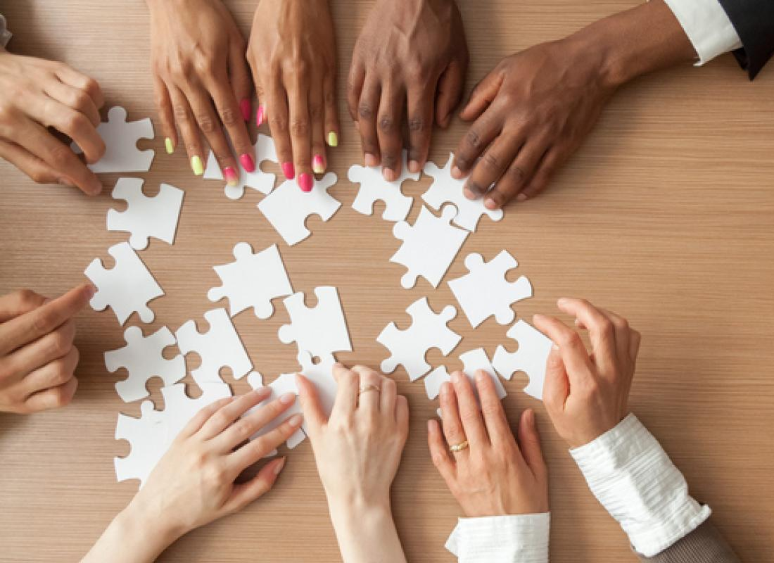
Participation
What does this word mean?
    Taking part
    Joining in
    Doing something with and for others
What do we participate in when in school What do we participate in within our communities
Mass
Events
(festivals, fayres, shopping)
Prayer
Charities
Lessons
Friendships
Clubs
Games
Notes:
Read through the slide and discuss things that we all participate in. The children might want to share clubs/groups they attend, things they participate in within their classrooms/the playground.
How does it feel to participate? Imagine you didn’t have anything to participate in, how would you feel then? We are very lucky to have an education, a school to come to and be part of, lessons to be involved in, clubs to be offered to us, events taking place in our communities and a Church that is open for us to go to and pray together.

Slide 12
Participation
How can we make Jesus happy by ‘participating’?
Going to Mass
Listening to one another when we speak
Being a good friend
Loving one another
Pope Francis has asked us to ‘participate’ by talking and listening to one another. He says,
“This is the first step in order to group in our journey of faith: Listening. Before speaking, listen."
Notes:
Discuss each point.
Going to Mass – actively participating, not just being present – altar server, offertory, Children’s Liturgy, listening to the Priest
Listening to one another – valuing others’ opinions and doing as others ask you to
Being a good friend – kindness, compassion, empathy, including others
Loving one another – treating others with respect and care, showing kindness by sharing

Slide 13

In Mark’s Gospel, it said,
“Go into all the world and proclaim the gospel to the whole creation” (Mark 16:15)
Participation
Notes:
Discuss this Biblical reference;
We have been asked, by Jesus, to go into our communities and spread God’s Word. This is how we can ‘participate’, by spreading God’s word, thinking of how Jesus lived and how we should live our lives, showing our love of God through our thoughts, words and actions in our daily lives.

Slide 14
Mission
Notes:
Introduce the third and final word from the CEW theme. Where have we heard this word before and what does it mean to us?

Slide 15


Mission
What does this word mean?
Being on a journey
An adventure that has difficulties along the way but that must be completed
Tackling something together with a common goal
Notes:
After taking suggestions from the children about the meaning of the word, ‘mission’, explain some more definitions from this slide.

Slide 16
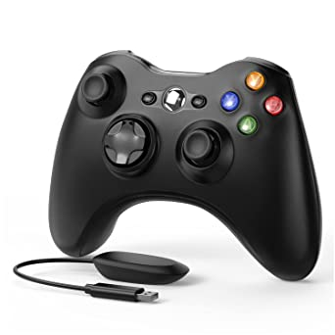
Mission
Have you ever been on a mission?
What was your end goal?
How did it feel during the mission?
How did you feel when you completed your mission?
Notes:
Examples could be Scout/Brownie camp, school project, learning something new, such as swimming.
Encourage children to express feelings of excitement but also of difficulty - wanting to give up, becoming bored, feeling afraid but then experiencing sense of achievement in the end. Some children might not have reached their end goal and solutions could be offered for this too, such as trying again, asking for help, changing mindset.

Slide 17
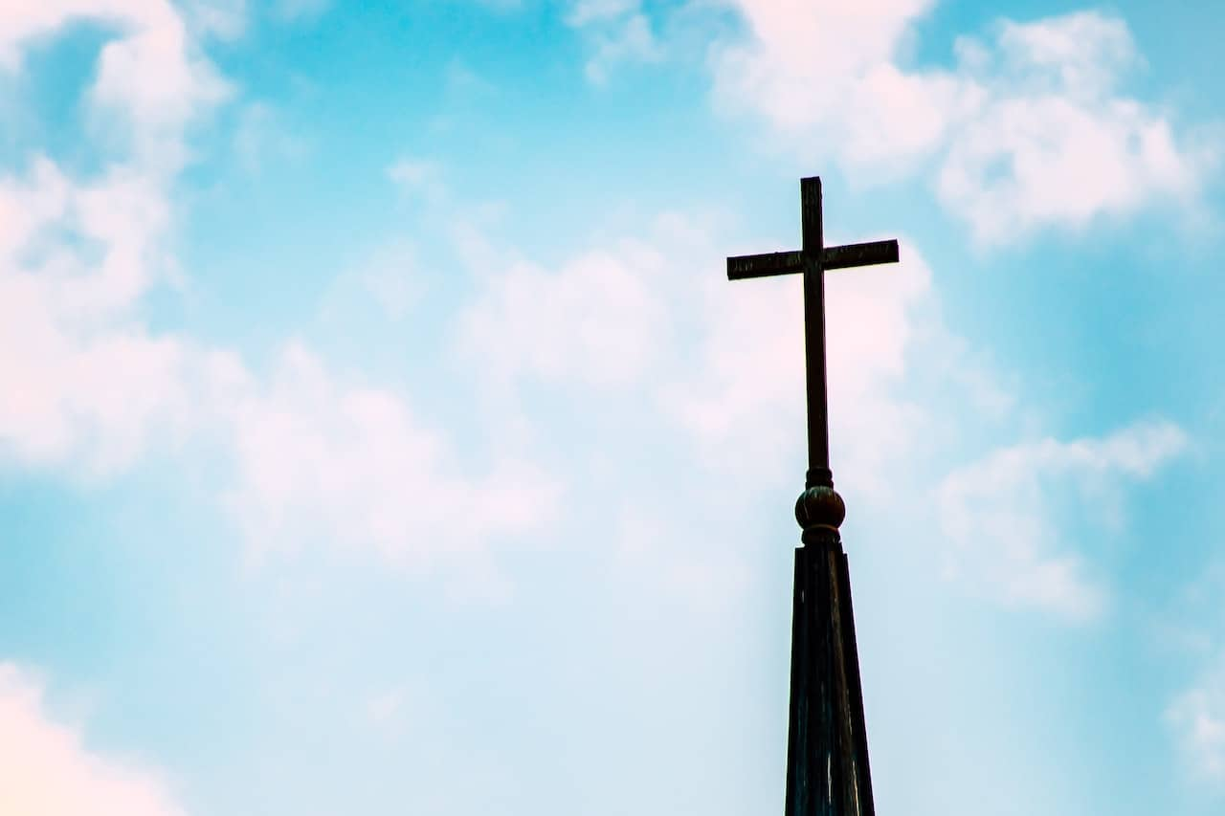
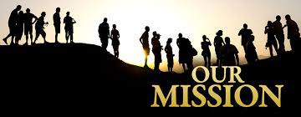
Mission
“All the Baptised are called to take part in the Church’s life and mission.” ~ Pope Francis
Notes:
Discuss the words from Pope Francis and suggest what we might need to make this journey easier in our school and our communities – Prayer groups, Mini Vinnies, PFFA, Rights Respecting Schools, Children’s Liturgy, Altar Serving, friendship groups, lessons in class, playground games which encourage love, joy, friendship, justice.

Slide 18
Communion, Participation and Mission
What can you see in this logo?
Think of the 3 words we have been talking about…
Notes:
During the week ahead, we will reflect on the three, very important words that we have discussed today, in our classes and think of how they affect our daily lives and how we can embrace the Mission of the Church together through Communion and Participation. We will also be exploring the logo that you can see now and discussing what is in the logo and what it means.
As we come to the end of our special assembly, we thank God for all that we have in our lives and for allowing us to be part of the Mission of the Church. We are thankful for our ability to participate in so many things each day (prayer, friendship, family, community life, education, fun, joy, play) and we thankful for the opportunity to be ‘in Communion’ with one another and for having one another to share our lives and experiences with.

Slide 19



Let’s give thanks…
Give Thanks ( With A Grateful Heart ) - YouTube
Notes:
We end our special assembly by listening to the words of this song, giving thanks to God.
When you click on the link, extend it to a full screen to avoid the children reading around the page and instead they can view the words/images displayed.
(This may be played as the children leave or they may close their eyes and listen/reflect before leaving)

