Slide 1

Catholic Education Week
2023
Notes:
Welcome the children to the assembly the way you always would.
Open the assembly in whatever way is usual for you and then introduce today’s assembly theme:
Welcome to our special assembly for Catholic Education Week 2023. This week is Catholic Education Week; you may remember that we celebrate this every year. During this week we remember and celebrate all that is special about our Catholic School life and we think about what is going on in our local Parishes and communities as well as around the world.

Slide 2
Catholic Education Week Prayer
Jesus our Teacher,
In your love for us, help us to develop our own talents
so that we may become like you,
and lead lives of goodness.
Bless all learners and all teachers.
May our Catholic schools continue to serve our families,
our communities and our country.
Help us, through our learning, to believe in you,
and to celebrate the life of your Church.
Help us to grow in holiness
as we grow in friendship with you,
and try to become saints.
We make this prayer in the name of Jesus, our Lord. Amen
Notes:
We begin this special assembly in prayer…

Slide 3
Theme
Every year there is a theme for Catholic Education Week and this year it is:
Pilgrims of Faith
Notes:
Pilgrims of Faith are words which you may have heard before and understand or words that you may not have heard before and don’t really understand. During this assembly, you will hear more about those words and hopefully by the end of it, you will understand what they mean.

Slide 4
What is a journey?
Have you ever been on a journey?
Did you plan your journey?
Where did you go to?
Who did you go with?
Notes:
Ask the questions on screen and encourage the children to talk in pairs and report back or take answers from various pupils.
Lead discussions by encouraging the children to think about the journeys they go on having an end destination and how they are usually accompanied on a journey and not alone.

Slide 5
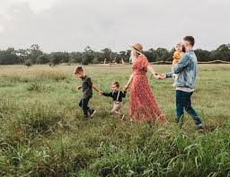
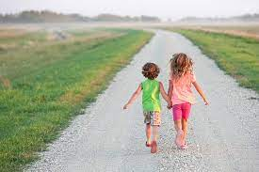
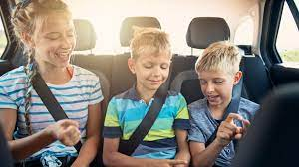

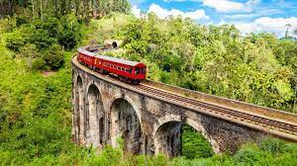
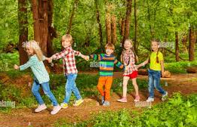
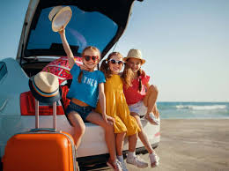
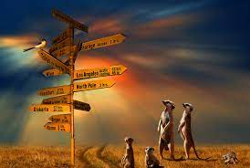
Journey
Notes:
This slide shows different types of journeys for different people.
Explain that we all go on different journeys to different places. A journey can be from leaving the house to arriving at school, walking to the shops, travelling by car to visit your family, going on holiday on an aeroplane. Most journeys are planned, and most journeys involve more than one person, especially if you’re a child, you do not often go on a journey by yourself.

Slide 6
A different type of journey…
Learning journey
Hobbie journey
Career journey
Notes:
Journeys don’t always have to be associated with travelling. They can describe the time that passes as we do things. For example, a learning journey can show your time from P1 to P7 and all the things that have happened in between. A hobbie journey can show, for example, your talents building as you learn and improve on your skills and an adult’s career journey can show their progress as they learn more and get better at their job and therefore progress onto better jobs.

Slide 7
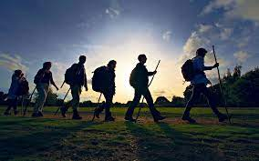
What do we call someone who is on a journey?
Traveller
Visitor
Sightseer
Voyager
Explorer
Tourist
Notes:
Discuss synonyms for someone who is on a journey. Take suggestions and then reveal some ideas.

Slide 8
A different type of journey is called a PILGRIMAGE
Notes:
Read the slide

Slide 9
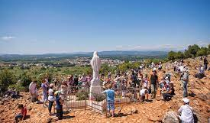
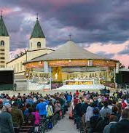
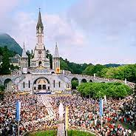
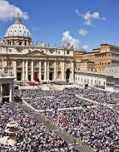
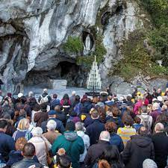
A PILGRIMAGE is when someone goes on a Spirtual journey
Notes:
There are many sacred places (holy places) that people can visit around the world. There are some pictures of some special places that people travel to on the screen now. The travellers are on a pilgrimage.

Slide 10
Question:
What do we call someone who is on a PILGRIMAGE?
Answer:
A PILGRIM

Slide 11
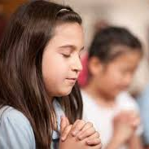
A pilgrimage doesn’t have to be travelling to a Sacred place.
We are all on pilgrimage right now as we live our lives and will visit a sacred place in the end, which is heaven.
A pilgrimage is a spiritual journey as we deepen our beliefs through prayer, worship and how we live our lives.
Notes:
Explain that we are all making our way through our lives – growing up, making friends, going to school, learning more and more, moving on to High School…and we are doing it together. It is like we are moving through a life map with one another and sometimes, people go in different directions, but we all look for the same destination.

Slide 12
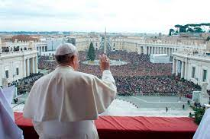
Pilgrims
Sometimes pilgrims:
Are interested in the same things
Want to visit the same places
Want to see the same things
Are quite alike
Their faith and beliefs bring them together
Notes:
Explain that this is not always the case but that if pilgrims are travelling together to visit a scared place (e.g. Lourdes) it may be that they have similar interests and want to visit the same things. Their faith brings them together.

Slide 13
Our Faith
In our school, most of us have faith.
This means we have Religious beliefs.
Most of our beliefs are the same: we believe in God the Father, the Son and the Holy Spirit.
Notes:
Read the slide

Slide 14
We are Pilgrims of Faith
We are all on a journey together.
We have the same shared beliefs.
We show our beliefs through the way think, act, behave and speak.
We join to together to play, to be friends, to show love and to help one another just like Jesus asked us to.
It is not always easy and there may be bumps in the road during our journey, but we continue to live our lives and carry on with our pilgrimage using our faith to help us…
We are Pilgrims of Faith
Notes:
Bringing the learning together. We have learned what Pilgrims are and what Faith means so this brings us to the conclusion that we are Pilgrims of Faith – on a journey together with the shared interest of our faith.

Slide 15

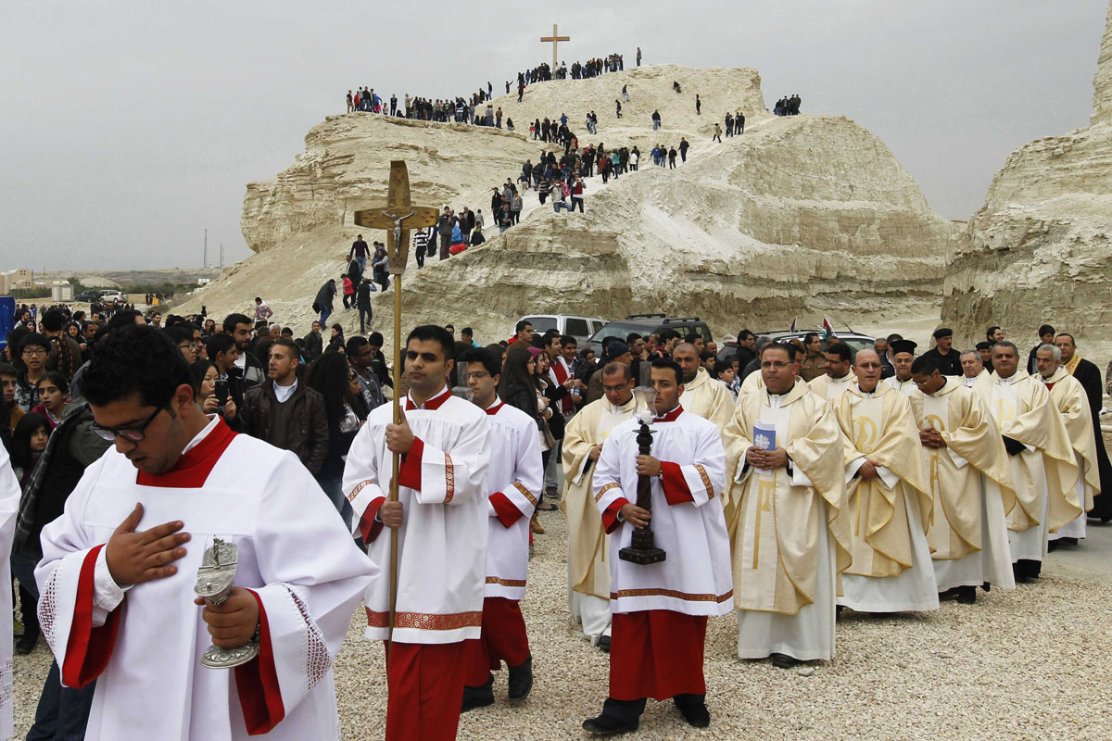
Let’s listen to the words of this hymn together
Notes:
Play hymn and encourage children to think about the lyrics. You may want to pause during the hymn and recap on some important words.

Slide 16
Walk with me oh my Lord
In this hymn, we hear words that remind us that we are on a pilgrimage of faith together and God is always with us…
Guide me
Be at my side
Walk WITH me
You are always there to help me when I call
I am given strength
Hold my hand
Notes:
Discuss the words and how they make us feel…accompanied, belonging, together, loved, supported, cared for, strong.

Slide 17
Let’s sing the hymn together now…
Notes:
Join together in singing the hymn.

Slide 18
How can we be Pilgrims of Faith?
Live our lives as Jesus asked us to
Listen to God
Help one another
Look to our Saints as role models
Love one another
Try to be the best we can in all that we do
Pray together
Think of others and not just ourselves

Slide 19
Catholic Education Week
Theme: Pilgrims of Faith
Thank You Lord - Don Moen - YouTube
Notes:
During the week ahead, we will think about the theme we have discussed today. We will be thinking about how we can be Pilgrims of Faith and you will be completing activities in class to celebrate this special time of year in our communities.
You may wish to complete the assembly by praying the Our Father, asking for guidance during Catholic Education Week.
As we come to the end of our special assembly, I am going to play a special song about being thankful to God for all that He does for us and with us. (This may be whilst the children close their eyes and listen, or it could be played as they leave the assembly hall)

