Slide 1

Catholic Education Week Secondary Assembly 2023
Pilgrims of Faith

Slide 2
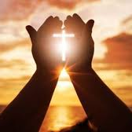
Opening Prayer
In all that I am today, all that I try to do,
all my encounters and reflections - even the frustrations and failings
and especially in this time of prayer,
in all of this, may I place my life in your hands.
Lord, I am yours. Make of me what you will. Amen.

Slide 3

What is faith?
The Church teaches that faith is an invitation from God to enter into His friendship.
Notes:
Remind the students that Catholic Education Week(CEW) is a special time to reflect on the distinctive nature of Catholic schools. The theme of CEW this year is ‘Pilgrims of Faith’. The BGE lesson for CEW focuses on this theme and this assembly reflects the content of that lesson.

Slide 4

To have religious faith is to be:
truly and adamantly convinced
that God loves us
and has great plans for us.

Slide 5
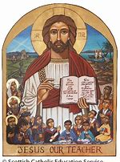
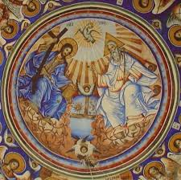
Catholic schools are communities of faith and learning.
Notes:
Our school is a community of faith and learning, with Jesus at its centre. We believe that God – Father, Son and Spirit – is active here. We are a community where learning is central to what we do and how we do it. However, we are also a community that is built on and nourished by faith. We believe that Jesus Christ and his teaching is at the centre not only of what we do and how we do it; he is also at the centre of why we do what we do.

Slide 6
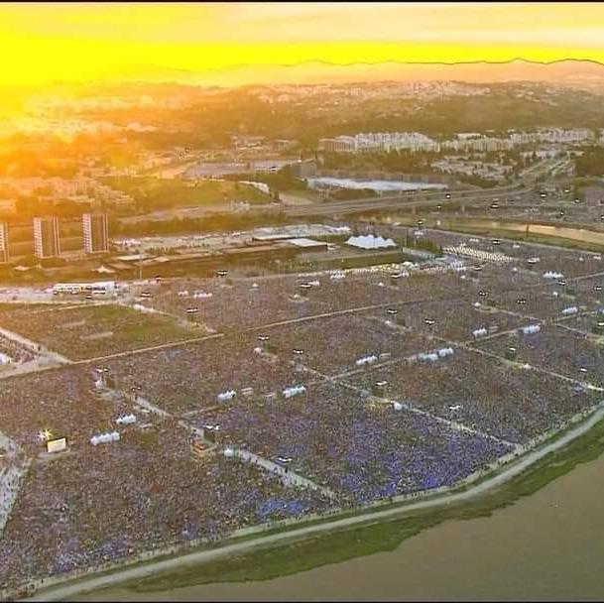
Pilgrims of Faith
What does it mean to be a pilgrim of faith?
There was the perfect example of that earlier in the year when 1.5 million young Catholics from around the world gathered in Lisbon, Portugal, for the World Youth Day in August.
Notes:
The World Youth Day is held every 4 years. Young Catholics from around the world travel to the designated country for a pilgrimage of faith which culminates in a Mass celebrated by the Pope. The photo is an aerial view of Pope Francis celebrating Mass with over 1.5 million young Catholics who had travelled to Portugal for the World Youth Day.

Slide 7
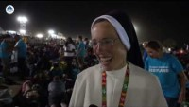
World Youth Day August 2023
Notes:
Watch this clip (7 minutes) prepared by Sancta Familia media which shows the young pilgrims of faith who had gathered the night before the Mass for a Vigil with Pope Francis They camped out overnight and spent time in silent prayer during Eucharistic adoration. Young people travelled from every diocese in Scotland to attend the WYD Mass. Those interviewed are from the group who travelled from the Diocese of Aberdeen. Reflect on what they say about their faith and the experience of being on pilgrimage.

Slide 8


What does it mean to be a pilgrim of faith?
Notes:
Ask yourself this question again having watched the video clip.

Slide 9

Reflect on what the following slides say about faith.
What does each statement mean to you?
Notes:
Display each of the next 5 slides for a short time to give the students time to read and reflect on the statements from Pope Francis about faith.

Slide 10


Slide 11
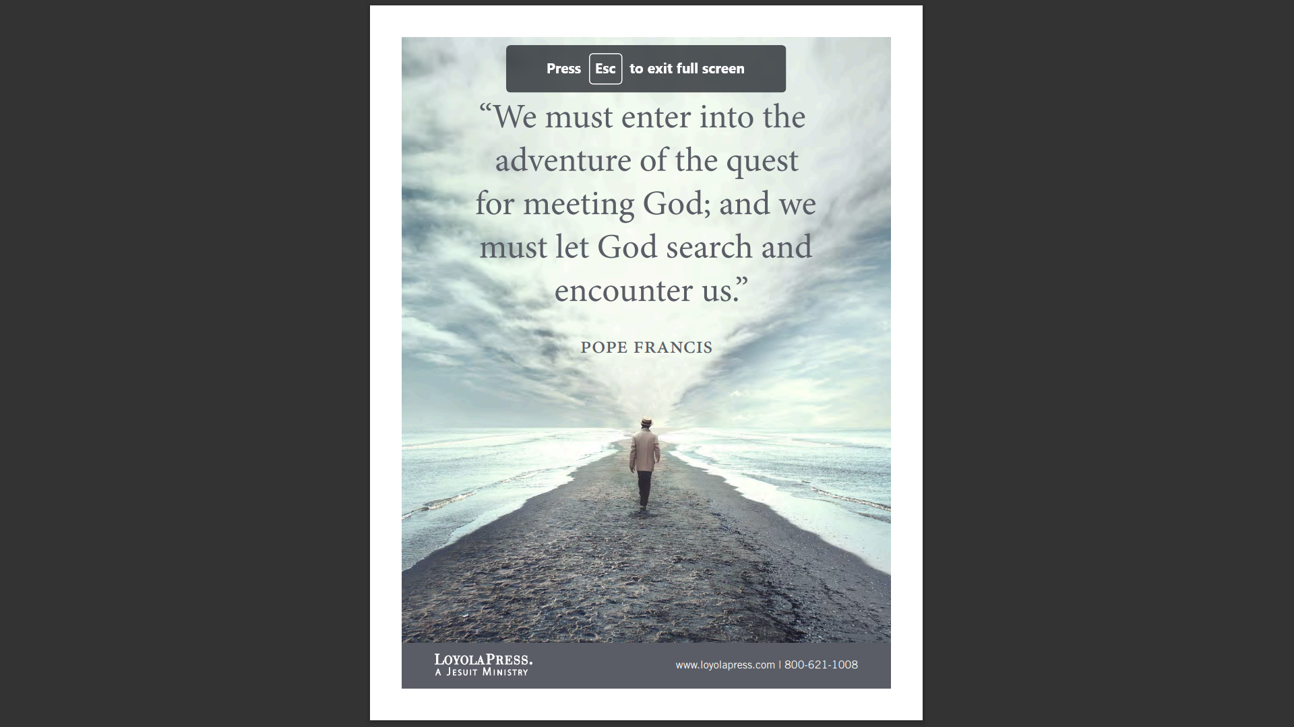

Slide 12


Slide 13


Slide 14
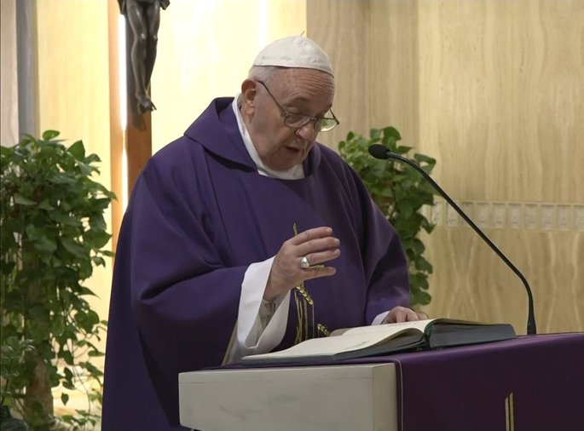
It is prayer that conserves the faith; without it, faith falters.
Pope Francis

Slide 15
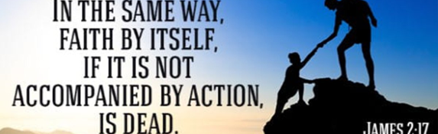
James 2:17 – Faith and Action
It is important that faith is accompanied by acts of Christian witness.
What can you do to put your faith into action?
Notes:
In his sermon at the WYD Mass, Pope Francis told the young pilgrims of Faith – ‘… we radiate light – we shine – by welcoming Jesus into our hearts and learning to love as he does. To love like Jesus: that is what makes us shine, makes us do works of love. Friends, I am telling you the truth: whenever you do works of love, you become light. But the moment you stop loving others and become self-centred, you extinguish your light.’ Here Pope Francis is telling you to copy the example of Jesus and live your faith through good works, which display love of neighbour. Think, then, about how you can be that light that shines for others. How can you put your faith into action?

Slide 16
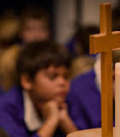

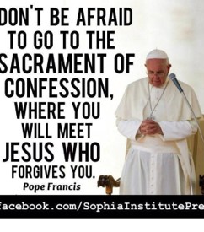


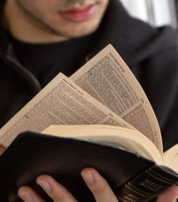
How can we nurture our faith?
Prayer
Receiving the Sacraments
Reading the Bible
Putting your faith into action by caring for others
Notes:
The students should consider the importance of nurturing their faith by considering the suggestions on this slide.

Slide 17
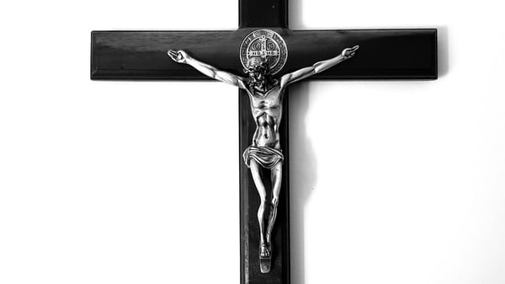
Catholic Education Week Prayer
Jesus our Teacher, in your love for us, help us to develop our own talents, so that we may become like you and lead lives of goodness.
Bless all learners and all teachers. May our Catholic schools continue to serve our families, our communities and our country.
Help us, through our learning, to believe in you and to celebrate the life of your Church. Help us to grow in holiness as we grow in friendship with you and try to become saints.
We make this prayer in the name of Jesus, our Lord. Amen.
Notes:
Complete the Assembly in prayer together.

