Slide 1
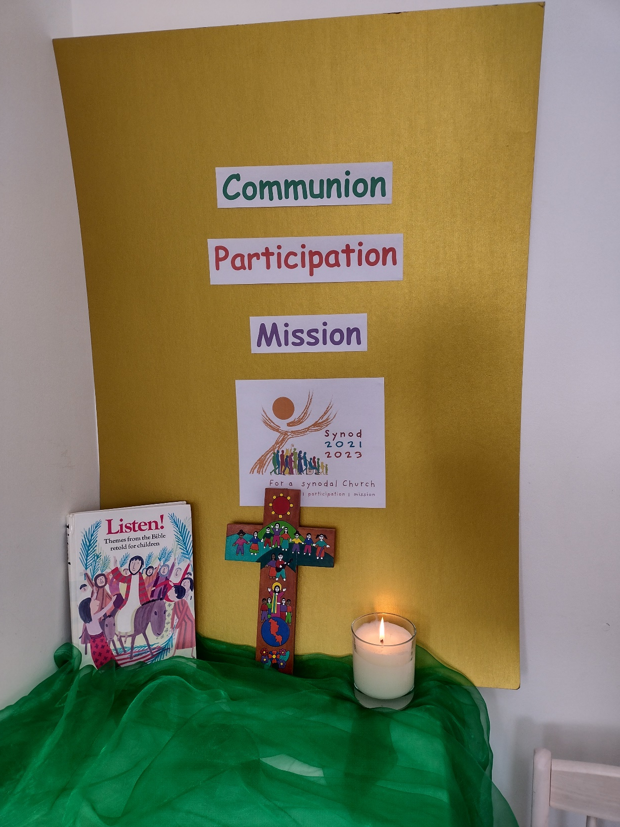
Catholic Education Week
2022
Children’s Liturgy

Slide 2
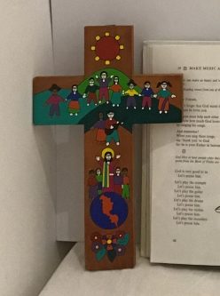
In the name of the Father
and of the Son
and of the Holy Spirit
Amen

Slide 3
The theme of Catholic Education Week is
Communion, Participation and Mission.
We will journey together as a Synodal Church

Slide 4
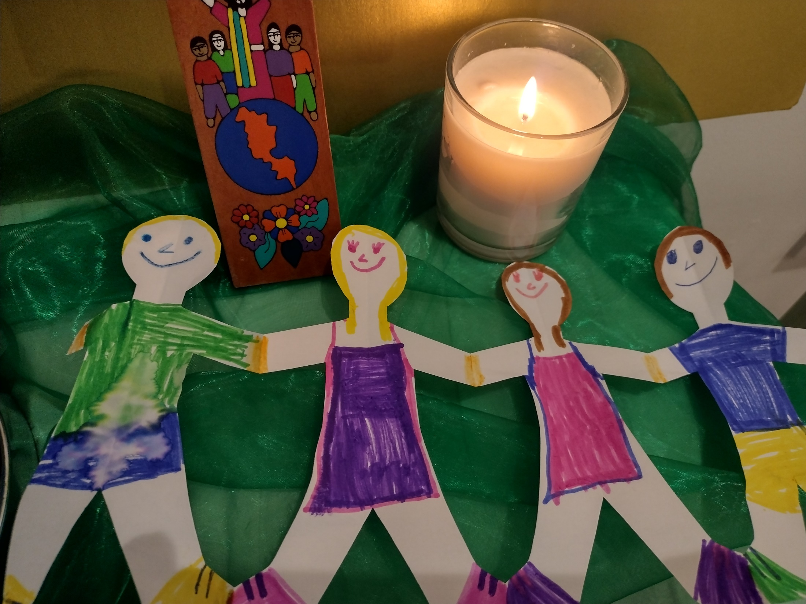
Communion
We journey TOGETHER!
We are all part of
ONE Church
ONE Faith
ONE Family
ONE Body in Christ Jesus
We are in Communion with God
and with one another!

Slide 5
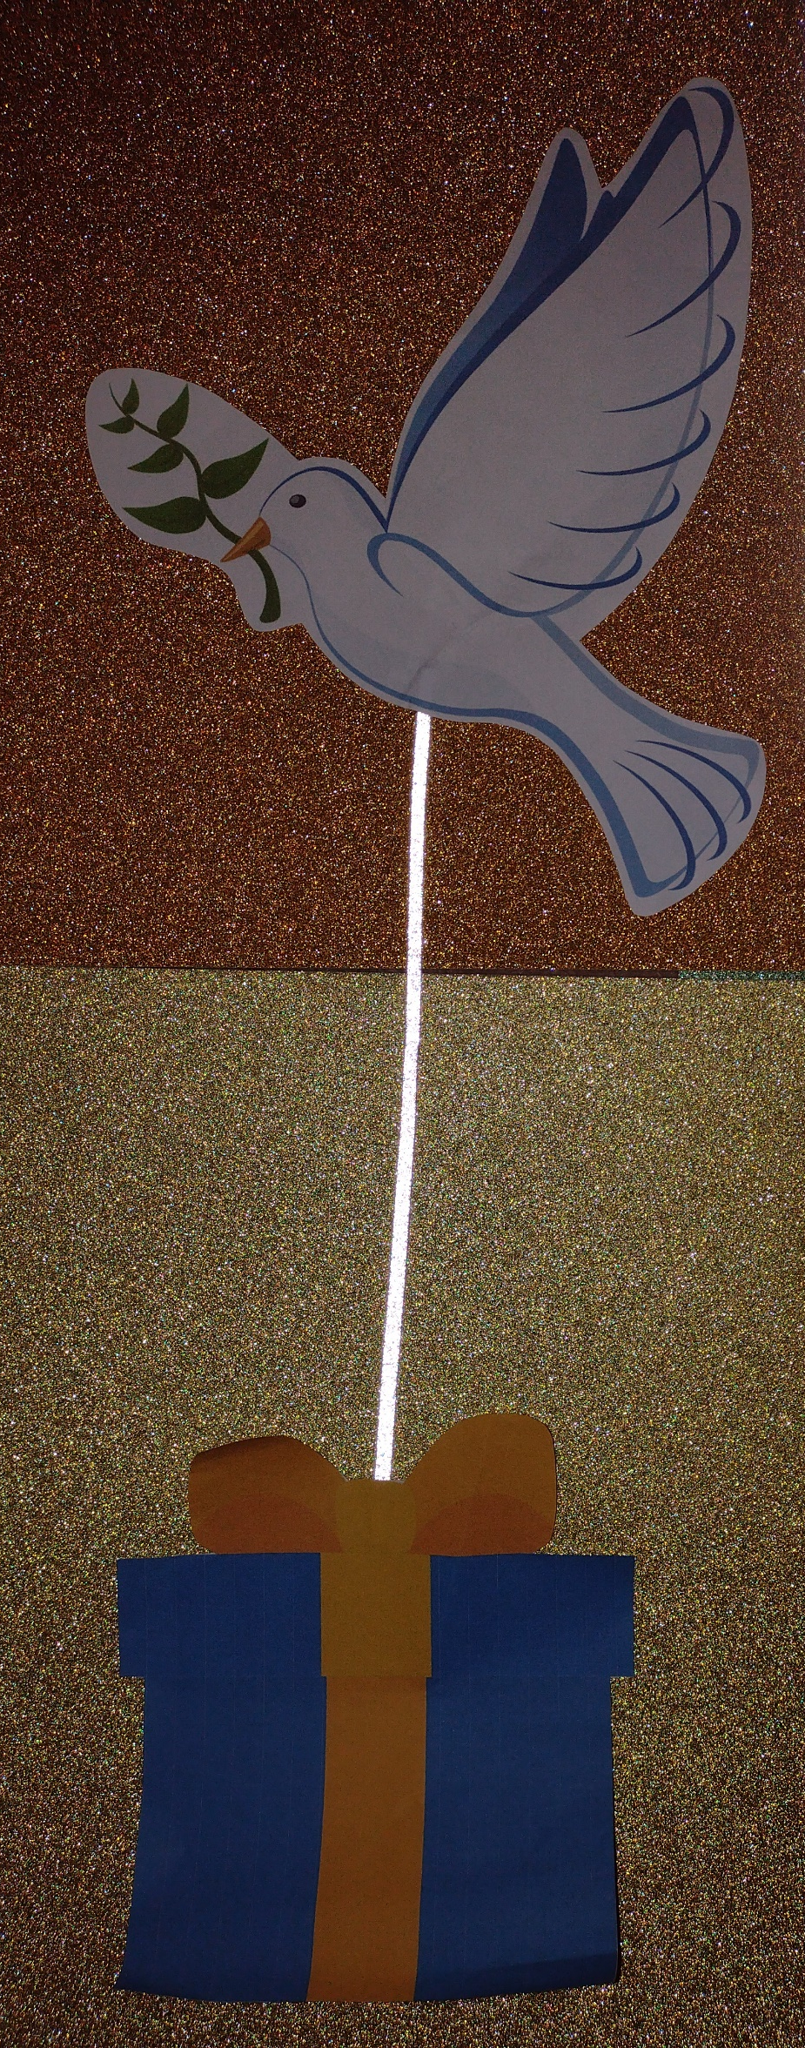
Participation
We are all invited to take part!
Saint Paul says that we are like One Body
made of many parts! We all have gifts to offer.
On our Synodal Journey, we are all invited to use our special gifts and open our hearts; that we may be guided by the Holy Spirit!
– Seeing the face of Jesus and hearing his voice in others.
The Holy Spirit can do very special work through anyone!

Slide 6
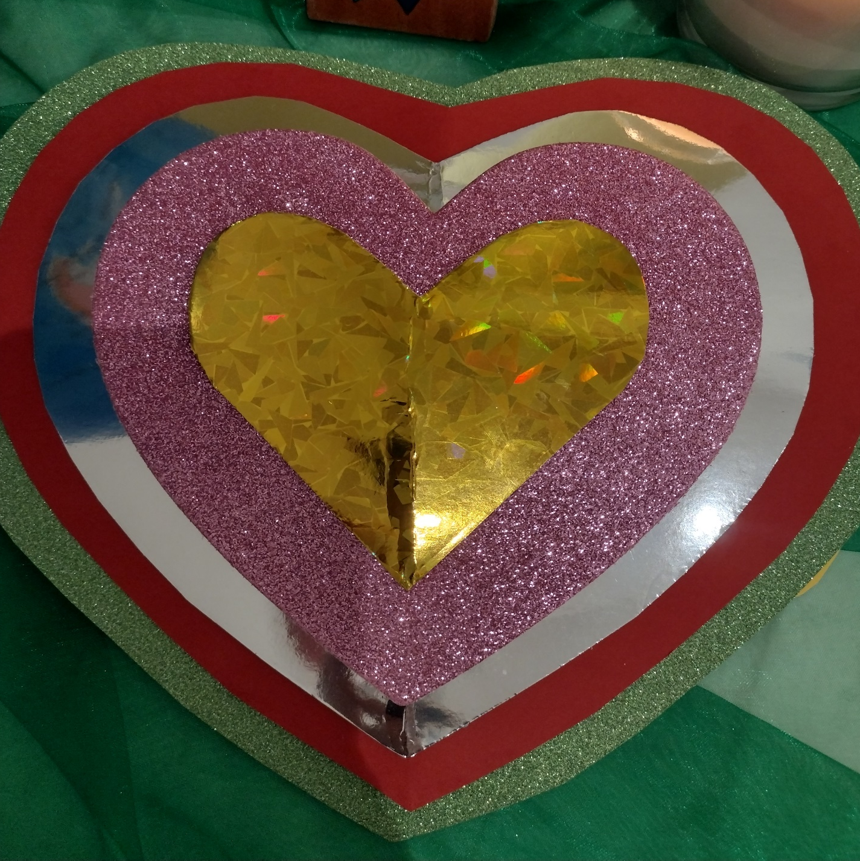
Mission
Our very special mission is to EVANGELISE!
This means to share the Gospel, the Good News of Jesus, with everybody!
Let’s all open our hearts and share the Gospel through the way we live our lives. When we follow the Lord’s example of
love for each other, we are preaching the Gospel with our lives!

Slide 7
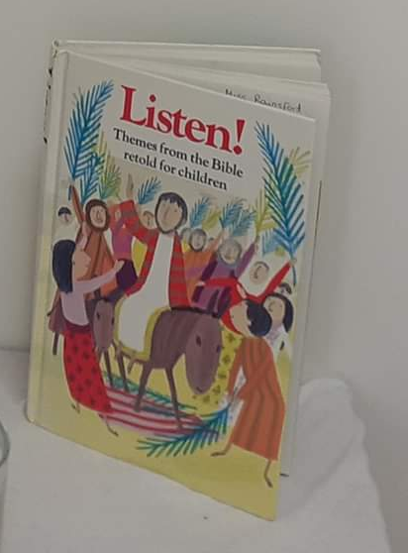
Listen to the Gospel reading from the ‘Listen’ Book (Page 84)
When they came to Emmaus, the two friends asked the stranger to stay for a meal, for it was getting dark.
So he went in with them,
and when they sat down at the table,
He took the bread,
He blessed it,
He broke it into pieces
And gave it to them to eat.
And all of a sudden, they saw that it was Jesus himself!
On Easter Sunday morning, two of the followers of Jesus had to go to a place called Emmaus, and as they walked along, they talked about Jesus, about what he has said and how he had died.
While they were talking, Jesus himself came and joined them, only they didn’t see that it was Jesus.

Slide 8
…and all of a sudden, they saw that it was Jesus himself!
Whilst the disciples were walking along to Emmaus, they didn’t realise that they were walking along with Jesus!
This is a great Gospel story to help us on our special journey. It helps us to understand that through the power of the Holy Spirit, we can hear the voice of Jesus and see his face in others when we listen, reflect, share and pray together. The Holy Spirit will guide us when we open the eyes and ears of our hearts!

Slide 9
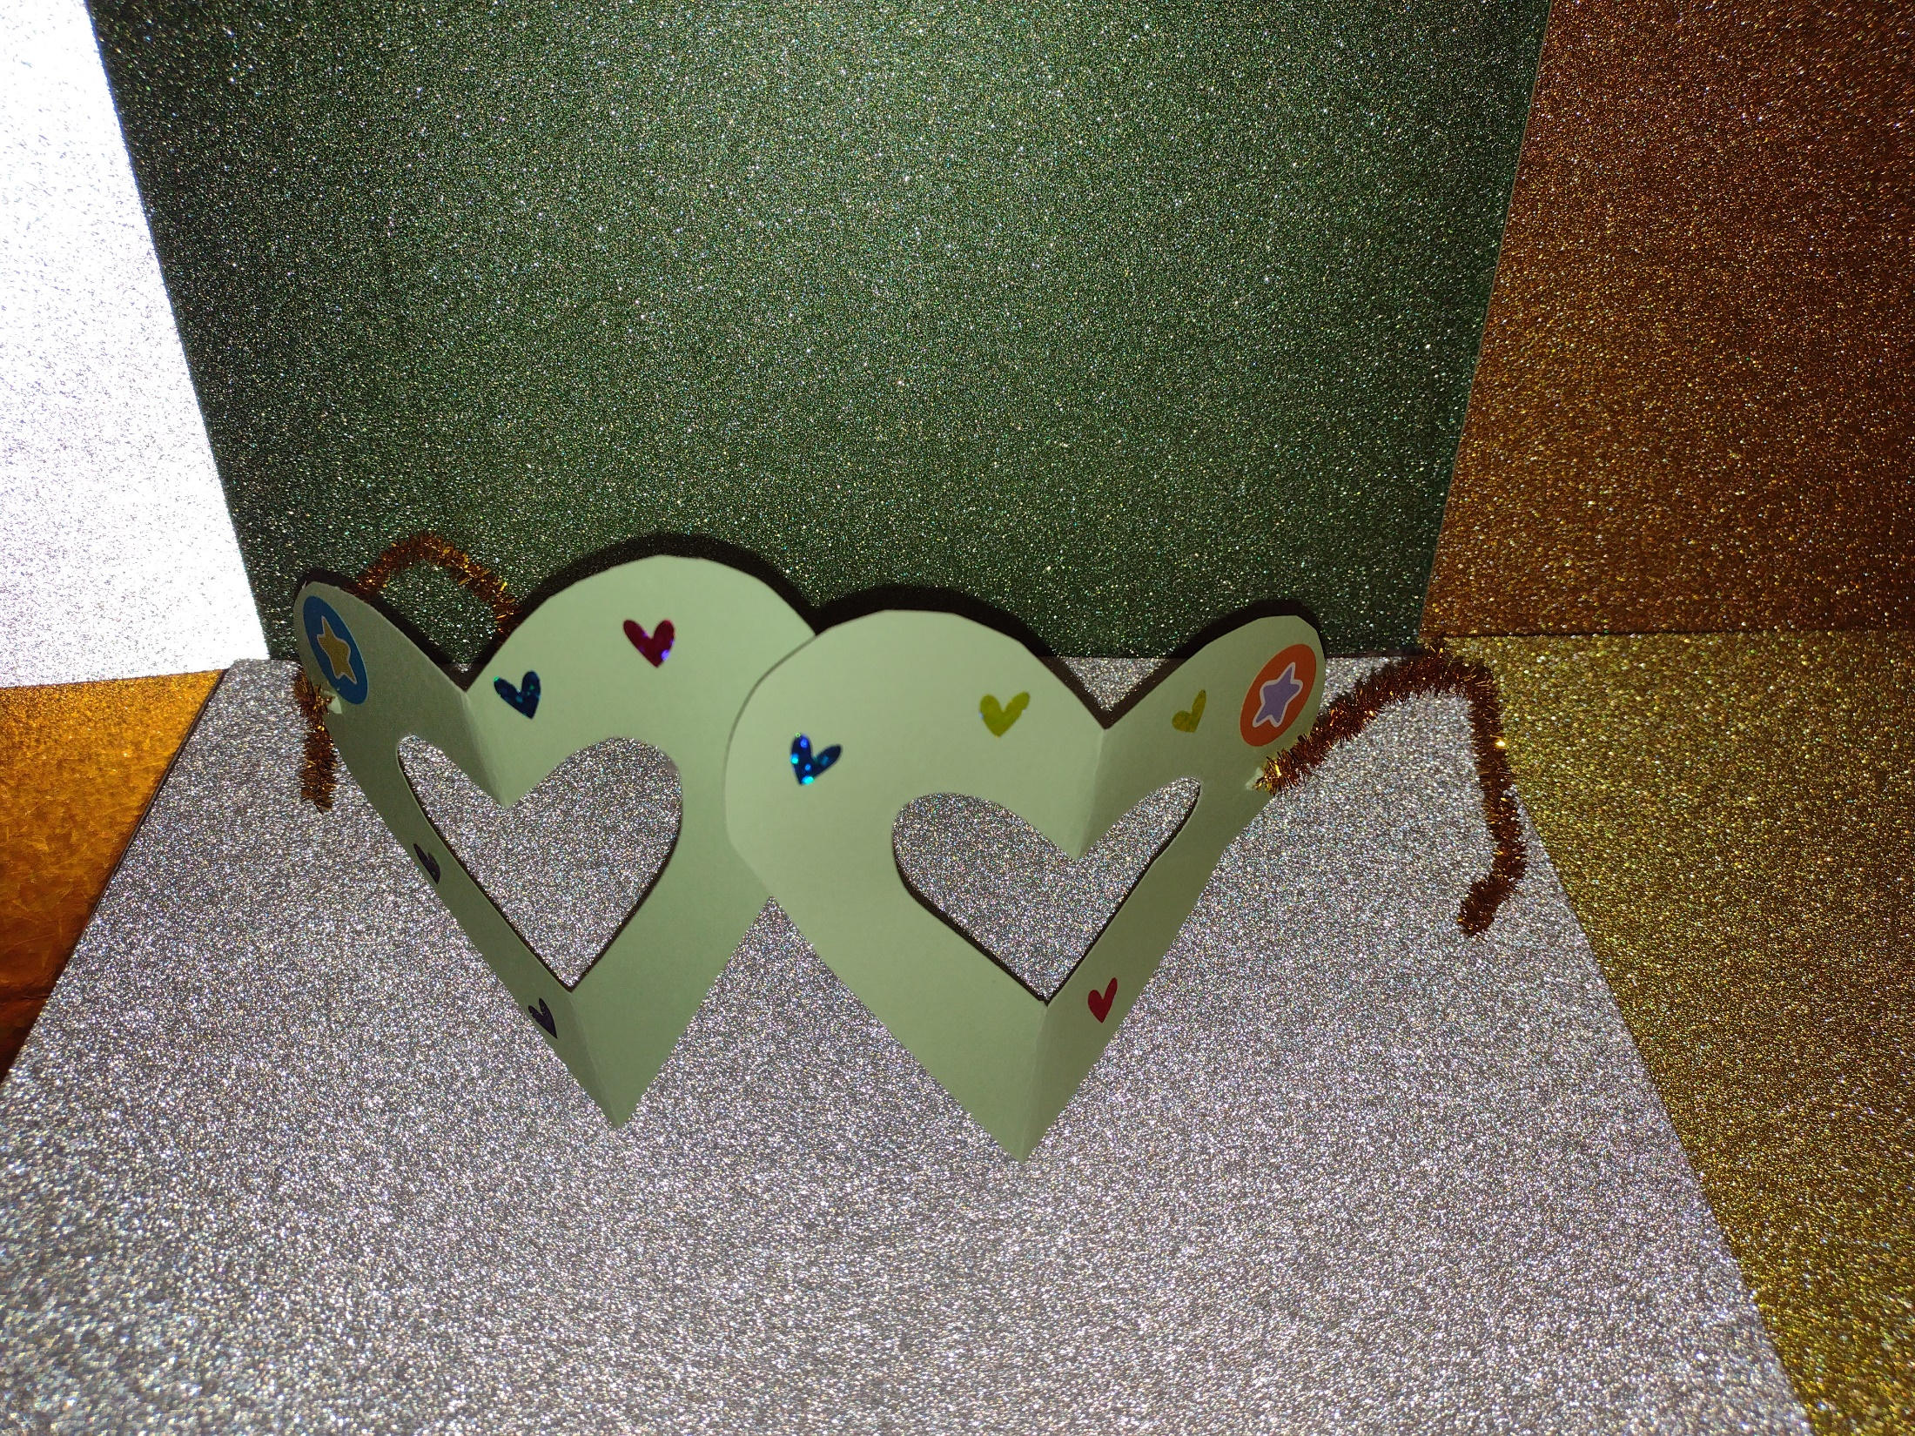
Let’s Create!
Make your very own pair of
Synodal Spectacles!
- To help remind us to see Jesus in each other whilst journeying together!
To make your spectacles, cut out 2 heart shapes and cut a heart shaped hole in each one so that you can see out of them. Use pipe cleaners to make the bits that go around your ears ☺

Slide 10
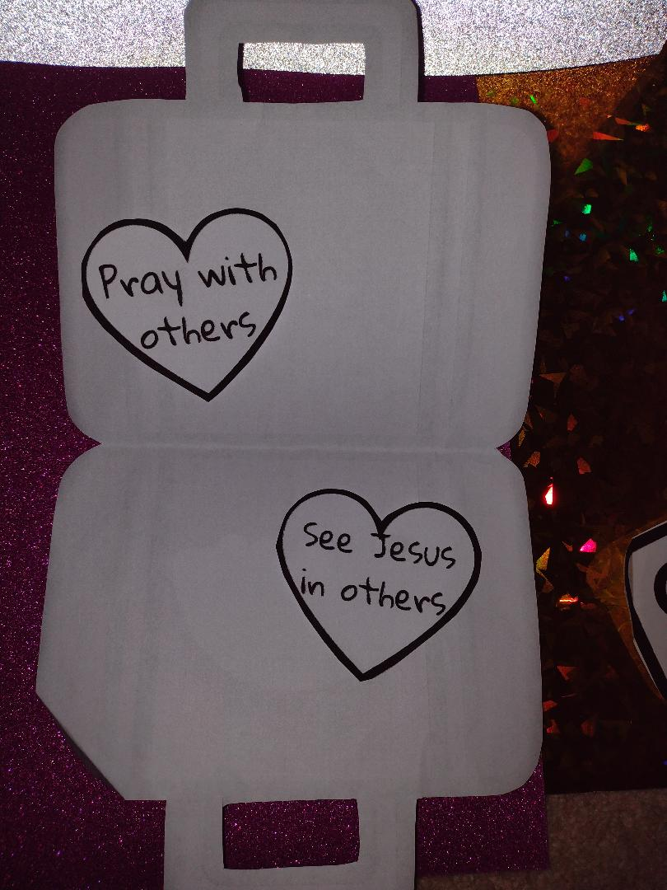
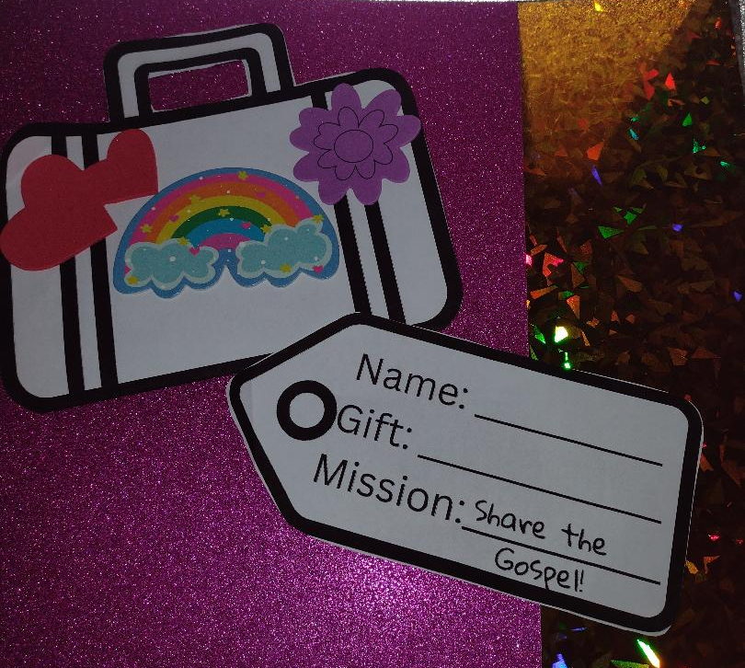
Make your own Synodal Suitcase!
What else can you think of to go inside your suitcase that you might need to carry in your heart on the journey?

Slide 11

Let’s Sing!
(To the tune of Ride a Cock Horse to Banbury Cross)
Walk down the road to Emmaus
To see there a stranger, who’s really Jesus
They recognised him in the breaking of bread
“It’s really you, Lord!” That’s what they said
Walk together, in one communion
United, we’ll journey on our holy mission
God’s Spirit is here! Listen now with your heart!
Let’s build God’s Kingdom, let’s all take part!

Slide 12
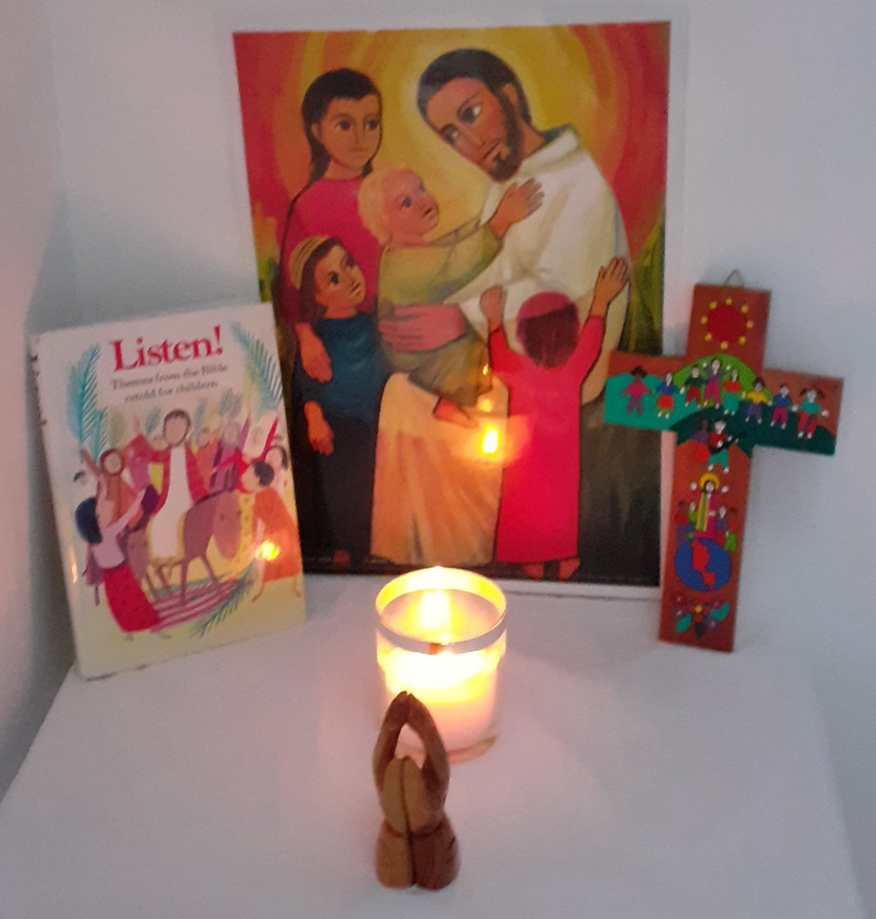
Let’s Pray!
Lord Jesus,
As we journey together as one family
May we all use our gifts
To share the Good News of your love
With smiles on our faces, and joy in our hearts
Amen

