Slide 1
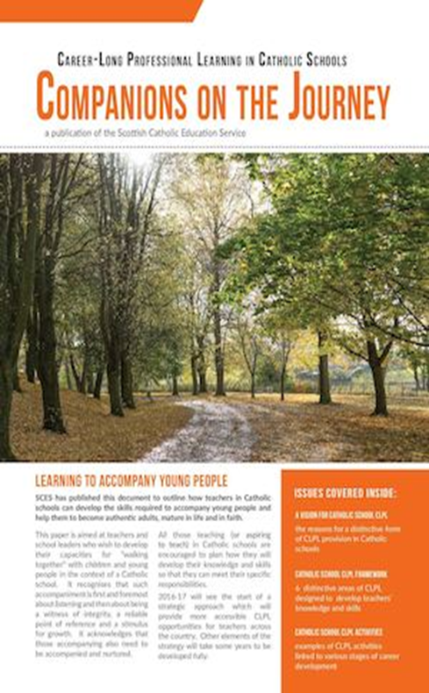
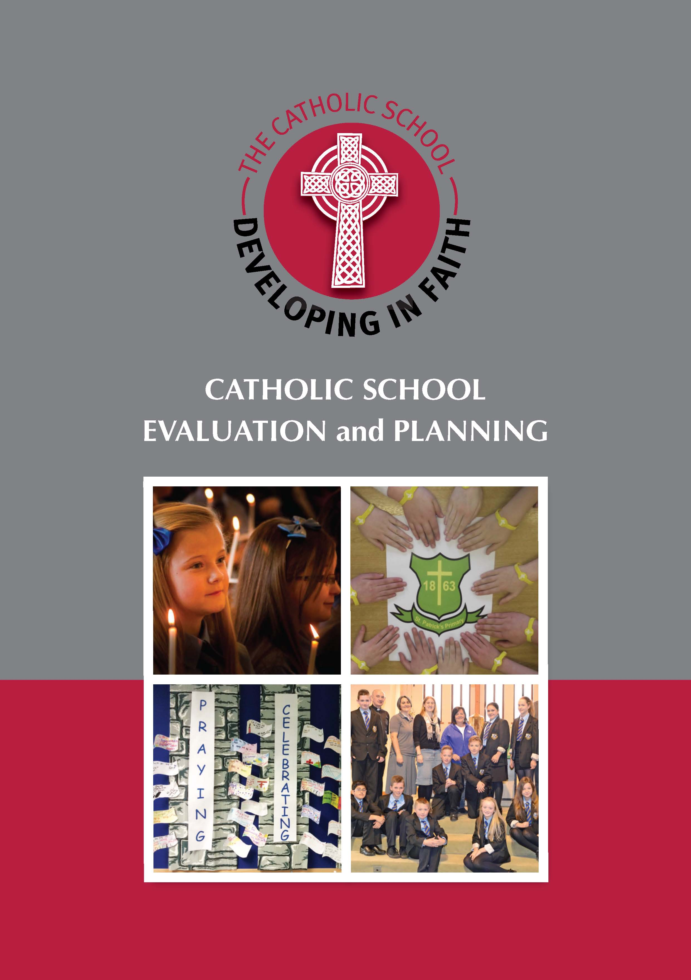


CLPL for Teachers in Catholic Schools
August 2017

Slide 2
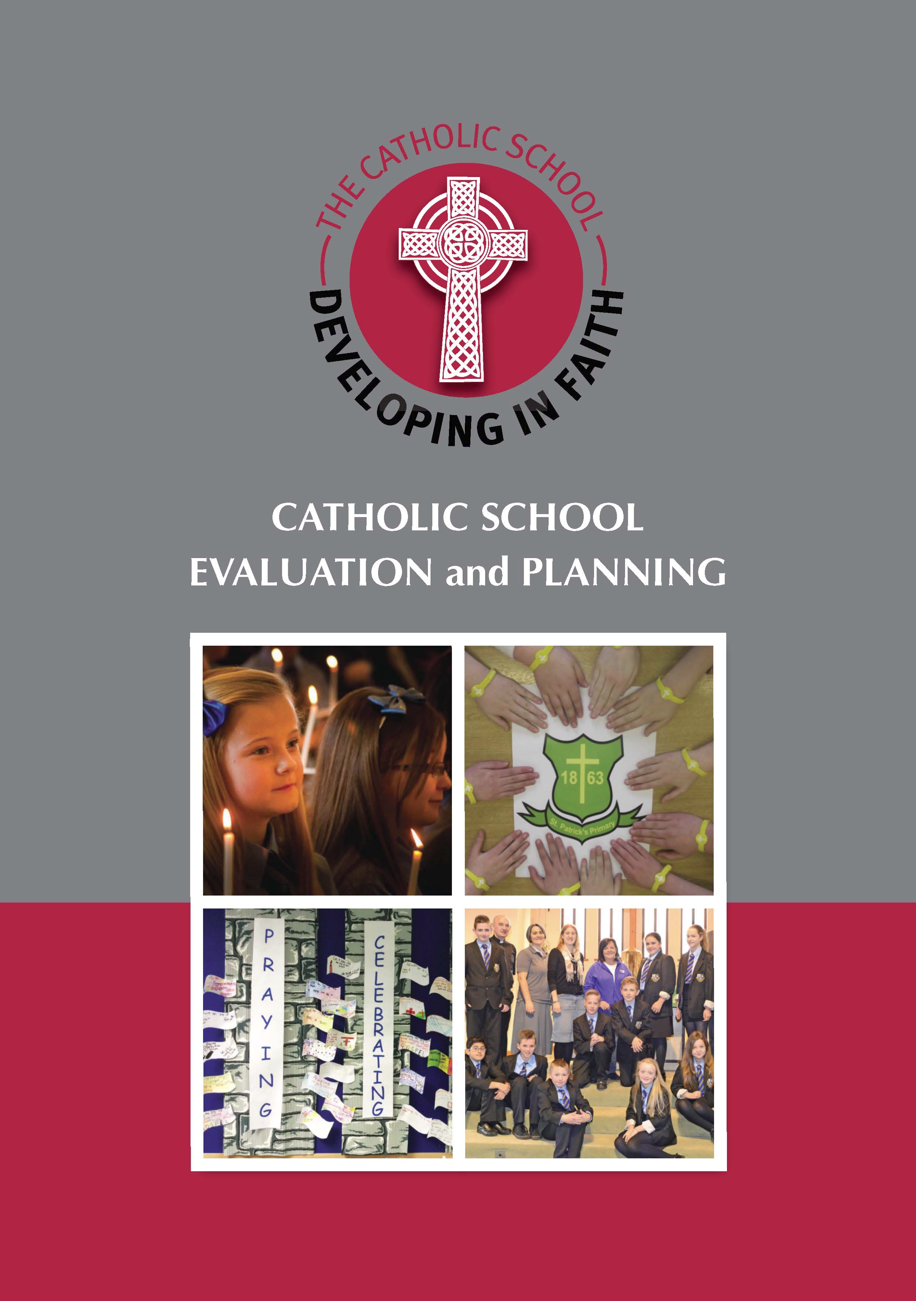

Catholic Schools – Delivering Our Mission
Catholic Religious Education
Strands of Faith
RE: A Divine Pedagogy
Core Learning
Prayers, Notes and Glossary
This is Our Faith
(BGE & Senior Phase)
Developing in Faith: Catholic School Evaluation and Planning
The Vision of the Catholic School
The Charter for Catholic Schools
Charter Themes and Characteristics
Advice on Catholic School Evaluation
Case Studies
Points for Reflection and Dialogue
Companions on the Journey: Career-Long Professional Learning in Catholic Schools
A Vision for Catholic School CLPL
Catholic School CLPL Framework
Catholic School CLPL Activities
Designed to articulate with GTCS Professional Standards
Notes:
This slide is intended to allow teachers to see how this suite of documents can work individually in different areas, looking at different aspects of how our schools function as communities of faith and learning, but also work together to ensure a continuity of approach.
Each box shows the main content headings of the associated document.
THIS IS OUR FAITH – the nature of the Catholic School and academic support for teachers in the school to support the building of a distinctive Catholic ethos and delivery of a quality core RE programme
DEVELOPING IN FAITH – evaluation and planning
COMPANIONS ON THE JOURNEY – CLPL: help with selecting Catholic School CLPL which will work in tandem with GTCS Professional Standards as well as addressing CLPL needs specific to teachers in Catholic schools.

Slide 3
Companions on the Journey
“A Catholic school CLPL strategy is intended to encourage teachers, school leaders and others to nurture a particular culture of professional development for teachers within the network of Scotland’s Catholic Schools. This culture will be distinguished by its recognition of teachers’ personal religious needs being part of their professional learning needs within schools which are communities of faith and learning.”
Notes:
Quote from document emphasising distinctive nature of the Catholic school as a community of faith and learning: addressing pupil needs by addressing teacher needs for personal and professional learning and development.

Slide 4

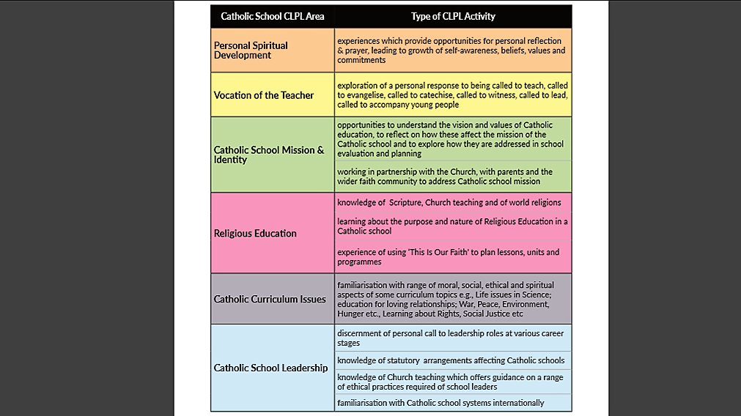
Framework for Catholic School CLPL:
6 Catholic School CLPL Areas (P.6)
When researching and planning CLPL opportunities, teachers in Catholic schools should consider the types of activities which can be matched to the GTCS Professional Standards for:
Provisional Registration
Full registration
Career-long Professional Learning
Middle Leadership
Headship
Examples of the kind of courses/activities which would be relevant at various career stages can be found on pages 8 & 9 of Companions on the Journey.
Notes:
The main organisers used for teachers in Catholic schools to identify their CLPL needs at any given stage of their career are contained in this table.
Taking into consideration their PRD discussions and the school/departmental improvement planning, teachers can use this as a tool to help them identify their CLPL needs, and to discuss this with colleagues and managers

Slide 5
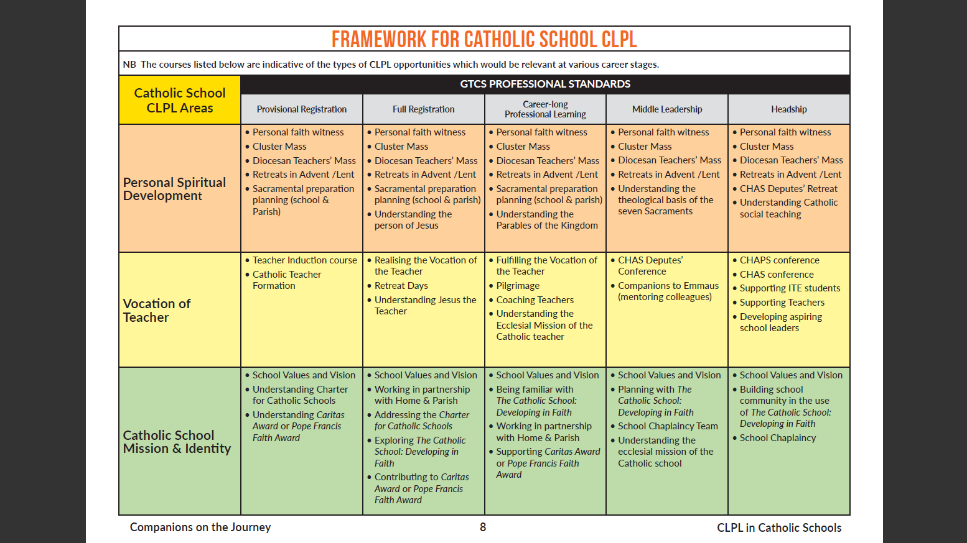
Framework for Catholic School CLPL
(Companions on the Journey, p.8 & 9)
Notes:
For this and for next slide, which is just the second part of the table, it is perhaps worth reminding staff that these would be examples of the kind of experiences/activities/courses which would help teachers in Catholic schools to fulfil their CLPL needs, and that not all CLPL is “going on a course”. For example, for Personal Spiritual Development , active participation in liturgy could be a valid method of professional learning. In other areas, engaging in online learning or professional reading and/or dialogue may be a more effective way of learning.
It is important however that all teachers keep a record of the CLPL activities they undertake, and are able to discuss the impact of these at their PRD discussions.

Slide 6
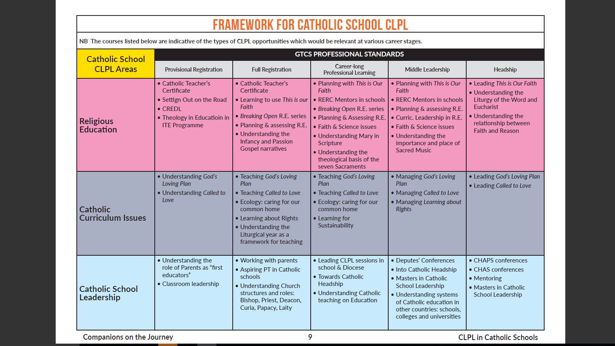
Framework for Catholic School CLPL
(Companions on the Journey, p.8 & 9)
Notes:
For this and for previous slide, which is just the first part of the table, it is perhaps worth reminding staff that these would be examples of the kind of experiences/activities/courses which would help teachers in Catholic schools to fulfil their CLPL needs, and that not all CLPL is “going on a course”. For example, for Personal Spiritual Development , active participation in liturgy could be a valid method of professional learning. In other areas, engaging in online learning or professional reading and/or dialogue may be a more effective way of learning.
It is important however that all teachers keep a record of the CLPL activities they undertake, and are able to discuss the impact of these at their PRD discussions.

Slide 7
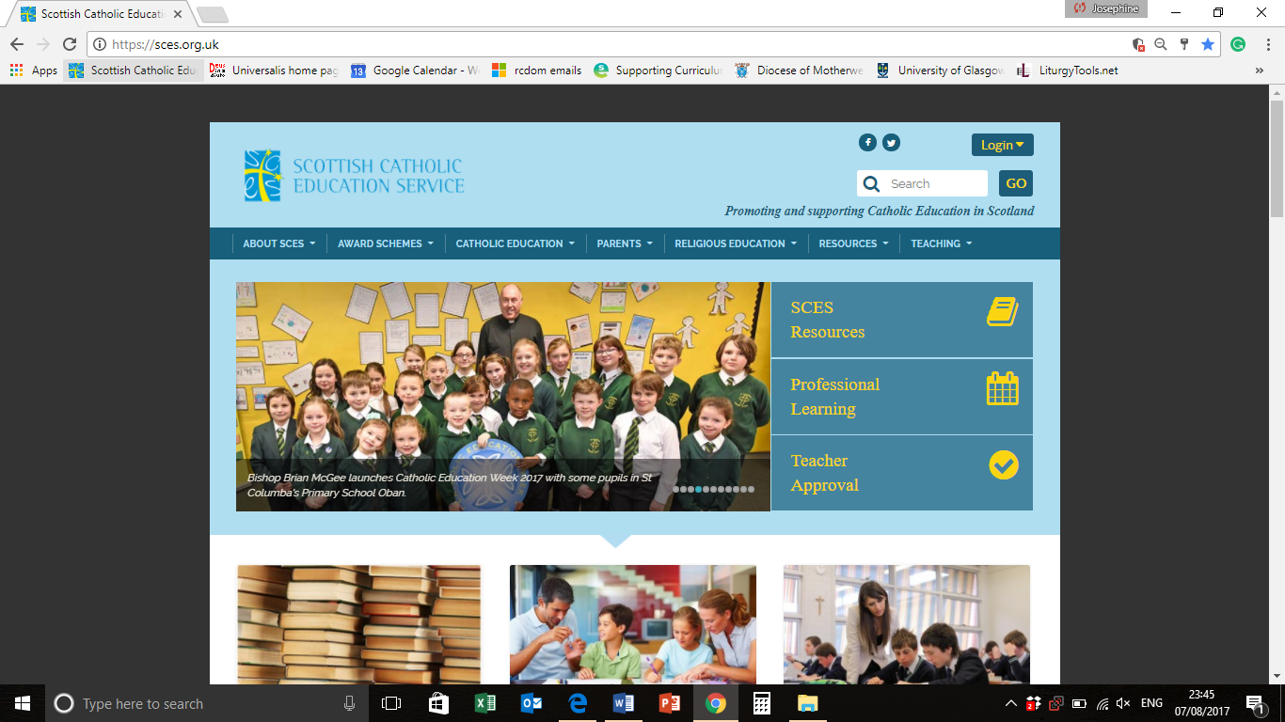
Sourcing and Selecting Catholic CLPL
Notes:
The SCES website allows teachers to access a comprehensive list of Catholic CLPL opportunities on offer across the country provided by SCES itself, Diocesan groups and advisers and universities.
From the home page, teachers can select either “Professional Learning” (click to highlight) or “TEACHING” (click to highlight} to take them to the CLPL Events Calendar

Slide 8
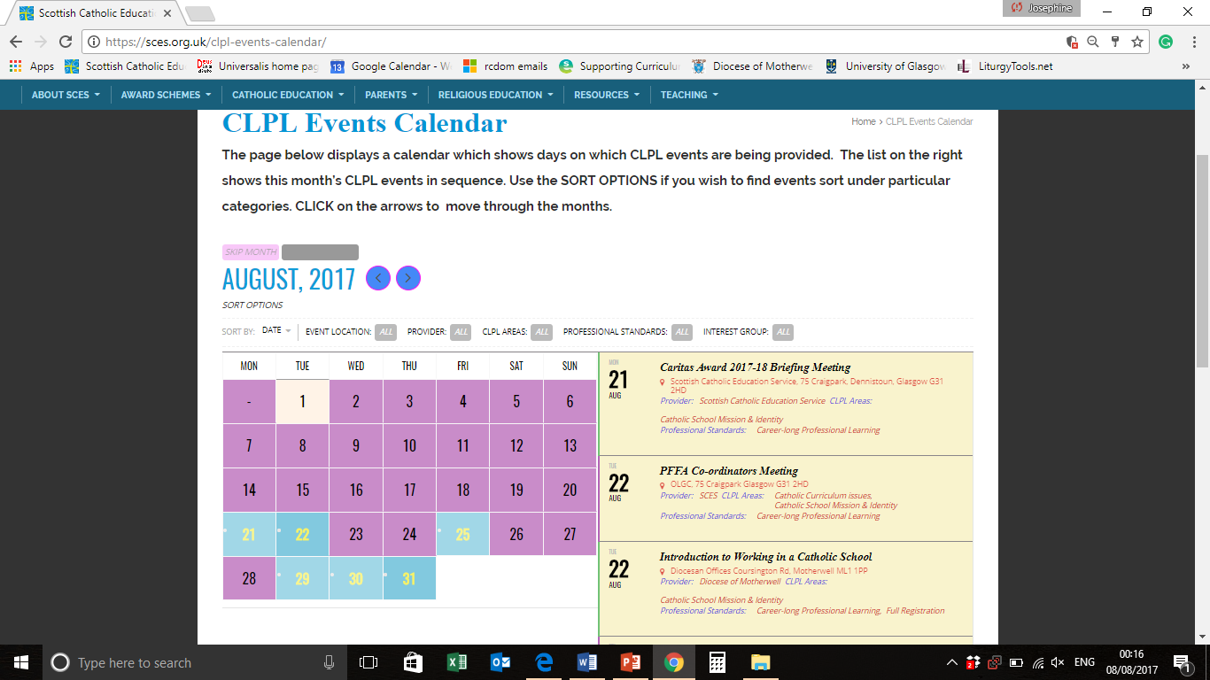
Sourcing and Selecting Catholic CLPL
Notes:
The CLPL Events Calendar will allow teachers to use the Sort Option (click to highlight) to select CLPL opportunities based on:
Date;
Location;
Provider
CLPL Areas (as shown in slides 4,5,6)
GTCS Professional Standards
Interest Groups (e.g. primary/secondary teachers; aspiring headteachers; Caritas co-ordinators; NQTs, etc . . .)

Slide 9
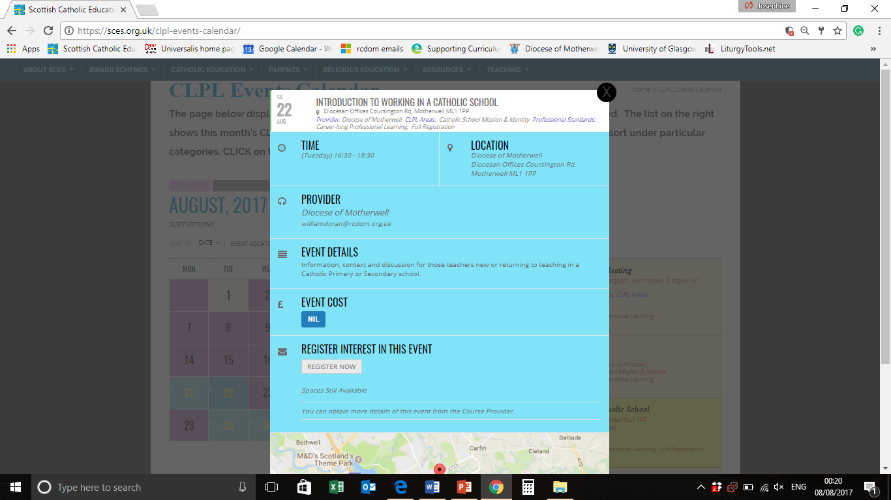
Sourcing and Selecting Catholic CLPL
Notes:
Selecting an event will bring up a page like this, allowing teachers to see all the necessary information about the event; to book the event if they wish to after discussion with their CLPL Co-ordinator, and to keep a record of the event on their own Google calendar to help maintain an accurate CLPL record.

Slide 10
Further Advice
For any further advice on matters related to Catholic CLPL, please feel free to contact:
Your CLPL co-ordinator
Your Diocesan RE Advisor
Scottish Catholic Education Service (SCES)

