Slide 1
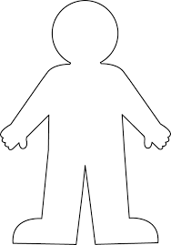
Outside
Inside

Slide 2
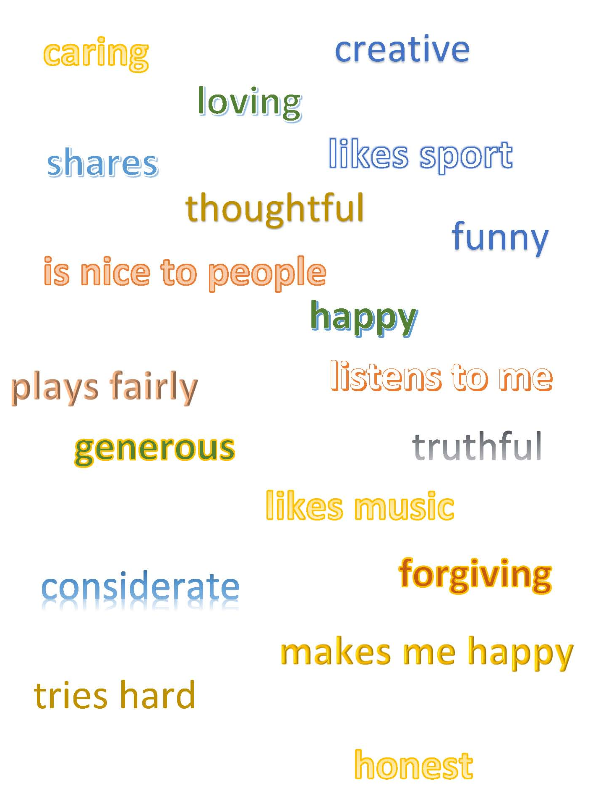
What words describe you on the outside?
Describe yourself to your partner
What words describe
you on the inside?

Slide 3
What words describe you on the outside?
different
ˈdɪf(ə)r(ə)nt/
adjective
1. not the same as another or each other;
What words describe
you on the inside?
unique
juːˈniːk/
adjective
being the only one of its kind; unlike anything else.
equal
ˈiːkw(ə)l/
adjective
being the same in quantity, size, degree, or value.
diversity
dʌɪˈvəːsɪti,dɪˈvəːsɪti/
noun
a range of different things.

Slide 4
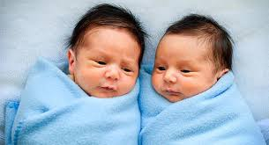
not the same as another or each other
different
unique
being the only one of its kind; unlike anything else.
being the same in value
equal
diverse
a range of different things (gifts)

