Slide 1
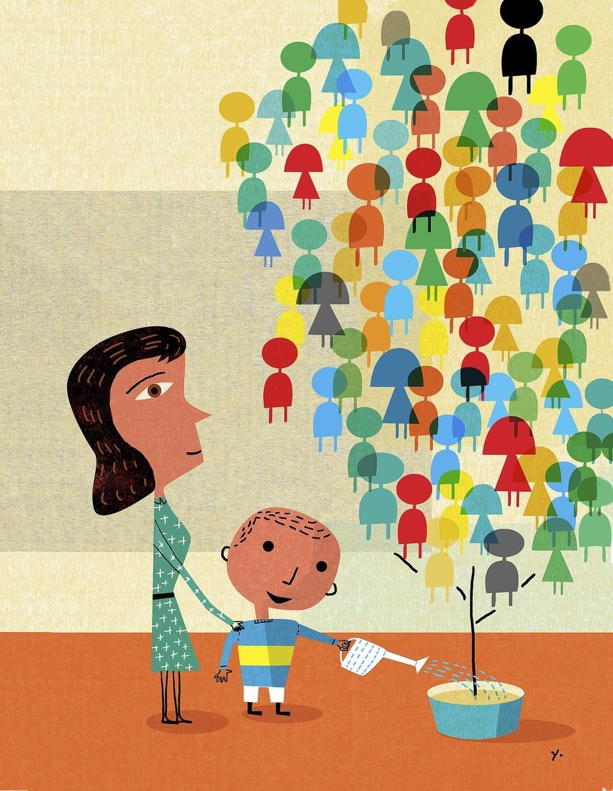
What is the child in the picture doing?
Who do you think all of the people are in the tree?
Create your own care tree showing all of the people who care for you and who you care for in return
https://www.pinterest.co.uk/pin/324118504412956904/?lp=true

Slide 2
