Slide 1

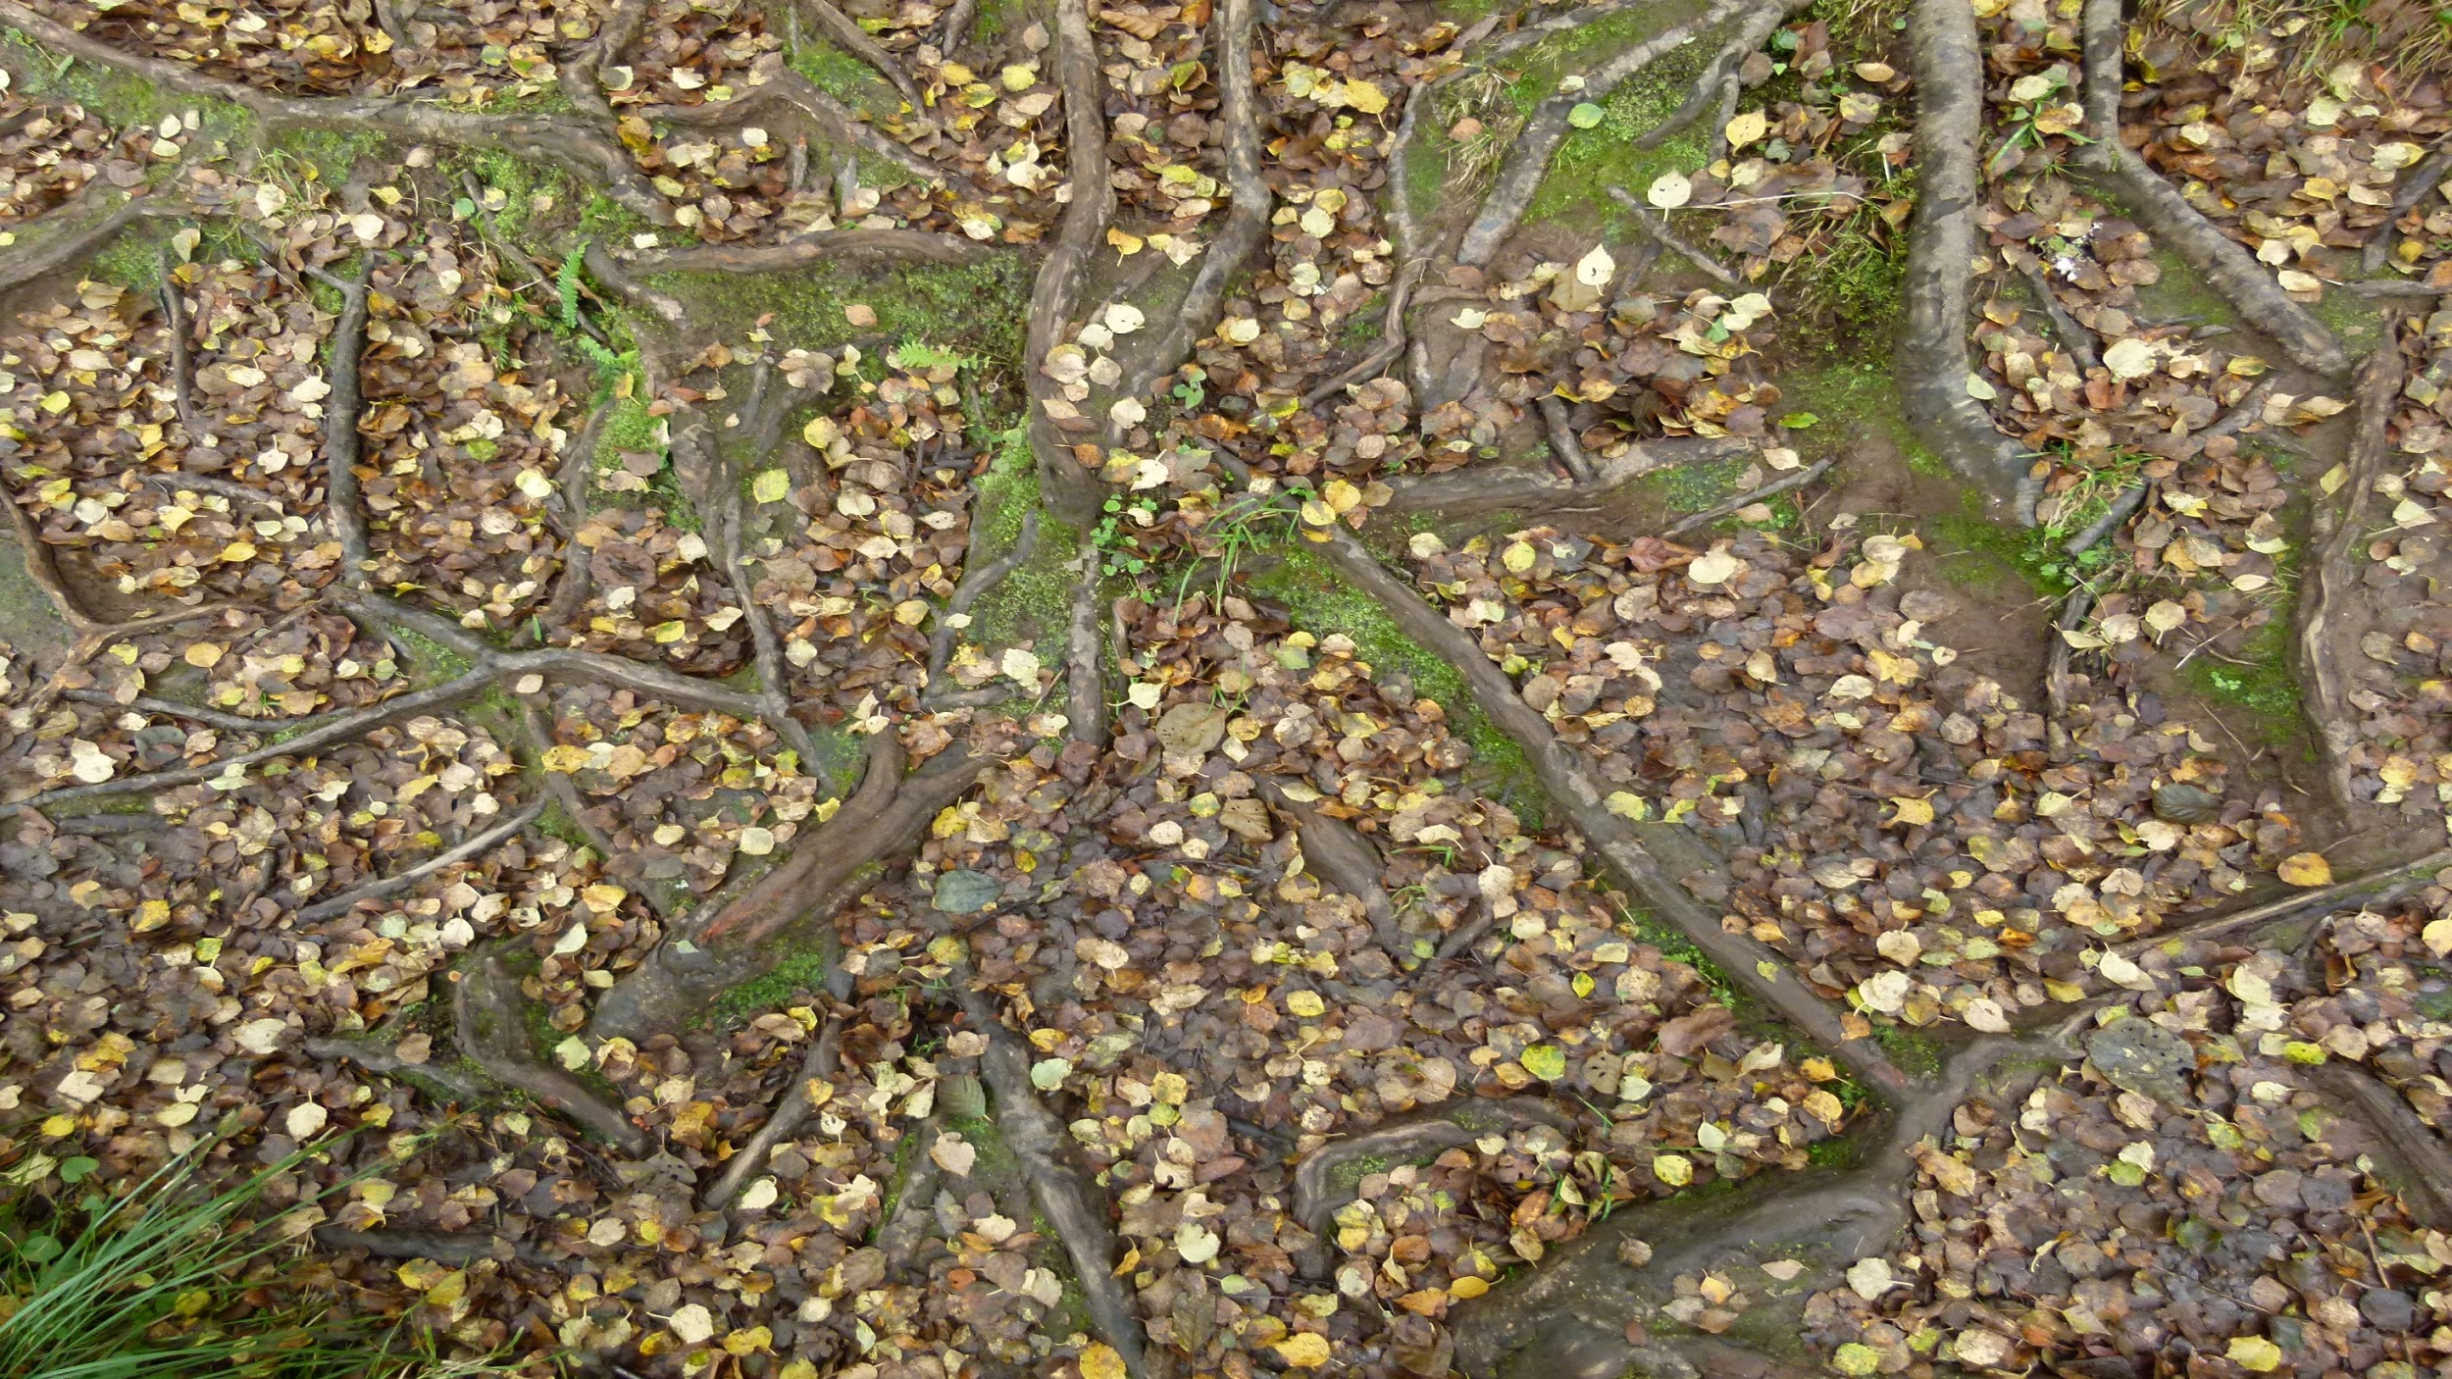

Laudato Si’
An Introduction

Slide 2
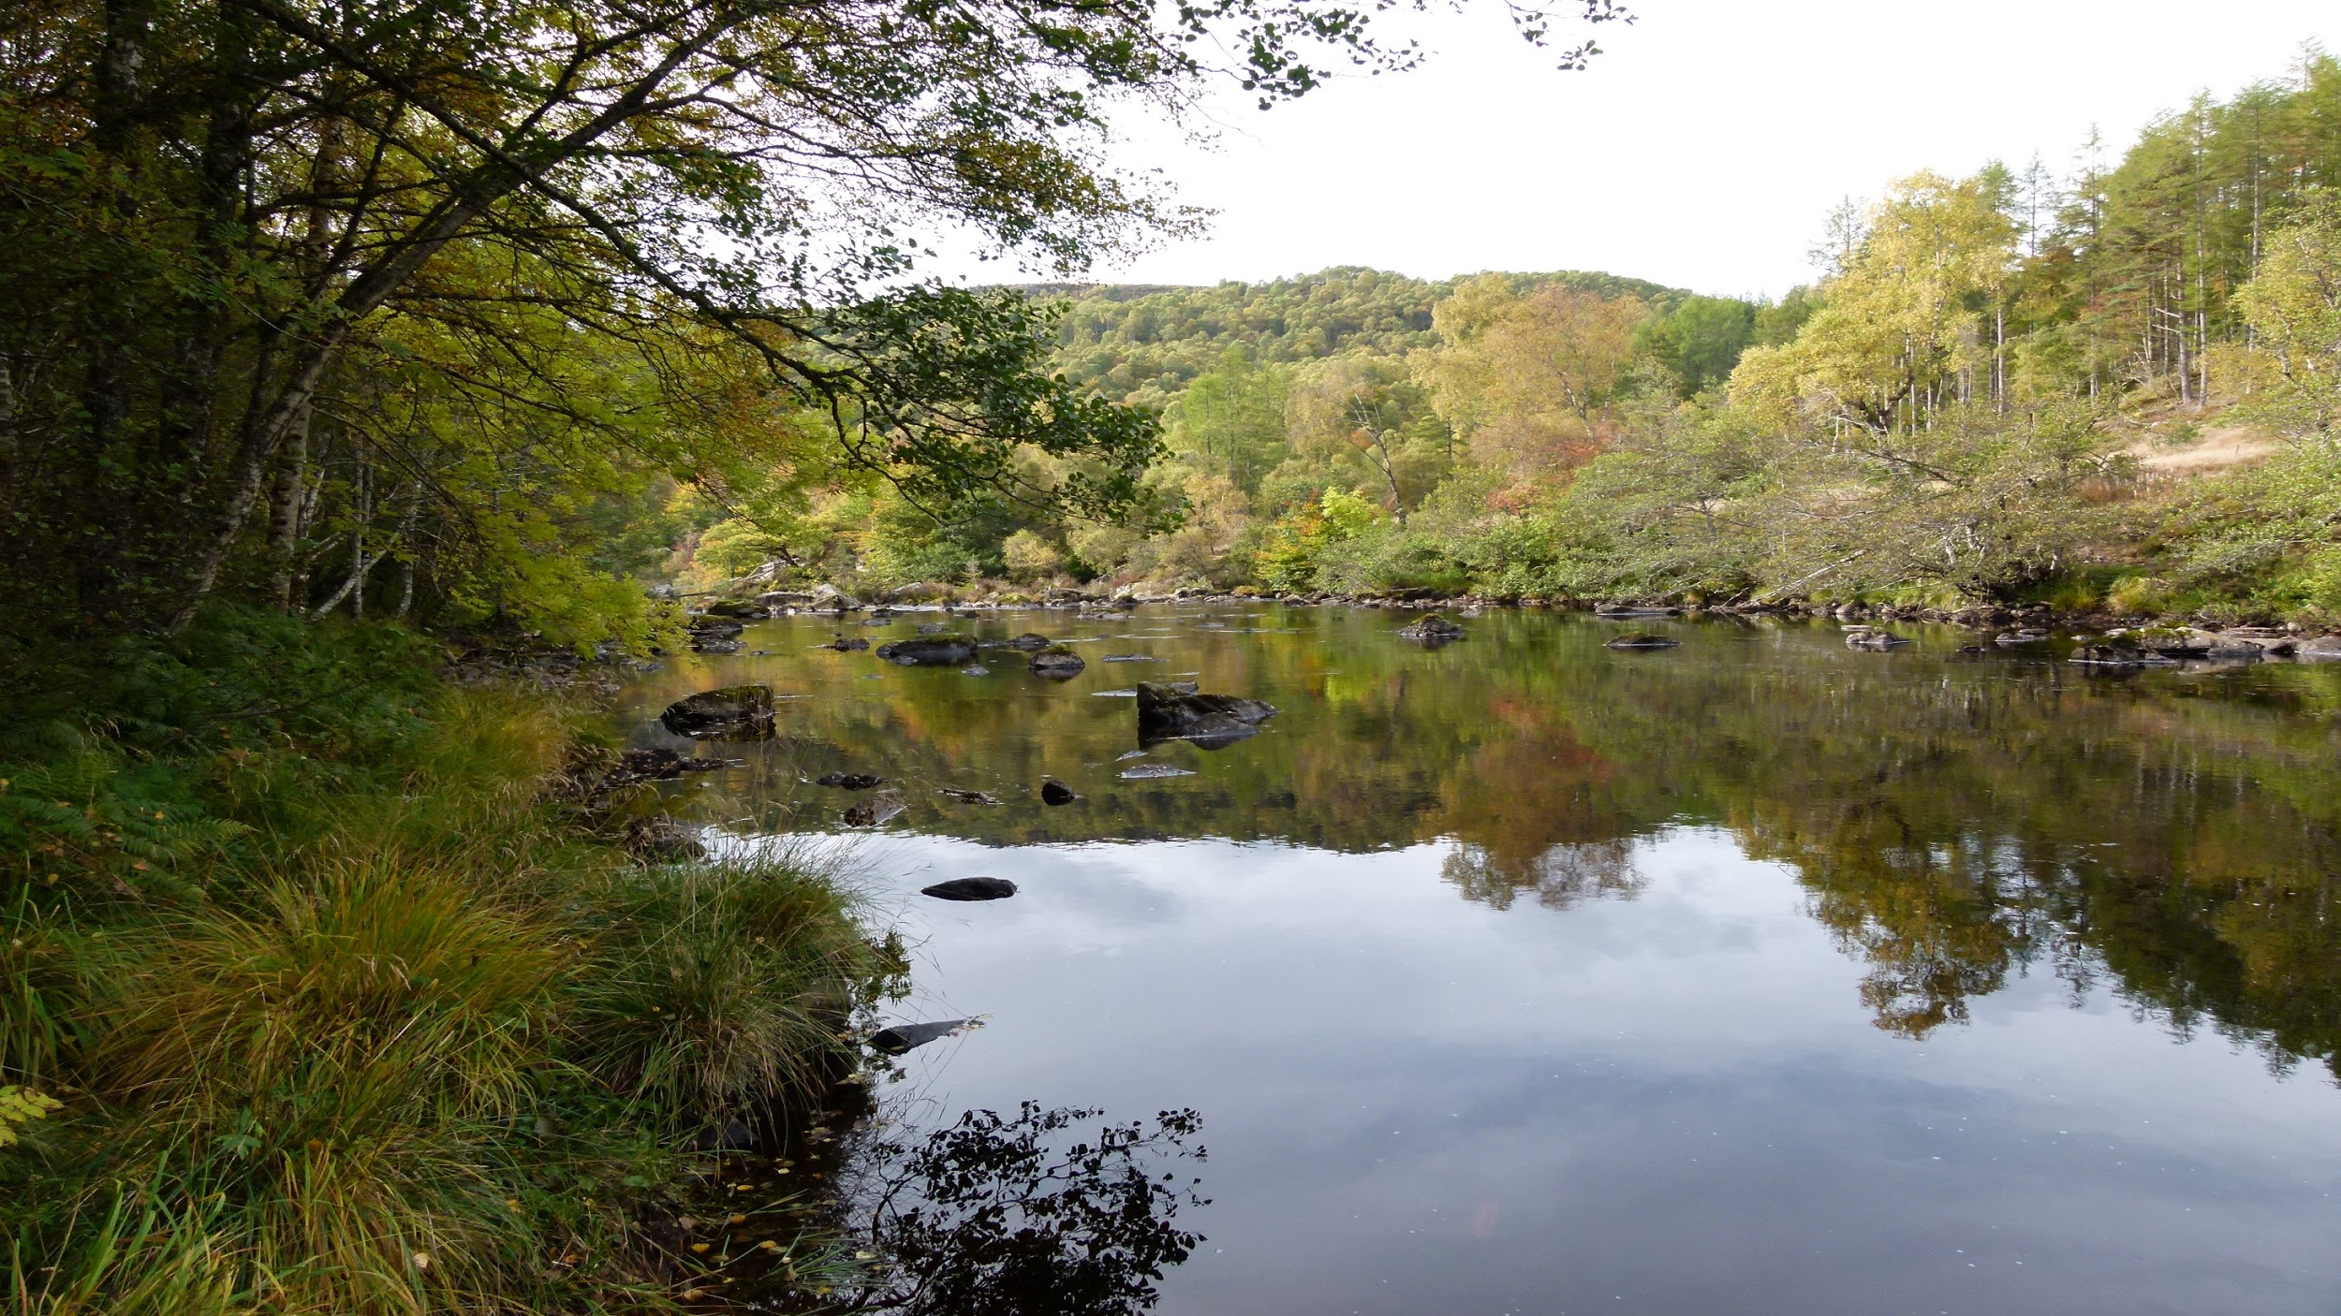
Setting the scene:
Call to action
Warning
“Authentic human development has a moral character”
Relationship with the natural world reflects social reality.
Importance of education

Slide 3
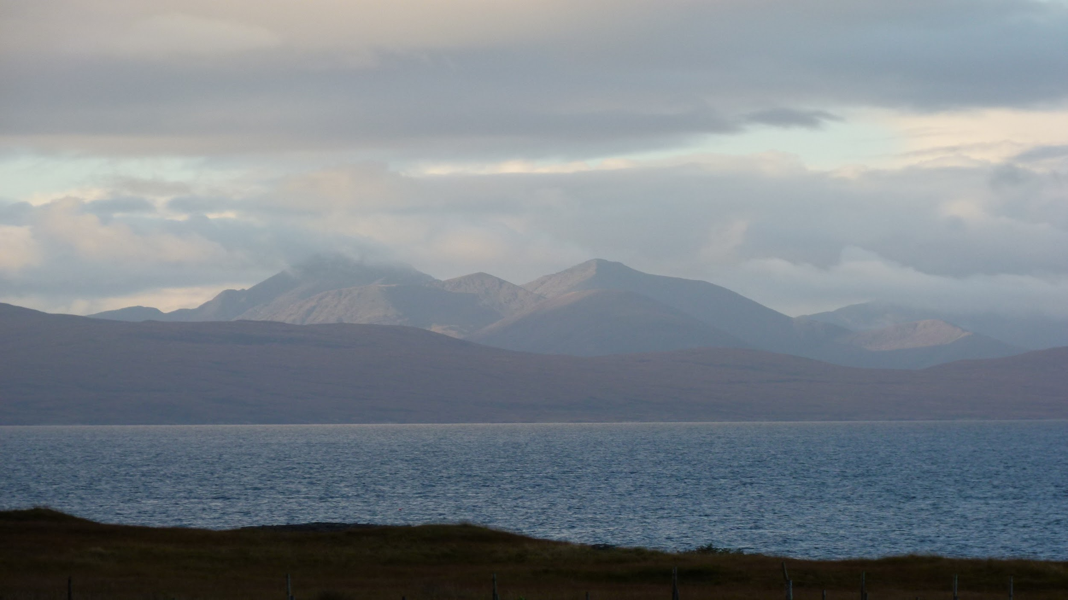
What is Happening to Our Common Home
Human activity
Our changing culture
Right to natural resources is the same as the right to life
Not just eternity
Social dimensions of global change

Slide 4
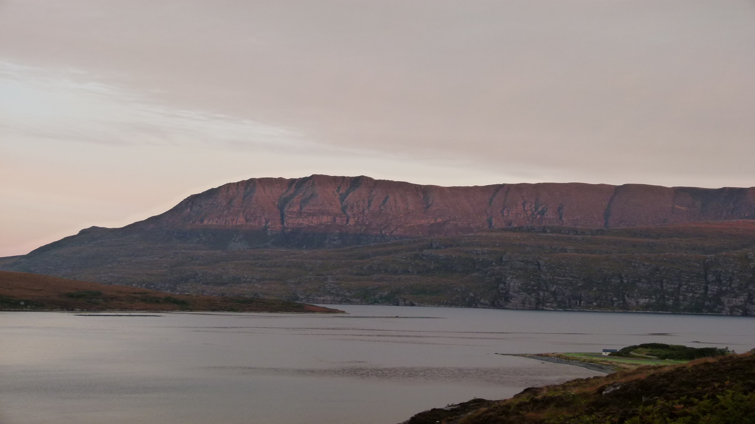
The Gospel of Creation
Essential part of our faith
Goodness of creation
Sin
“we can speak of the priority of being over being useful.”
The importance of rest

Slide 5
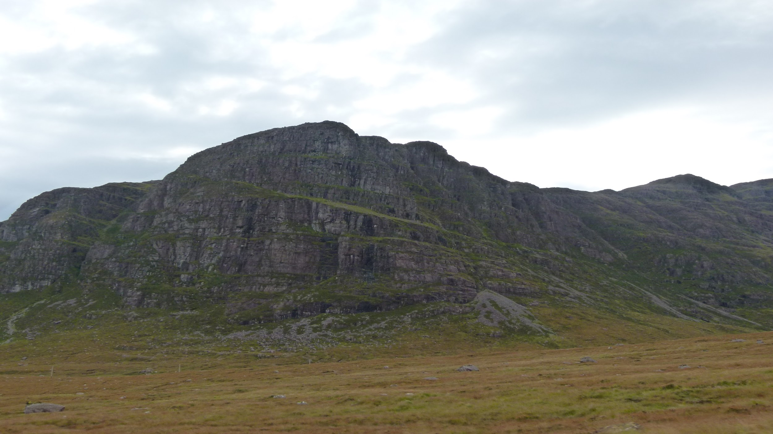
The Human Roots of the Ecological Crisis
Technology
Knowledge
Slavery
Responsible stewardship
Ora et labora

Slide 6
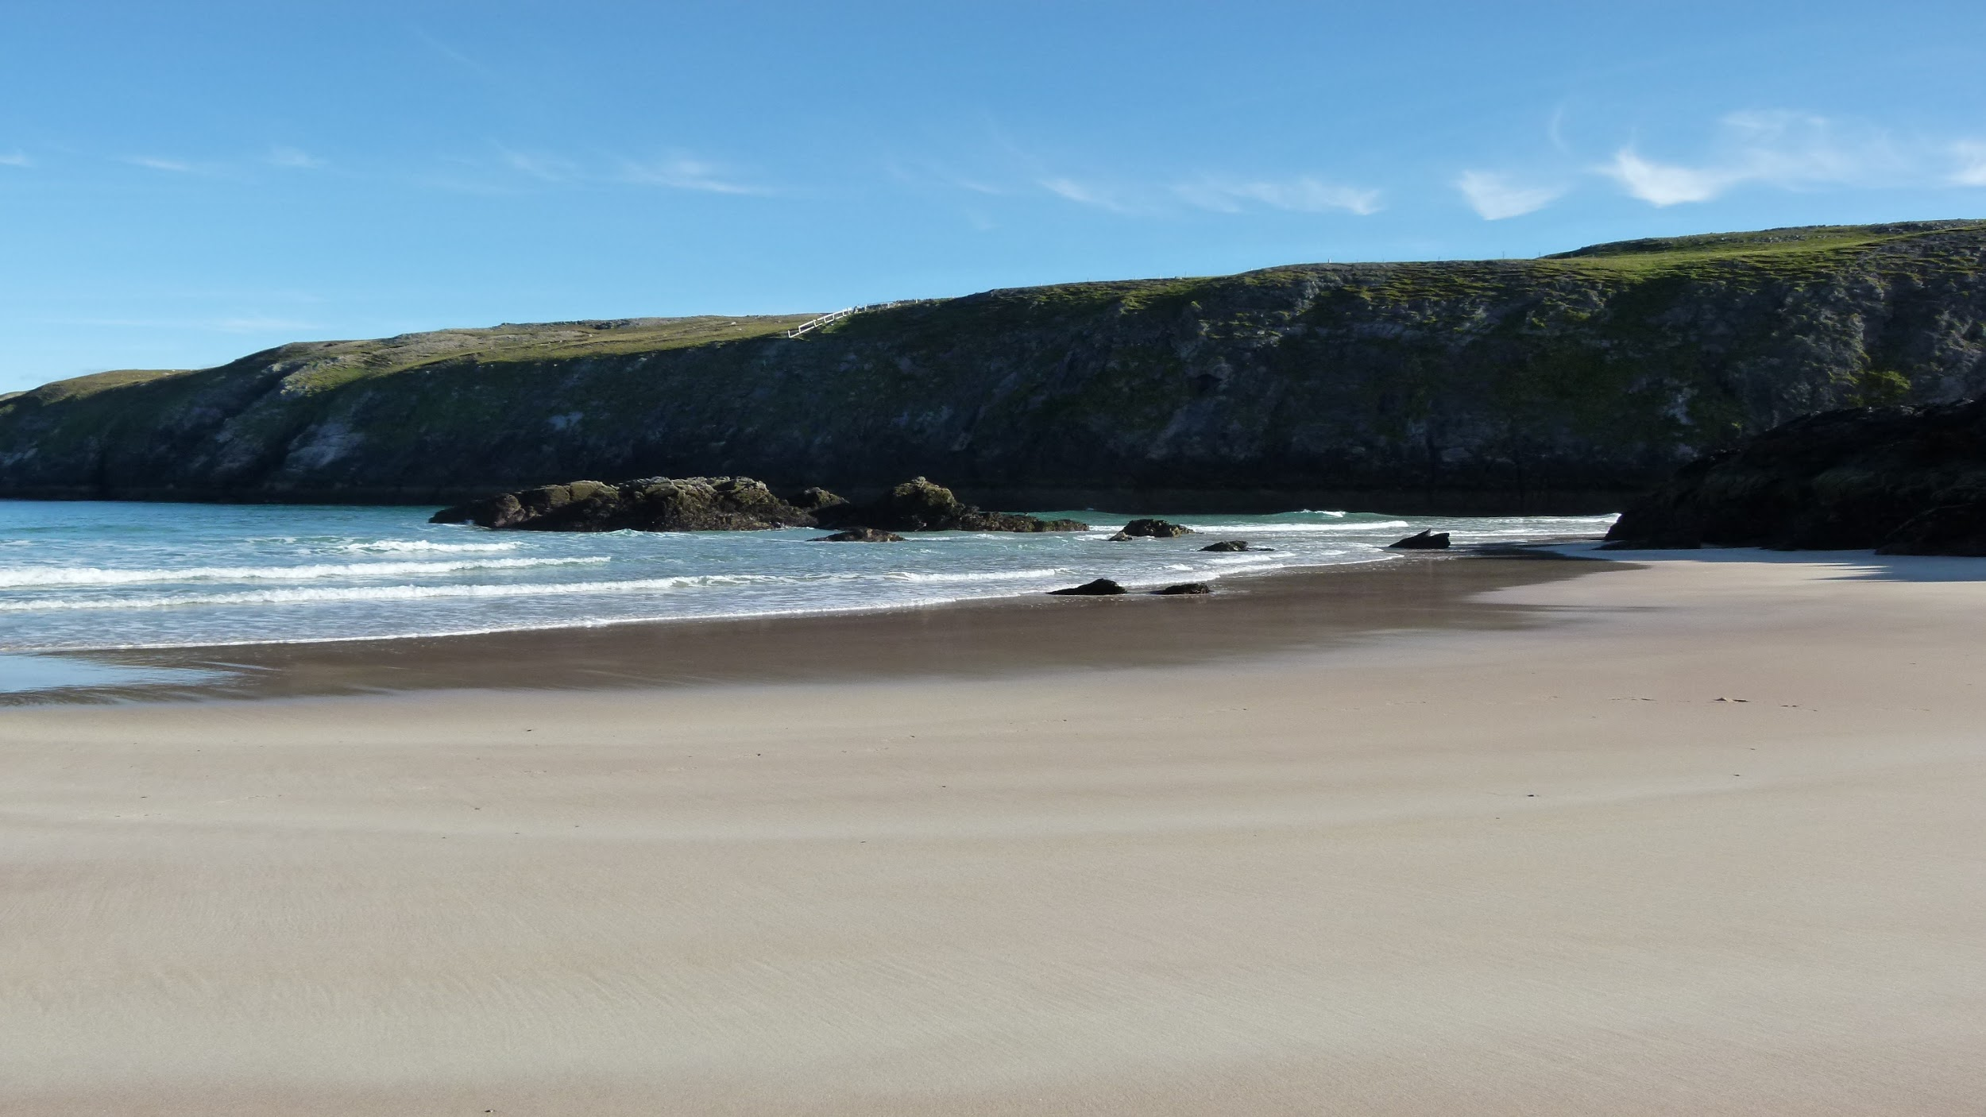
Integral Ecology
One crisis
Degradation of nature and culture
Ecology of Man

Slide 7
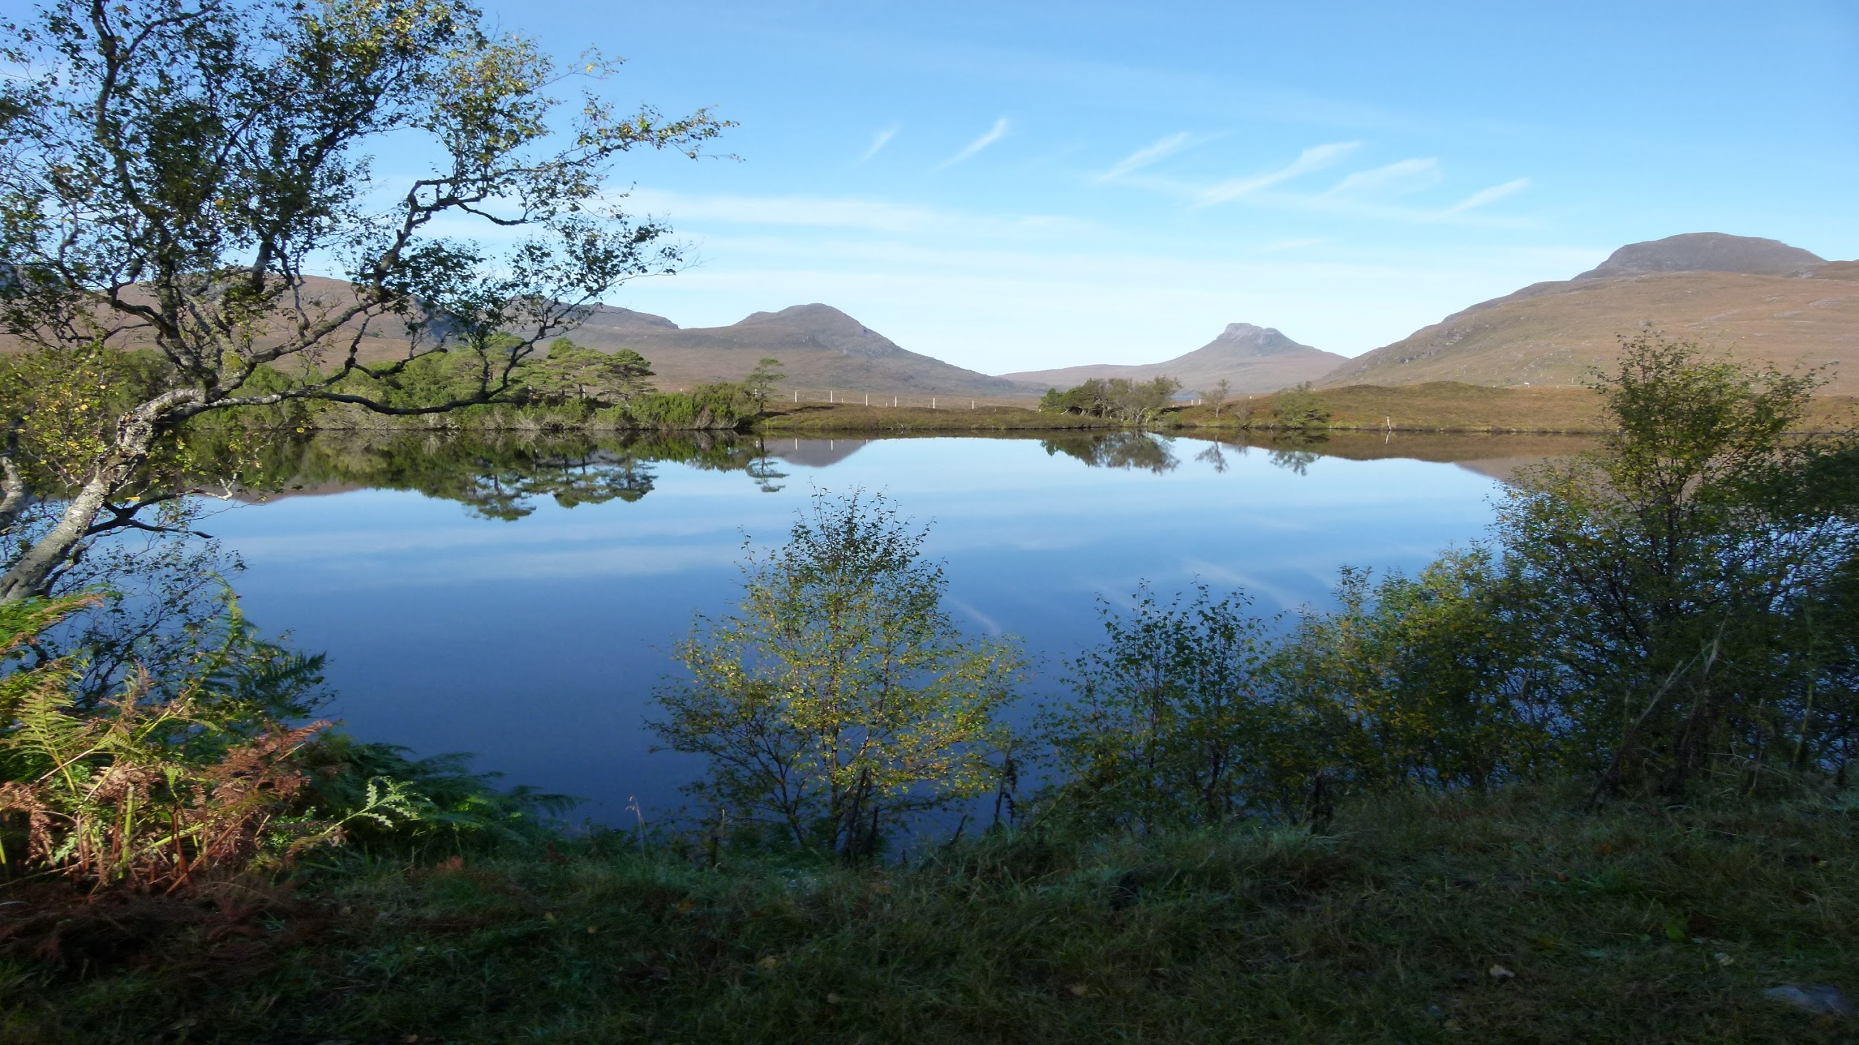
Lines of Approach and Action
Hope and Prayer
Responsibility

Slide 8
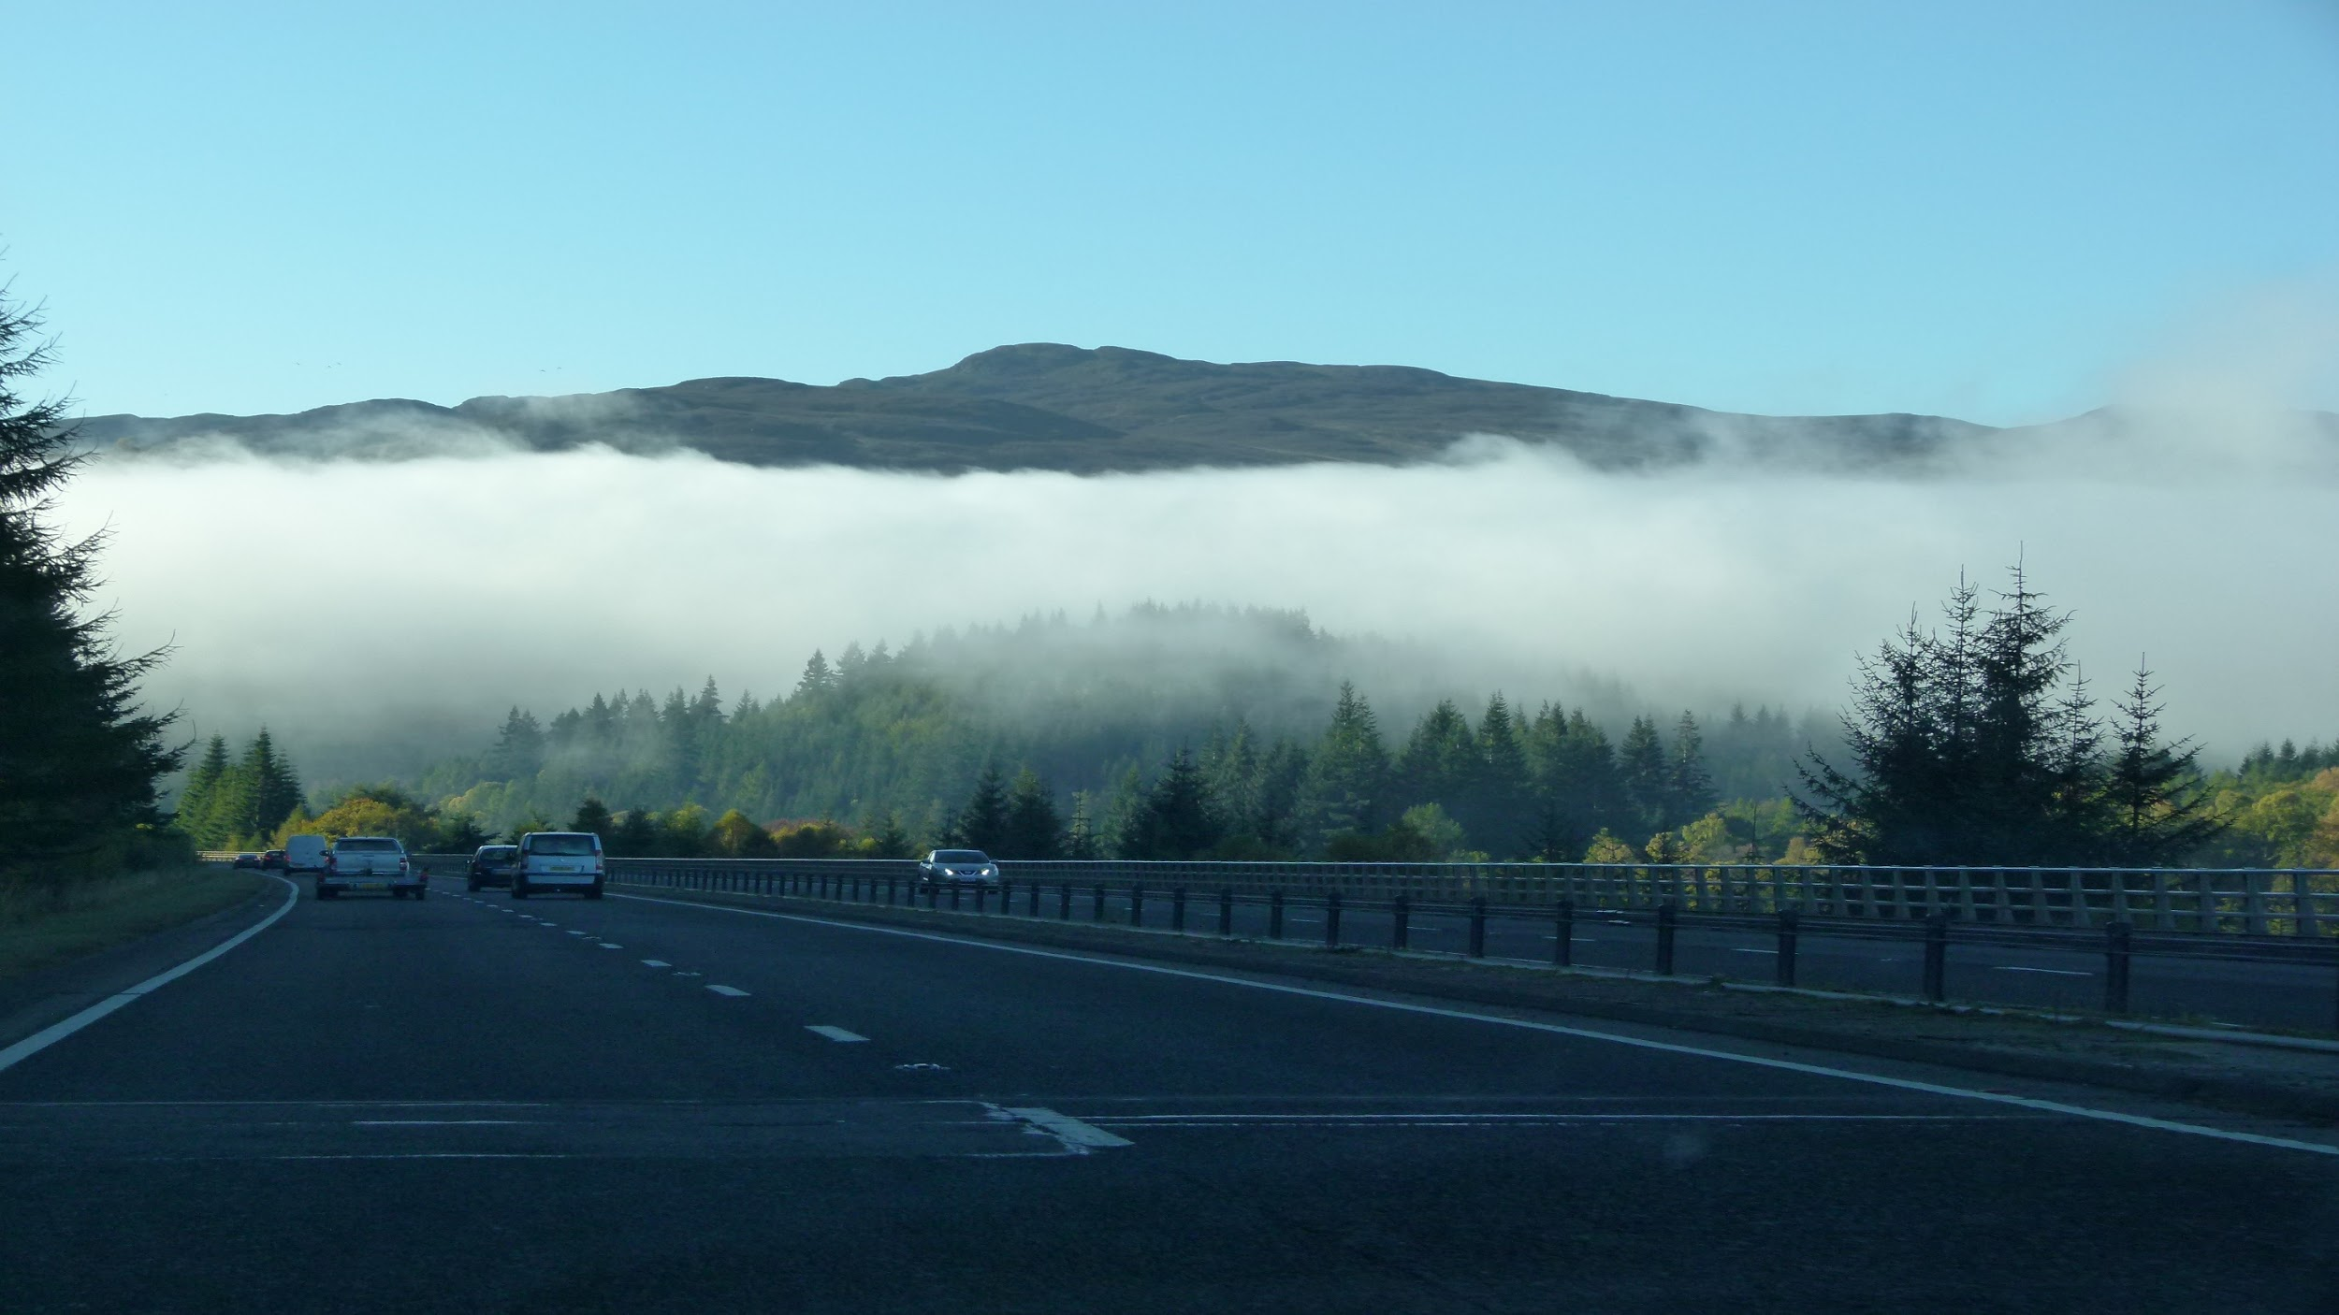
Ecological Education and Spirituality
Freedom
Goodness, Truth and Beauty
Individual changes
Trinitarian Dynamism

Slide 9
