Slide 1
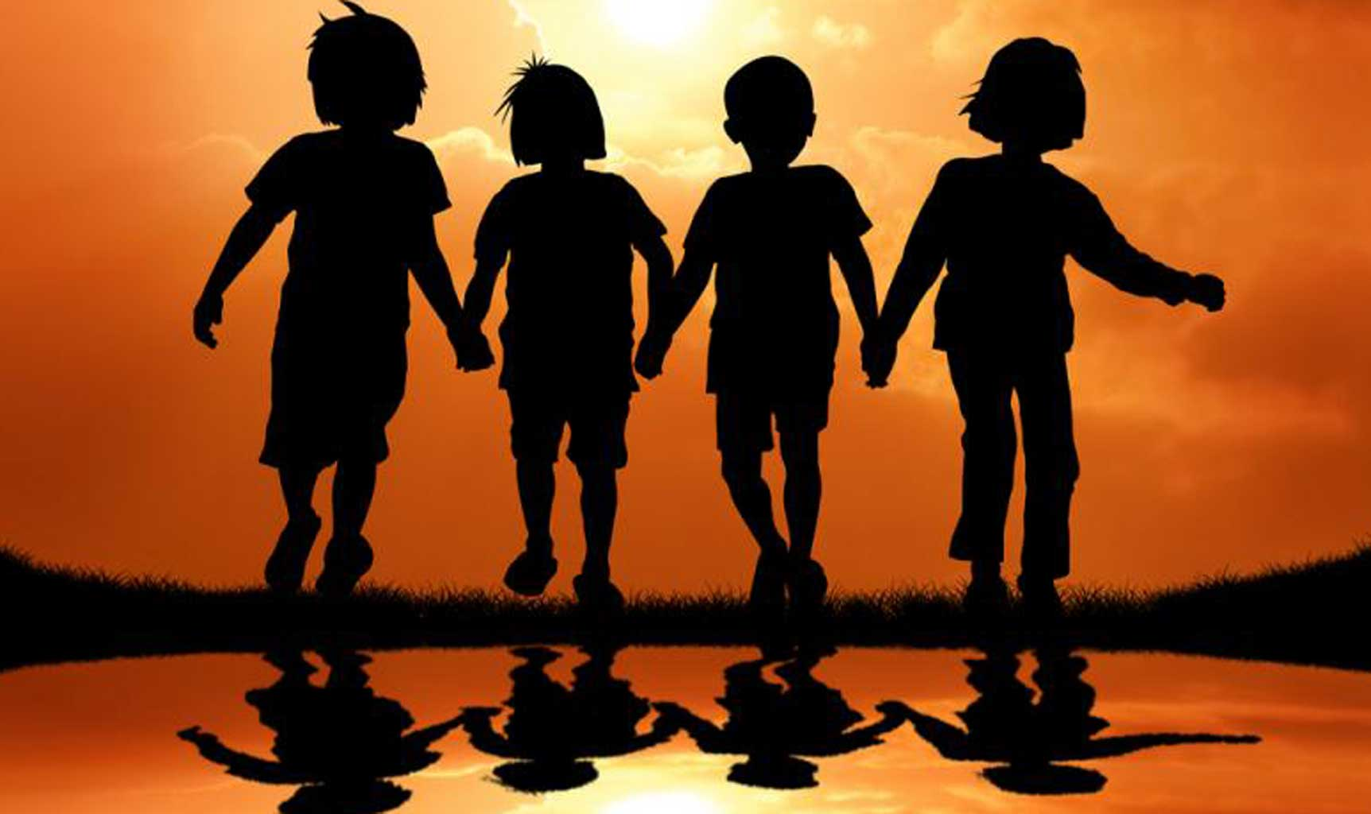
How do we show we are friends?

Slide 2
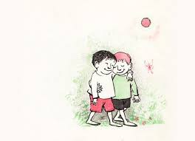
HOW TO BE
A GOOD FRIEND
To have good friends you must be a good friend. Here are some of the ways good friends treat each other:
• Good friends listen to each other.
• Good friends don't put each other down or hurt each other's feelings.
• Good friends try to understand each other's feelings and moods.
• Good friends help each other solve problems.
• Good friends give each other compliments.
• Good friends can disagree without hurting each other.
• Good friends are dependable.
• Good friends respect each other.
• Good friends are trustworthy.
• Good friends give each other room to change.
• Good friends care about each other.
https://www.brainpickings.org/2014/01/29/lets-be-enemies-maurice-sendak/

Slide 3
Luke 6:31
And as you wish that others would do to you, do so to them.
Proverbs 17:17
A friend loves at all times.
Proverbs 16:28 A dishonest man spreads strife,
and a whisperer separates close friends.
John 15:12-14 “This is my commandment, that you love one another as I have loved you.
Greater love has no one than this, that someone lay down his life for his friends.
You are my friends if you do what I command you.

Slide 4

Matthew 22:34-40 The Greatest Commandment
³⁴ When the Pharisees heard that he had silenced the Sadducees, they gathered together, ³⁵ and one of them, a lawyer, asked him a question to test him. ³⁶ ‘Teacher, which commandment in the law is the greatest?’ ³⁷ He said to him, ‘“You shall love the Lord your God with all your heart, and with all your soul, and with all your mind.” ³⁸ This is the greatest and first commandment. ³⁹ And a second is like it: “You shall love your neighbour as yourself.” ⁴⁰ On these two commandments hang all the law and the prophets.’

Slide 5
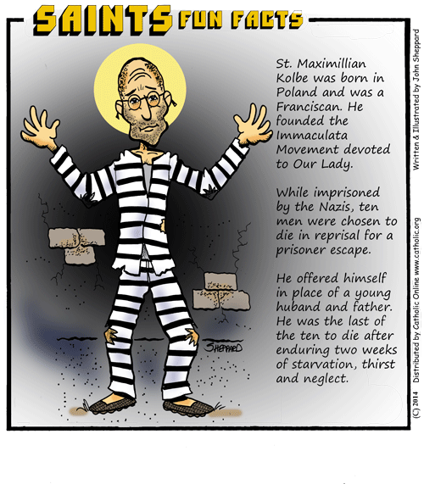

Slide 6
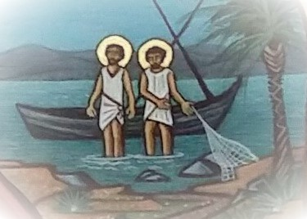
Matthew 4:18-22 Jesus Calls the First Disciples
¹⁸ As he walked by the Sea of Galilee, he saw two brothers, Simon, who is called Peter, and Andrew his brother, casting a net into the lake—for they were fishermen. ¹⁹ And he said to them, ‘Follow me, and I will make you fish for people.’ ²⁰ Immediately they left their nets and followed him. ²¹ As he went from there, he saw two other brothers, James son of Zebedee and his brother John, in the boat with their father Zebedee, mending their nets, and he called them. ²² Immediately they left the boat and their father, and followed him.

Slide 7


He said to him, ‘“You shall love the Lord your God with all your heart, and with all your soul, and with all your mind.” ³⁸ This is the greatest and first commandment. ³⁹ And a second is like it: “You shall love your neighbour as yourself.”

Slide 8
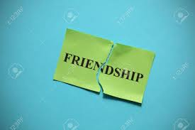
• don’t listen to each other.
• put each other down or hurt each other's feelings.
• don’t try to understand each other's feelings and moods.
• don’t help each other solve problems.
• don’t give each other compliments.
• disagree and hurt each other.
• aren’t dependable.
• don’t respect each other.
• are not trustworthy.
• don’t give each other room to change.
• don’t care about each other.

Slide 9
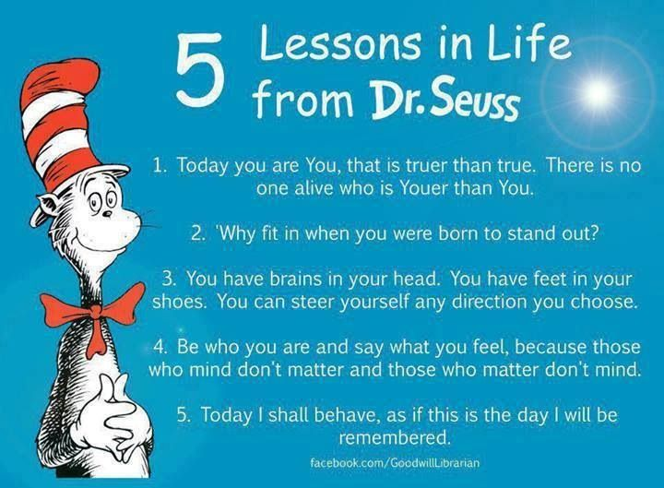

Slide 10
