Slide 1
Pope Francis Faith Award
Lord Jesus,
You ask those who believe in you
To give your Good News to others.
We pray that, with the help of the Holy Spirit,
Our words, actions and prayers
Will help other people
To hear of You,
To believe in You,
And to find the joy of knowing You.
Amen

Slide 2
Pope Francis Faith Award
Success Criteria
What do I need to do? | What evidence will I need?
I will use the gifts of the Holy Spirit when showing my love of God and my love of others in my daily life. | I will record my actions in my Faith Journal.
With the support of others, I will reflect on how my actions have made an impact on my journey of faith. | I will include some reflections on these actions in my Faith Journal and my P7 Personal Profile.

Slide 3







Pope Francis Faith Award

Slide 4
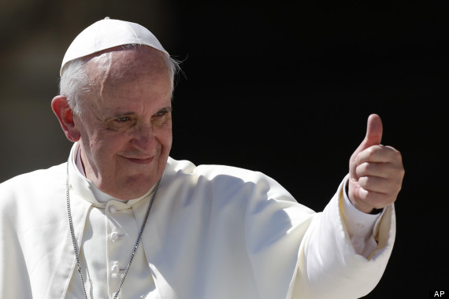
Pope Francis Faith Award
Gathering point 5 Fortitude
“Dear young people, do not bury your talents, the gifts that God has given you! Do not be afraid to dream of great things!”

Slide 5
Pope Francis Faith Award
Teacher note:
Teachers may use this power point in whatever way suits their class, and individual learners.
Time in which the gathering points are to be completed may be differentiated i.e., it may be of benefit to some learners to break each task into smaller activities.
It is important to have a timeline of when each GP will be started/completed to ensure that all learning and reflection is completed in time for submission for the award.

Slide 6
Pope Francis Faith Award
Learning intention
Explore the meaning of the word ‘fortitude’.
Listen to the Word of God, teaching us how fortitude can be used as a gift.
Challenge myself to an act of discipleship.
Learn
about the Gift of Fortitude
Reflect
to reflect on what Fortitude
means.
Act
to use Fortitude

Slide 7

Pope Francis Faith Award
‘Control your emotions when you feel under pressure from others to speak or behave badly.’
‘Explain your thinking patiently to someone whose language or actions has caused you offence.’
‘Challenge yourself to improve a new skill.’
‘Make a new friend.’
‘Explain your opinion honestly and patiently and allow others to do the same.’

Slide 8

Pope Francis Faith Award
Let us begin our time together
In the name of the Father
and of the Son
and of the Holy Spirit
Amen

Slide 9

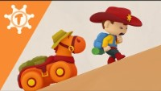

Pope Francis Faith Award
Can you explain what ‘Fortitude’ means?

Slide 10
Pope Francis Faith Award
Can you explain what ‘Fortitude’ means?
Fortitude is the gift of the Holy Spirit that helps us to be confident and say that we are disciples of Jesus.
A person with fortitude has the strength to stand up for what is right, even if it means being unpopular.

Slide 11

Scripture Time
Listen carefully as your teacher
reads the words of Scripture.

Slide 12
A Reading from the Gospel of Matthew
(14:25&27-29)
Between three and six o’clock in the morning Jesus came to the disciples, walking on the water. Jesus spoke to them at once. “Courage!” he said. “It is I. Don’t be afraid!” Then Peter spoke up. “Lord if it is really you, order me to come out on the water to you.”
“Come!” answered Jesus. So, Peter got out the boat and started walking on the water.

Slide 13
Scripture Time
Your teacher will read the words of Scripture again. This time in silence.
Listen for the key words and messages from this passage.

Slide 14

Scripture Time
Person 1 | Person 2
What makes someone courageous? | In the Gospel passage how does Peter show great courage?
Have you heard the saying: “Have the courage to stand up for what you believe in”? What does that mean? | Why do you think that sometimes people won’t stand up for what they believe in?
In the Gospel passage how does Peter show great courage? | Can you list ways that people show courage
Do you know anyone who has shown great courage? What did they do? Why did they do it? | Do you know anyone who has shown great courage? What did they do? Why did they do it?

Slide 15
Pope Francis Faith Award
Listen to our Gospel passage again.
This time imagine you are Saint Peter and Jesus invites you to walk on water.
Close our eyes and take time to reflect on our learning.
What do you say to Jesus?
What do you do?
How do you feel as you step out the boat
What causes you to be afraid and begin to sink?

Slide 16
Pope Francis Faith Award
Learning intention
Explore the meaning of the word ‘fortitude’.
Listen to the Word of God, teaching us how fortitude can be used as a gift.
Challenge myself to an act of discipleship.
Learn
about the Gift of Fortitude
Reflect
to reflect on what Fortitude
means.
Act
to use Fortitude

Slide 17
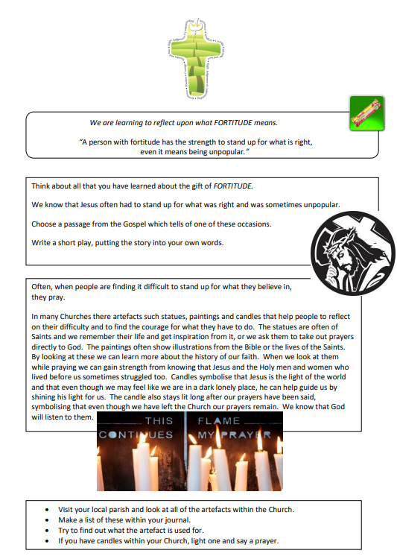
Pope Francis Faith Award
Think about all that you have learned about the gift of fortitude.
Choose a passage from the Gospel which tells of one of these occasions.
Write a short play, putting the story into your own words.

Slide 18
Pope Francis Faith Award
“A person with fortitude has the strength to stand up for what is right, even it means being unpopular.”
Answer the following questions in your journal for school, home, and parish:
Can you think of a time you needed God’s help to show fortitude?
Why was it important to use our gift of fortitude?
How can we use the gift of fortitude to serve others?

Slide 19
Pope Francis Faith Award
Reflection
Examination of Conscience

Slide 20
Pope Francis Faith Award
Think about all the times that we have made good decisions, loved God and others and done the right thing.
Think about the times when we made bad choices that we are not proud of.
Think about how not to do that again in the future.

Slide 21
Faith Prayer
Lord Jesus,
You ask those who believe in you
to give your Good News to others.
We pray that, with the help of the Holy Spirit,
our words and actions
will help other people
to hear of You,
to believe in You
to find the joy of knowing You.
Amen

Slide 22
Extension activity
Reflection
The following slides can be used to prompt children who are finished their play on slide 22. Answers can be recorded in their journal.

Slide 23
Extension activity
Reflection 1
Lord Jesus.
You ask those who believe in you
to give your Good News to others.
Read the part of our prayer above. Think about the questions below. Write your answer on the free pages of your journal.
1. How do I show others that I believe in Jesus?
2. How do I give the Good News to other people?

Slide 24
Extension activity
Reflection 2
We pray that, with the help
of the Holy Spirit,
our words and actions
Read the part of our prayer above. Think about the questions below. Write your answer on the free pages of your journal.
1. How are the words I speak inspired by the Holy Spirit?
2. How do my actions show God in the world to other people?

Slide 25
Extension activity
Reflection 3
….and prayers will help other people
to believe in You
Read the part of our prayer above. Think about the questions below. Share your thoughts on the free pages of your journal.
Do other people know God because of me?
Do they hear of God in what I say?
Do they believe in him from what I do?

Slide 26
Extension activity
Reflection 4
….and to find the joy of knowing You.
Read the part of our prayer above. Think about the questions below. Share your thoughts on the free pages of your journal.
How do I show others the beauty of God in the world?
How do I share the joy of having God as my friend?

Slide 27
Extension activity
Reflection 5
Examination of conscience
What could I do more of to share my faith?
How do I show my faith in school?
In what ways is my life at home filled with faith?
What do I do in my parish to show others I believe?

Slide 28
Pope Francis Faith Award
‘Control your emotions when you feel under pressure from others to speak or behave badly.’
‘Explain your thinking patiently to someone whose language or actions has caused you offence.’
‘Challenge yourself to improve a new skill.’
‘Make a new friend.’
‘Explain your opinion honestly and patiently and allow others to do the same.’

