Slide 1
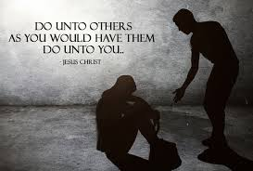
Prejudice, stereotyping and discrimination:
The Equality act 2010
Notes:
Consideration of words and image on the slide
Are they familiar with the words prejudice, discrimination and stereotypes? What understanding do they have of those terms?
How does this marry with the word equality?
What about the word Act in this context? We will be looking at law. We do we feel the need to pass laws on anything?
What about the image? Is that someone talking down to someone, and keeping them down? Or is it someone helping another person to their feet to stand beside them? Is this a good image to use in this context? Why/why not?
The text from Jesus Do unto others as you would have them do unto you: is that appropriate in this context? This is called The Golden Rule, and is an idea that recurs in all the major World Religions and in many other philosophies and belief systems. It is certainly a hugely important part of the teachings of Christ and of the Catholic Church.
Point out that it is NOT do unto others as they do unto you. It is not the same as an eye for an eye. If we are badly treated, it does not justify us in treating others badly. It is about setting and ideal; it reminds us that we are in control of our attitudes, words and actions; these should not be governed by others.
Teacher should sum up main points of discussion; these can then be recorded by pupils in jotters.

Slide 2

In this unit we will:
Analyse definitions of stereotype, prejudice and discrimination
Explore motivations for these
Look at how the Equalities Act tries to address these
Create Fact Files for how different groups have dealt with, and still deal with discrimination
Explore Christian stances on examining our behaviour in the face of discrimination, whether towards ourselves or towards others.

Slide 3
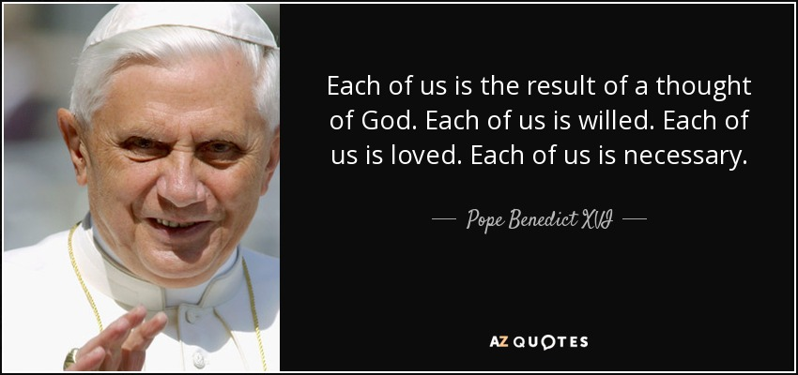
You will have seen this quote before.
Can you remember where?
Why do you think we would put it at the start of a unit which looks at prejudice and discrimination?
Bear this quote in mind throughout this unit . . .
Notes:
It is at the start of every unit in “Called to Love”. It is in a relationships unit because it reminds us of our innate value, dignity and worth.
This is true of us throughout our lives . And if it true of each of us, then it is true of all of us.
And it remains true.
It begins our unit on prejudice and discrimination to remind us that if we believe that all human beings are the work of God, then they have that innate value, dignity and worth. That does not change because we don’t like someone, or don’t approve of them.
The Christian call is to love of neighbour, and to treat others as we ourselves would like to be treated. To always remember that everyone we come across is just as made by God as we are ourselves.

Slide 4
Some definitions . . .
When we talk about discrimination, there are some words which come up over and over again. It helps the discussion, then, if we all know what we mean by these words.
STEREOTYPE
an overgeneralised belief about a particular group of people.
PREJUDICE
Prejudgement; an unjustified belief about a particular group of people.
DISCRIMINATION
Behaving in such a way as to deliberately advantage or disadvantage one group, or individual, over another group or individual, in the absence of any relevant differences.
Notes:
Each comes up separately . Ask pupils if they agree with definitions. Ask them if they can give examples. If they want to make changes, they can, so long as definitions are not inaccurate.
Emphasise the difference between prejudice being about our thoughts and attitudes, and discrimination, being about our words and actions.
Although we can make laws that punish discrimination (the way people act), we cannot pass laws that stop prejudice (the way people think).
And prejudice and discrimination often feed off one another.

Slide 5
“A new commandment I give you: love one another. As I have loved you, so you must love one another. By this will everyone know that you are my disciples.”
John 13:34-35
“Hold them in the highest regard. Live in peace with each other”
1Thess 5:12-13
“Be devoted to one another in love. In all things, honour one another above yourselves.”
Romans 12:10
In Scripture, and in the teachings of the Church, we are given very clear messages about how we should treat others. However, we know that sometimes people treat others badly, for any number of reasons. How do we as a society, and as a Church, deal with that?
“So, in all things, do unto others as you would have them do unto you. This sums up the Law and the Prophets.”
Matthew 7:12
Notes:
4 scripture quotes reminding us of the call to love our neighbor.
Particular emphasis to the bottom quote (Matthew 7:12). This is referred to as the Golden Rule: that we should treat others as we ourselves would hope to be treated.
If you had done something that upset or annoyed those you love, how would you want them to react?
Should they just not mention it? Do you let people get away with anything, just because you love them?
Should they talk about it with others behind your back?
Should they explain to you what has annoyed them, and ask you to change it?
Loving our neighbour doesn’t always mean liking them, or agreeing with them. But it does mean trying to understand them, and communicating with them, and treating them with dignity.
QUESTIONS FOR DISCUSSION:
Can you love someone you don’t like?
How do prejudice and discrimination feed off of one another?
Can you give examples of prejudice? (Really talking here about attitudes, and stereotypes)
Can you give examples of how that prejudicial attitude could lead to, or has led to, discrimination?
Do you have any thoughts on HOW we can deal with prejudice and/or discrimination?
FINAL POINT FOR EMPHASIS: THE GOLDEN RULE MAKES THE POINT THAT WE SHOULD TREAT OTHERS THE WAY WE WOULD LIKE THEM TO TREAT US; NOT THE WAY THEY DO TREAT US. IF SOMEONE TREATS US BADLY, IT DOES NOT MEAN THAT WE SHOULD DO THE SAME.

Slide 6

Equality Through Law
As a society, we hope that we can teach people that to be just and compassionate is best for us all. However, people will often base their attitudes on stereotypes and their own prejudice. We cannot use the law to control how people think or feel.
However, we can to some extent try to control the way people act and behave. We can try to affect the way that they are able to put their thoughts and attitudes into action. We can use the law to try to stamp out discrimination.
When it comes to protecting those who may be most vulnerable to discrimination, the law that is used is the Equality Act.
Notes:
Hopefully, this will be a short summary of the discussion from last three slides, in terms of the law.

Slide 7
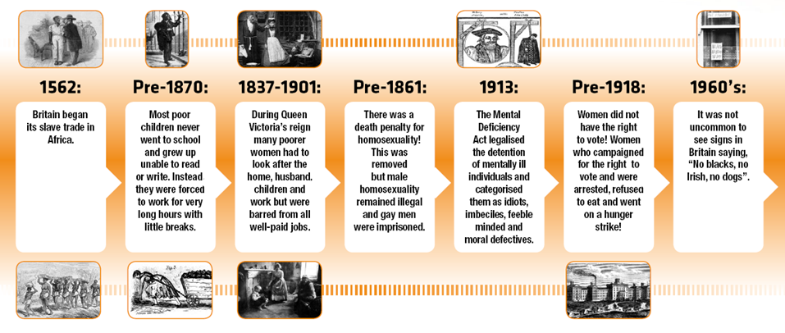
When Would You Like to Live?
Read the timeline on your worksheet.
Imagine you have to travel back in time to live in an era between 1562-1960’s.
Circle a time in which you would most want to live
Explain to your group why you would choose that time.
What would life be like then and how would it compare to life today?
Notes:
The Worksheet referred to is entitled “When Would You Like to Live?”
Pupils should read over the information. The idea is for them to realise that those groups we will look at when we come to examine the act are groups for whom, historically, legal discrimination was a fact of everyday life. If you have that discrimination as part of your history, then perhaps that makes you more aware than those who have never had to deal with it.
This may also lead into a discussion on “privilege”: a concept within sociology for examining social, economic, and political advantages or rights that are available to a group solely on the basis of their particular characteristic (e.g. male privilege; white privilege; class privilege). For example, if you have never been discriminated against because of a disability, and it has never touched you directly or indirectly, you may not think there’s anything wrong in parking in a disabled bay.
It also helps pupils to see that, although we talk a lot about prejudice and discrimination today, we have made great strides, legally and culturally.
Is it good that we focus so much on the differences between people?

Slide 8
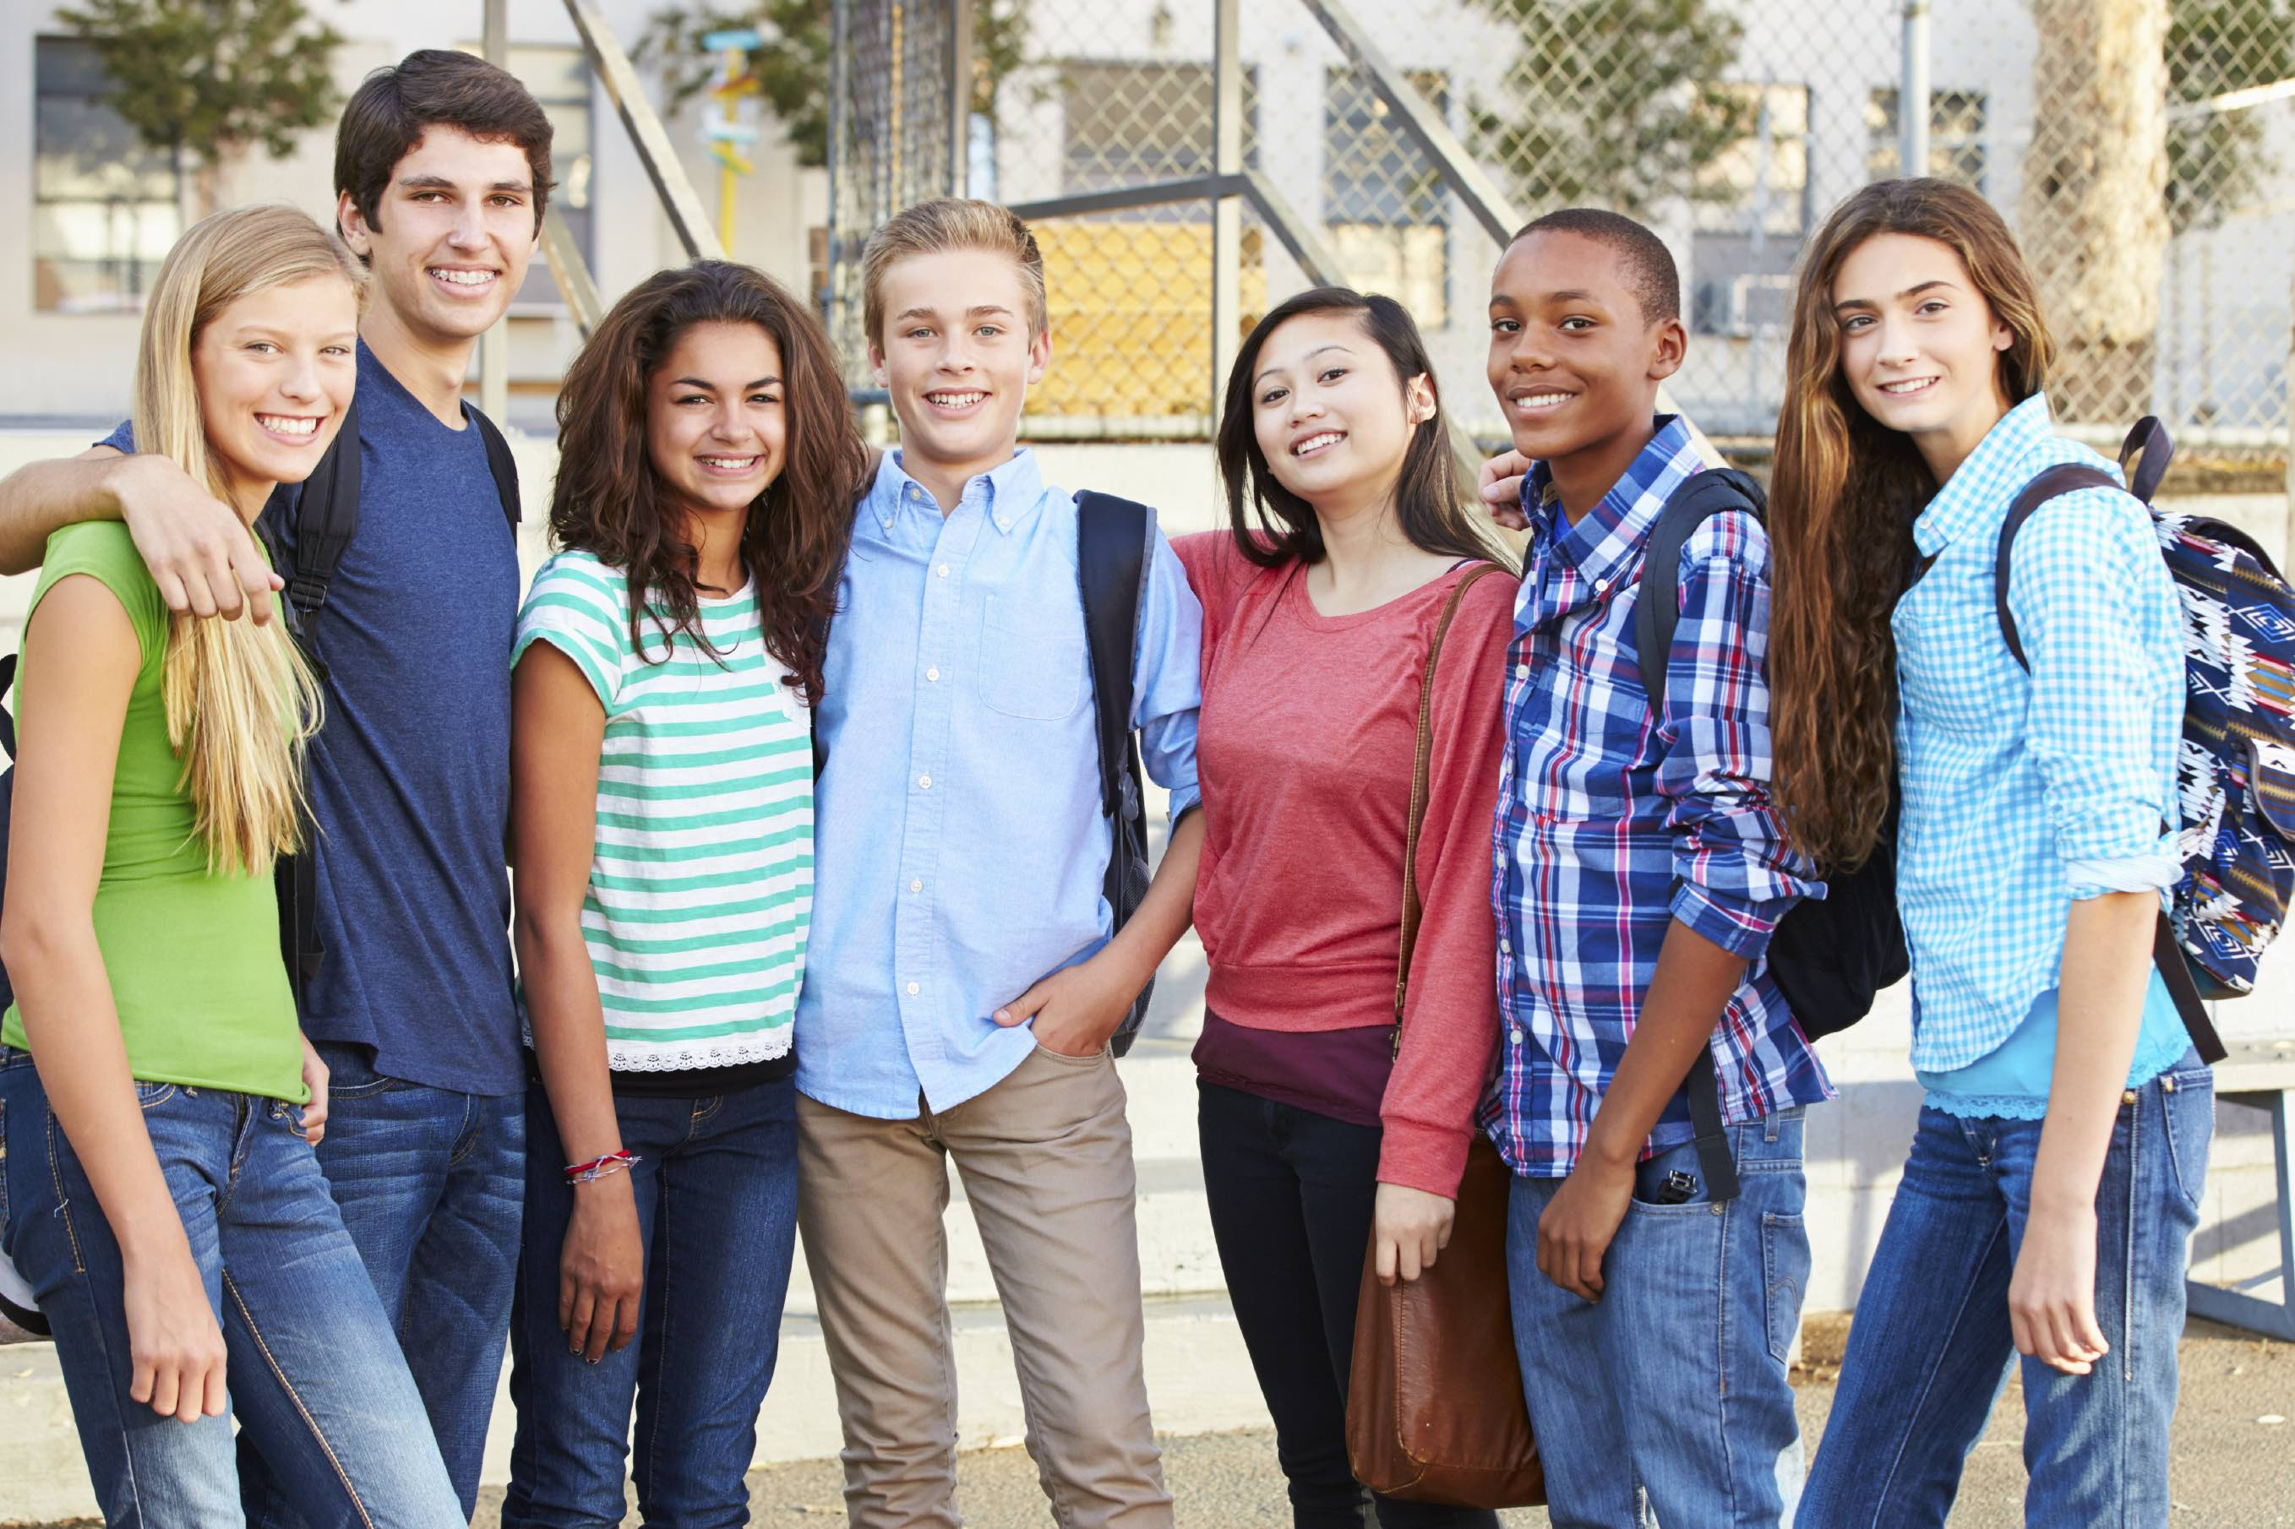
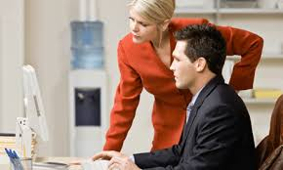


Equality Today?
There have been huge developments in equality over the years:
Figures show that the vast majority of us are happy studying, working and making friends with people from other ethnic minorities.
Some stereotypes about women, such as ‘a woman’s place is in the home’, have begun to fade.
There have been huge changes in attitudes and laws towards lesbian, gay, bisexual and transsexual people,
The rights of disabled people have stronger legal protection than ever before.
Notes:
Some changes that would be seen as poitive

Slide 9


However . . .
Recent figures show that 91% of hairdresser apprentices and 93% of childcare apprentices were women, while women made up only 3% of engineering apprentices and 2% of construction apprentices
Disabled adults are three times as likely to have no qualifications compared to non-disabled people.
LGBT students report far higher instances of being bullied in schools
In the 2010 election, only 27 out of 650 people elected to the UK Parliament were from ethnic minorities.
In a recent report, 3 out of 5 Nottingham Muslims said that they had been victims of hate crimes, and there was an increase of 500% in reported Islamophobic crime in Manchester after the Arena attack.
How can these inequalities still exist if we have so many laws on equality?
Notes:
SOURCES
Gender Segregation, Apprenticeship, and the Raising of the Participation Age in England: are Young Women at a Disadvantage? Alison Fuller and Lorna Unwin LLAKES Research Paper 44
Disability Stat – DFL survey, Key Facts https://www.dlf.org.uk/content/key-facts
LGBT - https://www.stonewall.org.uk/sites/default/files/the_school_report_2017.pdf
Poverty/race https://www.barnardos.org.uk/poverty_full_report_07.pdf
https://www.independent.co.uk/news/uk/home-news/muslims-nottingham-hate-crime-survey-islamophobia-racism-citizens-uk-a8341751.html
Think question:
Invite discussion on why the law is not stopping inequality:
Law can’t change people’s prejudices
Laws take time to work and change the culture
Laws only work where they are followed
Laws are only followed if they’re known
How easy is it for people to report that they have suffered discrimination, and what are the chances of things improving for them if they do?
Although the statistics show inequality, perhaps they also represent an improvement from recent times; perhaps figures would have been even worse a year or two prior to these surveys

Slide 10
Speed chat - stage 1
To your first partner, complete this sentence:
“When I think of equality, I think of ___________”
To your next partner, complete this sentence:
“When I think of inequality, I think of ___________”
Notes:
Pupils should be arranged so that they can work with one partner, then move to another. At each stage of the task, pupils will be working in pairs.
First statement: First speaker of the pair can talk for a set, short time (recommend one minute; no more than two) to complete the sentence. Other pupil listens
.
Listener now gives their own answer; person who spoke first now listens.
Change partners: repeat task with second statement

Slide 11
Speed chat - stage 2
Now think about your own experiences of being treated unfairly and
complete these sentences.
To your first partner, complete this sentence:
“It is unfair when ____________ , this makes me feel _____________”
To your next partner, complete this sentence:
“It is fair when ___________ , this makes me feel ______________ ”
Notes:
Complete task as for previous slide, using these two new statements.
When all 4 statements have been addressed, take pupil feedback on what was said.
How does it make us feel when we are treated unfairly? How does it impact our behaviour?
What does this do to the Common Good?
Leads into next slide

Slide 12
Equality / Inequality
Were your feelings or descriptions more positive when you described equality / fairness or inequality / unfairness?
When we experience discrimination and are not treated equally it can lead to many negative consequences. How many consequences of unfairness or inequality can you think of?
  Unhappiness
  Under achievement
  Low self-confidence
  Unemployment and poor education
  Poor relationships
  Exclusion.
Notes:
Ask pupils to give some of the consequences of people being treated unjustly – whether for the person themselves, or for the culture that it builds in society
As an example – shops that will not allow young people to go in, or only to go in if there are under a certain number of them.
- Can you understand why they do that?
- How does it make you feel if you are refused entry to a shop in front of you friends, etc?
- How does it make you feel, even if you yourself have never been refused entry?
- How does it make other customers feel about young people?
How do the positive outcomes of that decision weigh up against the negative outcomes? What does it do for feelings/relationships in the community?

Slide 13

Tackling inequality
Over the years, laws have been introduced to tackle discrimination and to help ensure that all people are treated fairly.
These laws are called civil laws.
Civil law mostly involves disagreements between people, companies or other organisations. It is enforced by one person suing another person or corporation and the case will end up in a civil court.
Criminal laws, however, are enforced by the police and the courts, and if they are broken you can face very serious consequences, including time in prison.
Notes:
Using the law to tackle inequality.. Difference between Civil Law and Criminal Law

Slide 14
Anti-discrimination laws timeline
Slavery Abolition Act 1833:
Abolished slavery throughout the British Empire.
1918 Representation of the People Act:
Gave women of property over the age of 30 the right to vote – not all women could vote. It took until 1928 for women to have the same voting rights as men.
Equal Pay Act 1970:
Made it unlawful for there to be less favourable treatment between men and women in terms of pay and conditions of employment.
Notes:
This slide and the two following show a timeline of some of the major laws passed in Britain since 1833 to try to deal with social inequalities and a lack of civil rights for some people.
Read through the various boxes, and ask pupils who is benefitting, remembering always to look at the impact upon society and the Common Good. For example – Does the 1918 Representation of the People Act only benefit “women of property over the age of 30”? Does it benefit all of us if MPs have to now consider areas thought in the past to have been “women’s issues”? Do we all benefit if our MPs have to please more people in order to get votes? Once “women of property over the age of 30” have managed to win the vote, what does that say to other groups who don’t have the vote?
Notice the time span here. It takes 137 years to bring these laws. However, when people begin to realise that change is possible . . . (next slide)

Slide 15
Anti-discrimination laws timeline
Race Relations Act 1976:
Prevents discrimination because of race in employment, the provision of goods and services, education and public functions.
Sex Discrimination Act 1975:
Protects men and women from discrimination because of sex or marriage in employment, training, education, provision of goods and services, and the disposal of premises.
Disability Discrimination Act 1995:
Prevents discrimination against people because of disabilities in employment, the provision of goods and services, education and transport.
Notes:
. . .it takes only 20 years to pass the next 3 (again, read through and discuss who benefits) . . .

Slide 16
Anti-discrimination laws timeline
The Employment Equality (Sexual Orientation) Regulations 2003:
Made it unlawful to discriminate because of sexual orientation in employment.
The Employment Equality (Age) Regulations 2006:
Made it unlawful for employers to discriminate against employees because of age.
The Equality Act (Sexual Orientation) Regulations 2007:
Made it unlawful to discriminate because of sexual orientation in the provision of goods, facilities, services, education and public functions.
The Employment Equality (Religion or Belief) Regulations 2003: Made it unlawful to discriminate because of religion or belief in employment.
Notes:
. . . and only 4 years for the next 4 (again, read over and discuss . . .)
It would seem that the more we talk to and engage with one another, the more aware we become of each other’s concerns, and more we are able to make changes and empower others.

Slide 17
Equality Act 2010
The Equality Act 2010 brings together all previous equality laws.
It makes it law that every private, public and voluntary sector must not discriminate against employees and service users based on particular characteristics
So, if they discriminate against their employees or service users, they could be breaking the law.
Notes:
The next big change on the timeline would the Equality Act 2010.
Main elements outlined on this and next three slides.

Slide 18

Equality Act 2010
It also makes it law that public bodies, like schools, must encourage good relations and ensure everyone has equality of opportunity.
This helps to make sure everyone has an equal chance to make the most of their lives and talents.

Slide 19
Equality Act 2010
The Equality Act aims to make sure that people with certain characteristics are protected from discrimination.
What groups of people commonly experience discrimination?
What characteristics do they share that result in people treating them unfairly?
Religion or belief
Sexual orientation
Gender reassignment
Age
Sex
Disability
Marriage & Civil Partnership
Race
Pregnancy and maternity
Notes:
Bullet point 2 – ask pupils to name groups whom they know suffer discrimination
Bullet point 3 - these groups are often relatively small groups compared to the overall population
- they may not have a clear body who stands up for them and represents them
- they have probably suffered discrimination of one type or another for many years
- etc . . . .
The titles on the slide are the PROTECTED CHARACTERISTICS under the 2010 Equality Act..
These, and the main points of the Act, are on the EQUALITY ACT 2010 FACT SHEET which is available with this resource.. This should be issued to all pupils .

Slide 20
Examples
It is likely, therefore, to be unlawful discrimination if:
  A teacher tells a girl not to take a course in engineering as it is unsuitable for a female (Protected characteristic – sex).
  A school refuses to provide resources that a disabled child needs to study and achieve (Protected characteristic – disability).
  A company refuses to employ a man because they discover he is gay (Protected characteristic – sexual orientation).
Any individual who believes that they have been discriminated against, harassed or victimised can make a claim under the Equality Act 2010.
Notes:
Give pupils a chance to look over the Fact Sheet. They are about to be asked to do a Quiz.
SLIDES 22 – 31 ARE THE QUESTIONS; SLIDES 32 – 42 ARE THE ANSWERS

Slide 21
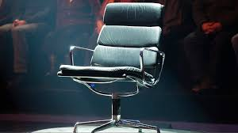
Equality Masterminds
You are going to work in groups as equality quizmasters.
10 quick fire questions about the Equality Act 2010 - worth 10 points!
You will have 5 mins to review the Equality Act 2010 fact sheet in advance.
All fact sheets must then be put away!
Notes:
SOURCE:
Quiz from Equality and Human Rights Commission https://www.equalityhumanrights.com/en/lesson-plan-ideas

Slide 22
Question 1
What year was the Equality Act introduced?

Slide 23
Question 2
The Equality Act makes it law that certain organisations and individuals must not discriminate against people with protected characteristics. To which organisations does this apply?
A – Private
B - Public
C – Voluntary
D - All

Slide 24
Question 3
Is a state school a private or public organisation?
A - Private
B - Public

Slide 25
Question 4
The Equality Act protects people with particular characteristics from discrimination.
Name three of the characteristics which are protected by law.

Slide 26
Question 5
Is hair colour a protected characteristic?

Slide 27
Question 6
Are children and young people in school protected against age discrimination?
A - Yes
B - No

Slide 28
Question 7
Positive Action is acting in a way that treats all groups of people in the same positive way.
A - True
B - False

Slide 29
Question 8
Which of the below is the odd one out? Public bodies have a duty under the Equality Act to:
A - Advance equality of opportunity
B - Promote good relations
C - Offer a lawyer to every employee
D - Eliminate discrimination

Slide 30
Question 9
Provide one example of how a school can make sure everyone has equal opportunities.

Slide 31
Question 10
Provide a definition of unlawful discrimination.

Slide 32
Answers...
No cheating!

Slide 33
Question 1
What year was the Equality Act introduced?
2010

Slide 34
Question 2
The Equality Act makes it law that certain organisations must not discriminate against people with protected characteristics. To which organisations does this apply?
D - ALL

Slide 35
Question 3
Is a state school a private or public organisation?
B - Public

Slide 36
Question 4
Name three of the characteristics which are protected by law.
  Age
  Disability
  Gender Reassignment
  Marriage and civil partnerships
  Pregnancy and maternity
  Race
  Religion or belief
  Sex
  Sexual orientation (Gay, lesbian or bisexual)

Slide 37
Question 5
Is hair colour a protected characteristic?
No!

Slide 38
Question 6
Are children and young people in school protected against age discrimination?
No!

Slide 39
Question 7
Positive Action is acting in a way that treats all groups of people in the same positive way.
B – False
Positive Action enables public bodies to provide additional benefits to some groups of people to tackle disadvantage

Slide 40
Question 8
Which of the below is the odd one out? Public bodies have a duty under the Equality Act to:
C – Offer a lawyer to every employee

Slide 41
Question 9
Provide one example of how a school can make sure everyone has equal opportunities.
For example, providing football lessons for girls and boys or making sure students of all races and religions understand beliefs and religions different to their own
Notes:
Pupils can provide other examples. Anything that would fall within the Act would be acceptable.

Slide 42
Question 10
Provide a definition of discrimination.
Treating someone unfairly because of their protected characteristics
Notes:
This definition is specific to the Act. Pupils may also use the definition given on slide 4, which gives a wider definition.

Slide 43
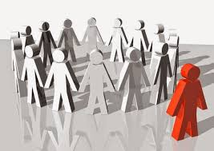
Research Task
Looking at Discrimination
“ . . . and there are no more distinctions between Jew and Greek, slave and free, male and female, but all of you are one in Christ Jesus.” Galatians 3:28
Notes:
Take some time to look at the quote from St Paul’s letter to the Galatians.
In this letter, Paul is talking to a fractured community who are arguing about whose law should be followed. Paul tries to make clear to them the benefits of living by the teachings of \Christ, and asks them to decide which is better. He talks about how we are all united under Christ.
This would be a good point then to remind pupils about the quotes used earlier from Pope Benedict (Slide 3) and from Matthew’s gospel (Slide 5)

Slide 44
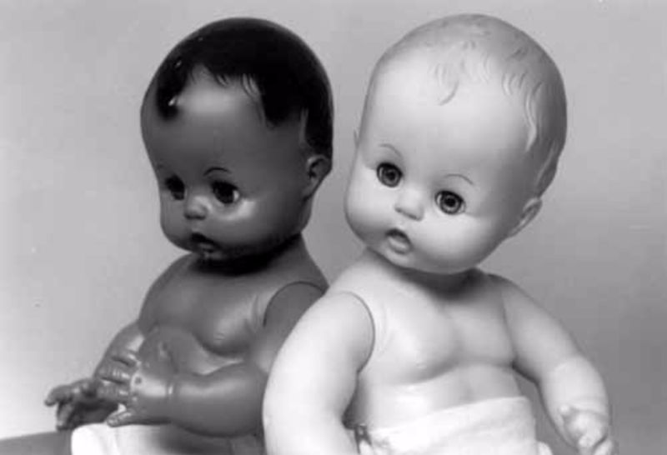
“Prejudice is a learned trait. You’re not born prejudiced; you’re taught it.” Charles R. Swindoll
Watch the video clip. It shows a number of different versions of the Clark Doll Test.
What struck you most about the children’s reactions?
Why?
Where do you think these attitudes came from?
What impact do they have?
Notes:
Click on photo of dolls takes you to hyperlink https://www.youtube.com/watch?v=fRJrg-WTpYs Allow pupils to watch the clip without giving background
In the 1940s, psychologists Kenneth and Mamie Clark designed and conducted a series of experiments throughout the USA known colloquially as “The Doll Tests” to study the psychological effects of segregation on African-American children.
Drs. Clark used four dolls, identical except for colour, to test children’s racial perceptions. Their subjects, children between the ages of three to seven, were asked to identify both the race of the dolls and which colour doll they prefer. A majority of the children preferred the white doll and assigned positive characteristics to it. The Clarks concluded that “prejudice, discrimination, and segregation” created a feeling of inferiority among African-American children and damaged their self-esteem.
Points to start/grow the discussion:
What do you notice about the responses? – Almost all children attribute positive characteristics to the white doll and negative characteristics to the black doll – even the black children
Responses refer not only to questions about appearance, but assumptions are made based on appearance (ie not just which is the black doll/ pretty doll, etc, but which is the smart doll, which is the bad doll; which kid would you like to play with, etc . . .)
Are these responses based on childrens’ own experiences, do you think? What are the other influences?
What about the age of the clips? How do attitudes in the more recent clips differ from/reflect those in the older clips? How much of a difference do you see?
The black children often identified the back doll as “dumb”, or “ugly”, or “bad”, yet also identify it as the one “most like you”. What does this tell us about the impact of discrimination on those who suffer it?
How do the children feel about their views? Are they ashamed? Embarrassed? Proud? Unperturbed? Matter-of-fact?
How does this make you feel? How would you relate it to the quotes from Matthew’s Gospel/ St Paul’s letter to the Galatians/ Pope Benedict?

Slide 45
Research Task
In order for us to be able to talk about and deal with prejudice and discrimination, we have to try to understand:
Where it comes from (the historical context)
Who suffers, and why
The effects of prejudice and discrimination on those who suffer, both overt (eg. laws and restrictions) and covert (e.g. impact on self-esteem, ambition and achievement, etc.)
Has there been a change in social attitudes? How do we know?
You are going to be asked create a Fact File looking at the prejudice and discrimination against a group who are now protected under the Equality Act. Why do they need this protection?

Slide 46

Recap: Protected Characteristics
Age
Disability
Gender Reassignment
Marriage and Civil Partnership
Pregnancy and Maternity
Race
Religion or Belief
Sex
Sexual Orientation
Notes:
Recap on Protected Characteristics
Discuss what each of these mean

Slide 47
Research Task (cont.)
With your group, you will put together a brief Powerpoint to inform the class about the impact of discrimination in one of the protected characteristics. Your group will also be asked to complete an A3 poster, using the FactFile template, for display in the class. Your presentation/poster must cover the following areas:
A historical context (where does the discrimination come from?);
What does the Church teach us?
Some examples of what form it takes (what the discrimination looks/sounds like);
Important events/people who highlighted the discrimination;
Testimony from those who have suffered discrimination;
Has there been a change in social attitudes? How do we know?
Notes:
Pupils to be asked to work in groups to research one particular Protected Characteristic and to produce
- a Powerpoint presentation
- an A3 poster for classroom display
on their allocated Characteristic (chosen by teacher), which covers all the headings given.
Teacher will now take them through an exemplar presentation based upon the characteristic of Sexual Orientation

Slide 48
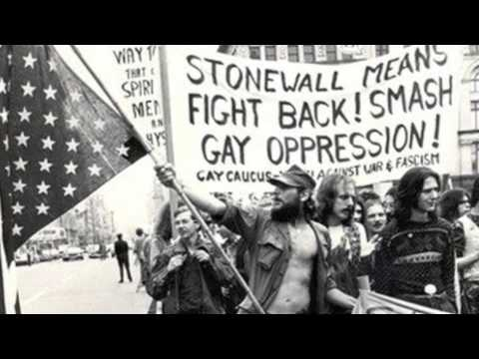
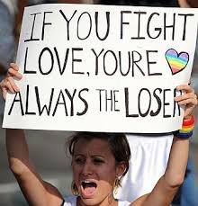
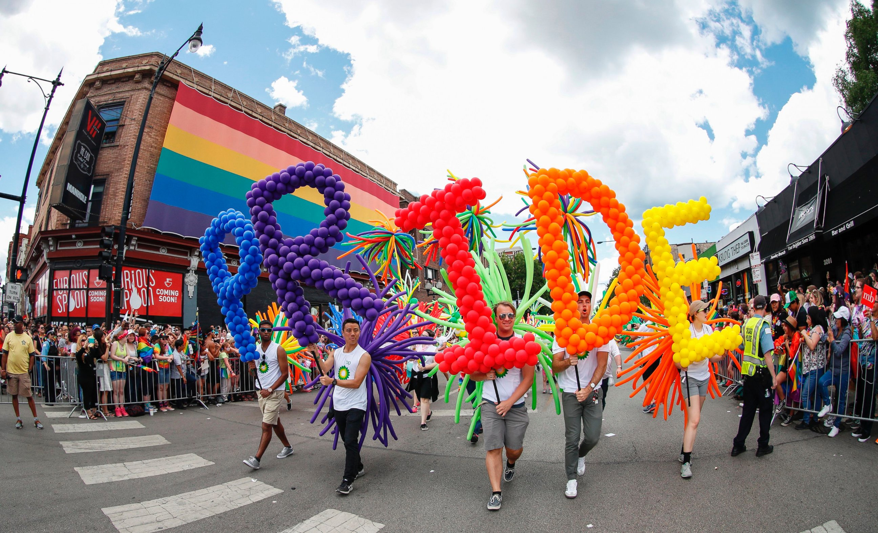
An Example . . .
Sexual Orientation:
A Protected Characteristic

Slide 49
FYI – some definitions
Homosexual – Sexually attracted to people of one’s own sex
Bisexual - Sexually attracted not exclusively to people of one particular gender; attracted to both men and women.
Homophobia - Dislike of or prejudice against homosexual people.
Biphobia - Dislike of or prejudice against bisexual people.
Notes:
Definitions taken from https://en.oxforddictionaries.com

Slide 50



FACT FILE: SECTION 1
Historical context

Slide 51
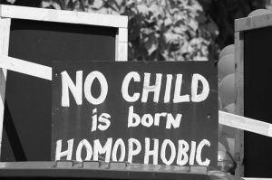
Historical Context
Many people feel very awkward and embarrassed talking about sex at all, never mind their own sexual orientation.
For many, many years society seemed to operate on the understanding that everyone was heterosexual. That has made it doubly difficult for people who felt same-sex attraction to be open about their feelings.
Many, many people fall into the category of being gay or bisexual, but they are still a minority of the population. Like all minority groups, they can often become the target of prejudice and discrimination from others, particularly those who don’t understand same sex attraction, or have never knowingly come into contact with gay people within their own family, friends, colleagues or social circle.
This lack of understanding has given rise to situations where gay or bisexual people’s rights and opinions have not been considered or taken into account, and where the law has set out to punish them for being themselves.
Notes:
Literally just a bit of background to set the scene.
In doing their research, pupils should be encouraged to look at the timelines in slides 14, 15 and 16, and to look at the “When Would You Like to Live?” worksheet they completed with Slide 7
It may be worth pointing out to pupils that while much of this is actually true for transsexual people too, the Protected Characteristic we are looking at in this exemplar is Sexual Orientation, and not Gender Reassignment.

Slide 52

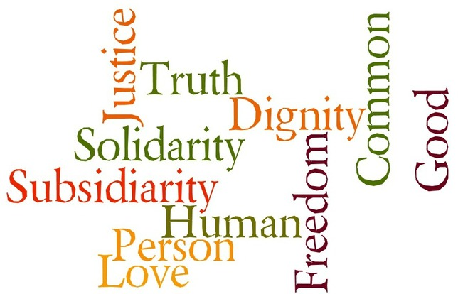
FACT FILE
SECTION 2
What does the Church teach us?
Notes:
The images show a copy of the Catechism of the Catholic Church, and a graphic outlining the principles of Catholic Social Teaching
Remember that this is simply an exemplar for the Fact File. This is not a lesson human sexuality; our focus in this unit is on equalty, prejudice and discrimination.

Slide 53
What does the Church teach us?
The teaching of the Church is that sex belongs within the commitment to the whole person found within the sacrament of marriage, and that it should be open to the gift of children.
However, the Church also teaches that although God made us sexual beings, there is more to a person than that. It teaches us to consider the whole person, and that all people are the work of God and should be treated with the dignity that deserves.
The Catechism of the Catholic Church is very clear on its stance regarding treatment of people of differing sexual orientations. In paragraph 2358 we find this statement about homosexual people:
“They must be accepted with respect, compassion, and sensitivity. Every sign of unjust discrimination in their regard should be avoided.”
(Catechism of the Catholic Church, #2358)
Notes:
In their own research, remind pupils that they are looking at prejudice and discrimination. They may not find much from Church teaching on disability, for example, but they will find a great deal on the sanctity of human life and on the innate dinity of the human person.

Slide 54
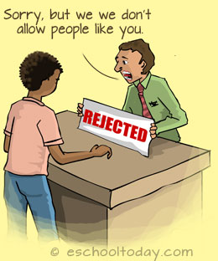

FACT FILE:
SECTION 3
What form does it take?
Notes:
This heading invites pupils to engage with more recent research and with reportage on how prejudice is put into action through discriminatory behaviour.

Slide 55

What Form Does It Take?
Prejudice against LGBT people may take many forms:
Name calling
Violence towards people who are LGBT
Different laws regarding sexual behaviour : Sex between men was illegal until 1967, when the Sexual Offences Act came into force making it legal for men aged 21 or above. In 1994 that age was lowered to 18 and in 2001 it was lowered again to 16 – making it the same as the age of consent for heterosexual people.
Discrimination at Work: e.g.LGBT people were not allowed to join and serve in the British Armed Forces until January 2000, and employers were allowed to discriminate on the basis of sexual orientation until 2003
Notes:
Photo shows BLAIR WILSON, a young man from East Renfrewshire, who was the victim of a homophobic attack in July 2018, and posted a defiant selfie:
https://www.bbc.co.uk/news/uk-scotland-glasgow-west-44820921
He then was mentioned by Nicola Sturgeon at Glasgow Pride, who congratulated him for his “dignity, courage and compassion . . .”
https://www.bbc.co.uk/news/uk-scotland-glasgow-west-44846416

Slide 56
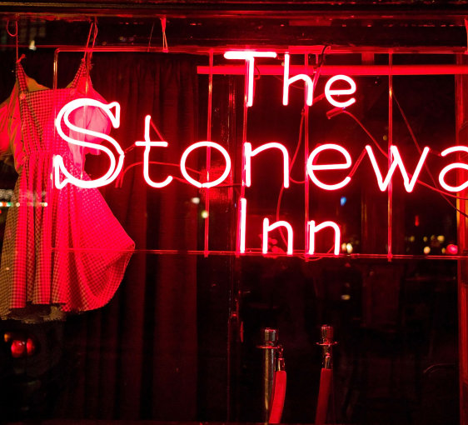
FACT FILE: SECTION 4
Important events/people
Notes:
As part of their research, pupils should find at least one event/person central to highlighting the particular issue they are researching,.
They should give some background to that person/event, and be able to recount the story and evaluate the impact.
For this exemplar we are using The Stonewall Riots, which took place in New York in 1969
In the Resources pack for this lesson you will find a set of notes for a lesson from the Stanford University’s Stanford History Education Group’s “Read Like A Historian” resource. https://sheg.stanford.edu/history-lessons This is a lesson designed to help pupils engage with historical research and develop the skill of analysing and interrogating sources.
There is a lesson on the Stonewall Riots. You do not have to use it to teach this unit, but you may wish to use it:
- to augment this lesson
- to use as a resource to increase your own knowledge of the topic
- to give to your own History/Social Subjects Dept to use as a possible IDL link for pupils doing this unit in RE/PSE
NB. WITH THE DOCUMENTS FOR THE STANFORD LESSONS, THERE ARE 2 SETS OF SOURCES. ONE HAS THE FULL FORM OF THE SOURCE, AND ONE HAS EXCERPTS. YOU MAY WISH TO USE THE FULL SOURCES AS TEACHER MATERIAL, AND USE ONLY THE EXCERPTS WITH PUPILS.

Slide 57
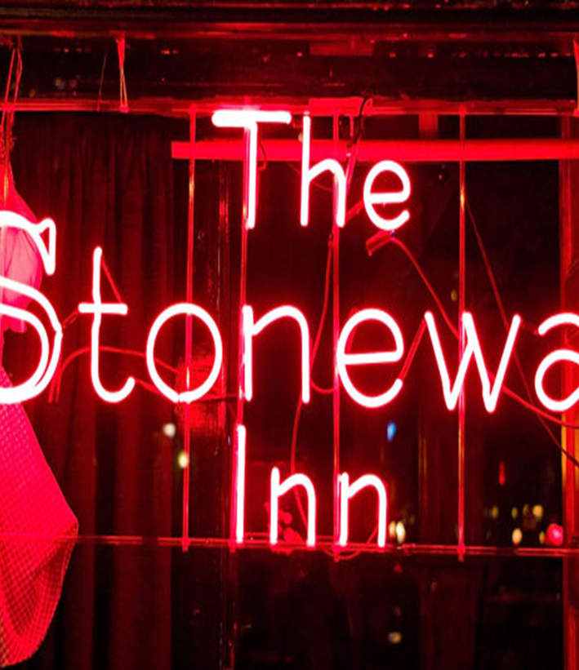
Important Events/People
An important event in the history of LGBT rights was a series of protests called The Stonewall Riots, which took place at a club used by the community in New York called The Stonewall Inn.
Police raided the club in the early hours of June 28th 1969. The raid sparked a riot among bar patrons and neighborhood residents as police roughly hauled employees and patrons out of the bar, leading to six days of protests and violent clashes with law enforcement.
The Stonewall Riots served as a catalyst for the gay rights movement in the United States and around the world.
Notes:
Background to the event
Clicking on image will take you to the History Channel Page, where there is a 4 minute video entitled “How the Stonewall Riots sparked a movement”
https://www.history.com/topics/the-stonewall-riots/videos/how-the-stonewall-riots-sparked-a-movement-riots
Pupils should watch clip, Then teacher leads a discussion to guage reactions.

Slide 58
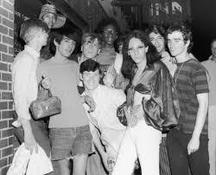
FACT FILE: SECTION 5
Testimony from those who have suffered
discrimination:
Tommy Lanigan-Schmidt
Notes:
Clicking on image will take you to a video hosted on Youtube. If you do not have access to Youtube, the video is available on SCES website. The URL is https://www.youtube.com/watch?v=ywtvJyXDWkk
The video is from The Obama Whitehouse, and is voiced by former US President Barack Obama. It was made to mark the decision to make the Stonewall Club and the area around it as a National Monument because of what happened there. One of the people interviewed is Tommy Lanigan-Schmidt, who was there the night of the raid and the riots.
Again, pupils should watch the video and then have time to discuss reactions.
It may be worth asking them to compare the scene outside the Stonewall in the first video (violent rioting) with the same street in the second video, with flags and a speech from the president, especially remembering that there were only 47 years between the two events – a relatively short time, as we have seen, in which to turn around a culture. The inauguration speech shown in the video, where he is cheered for mentioning Stonewall, was three years earlier, in 2013.
What is their reaction to the testimony of Tommy Lanigan-Schmidt, and to that of the other activists who are interviewed?

Slide 59
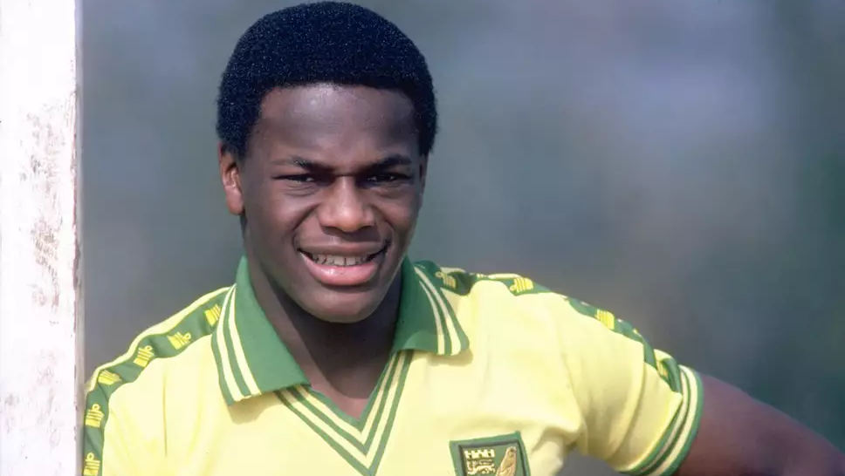
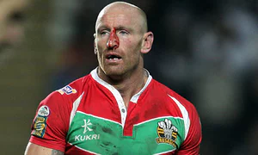
FACT FILE: SECTION 6
Has there been a change in social attitudes?
How do we know?
Notes:
Images are (top) Justin Fashanu, very successful top league footballer who was also capped for his country. He came out as gay in 1990, the first professional footballer in Britain to do so
(bottom) Gareth Thomas, professional rugby player in both Rugby League and Rugby Union at club and national level, who recently came out as gay.

Slide 60
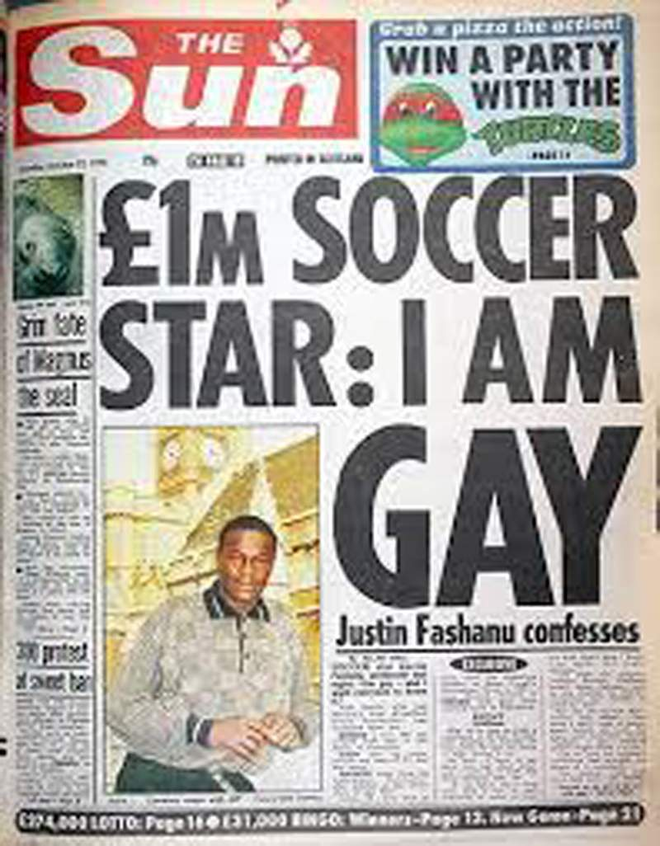
It would seem that there has been an improvement in social attitudes towards LGBT people in Britain and in many other countries.
In 1967, the law was changed so that homosexuality was no longer illegal in Britain. While this was a major change, it did not necessarily change social attitudes. This is a front page taken from The Sun newspaper in 1990:
Justin Fashanu was a hugely successful footballer in the late 80s and early 90s. His brother, John, was also a professional footballer, but not quite so successful as his brother. The two boys had been taken from their mother and siblings and lived with foster parents.
When word began to spread that Justin was being seen in gay clubs, his brother was so ashamed that he offered him £75,000 to keep quiet. John also admitted that he was scared that, because they were both “J.Fashanu”, people might think that he was also gay.
After Justin came out his career nosedived: he played for 20 lower division clubs over the next 7 years and committed suicide in 1997. His brother said that homophobic abuse was a factor.
Notes:
https://www.telegraph.co.uk/football/2018/04/18/john-fashanu-paid-late-brother-justin-75000-not-reveal-gay/
This link will take you to an article in which John Fashanu discusses his reactions to his brother’s life and sexuality, and how different that would be now.
Emphasise the use of the word “confesses” on newspaper front page. Remember that this is less than 30 years ago

Slide 61

Gareth Thomas is a Welsh rugby professional who has represented his country in both rgby union and rugby league. He came out as gay in 2009, and retired from rugby in 2011. He now does a lot of work in the media, writing and presenting on sports, and has appeared on Dancing on Ice and Celebrity Big Brother.
"It's been really tough for me, hiding who I really am and I don't want it to be like that for the next young person who wants to play rugby or some frightened young kid.
"I don't know if my life is going to be easier because I'm out but, if it helps someone else, if it makes one young lad pick up the phone to ChildLine, then it will have been worth it. My parents, my family and my friends all love me and accept me for who I am and, even if the public are upset by this, I know the love of those people who mean the most to me will never change.
"I'm not going on a crusade but I'm proud of who I am. I feel I have achieved everything I could ever possibly have hoped to achieve out of rugby and I did it being gay. I want to send a positive message to other gay people that they can do it, too."
Notes:
Quote taken from: “Gareth Thomas Comes Out as Gay”, from The Guardian, 19.12.2009, https://www.theguardian.com/sport/2009/dec/19/gareth-thomas-gay
Worth mentioning that this story was in the Sports section of the newspaper; not the front page. It is not seen as shocking news, the way that Justin Fashanu’s announcement was, and certainly is not treated as a “confession”! A huge difference in tone for only 19years apart.
Ask pupils to comment on the different tones of these two pieces. What does this tell us about societal attitudes? Notice that in the Sun article, the word “gay” is the focus, in large print. In the Attitude front page, it is his name that is the focus, and the word “gay” gets no more emphasis than the words “rugby superstar”.
Also, this is a magazine that markets itself as a gay lifestyle magazine. This itself would have been considered outrageous within Justin Fashanu’s lifetime.
Do they notice anything that hasn’t changed across the two articles? For example, Gareth Thomas himself acknowledges that he may get a bad reception from some people because he has come out.(“I don’t know if life is going to be easier . . .”; “ . . .even if the public are upset by this . . .”) He also refers to how difficult it is for young people to be open about their sexual orientation or homophobic abuse (“If it makes one young lad pick up the phone to Childline . . .”). He clearly feels that life as an openly gay person, even one who is very successful, brings real challenges that heterosexual people don’t face (“I’m not going on a crusade . . . that they can do it, too.”)

Slide 62
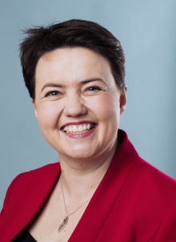
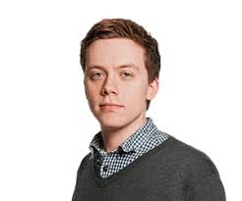
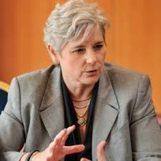
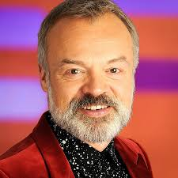
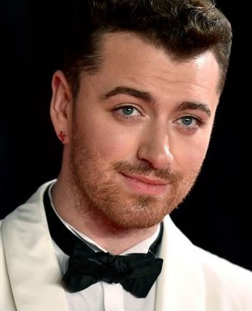
Today, there are many openly gay people who hold positions of importance and influence in society.
However, research shows us that there are still many reports of people in schools and in their place of work being bullied because of their sexual orientation.
In addition, the Galop Hate Crime Report found that 4 out of 5 LGBT people questioned had been victims of homophobic hate crime; a quarter had experienced violent hate crime ; a third had experienced online hate crime.
There are still many countries where homosexuality is illegal, and people face severe punishment based upon their sexual orientation.
Notes:
Galop source: https://www.galop.org.uk/wp-content/uploads/2016/10/The-Hate-Crime-Report-2016.pdf
Pointing out that while there are many famous and successful people who are openly gay, many other people still experience prejudice and discrimination on a regular basis.
NB – With time, it may well be the case that there are better/more recent examples of successful people who have come out as gay. These pictures can be changed.
Those currently pictured are (from top)
Ruth Davidson – Head of the Conservative Party in Scotland
Owen Jones – Guardian columnist, journalist and political commentator
Claudia Brind-Woody – Vice President of IBM
Graham Norton – Actor, comedian and broadcaster
Sam Smith – Singer, songwriter and musician

Slide 63

Over to you . . .
Having seen these slides, each group will now be given one of the Protected Characteristics to explore and research, so that they can put together and deliver your presentation and poster
As each group presents, you should be prepared to gather on your sheet at least two pieces of information which are new for you.

Slide 64





Your Presentations
Notes:
For pupil presentations, issue each pupil with a “New Knowledge” sheet (in lesson pack). Remind them of the need to listen and be attentive, and that they should gather information from each presentation on their sheet.. They will have to use this sheet for a later task.

Slide 65
A reminder . . .
Protected Characteristics
Age
Disability
Gender Reassignment
Marriage and Civil Partnership
Pregnancy and Maternity
Race
Religion or Belief
Sex
Sexual Orientation
Main Headings for Presentation
A historical context (where does the discrimination come from?);
What does the Church teach us?
Some examples of what form it takes (what the discrimination looks/sounds like);
Important events/people who highlighted the discrimination;
Testimony from those who have suffered discrimination;
Has there been an improvement in social attitudes? How do we know?
Notes:
Just a slide to display while pupils are working on research to reinforce the Protected Characteristics and to remind them of their remit

Slide 66
What have we learned?
Pair & Share:
Take your New Knowledge sheet. Take a few minutes to look over all the new knowledge you’ve recorded.
What is the most surprising/interesting thing that you have learned? (You can’t choose from your own presentation.).
Working in pairs, tell your partner what you have chosen and why.
Exchange sheets and, having read your partner’s sheet, repeat the task.
Reflection Task
In your jotter, write a paragraph or two on the attitudes that you have seen in the presentations. Rather than just retelling information you have learned, say something about how it makes you feel.
How would you improve things for those people who fall within the Protected Characteristics?

Slide 67

Jesus tells us - commands us - that we must try to love others as He loves us.
He doesn’t say we should only love those we like; those we agree with; those with whom we identify; those who have the same ideas as us.
Our call is to treat all people with love and respect.
This can be very difficult in a world that often asks us to take sides, and often congratulates confrontation.
Take a moment in quiet now to think of how it feels to be loved and valued. You may think of family; of friends; of community; of Jesus.
Now, think of a practical way that you can take that feeling into someone else’s life.
How will you live the command?

