Slide 1
Pope Francis Faith Award
Lord Jesus,
You ask those who believe in you
To give your Good News to others.
We pray that, with the help of the Holy Spirit,
Our words, actions and prayers
Will help other people
To hear of You,
To believe in You,
And to find the joy of knowing You.
Amen

Slide 2
Pope Francis Faith Award
Success Criteria
What do I need to do? | What evidence will I need?
I will use the gifts of the Holy Spirit when showing my love of God and my love of others in my daily life. | I will record my actions in my Faith Journal.
With the support of others, I will reflect on how my actions have made an impact on my journey of faith. | I will include some reflections on these actions in my Faith Journal and my P7 Personal Profile.

Slide 3



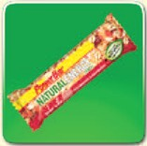



Pope Francis Faith Award

Slide 4
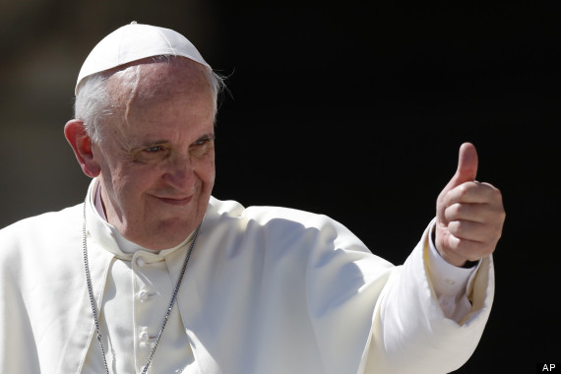
Pope Francis Faith Award
Gathering point 2 Knowledge
“The gift of knowledge puts us in tune with God's gaze on things and on people”

Slide 5
Pope Francis Faith Award
Teacher note:
Teachers may use this power point in whatever way suits their class, and individual learners.
Time in which the gathering points are to be completed may be differentiated i.e., it may be of benefit to some learners to break each task into smaller activities.
It is important to have a timeline of when each GP will be started/completed to ensure that all learning and reflection is completed in time for submission for the award.

Slide 6
Pope Francis Faith Award
Learning intention
Explore the meaning of the word ‘knowledge’.
Listen to the Word of God, teaching us how knowledge can be used as a gift.
Challenge myself to an act of discipleship.
Learn
about the Gift of Knowledge.
Reflect
to reflect on what Knowledge
means.
Act
to use Knowledge.

Slide 7

Pope Francis Faith Award
‘Share with someone in your family something you have been learning in school this week.’
‘Interview your local Priest to learn something about his daily routine.’
‘Share some knowledge about a special interest or hobby.’
‘Find out about your school’s patron saint and create a poster or a leaflet.’
‘Tell your family about what you have learned in school about ‘reduce, reuse, recycle’ and agree a new action for your family.’

Slide 8

Pope Francis Faith Award
Let us begin our time together
In the name of the Father
and of the Son
and of the Holy Spirit
Amen

Slide 9



Pope Francis Faith Award
Can you list some of the things The Trackers have been learning about?

Slide 10
Pope Francis Faith Award
Can you explain why ‘Knowledge’ is important to Catholics?
Knowledge is the gift of the Holy Spirit that helps us to learn. We can learn about ourselves, and how we were made in the image of God. We can learn about creation, and how it is Gods gift to us.
A person with knowledge has the power to teach others about the kingdom of God.

Slide 11
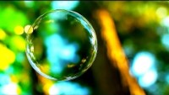
Scripture Time
Listen carefully as your teacher
reads the words of Scripture.
King Solomon wrote the Book of Proverbs in 700 BC so that his followers would know how to use the gifts of the Holy Spirit!

Slide 12
A Reading from the Book of Proverbs 2:1-6, 8-10
Learn what I teach you and never forget what I tell you to do. Listen to what is wise and try to understand it. Yes, beg for knowledge, please for insight. Look for it as hard as you would for silver or some hidden treasure. If you do, you will know what it means to fear the Lord and you will succeed in learning about God. It is the Lord who gives wisdom; from him comes knowledge and understanding. He protects those who treat others fairly, and guards those who are devoted to Him. If you listen to me, you will know what is right, just, and fair. You will know what you should do.
Notes:
Further reading: Paul wrote to the Ephesians about his desire that they experience the knowledge of the Lord. He put it this way.
May you experience the love of Christ, though it is so great you will never fully understand it. Then you will be filled with the fullness of life and power that comes from God (Ephesians 3:19 NLT).
Knowledge of God is essential. This is why the apostle wanted the believers to understand it as much as possible.

Slide 13
Scripture Time
Your teacher will read the words of Scripture again. This time in silence.
Listen for the key words and messages from this passage.

Slide 14

Scripture Time
Person 1 | Person 2
What makes someone knowledgeable? | What do we learn about God from the Book of Proverbs?
Knowledge is a gift from God. How does it make you feel to receive a gift? | How does it make you feel when you have learned something new that you didn’t understand before?
In the Book of Proverbs, we read that that knowledge helps us to treat people fairly. Can you describe this with an example? | Why do you think we should ‘look for knowledge like it is treasure’?
Do you know anyone who has shown great knowledge? What did they do? Why did they do it? | Do you know anyone who has shown great knowledge? What did they do? Why did they do it?

Slide 15
Pope Francis Faith Award
Listen to the passage from the Book of Proverbs again.
This time imagine you are one of King Solomons followers.
Close our eyes and take time to reflect on our learning.
Imagine that you are not allowed to go to school or to learn.
It might be exciting at first.
What would you miss out on by not learning? Who would you miss by not coming to school?
Why do we need knowledge? Why do you think that the Holy Spirit gives us knowledge as one of his gifts? What should we do with our knowledge?

Slide 16
Pope Francis Faith Award
Learning intention
Explore the meaning of the word ‘Knowledge’.
Listen to the Word of God, teaching us how fortitude can be used as a gift.
Challenge myself to an act of discipleship.
Learn
about the Gift of Knowledge
Reflect
to reflect on what Knowledge
means.
Act
to use Knowledge.

Slide 17
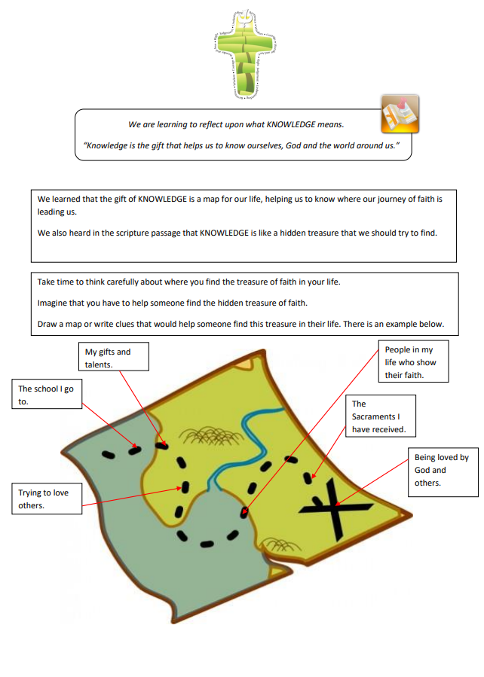
Pope Francis Faith Award
Think about all that you have learned about the gift of knowledge.
We learned that the gift of knowledge is a map for our life, helping us to know where our journey of faith is leading us.
We heard in scripture that knowledge is like a hidden treasure that we should try to find.
Take time to think carefully about where you find the treasure of faith in your life.
Imagine that you have to help someone find the hidden treasure of faith. Draw a map or write clues that would help someone find this treasure in their life.

Slide 18
Pope Francis Faith Award
“Knowledge is the gift that helps us to know ourselves, God, and the world around us. It is more than just facts. Knowledge is our map to know where our faith is leading us and what our Church is about.”
Answer the following questions in your journal for school, home, and parish:
Can you think of a time you needed God’s help to show knowledge?
Why was it important to use our gift of knowledge?
How can we use the gift of knowledge to serve others?

Slide 19
Pope Francis Faith Award
Reflection
Examination of Conscience

Slide 20
Pope Francis Faith Award
Think about all the times that we have made good decisions, loved God and others and done the right thing.
Think about the times when we made bad choices that we are not proud of.
Think about how not to do that again in the future.

Slide 21
Faith Prayer
Lord Jesus,
You ask those who believe in you
to give your Good News to others.
We pray that, with the help of the Holy Spirit,
our words and actions
will help other people
to hear of You,
to believe in You
to find the joy of knowing You.
Amen

Slide 22
Extension activity
Reflection
The following slides can be used to prompt children who are finished their map on slide 17. Answers can be recorded in their journal.

Slide 23
Extension activity
Reflection 1
Lord Jesus.
You ask those who believe in you
to give your Good News to others.
Read the part of our prayer above. Think about the questions below. Write your answer on the free pages of your journal.
1. How do I use my knowledge to show others that I believe in Jesus?
2. How can my friends and I give the Good News to other people?

Slide 24
Extension activity
Reflection 2
We pray that, with the help
of the Holy Spirit,
our words and actions
Read the part of our prayer above. Think about the questions below. Write your answer on the free pages of your journal.
1. How do the words I speak show that I have the gift of knowledge?
2. How do my actions show God that I am using my gift of knowledge?

Slide 25
Extension activity
Reflection 3
….and prayers will help other people
to believe in You
Read the part of our prayer above. Think about the questions below. Share your thoughts on the free pages of your journal.
Do other people know God because of me?
Do they hear of God from what I have learned?
Do they believe in him from how I share my knowledge?

Slide 26
Extension activity
Reflection 4
….and to find the joy of knowing You.
Read the part of our prayer above. Think about the questions below. Share your thoughts on the free pages of your journal.
How do I show others the beauty of God in the world from my knowledge?
How do I share the what I have learned about God?

Slide 27
Extension activity
Reflection 5
Examination of conscience
What could I do more of to share my knowledge?
How do I show my knowledge in school?
What could I do at home to share my knowledge?
What could I do in my parish to share my knowledge?

Slide 28
Pope Francis Faith Award
‘Share with someone in your family something you have been learning in school this week.’
‘Interview your local Priest to learn something about his daily routine.’
‘Share some knowledge about a special interest or hobby.’
‘Find out about your school’s patron saint and create a poster or a leaflet.’
‘Tell your family about what you have learned in school about ‘reduce, reuse, recycle’ and agree a new action for your family.’

