Slide 1
Verification 2021_23 CLPL

Slide 2
Pope Francis Faith Award Prayer
Lord Jesus,
You ask those who believe in You
to give your Good News to others.
We pray that, with the help of the Holy Spirit,
our words, actions and prayers will help other people
to hear of You,
to believe in you
and to find the joy of knowing You.
Amen

Slide 3
Overview
1245 Sign in, tea/coffee
1300 Peer verification
1330 Verifier role and responsibility
1430 Feedback and Q&A
1500 Close

Slide 4
Role of the Cluster Verifier(s)
1. Attend SCES Verification Training Meeting November
2. Co-ordinate cluster verification January/February
3. Submit Confirmation of Cluster Verification 28th February

Slide 5
Role of the Cluster Verifier(s)
2. Co-ordinate cluster verification January/February
Ask each co-ordinator to bring to the meeting:
  6 examples of pupil work
  Verification of School Assessment document with Section A complete
  Steps for Verification of School Assessments
Hold meeting January/February.
Exchange samples and complete Verification of School Assessment document Section B.

Slide 6
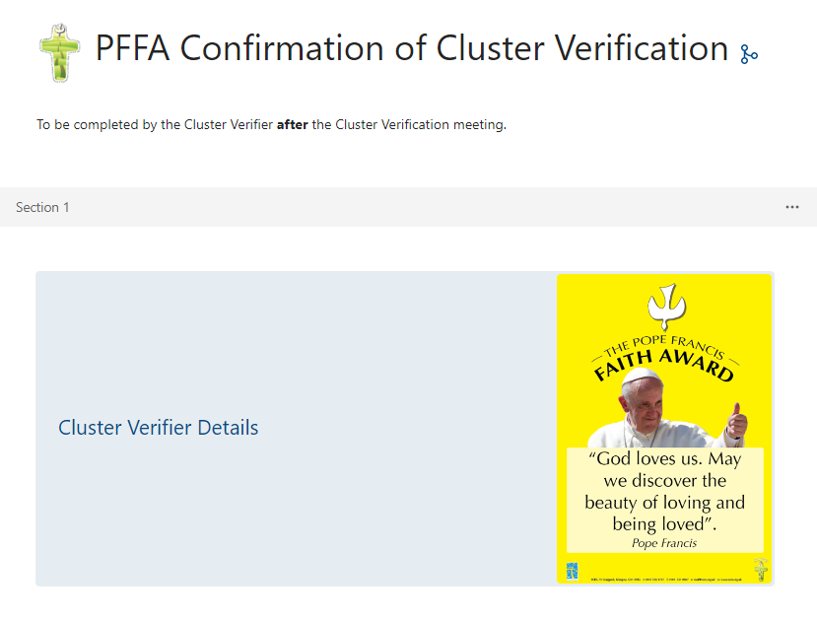
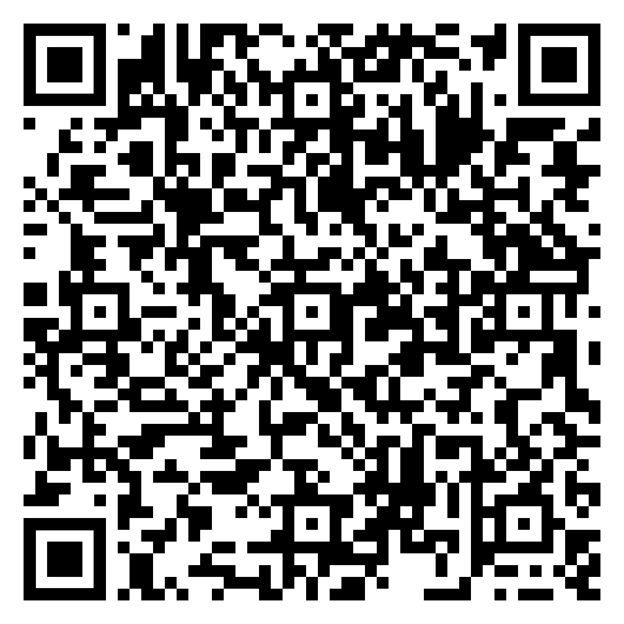
Role of the Cluster Verifier(s)
3. Submit Confirmation of Cluster Verification 28th February

Slide 7
Role of the Cluster Verifier(s)
Today:
Submit examples of assessed pupil work, accompanied by Verification of School Assessment form part A.
Cross-mark and compare standards.
Complete part B of Verification of School Assessment form (each school keeps their own sheet for later submission to SCES).
Cluster Verifier submits Confirmation of Cluster Verification Form >>>>>>>>>>>>

Slide 8
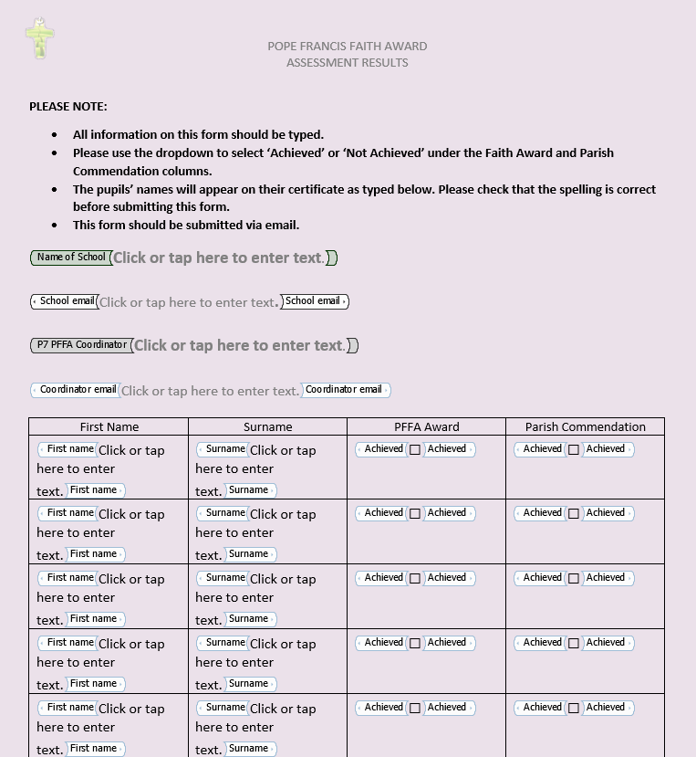
Submitting Final Results: Assessment Results List completed by the school and submitted by 28th February.

Slide 9
Feedback

Slide 10

Closing Prayer

