Slide 1
Pope Francis Faith Award
Lord Jesus,
You ask those who believe in you
To give your Good News to others.
We pray that, with the help of the Holy Spirit,
Our words, actions and prayers
Will help other people
To hear of You,
To believe in You,
And to find the joy of knowing You.
Amen

Slide 2
Pope Francis Faith Award
Success Criteria
What do I need to do? | What evidence will I need?
I will use the gifts of the Holy Spirit when showing my love of God and my love of others in my daily life. | I will record my actions in my Faith Journal.
With the support of others, I will reflect on how my actions have made an impact on my journey of faith. | I will include some reflections on these actions in my Faith Journal and my P7 Personal Profile.

Slide 3



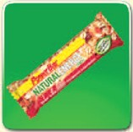



Pope Francis Faith Award

Slide 4
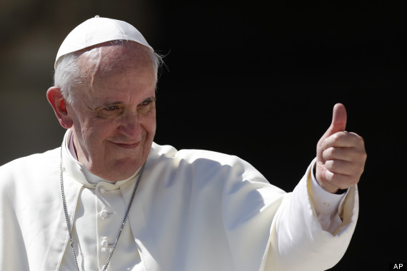
Pope Francis Faith Award
Gathering point 3 Piety
“Dear young people, do not bury your talents, the gifts that God has given you! Do not be afraid to dream of great things!”

Slide 5
Pope Francis Faith Award
Teacher note:
Teachers may use this power point in whatever way suits their class, and individual learners.
Time in which the gathering points are to be completed may be differentiated i.e., it may be of benefit to some learners to break each task into smaller activities.
It is important to have a timeline of when each GP will be started/completed to ensure that all learning and reflection is completed in time for submission for the award.

Slide 6
Pope Francis Faith Award
Learning intention
Explore the meaning of the word ‘piety’.
Listen to the Word of God, teaching us how piety can be used as a gift.
Challenge myself to an act of discipleship.
Learn
about the Gift of Piety.
Reflect
to reflect on what Piety
means.
Act
to be Pious.

Slide 7

Pope Francis Faith Award
‘Make a card including a prayer for someone in your family.’
‘At the end of Mass, stay standing until the priest has left the sanctuary.’
‘Light a candle in the church and pray for someone you know who needs your prayers.’
Receive Communion respectfully by bowing first and answering ‘’Amen’’ clearly.’
‘Each night, give thanks to God for your life and for your opportunities to grow.’

Slide 8

Pope Francis Faith Award
Let us begin our time together
In the name of the Father
and of the Son
and of the Holy Spirit
Amen

Slide 9



Pope Francis Faith Award
Listen to Christine sing her song ‘The Seven Gifts of the Holy Spirit’.
Where are you on your learning journey? Did you hear any familiar words or terms?

Slide 10
Pope Francis Faith Award
Can you explain why ‘Piety’ is important to Catholics? Use the word bank to complete the following sentences:
Piety means a devotion, or a commitment to practice r_ _ _ _ _ _ _.
Piety _ _ l_ _ us to gain favor or forgiveness from _ _ _.
Piety helps us to pray with trust and r_ _ _ _ _ _ and to see God in everything around us.
Word bank
God
respect
religion
helps

Slide 11
Pope Francis Faith Award
Can you explain why ‘Piety’ is important to Catholics? Use the word bank to complete the following sentences:
Piety means a devotion, or a commitment to practice religion.
Piety helps us to gain favor or forgiveness from God.
Piety helps us to pray with trust and respect and to see God in everything around us.

Slide 12

Scripture Time
Listen carefully as your teacher
reads the words of Scripture.
The Letters from St Peter were sent to persecuted Christians, to encourage them to be Pious and to have faith that God would save them.
Notes:
It may be useful to remind pupils that, when we listen to Scripture passages, we are listening to the inspired Word of God (RERC 2-12a) and that we “read aloud from Sacred Scripture in such a way that I am proclaiming the Word of God”. (core learning P6. 2-12a). While the Scripture passages have been included in each PowerPoint, you may want to first use a Bible to read from to show the proclamation of the Word, and then display the slides that follow.

Slide 13
A Reading from the 1st letter from Peter (3:15-16)
Have reverence for Christ in your hearts, and honour him as Lord. Be ready at all times to answer anyone who asks you explain the hope you have in you, but do it with gentleness and respect. Keep your conscience clear, so that when you are insulted, those who speak evil of your good conduct as followers of Christ will be ashamed of what they say.
Notes:
Further reading: Paul wrote to the Ephesians about his desire that they experience the knowledge of the Lord. He put it this way.
May you experience the love of Christ, though it is so great you will never fully understand it. Then you will be filled with the fullness of life and power that comes from God (Ephesians 3:19 NLT).
Knowledge of God is essential. This is why the apostle wanted the believers to understand it as much as possible.

Slide 14
Scripture Time
Your teacher will read the words of Scripture again. This time in silence.
Listen for the key words and messages from this passage.

Slide 15

Scripture Time
Person 1 | Person 2
What makes someone pious? | What do we learn about God from Peter’s Letters?
Piety is a gift from God. How does it make you feel to receive a gift? | How does it make you feel when you have time in silence to pray?
In the Letter from Peter, we read that piety helps us to face difficult times. Can you describe this with an example? | Why do you think we should 'keep our conscience clear'?
Do you know anyone who has shown great piety? What did they do? Why did they do it? | Do you know anyone who has shown great piety? What did they do? Why did they do it?

Slide 16
Pope Francis Faith Award
Listen to the passage from the Letter from Peter again. This time imagine you are a Christian in 64 AD*.
Close your eyes and take time to reflect on your learning.
Imagine that you are a persecuted Christian. This means that someone is treating you badly because of your beliefs.
How does this make you feel about the people treating you this way? Are you worried for other Christians? Perhaps your family and friends.
How do you feel about Jesus?
Why do we need Piety? Why do you think that the Holy Spirit gives us Piety as one of his gifts? What should we do with our Piety?
*See slide 12

Slide 17
Pope Francis Faith Award
Learning intention
Explore the meaning of the word ‘Piety’.
Listen to the Word of God, teaching us how Piety can be used as a gift.
Challenge myself to an act of discipleship.
Learn
about the Gift of Piety.
Reflect
to reflect on what Piety
means.
Act
to use Piety.

Slide 18
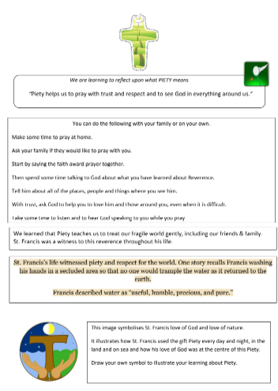
Pope Francis Faith Award
Think about all that you have learned about the gift of Piety.
We understand that the gift of Piety helps us to gain favor or forgiveness from God.
We heard in scripture that we can show our Piety by being kind and gentle.
Study the worksheet for this Gathering Point. Think about how St Francis used his gift of Piety. Can you remember the symbol Youtuber Christine used for Piety in her video on slide 9?
Draw your own symbol to illustrate your learning about Piety.

Slide 19
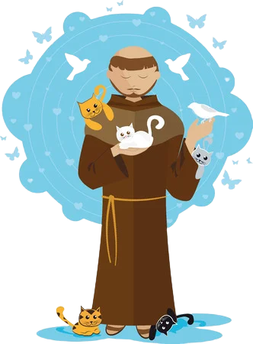
Pope Francis Faith Award
““Piety helps us to pray with trust and respect and to see God in everything around us.”
Answer the following questions in your journal for school, home, and parish:
Can you think of a time you needed God’s help to show piety?
Why was it important to use our gift of piety?
How can we use the gift of piety to serve others?

Slide 20
Pope Francis Faith Award
Reflection
Examination of Conscience

Slide 21
Pope Francis Faith Award
Think about all the times that we have made good decisions, loved God and others and done the right thing.
Think about the times when we made bad choices that we are not proud of.
Think about how not to do that again in the future.

Slide 22
Faith Prayer
Lord Jesus,
You ask those who believe in you
to give your Good News to others.
We pray that, with the help of the Holy Spirit,
our words and actions
will help other people
to hear of You,
to believe in You
to find the joy of knowing You.
Amen

Slide 23
Extension activity
Reflection
The following slides can be used to prompt children who are finished their symbol for piety on slide 18. Answers can be recorded in their journal.

Slide 24
Extension activity
Reflection 1
Lord Jesus.
You ask those who believe in you
to give your Good News to others.
Read the part of our prayer above. Think about the questions below. Write your answer on the free pages of your journal.
1. How do I use my piety to show others that I believe in Jesus?
2. How can my friends and I give the Good News to other people?

Slide 25
Extension activity
Reflection 2
We pray that, with the help
of the Holy Spirit,
our words and actions
Read the part of our prayer above. Think about the questions below. Write your answer on the free pages of your journal.
1. How do the words I speak show that I have the gift of piety?
2. How do my actions show God that I am using my gift of piety?

Slide 26
Extension activity
Reflection 3
….and prayers will help other people
to believe in You
Read the part of our prayer above. Think about the questions below. Share your thoughts on the free pages of your journal.
Do other people know God because of me?
Do they hear of God from what I have learned?
Do they believe in him from how I share my piety?

Slide 27
Extension activity
Reflection 4
….and to find the joy of knowing You.
Read the part of our prayer above. Think about the questions below. Share your thoughts on the free pages of your journal.
How do I show others the beauty of God in the world from my piety?
How do I share what I have learned about God, with piety?

Slide 28

Extension activity
Reflection 5
Examination of conscience
What could I do more of to share my piety?
How do I show my piety in school?
What could I do at home to share my piety?
What could I do in my parish to share my piety?

Slide 29
Pope Francis Faith Award
‘Make a card including a prayer for someone in your family.’
‘At the end of Mass, stay standing until the priest has left the sanctuary.’
‘Light a candle in the church and pray for someone you know who needs your prayers.’
Receive Communion respectfully by bowing first and answering ‘’Amen’’ clearly.’
‘Each night, give thanks to God for your life and for your opportunities to grow.’

