Slide 1

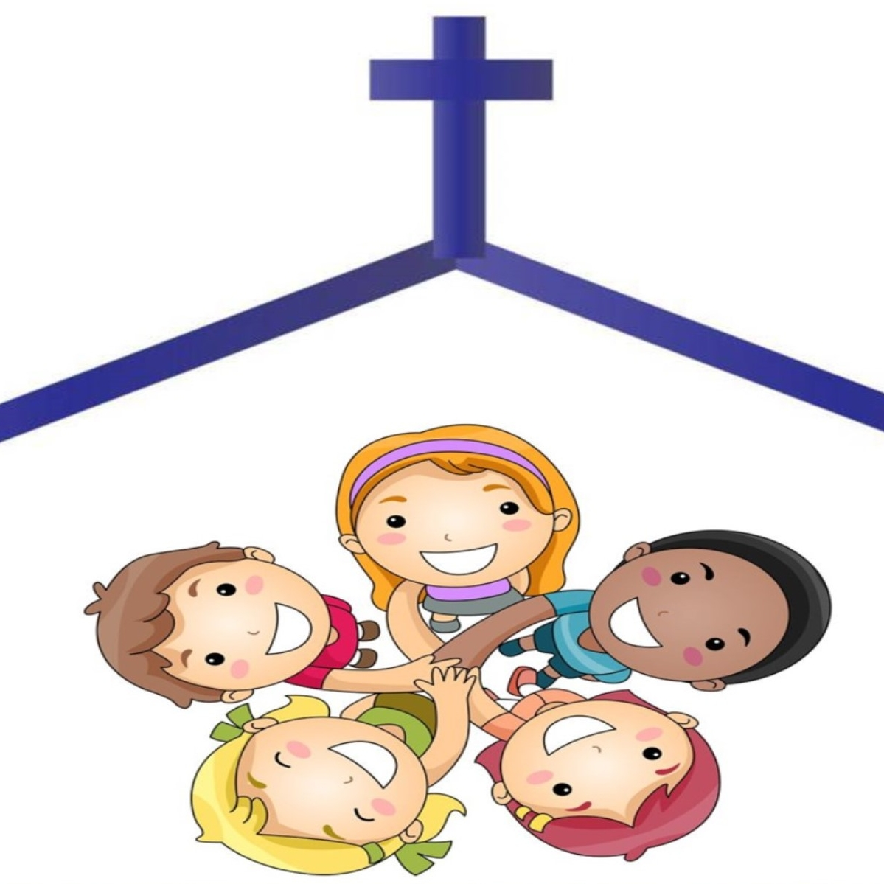
Catholic Education Week
Celebrating and worshipping
Primary assembly
Notes:
Explain that this is Catholic Education Week, the week when we think about how great it is to be part of the community of our Catholic school
The theme this year is Celebrating and Worshipping so we will learn about those in today’s assembly.

Slide 2

Come on and Celebrate!
Listen to the song and then sing along together!
Notes:
Play and sing the song together.
Ask the children who this song is celebrating ( Jesus)
Ask the children to talk about celebrations they have been part of and what some of the signs of celebration are e.g: food, drinks, fun, special clothes . . .
Help the children to see the link between celebration and gratitude: e.g. we celebrate a birthday because we are grateful that person was born;
we celebrate a wedding because we are grateful a new family is beginning;
we celebrate homecomings because we are grateful someone we love has come home

Slide 3

What does celebrating look like?
What does it sound like?
What does it feel like?
Notes:
Encourage the children to share their experiences of celebrating: parties, weddings etc. . .
What are the signs of celebration:
music,
dancing,
food and drinks
time to talk to people
catching up with news
sharing memories, etc
How does all of this make us feel?
Why do we have special celebrations in the first place?

Slide 4

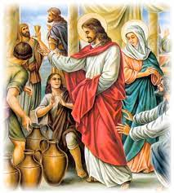
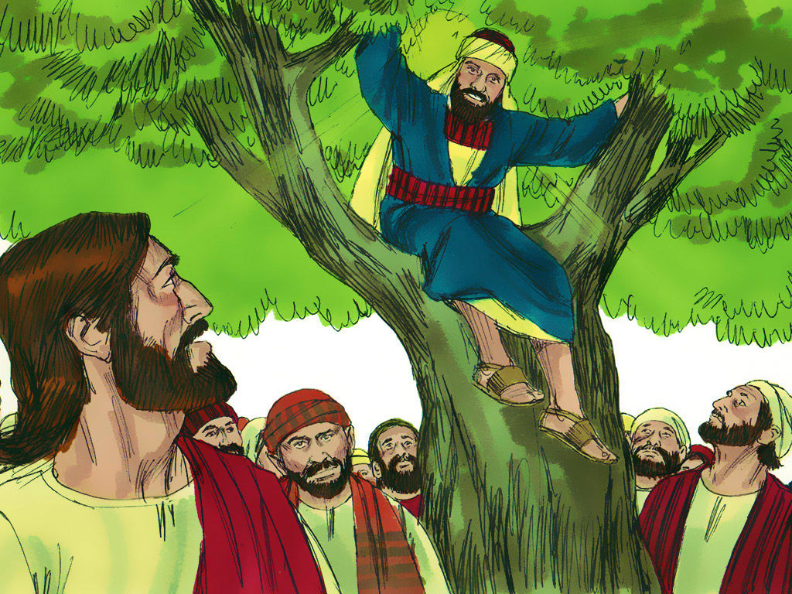



How did Jesus celebrate?...
Weddings and dinner parties
Notes:
Use the examples of the wedding feast at Cana and the meal at Zacchaeus’ house to illustrate that Jesus loved to celebrate just like us
Notice again the link to gratitude:
Jesus was grateful to have a new friend in Zacchaeus; the wedding guests were delighted to have the wine Jesus provided

Slide 5
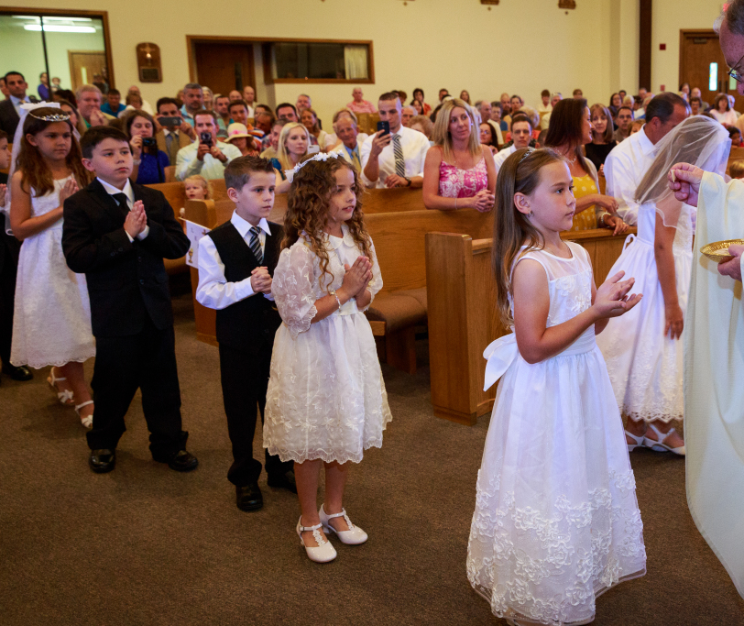
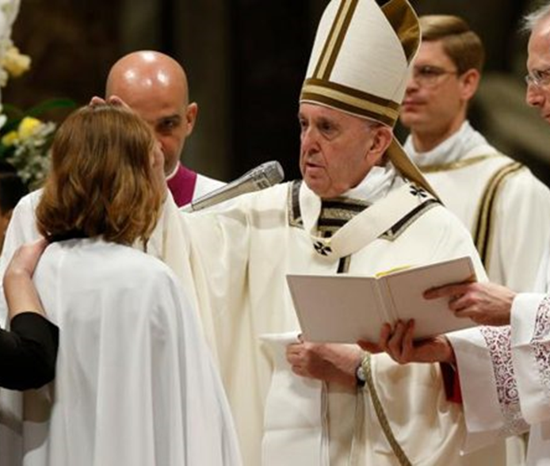
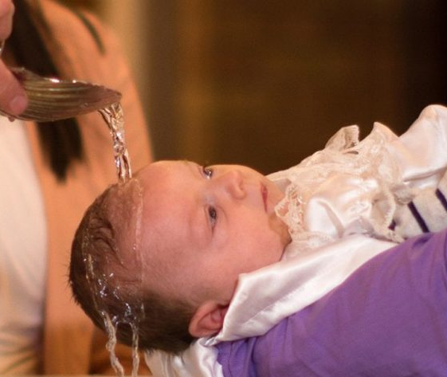
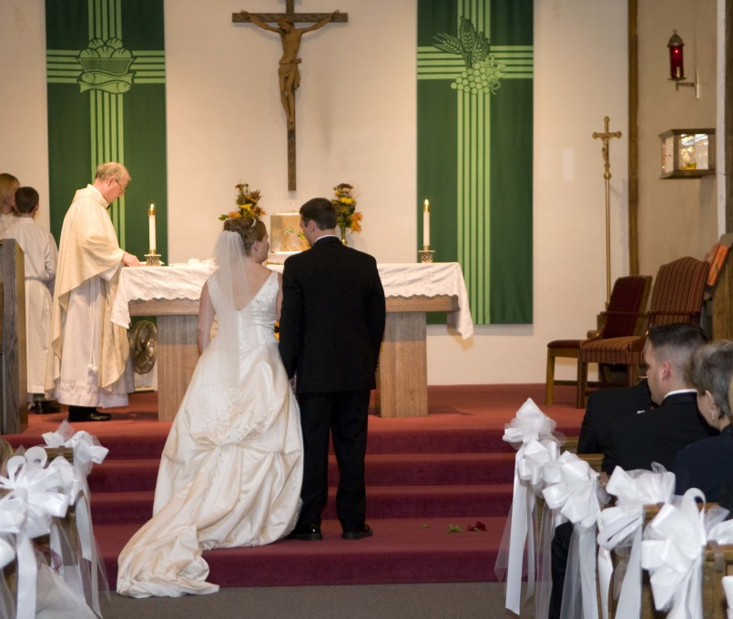
What celebrations have you seen or been part of at Church?
Notes:
Expect:
First Communion (although it is worth teasing this out to make the point that every Mass and every Eucharist is a celebration)
Confirmation
Baptism
Marriage
We have a big celebration when we are part of these events for the first time but every time we are present when the Mass is Celebrated is a celebration for us and a time of Gratitude to God for all that He gives us
During this special week of celebration can we exprss our gratitude/thanks to God
If you are having a school Mass the children could wriet/read thank you prayers
And these could be placed in a classroom sacred space or perhaps a gratitude wall in the school

Slide 6
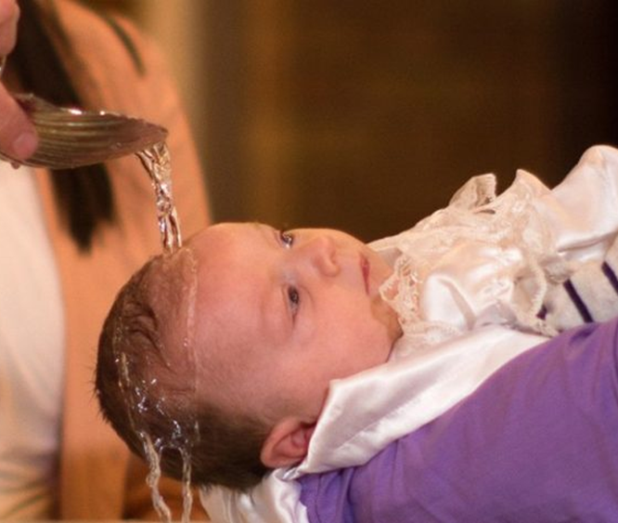

Baptism
Notes:
Invite pupils to “tell you something good” about this picture/ about Baptism. Pupils may want to talk about the different things they see in the picture, or they may want to talk about their own experiences of being at a baptism or, indeed, their own baptism.
Discussion Starters:
Why do we celebrate a baptism? (New member of God’s family/ new member of the Church)
What does the priest do to celebrate a baptism? (Mention water, oil, candle, prayers, white garment, blessings, promises of Godparents, etc – anything from the Rite or about the symbols used)
How do we celebrate a baptism? (We join the family in the Church for the sacrament; we give cards and gifts; wear special clothes; we might have a party. N.B. Try to help pupils towards seeing a difference between the use of the word “celebrate” in a Church or religious sense and “celebrate” in a secular sense. It might be worth pointing out/reminding them that when the priest is saying Mass he is referred to as the celebrant)

Slide 7


Confirmation
Notes:
As with previous slide, invite pupils to “tell you something good” about this picture/ about Confirmation. Pupils may want to talk about the different things they see in the picture, or they may want to talk about their own experiences of being at a confirmation or, indeed, their own confirmation.
Discussion Starters:
Why do we celebrate a confirmation? (receiving the Holy Spirit/ the gifts of the Holy Spirit)
What does the priest do to celebrate a confirmation? (Mention Bishop, vestments, oil, prayers, blessings, role of sponsor, Holy Spirit, dove, tongue of fire, etc – anything from the Rite or about the symbols used)
How do we celebrate a confirmation? (We join the family and the community in the Church for the sacrament; we give cards and gifts; we might have a party. N.B. Try to help pupils towards seeing a difference between the use of the word “celebrate” in a Church or religious sense and “celebrate” in a secular sense. It might be worth pointing out/reminding them that when the priest is saying Mass he is referred to as the celebrant)

Slide 8
Marriage
Notes:
As with previous slide, invite pupils to “tell you something good” about this picture/ about Marriage. Pupils may want to talk about the different things they see in the picture, or they may want to talk about their own experiences of being at a nuptial mass.
Discussion Starters:
Why do we celebrate a marriage? (establishing a new family/ new beginnings/the power and beauty of love . . . )
What does the priest do to celebrate a marriage? (Mention rings, prayers, blessings, vows; role of Best Man/Bridesmaids, signing of the register, etc – anything from the Rite or about the symbols used. May also be worth mentioning that the religious rite also serves as a civil/legal act)
How do we celebrate a marriage? (We join the family and the community in the Church for the sacrament; we give cards and gifts; we wear our best clothes; we might have a special meal and/or party, there are speeches to wish them well, etc. . . N.B. Try to help pupils towards seeing a difference between the use of the word “celebrate” in a Church or religious sense and “celebrate” in a secular sense. It might be worth pointing out/reminding them that when the priest is saying Mass he is referred to as the celebrant)

Slide 9
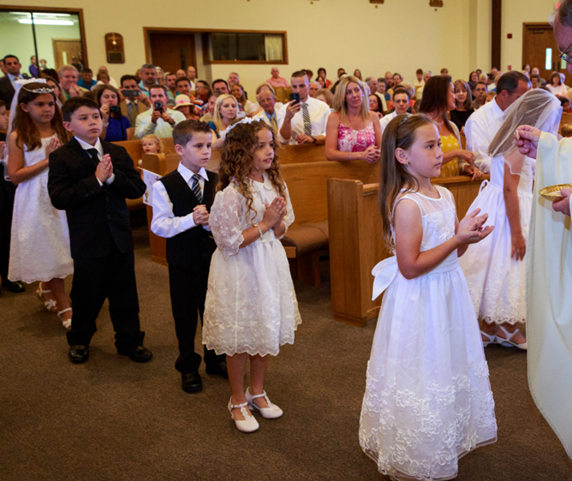
Holy Communion
Notes:
As with previous slide, invite pupils to “tell you something good” about this picture/ about Holy Communion. Pupils may want to talk about the different things they see in the picture, or they may want to talk about their own experiences of being at a First Holy Communion or, indeed, their own First Communion.
With this slide, it would be good to emphasise again that, although our First Communion day is a very special event, EVERY Mass and EVERY sharing of the Holy Eucharist is a celebration in the Church.
Discussion Starters:
Why do we celebrate a (First) Communion? (receiving Jesus in a very special way; Jesus being truly present with us)
What does the priest do to celebrate Holy Communion? (Mention bread, wine, Body of Christ, Blood of Christ, transubstantiation, prayers, blessings, Liturgy of the Eucharist/Last Supper etc – anything from the Rite or about the symbols used; this might include mention of what the First Communicants wear)
How do we celebrate Holy Communion? (We join the family and the community in the Church for the sacrament; we give cards and gifts for a First Communion; special clothes; we might have a party for a First Communion. N.B. Try to help pupils towards seeing a difference between the use of the word “celebrate” in a Church or religious sense and “celebrate” in a secular sense. It might be worth pointing out/reminding them that when the priest is saying Mass he is referred to as the celebrant)

Slide 10

Bless the Lord, Oh My Soul
Notes:
As we bring the assembly to a close we focus on worship: a word that means we recognise God is worthy of our praise and that is why we will close with a song of worship.
The song suggests we should think of reasons to praise and worship God, perhaps challenge the children to see how many reasons they can think of to praise and worship God during the song.
Some examples might be:
parents,
Home
Friends
brothers and sisters,
teachers,
being healthy,
favourite foods.games etc
Have the children share some of their ideas and play/sing the song, keeping it playing as they leave the assembly.
This activity could be repeated in prayer times in class over the week, perhaps building up each day a “Gratitude List”. If the children are participating in Mass this week perhaps have them write thank you prayers for use in the liturgy.

Slide 11
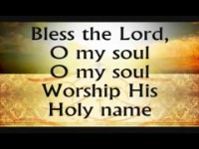
Bless the Lord, Oh My Soul

