Slide 1

Celebrating and Worshipping
2021
Notes:
Each year in our parish and school communities we stop and take some time to reflect on Catholic education and to celebrate the great work that is achieved in our schools. During Catholic Education Week, Catholic schools all over Scotland reflect on the same theme and this year our theme is Celebrating and Worshipping.

Slide 2

Notes:
We are going to explore this theme further in today’s lesson/assembly. We will begin by reflecting on Jesus’ words in Matthew’s Gospel where he tells us “where two or three are gathered in my name, I am with them,” Matthew 18:20.
Jesus is not a distant memory; he is a real presence in our lives today. Jesus promised us that he would be with us “when two or three gather” in his name (Matthew 18:20) – later in Matthew’s Gospel he tells us he will be with us “always, to the end of time” (Matthew 28:20). We are aware of his presence in many ways at many times in our homes, our schools and our parishes but, there are often specific occasions when we are more aware of his presence. Think, pair and share Think of some of the times when you are aware of Jesus’ presence in your life.
Pupils share their responses. These might include: praying as a family/class/parish; listening to Scripture (God’s speak to us through His Word); perhaps sacramental times: attending a Baptism, preparing for and receiving a Sacrament, attending a wedding; in our RERC lessons or learning about the lives of the saints; through Serving Others: putting the needs of others before our own; attending Mass and Eucharistic Adoration.

Slide 3
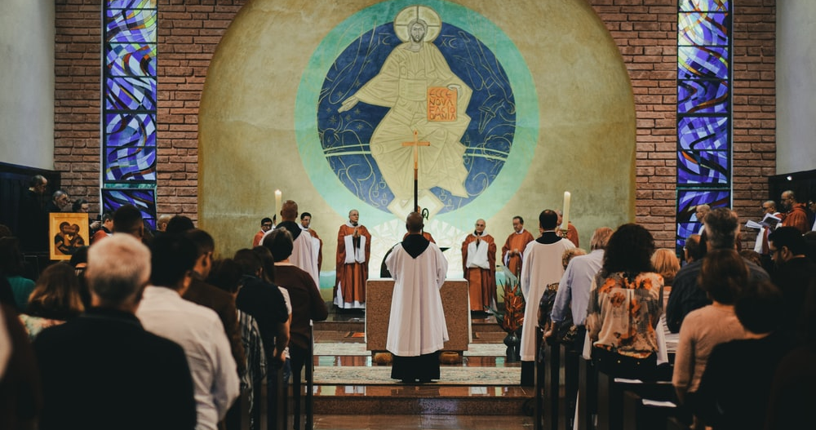
Notes:
Jesus is present in our families and our school and parish communities when we do all of the things that we have just discussed. In our Catholic schools everything that we do is focused on Jesus: our daily prayer, gathering as a community for Mass, prayer services, our school values (that come from the Beatitudes which Jesus gave us), the way that we behave and treat one another (following Jesus’ example), our charity work which is guided by our love of neighbour…
Jesus, however, is especially present in the Eucharist. Each and every time that we celebrate Mass, Jesus is truly present with us in a unique way. When we celebrate the Eucharist/Mass, we draw closer to Jesus and to one another as a Community of Faith. And every time that we receive Jesus in the Eucharist, we are strengthened for our journey of faith.

Slide 4
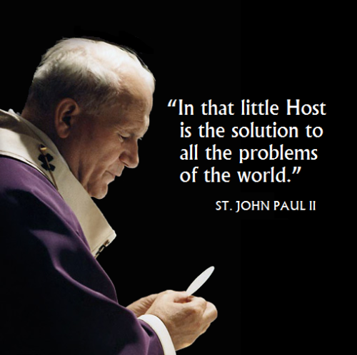
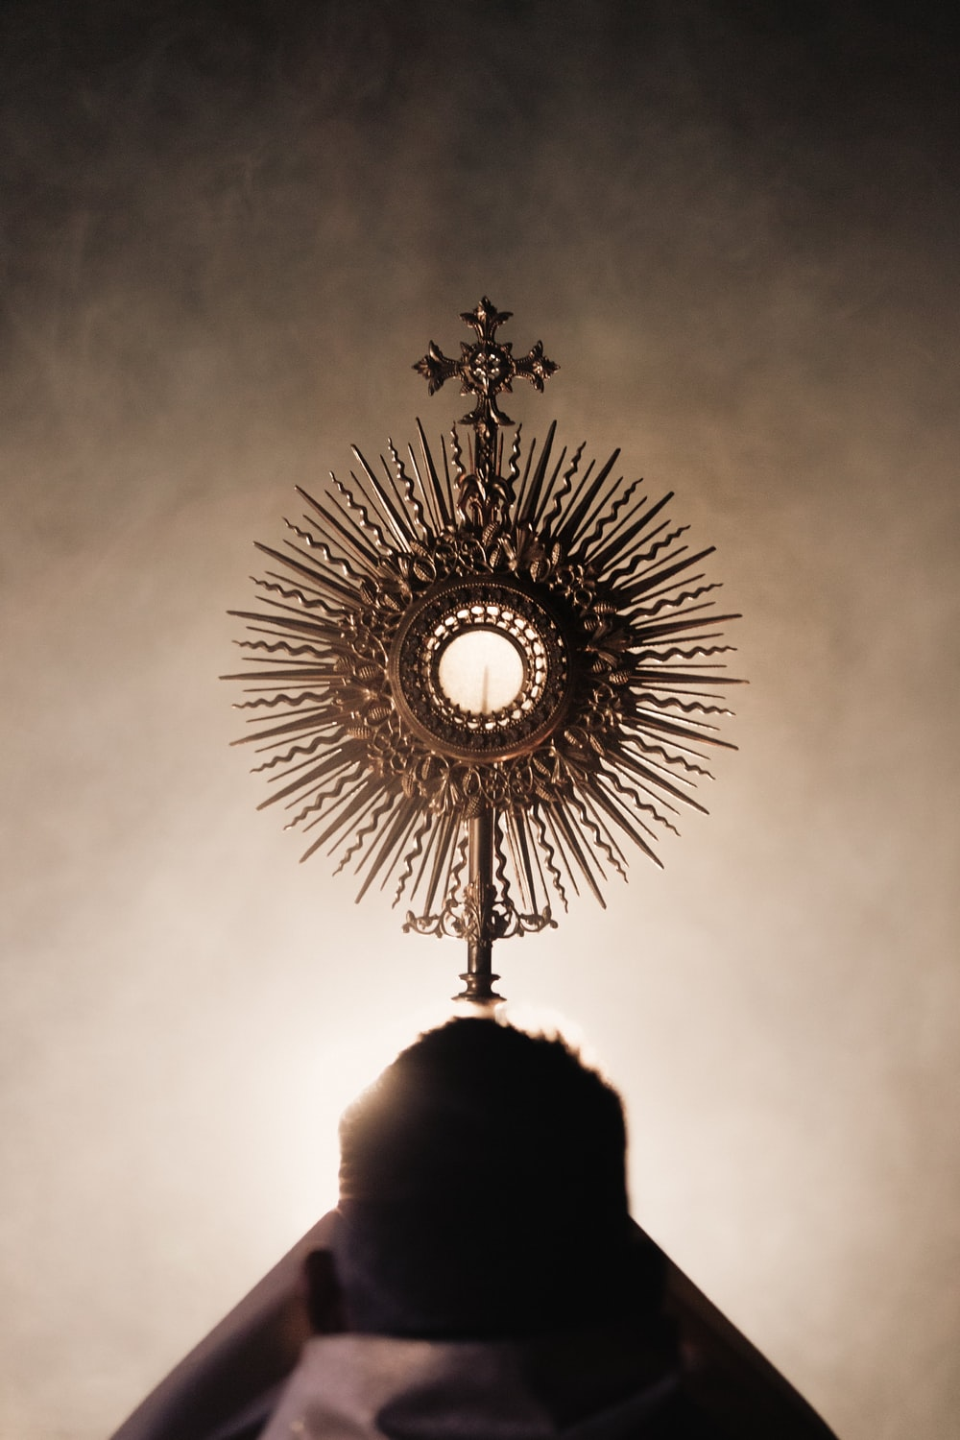
Notes:
Many Catholics also spend time in prayer before the Eucharist in what we call ‘Eucharistic Adoration’. Pope St.John Paul II would sit before Jesus in the Eucharist every day in Eucharistic Adoration. He always had an hour or 2 of adoration each day throughout his life, despite how frantic his life was. He would spend long periods in the Presence of Jesus, particularly before any missionary trip he would or before making any big decisions. His quote on the slide is, read quote. He is telling us that Jesus, continually present for us in the Blessed Sacrament, is the answer to any problem anyone has ever or will have.
Most saints and certainly many, many lay people in the Church have a great devotion to the Blessed Sacrament. (Perhaps the pupils could research saints who were particularly devoted to the Blessed Sacrament.)

Slide 5

Notes:
The pandemic has disrupted many aspects of our lives and for several months our Churches were closed and we were unable to attend Mass. Happily, though, our churches are now reopened and our parishes are beginning to return to normal. We no longer need to book or sign up to attend Mass and our Churches are open for prayer. Many Catholics are now once again regularly receiving Jesus in the Eucharist and gathering with friends and family as a community of faith. Some people may however not yet have retuned to weekly Mass.
At the beginning of this lesson we heard in Matthew’s Gospel that Jesus told us that he would be with us always. At the beginning of that passage Jesus tells his disciples "Go, therefore, and make disciples of all nations, baptizing them in the name of the Father, and of the Son, and of the holy Spirit, teaching them to observe all that I have commanded you. And behold, I am with you always, until the end of the age." (Mt 28:19-20).
This message was not only for the disciples, we are all called to evangelise and share the Good News with others.

Slide 6

Notes:
As part of our Catholic Education Week celebrations, we are going to create invitations for friends and family to encourage them to attend Mass. (Perhaps your school/parish is involved in a special Mass for Catholic education week. You could provide the children with the details of this and have them include this information on their invitations.)
The pupils can send their invitations to anyone - they may wish to take them home to their families or share it with an extended family member or neighbour.

