Slide 1

Celebrating and Worshipping
2021
Notes:
Each year in our parish and school communities we stop and take some time to reflect on Catholic education and to celebrate the great work that is achieved in our schools. During Catholic Education Week, Catholic schools all over Scotland reflect on the same theme and this year our theme is Celebrating and Worshipping.

Slide 2
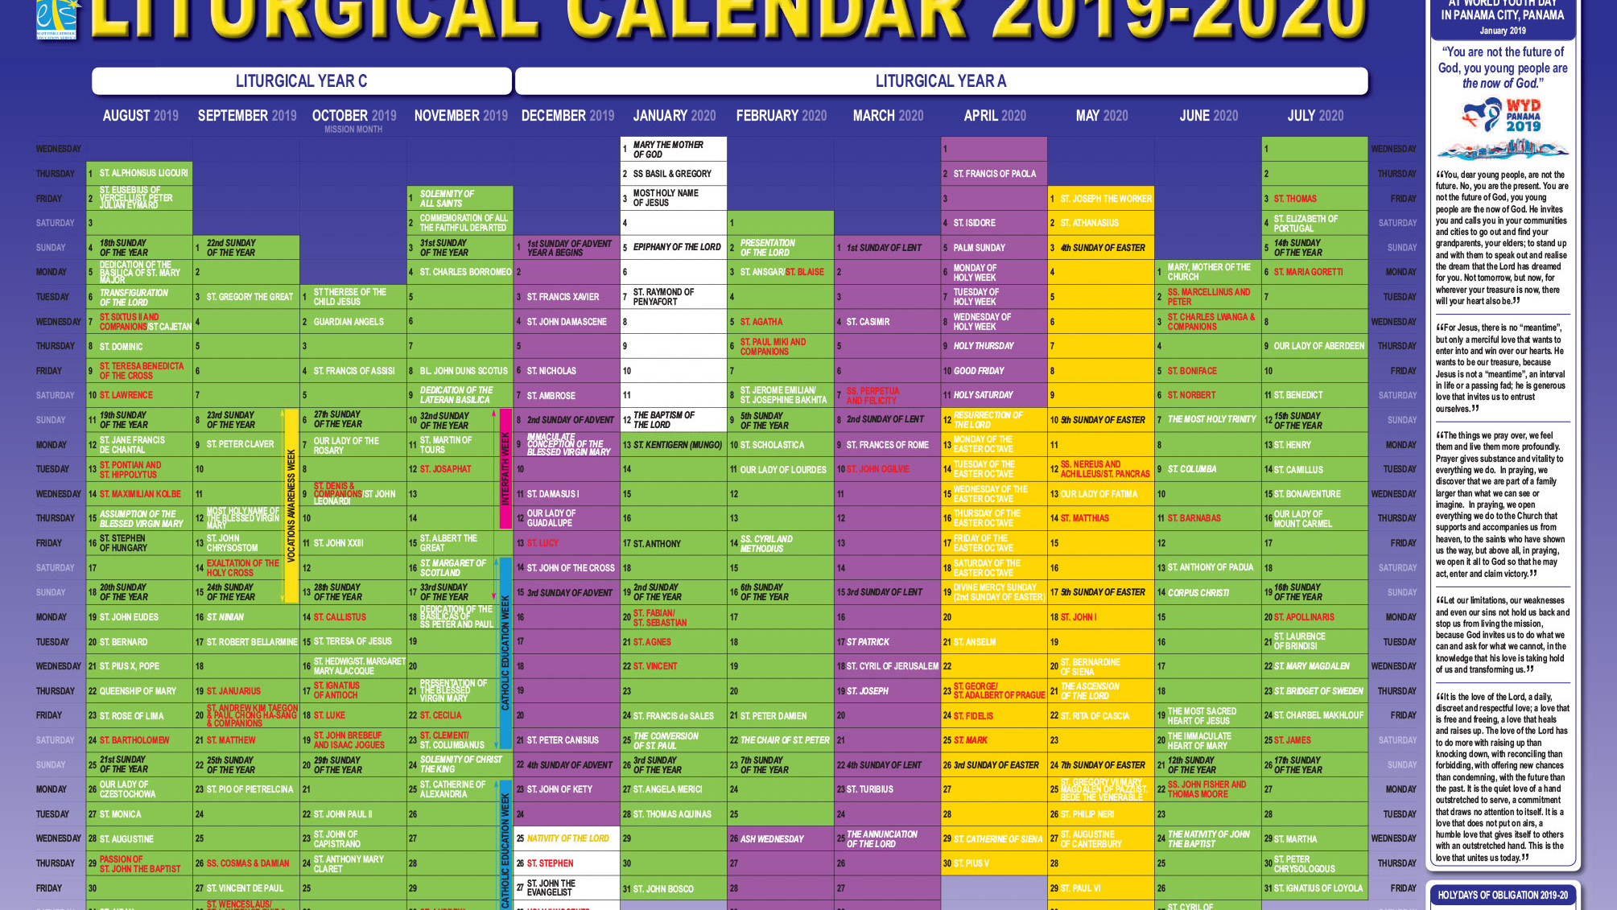
How well do we connect our school calendar to the Church’s Liturgical year?
Notes:
As part of our work for Catholic Education Week this year, we are asked to evaluate How well do we connect our school calendar to the Church’s Liturgical year?
Before we reflect on this question however we are going to learn about the Liturgical year.
Think, pair and share: what do I already know about the Liturgical Year?

Slide 3

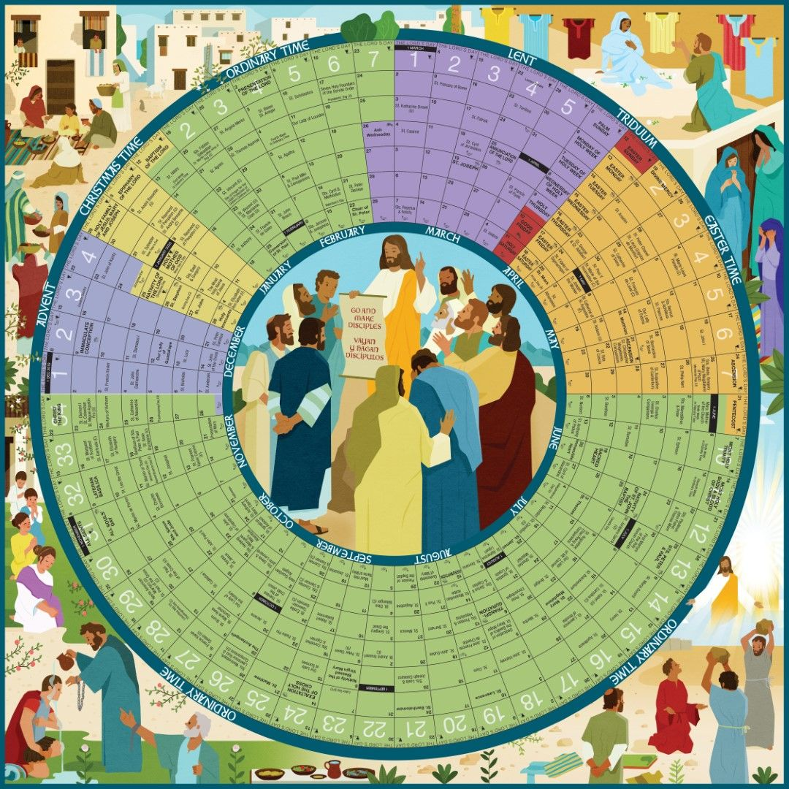
Notes:
Explain that throughout the year the Catholic Church celebrate different feasts and seasons – this is called the Liturgical Year. Just as our calendar year is divided into seasons: Autumn, Winter, Spring and Summer so our Church is year is divided into seasons: Can anyone name some of them?
Unlike the calendar year, which marks the passage of time, the liturgical year celebrates the sacred mysteries of the birth, life, death and resurrection of Jesus.

Slide 4
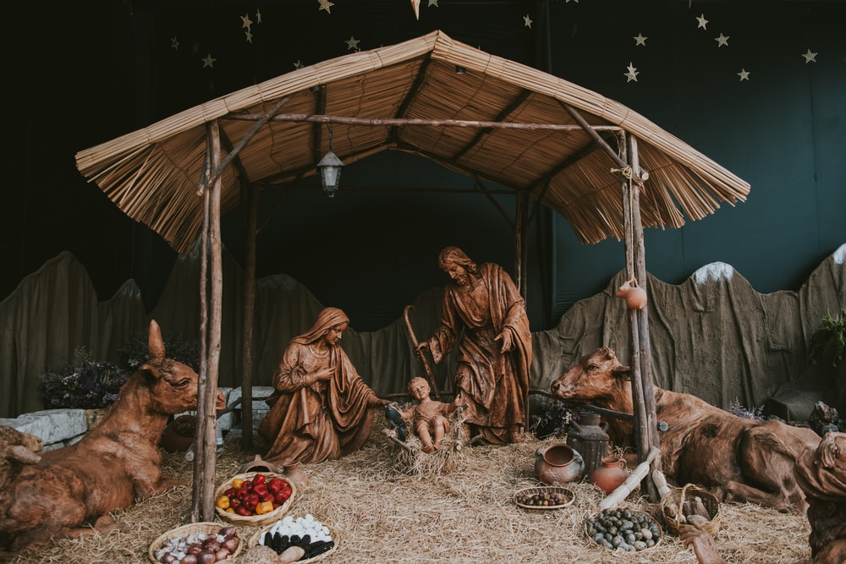
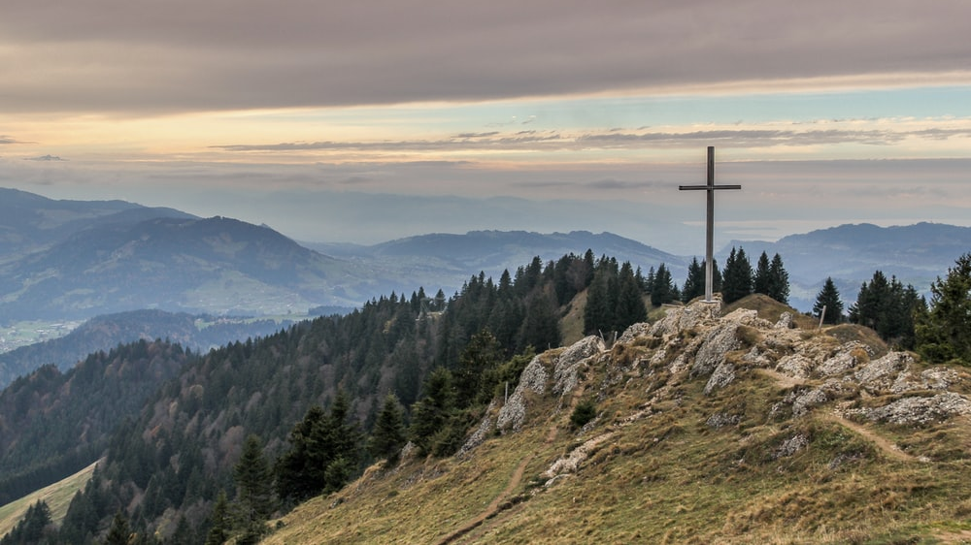

Seasons
Advent
Christmas
Ordinary Time
Lent
Easter
Notes:
There are five specific seasons in the Church’s calendar: Advent, Christmas, Ordinary Time, Lent and Easter.

Slide 5
Notes:
The Liturgical year is a cycle of seasons repeating itself at the end of each cycle.
The Church year or cycle begins with Advent and ends with ordinary time.
Each season in the Liturgical calendar has a particular theme.
Each season has a particular liturgical color.
Each season concentrates on different parts of the Bible.
Each season has different religious practices, and symbols.
Can the pupils name/describe anyof the above?

Slide 6
How well do we connect our school calendar to the Church’s Liturgical year?
Notes:
Think, pair and share: how do we mark the various feasts and seasons of the Church as a class/school?
If any of our practices have stopped due to Covid, think about how we might begin to return to our traditional ways of celebrating the liturgical year.
Task: Pupils then create a liturgical calendar for their class. They should try to include a variety of liturgical experiences that will fit with the season/month e.g. Mass, Eucharistic Adoration, the rosary (October and May), Stations of the Cross (Lent), the Angelus (Advent), Reconciliation service (Lent, Advent, before receiving a sacrament), processions (May, Corpus Christi), patronal feast day celebrations, prayer to the Sacred Heart in June, prayers for the dead in November etc. They should also think about who will be involved: will you invite the parish priest, parents, parish catechists? Where will it be celebrated in the school or parish? There is a space at the bottom of their planner to plan the prayers that they will learn/focus on each month. They can use their TIOF prayer planners to make sure they cover them all.

Slide 7
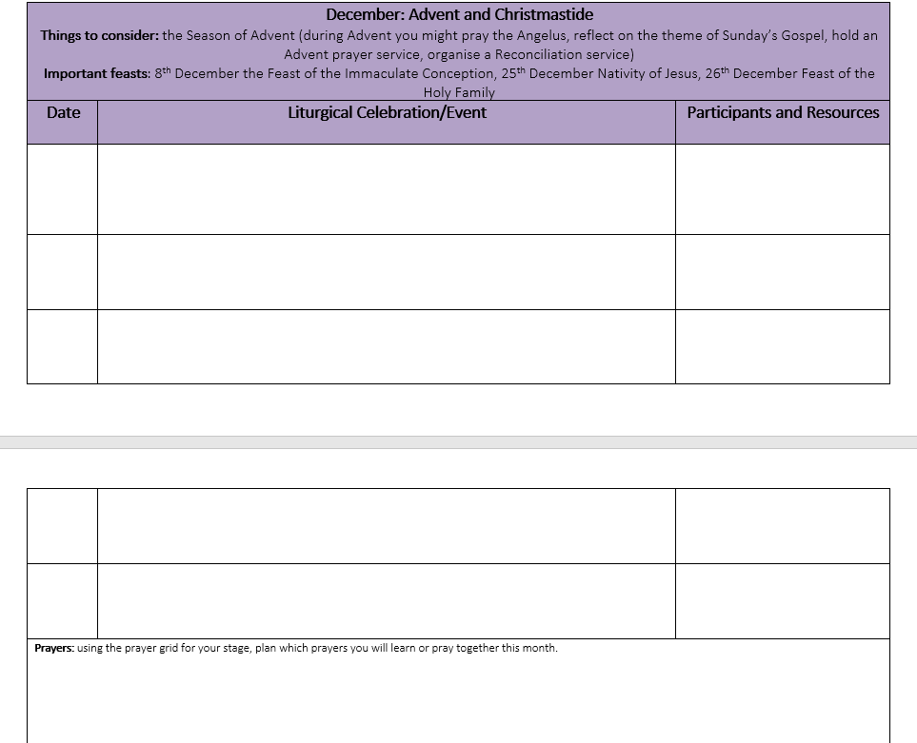
Task:
Use the planner to plan the liturgical events for your class this year.
Try to include a variety of liturgical experiences that will fit with the season/month
Think about who will be involved: will you invite the parish priest, parents, parish catechists? Where will it be celebrated in the school or parish?
Notes:
Task: Pupils then create a liturgical calendar for their class. They should try to include a variety of liturgical experiences that will fit with the season/month e.g. Mass, Eucharistic Adoration, the rosary (October and May), Stations of the Cross (Lent), the Angelus (Advent), Reconciliation service (Lent, Advent, before receiving a sacrament), processions (May, Corpus Christi), patronal feast day celebrations, prayer to the Sacred Heart in June, prayers for the dead in November etc. They should also think about who will be involved: will you invite the parish priest, parents, parish catechists? Where will it be celebrated in the school or parish? There is a space at the bottom of their planner to plan the prayers that they will learn/focus on each month. They can use their TIOF prayer planners to make sure they cover them all.

