Slide 1
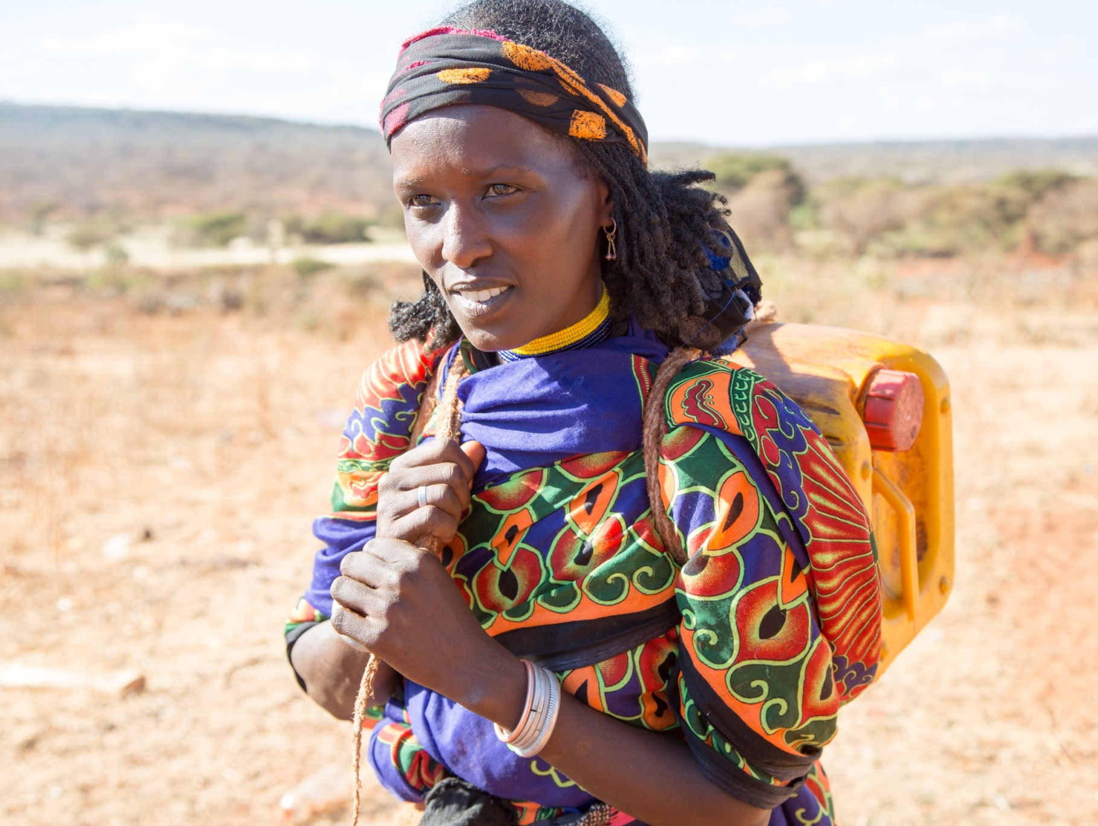
Stations of the Cross

Slide 2
God, our Father,
You are the source of grace and mercy.
Your Spirit drives us into the desert where we too,
like your Son, make our own Lenten journey.
But your presence makes the parched land springs of water
and the wilderness a garden of life.
As we follow in the steps of your Son’s Passion,
may we grow more merciful.
As we carry the cross with him, may we become more aware
of our own need of mercy.
As we look upon the Pierced One, may we be refreshed
and washed clean in his love.
We ask this through Christ our Lord.
Amen.

Slide 3
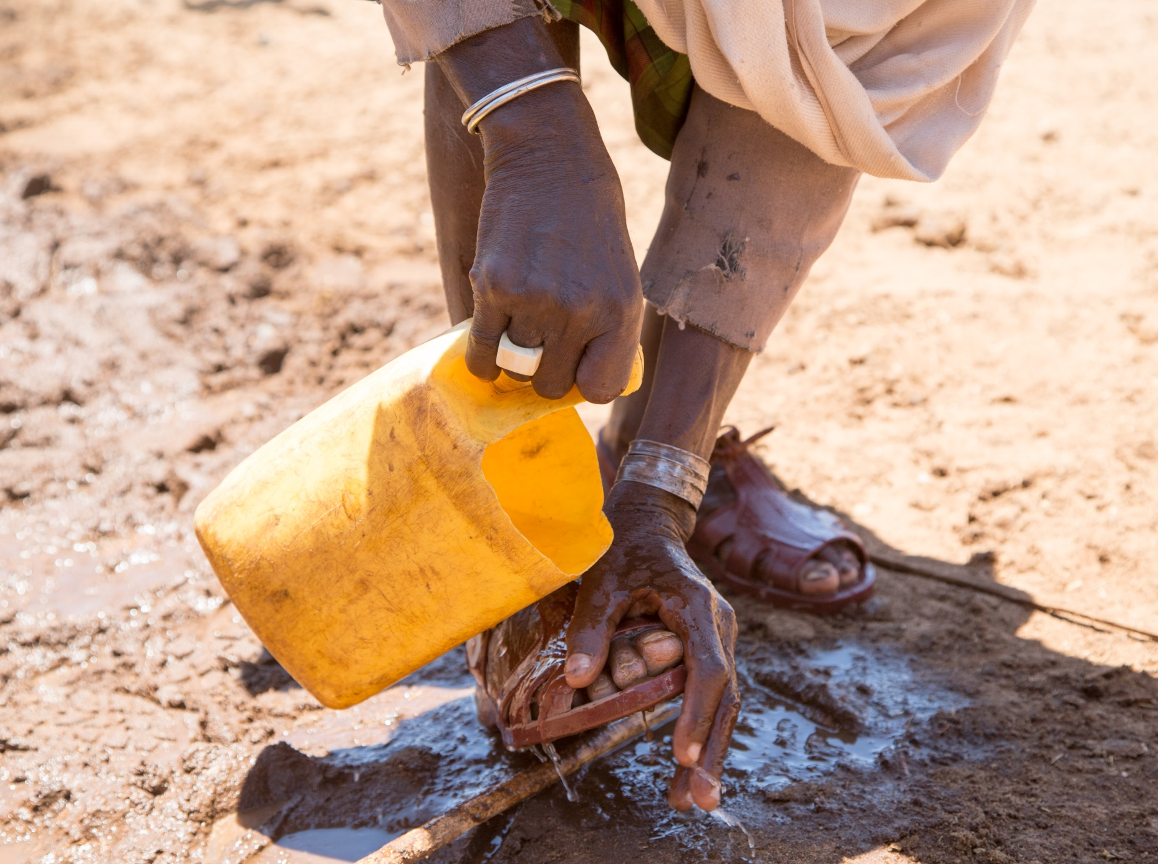
1. Jesus is condemned to death: Fear is the Enemy

Slide 4
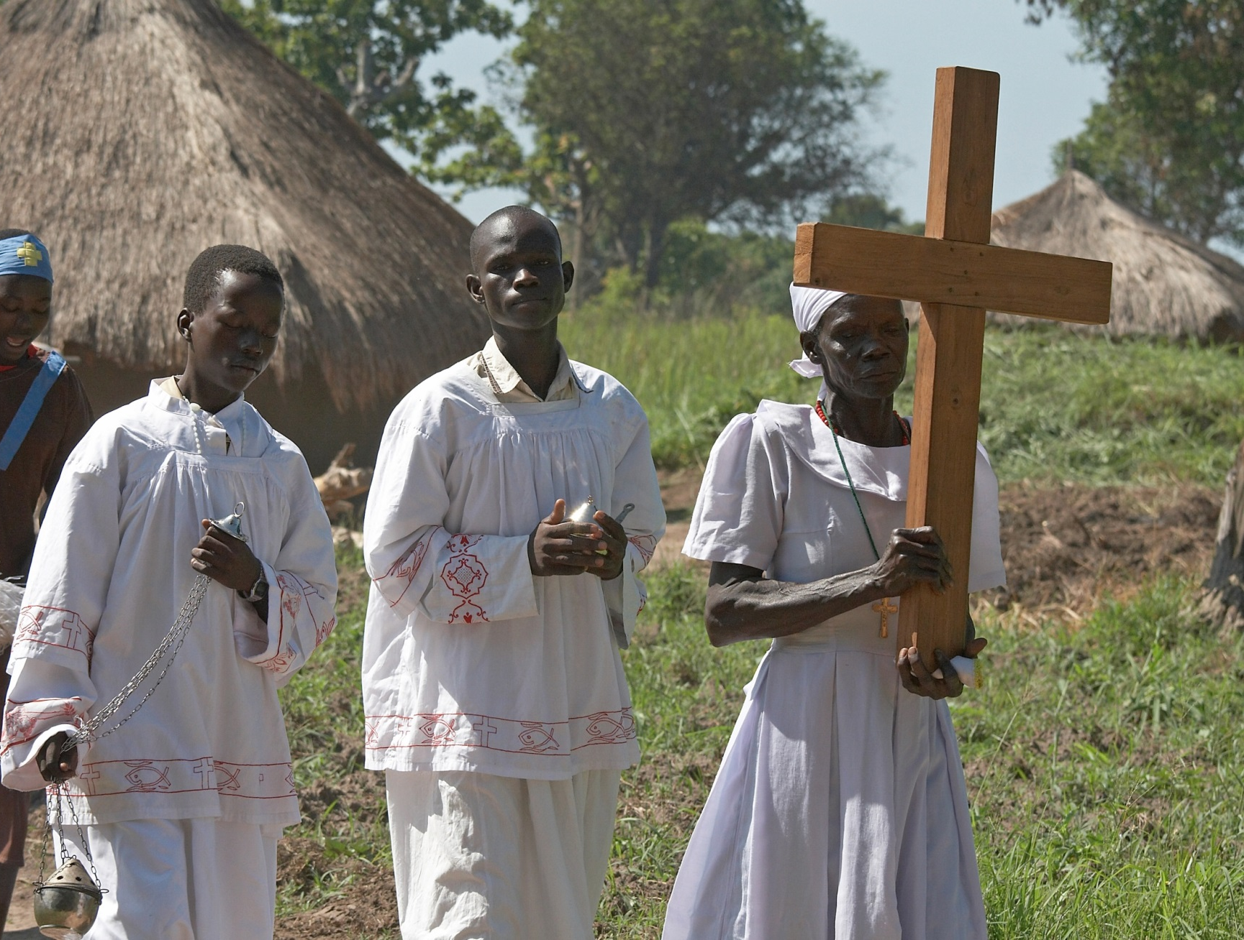
2. Jesus takes up his cross: The Cross

Slide 5
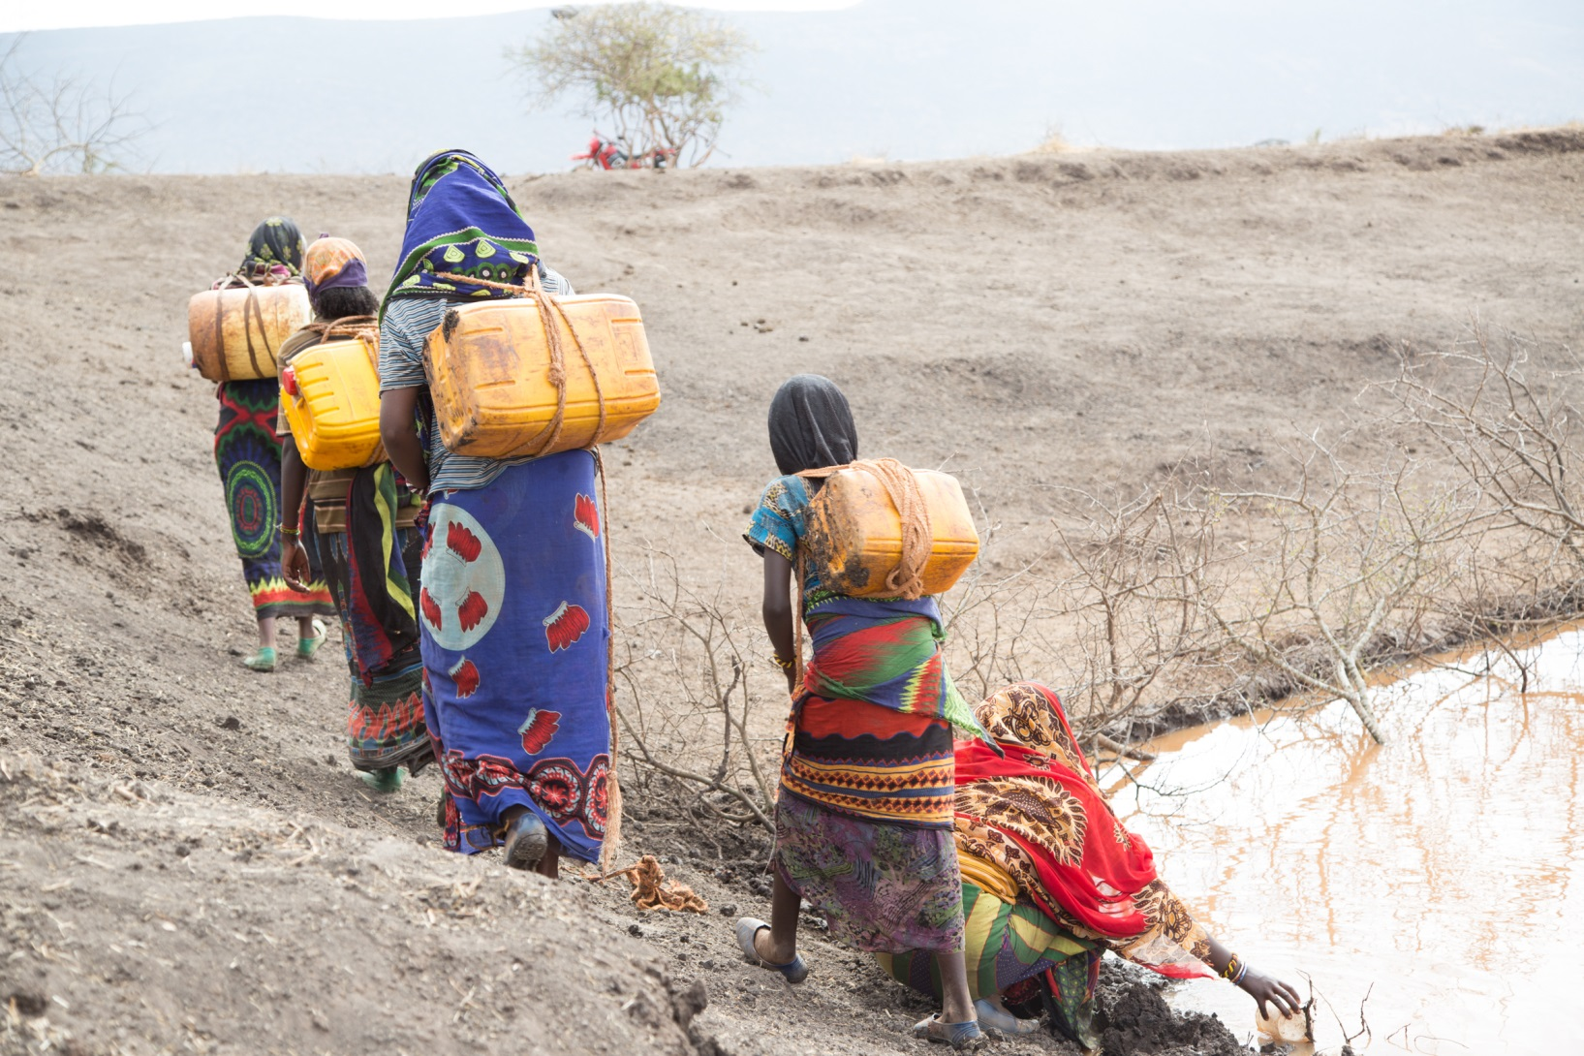
3. Jesus falls the first time: For a stronger Faith

Slide 6
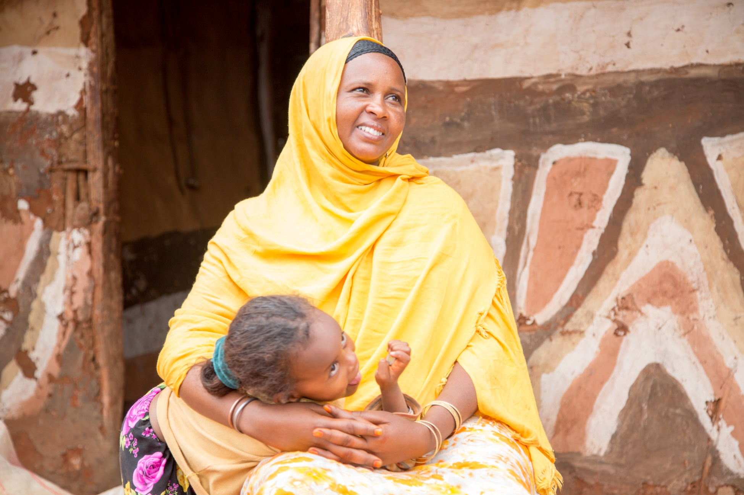
4. Jesus meets his mother: Mother of Mercy

Slide 7
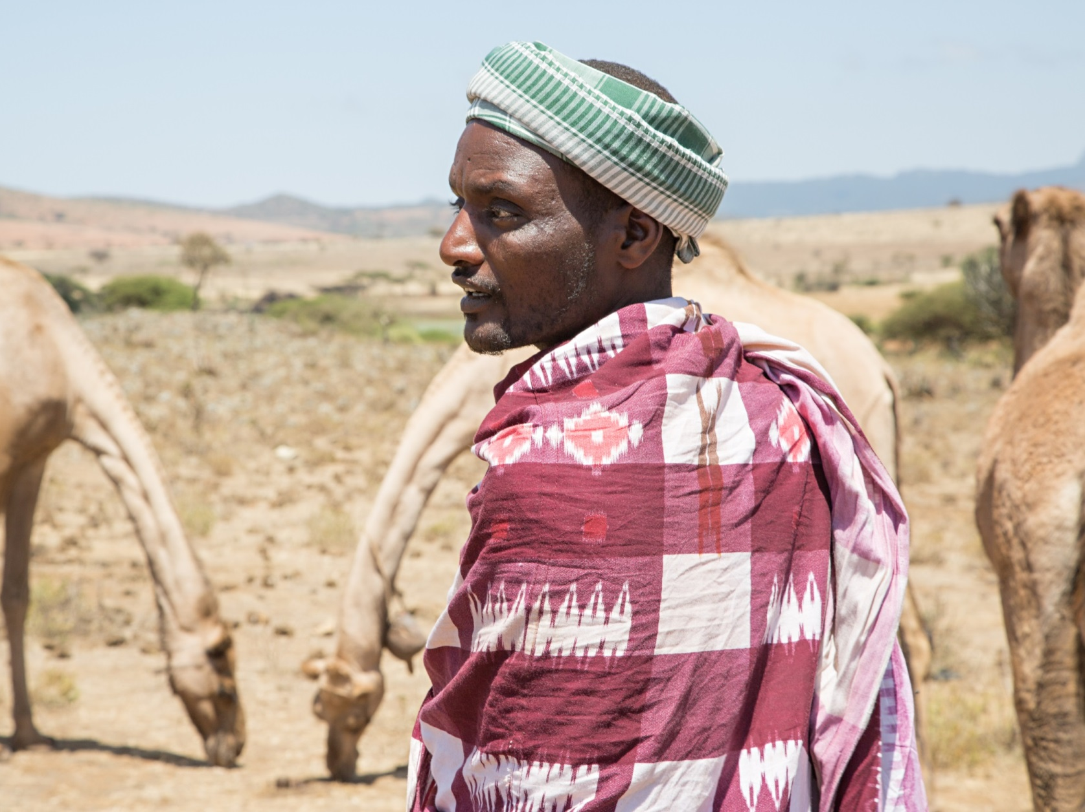
5. Simon of Cyrene helps Jesus: God makes haste to help us

Slide 8
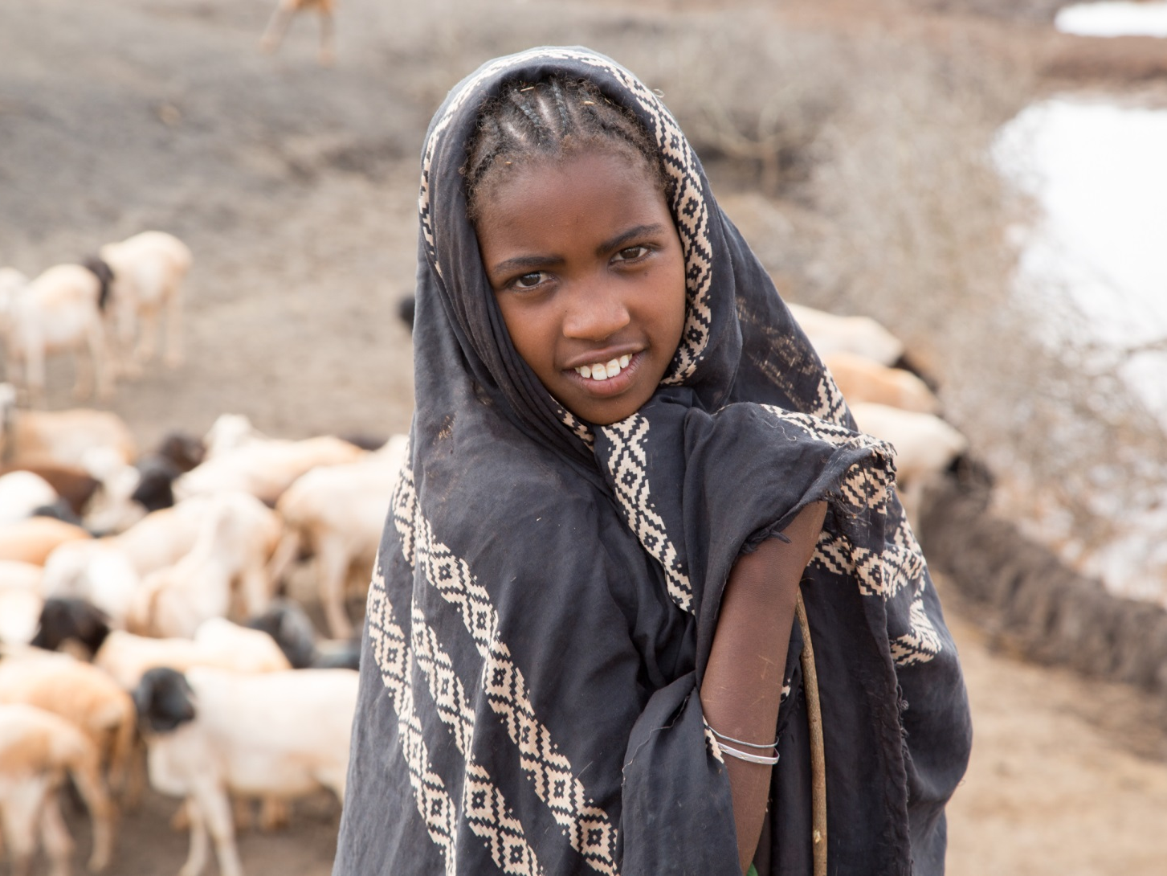
6. Veronica wipes the face of Jesus: The Face of Mercy

Slide 9
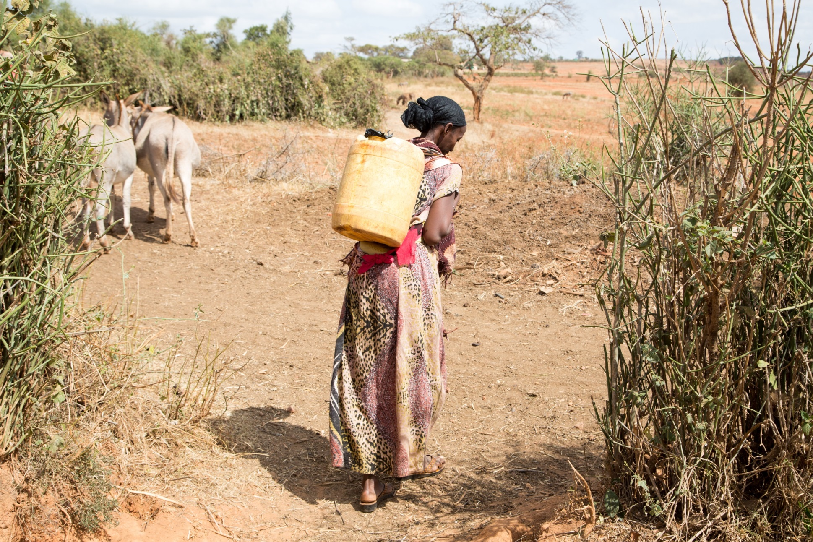
7. Jesus falls the second time: A Renewed Hope

Slide 10
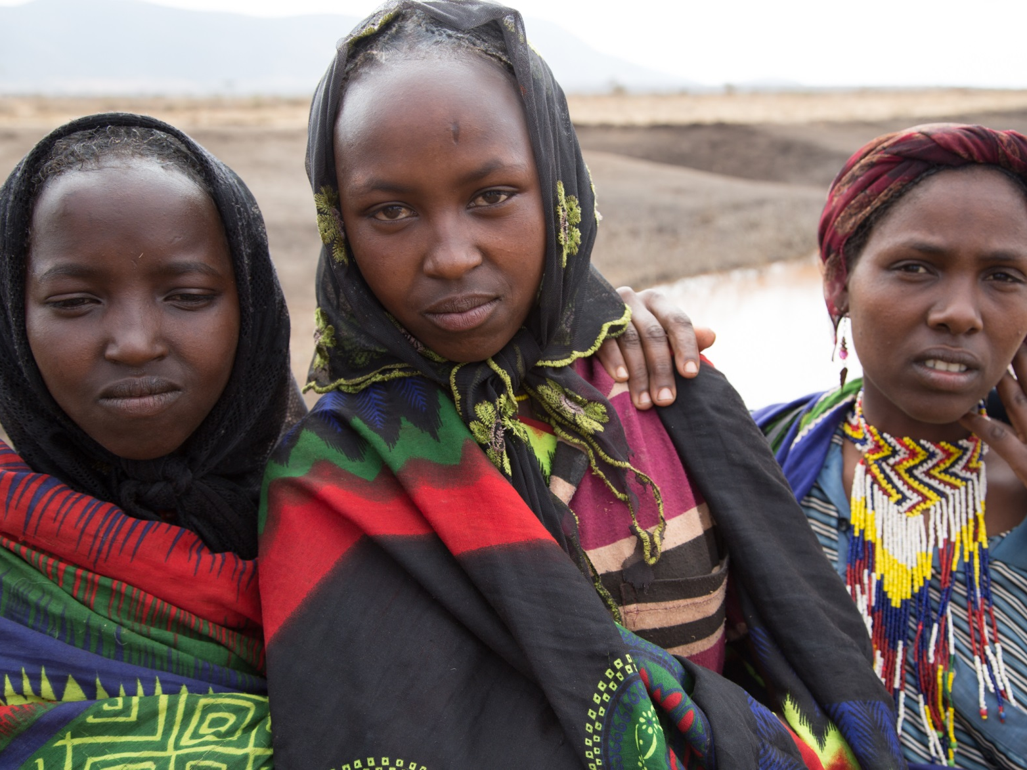
8. Jesus meets the women of Jerusalem: The Little Ones

Slide 11
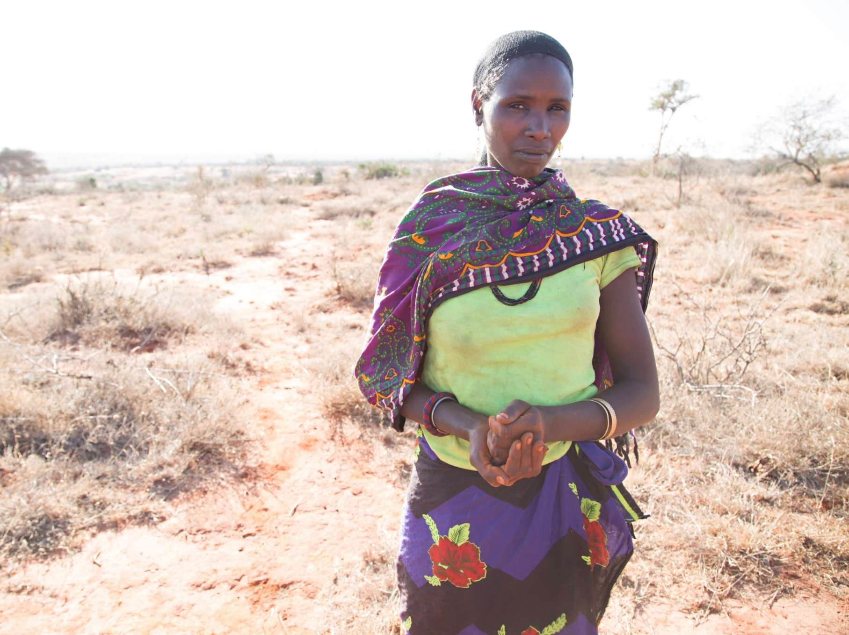
9. Jesus falls the third time: Redeeming Love

Slide 12
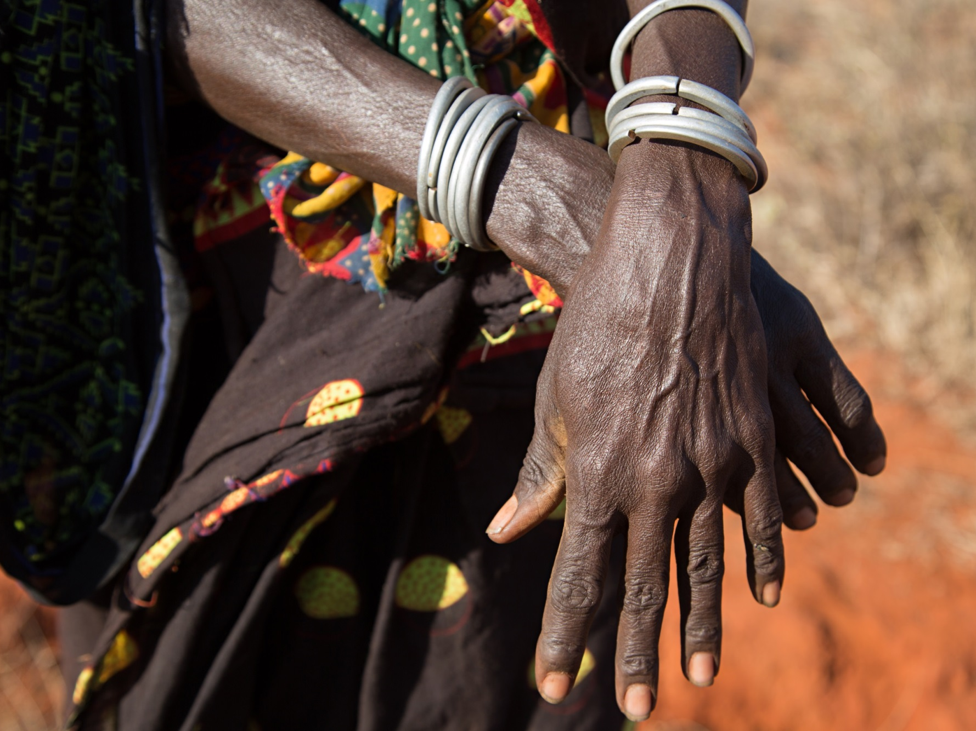
10. Jesus is stripped of his clothing: Restoring Eden

Slide 13
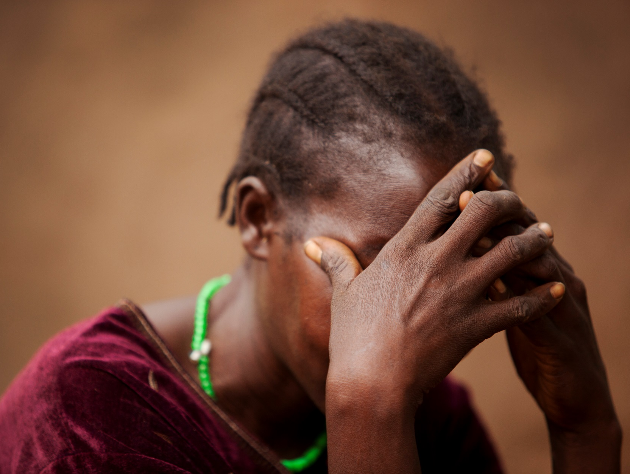
11. Jesus is crucified: Nails, words and other weapons

Slide 14
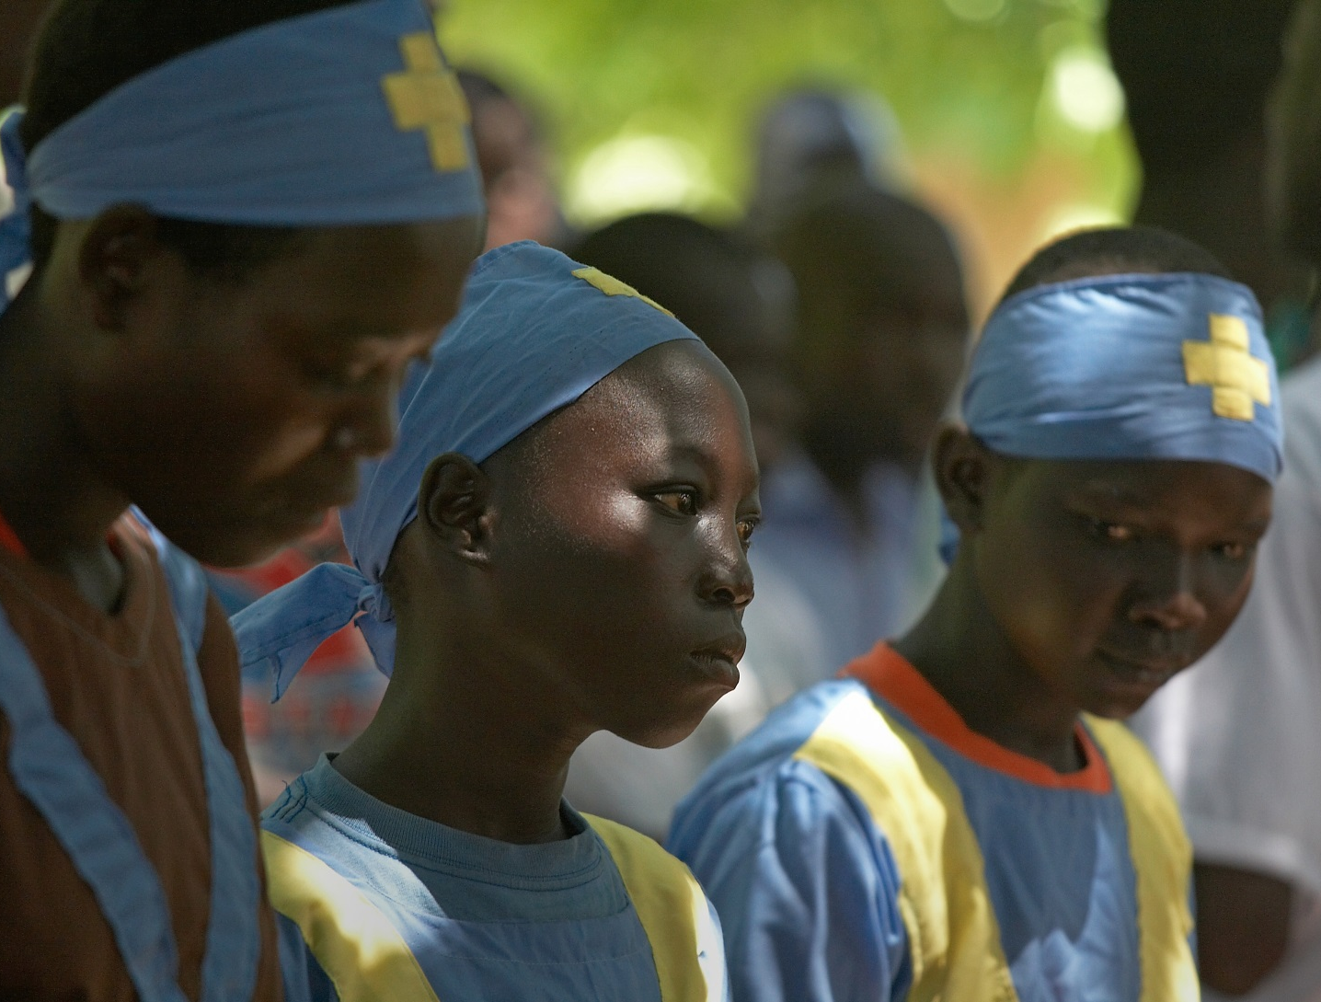
12. Jesus dies on the cross: It is accomplished

Slide 15
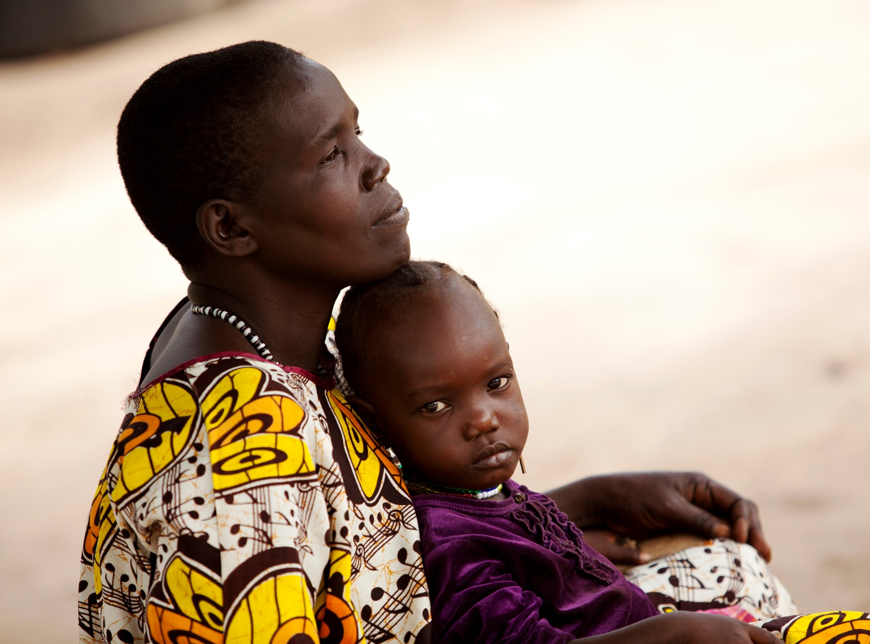
13. Jesus is placed in the arms of his mother: The Passion of Mary

Slide 16
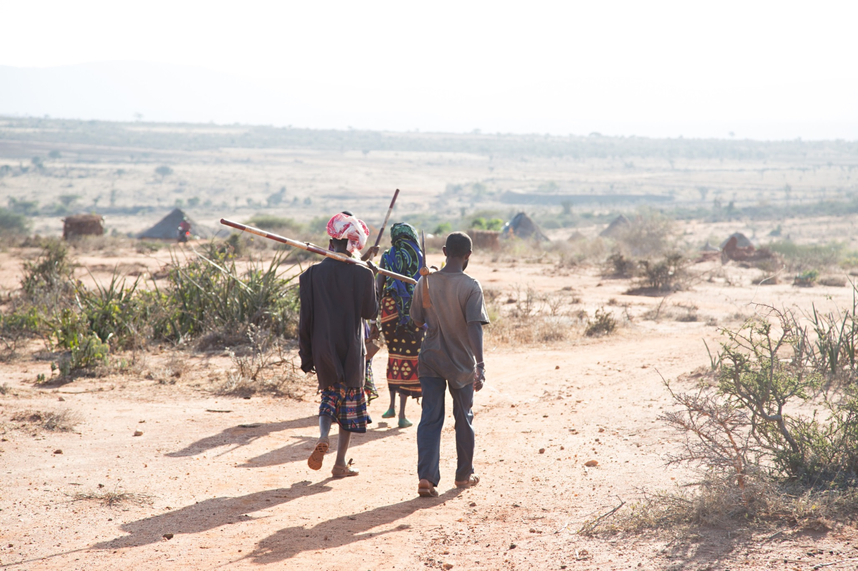
14. Jesus is laid in the tomb

Slide 17
God our Father,
You watch the road for our coming back to you:
You run to meet us on our way rejoicing that we have come back to life.
We can only do this because you have sent Jesus, your first-born and our brother, to show us the path of mercy
which is the Way of the Cross.
He has paid the price of our ransom, he has freed us from death.
Make us joyful witnesses of his risen love and help us, in our own lives, to show that face of mercy to all we meet.
Amen.

Slide 18

This presentation was made to accompany the
Stations of the Cross written for SCIAF by Fr John Bollan.
The photographs show our work with communities across Africa, Asia and Latin America. They were taken by Thomas Omondi, Sean Sprague, Sarah Hunter and SCIAF staff.
Find out more at www.theweebox.org
or call us on 0141 354 5555
SCIAF is the official overseas aid and development charity of the Catholic Church in Scotland.
Registered Scottish Charity No: SC012302. Company No: SC197327. Office: 19 Park Circus, Glasgow G3 6BE

