Slide 1
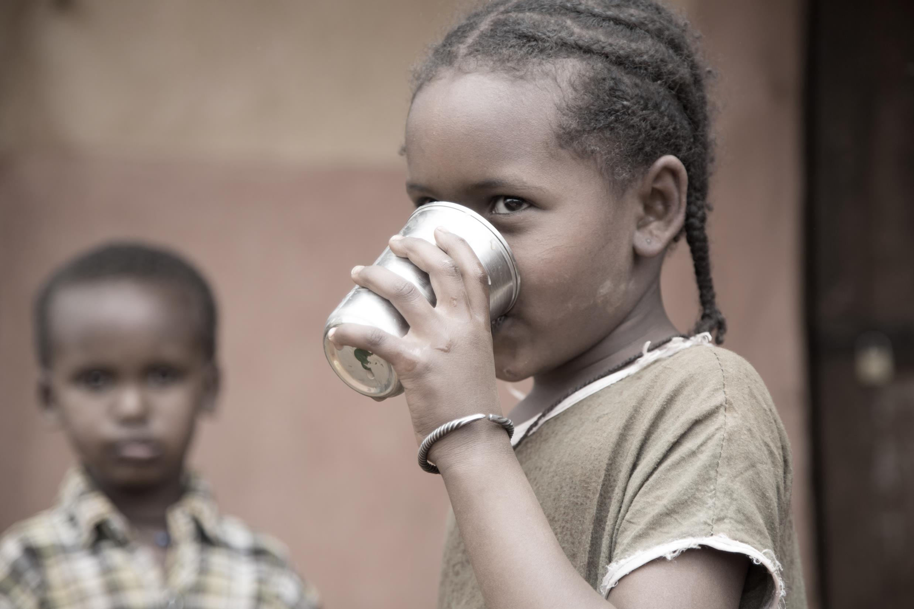

WEE BOX 2016 Prayer Resource Slides

Slide 2
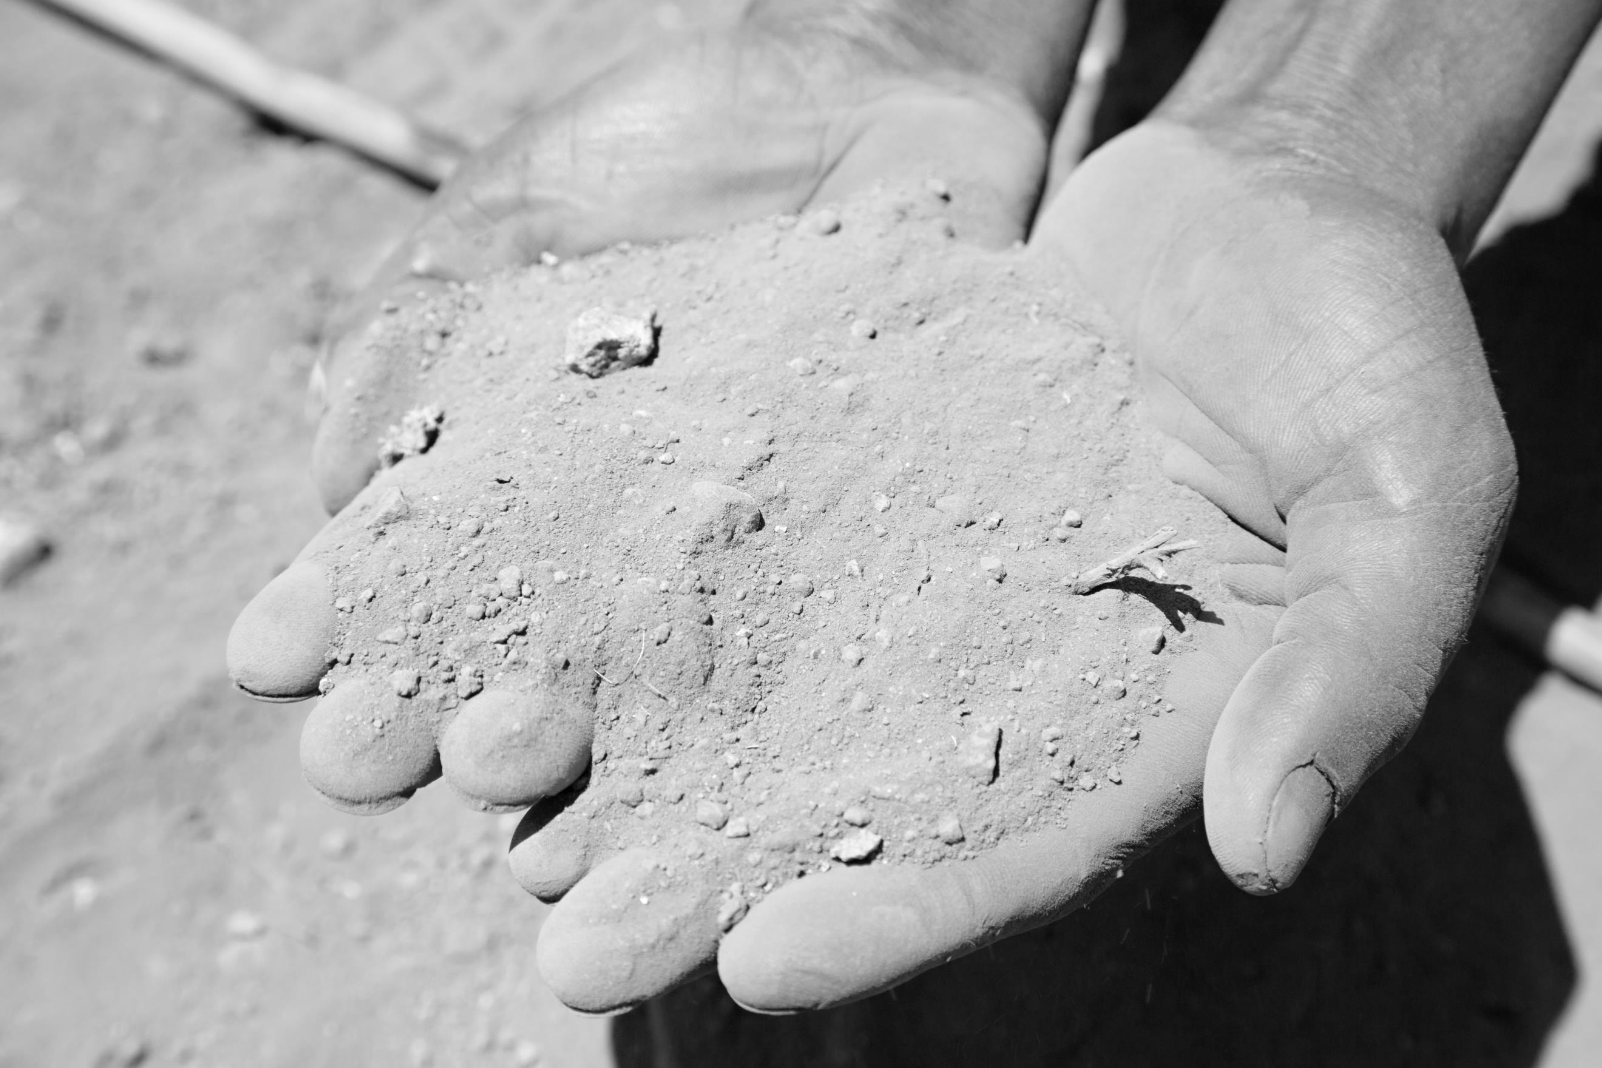
Loving God, whose son Jesus Christ
called all who were thirsty
to come to him, believe and drink.
Look in mercy on your people living in dry lands, and
struggling to survive without access to safe drinking water.
Forgive our selfishness in life and our misuse of
our natural resources.
We commit ourselves to value and care for your gifts to us.

Slide 3

May rivers of living water
and practical compassion for all who
suffer flow out from our hearts.
Refreshed by your Spirit,
and following in the way of Jesus Christ,
help us continue to serve you and the people and creation
entrusted to our care.
Amen

Slide 4
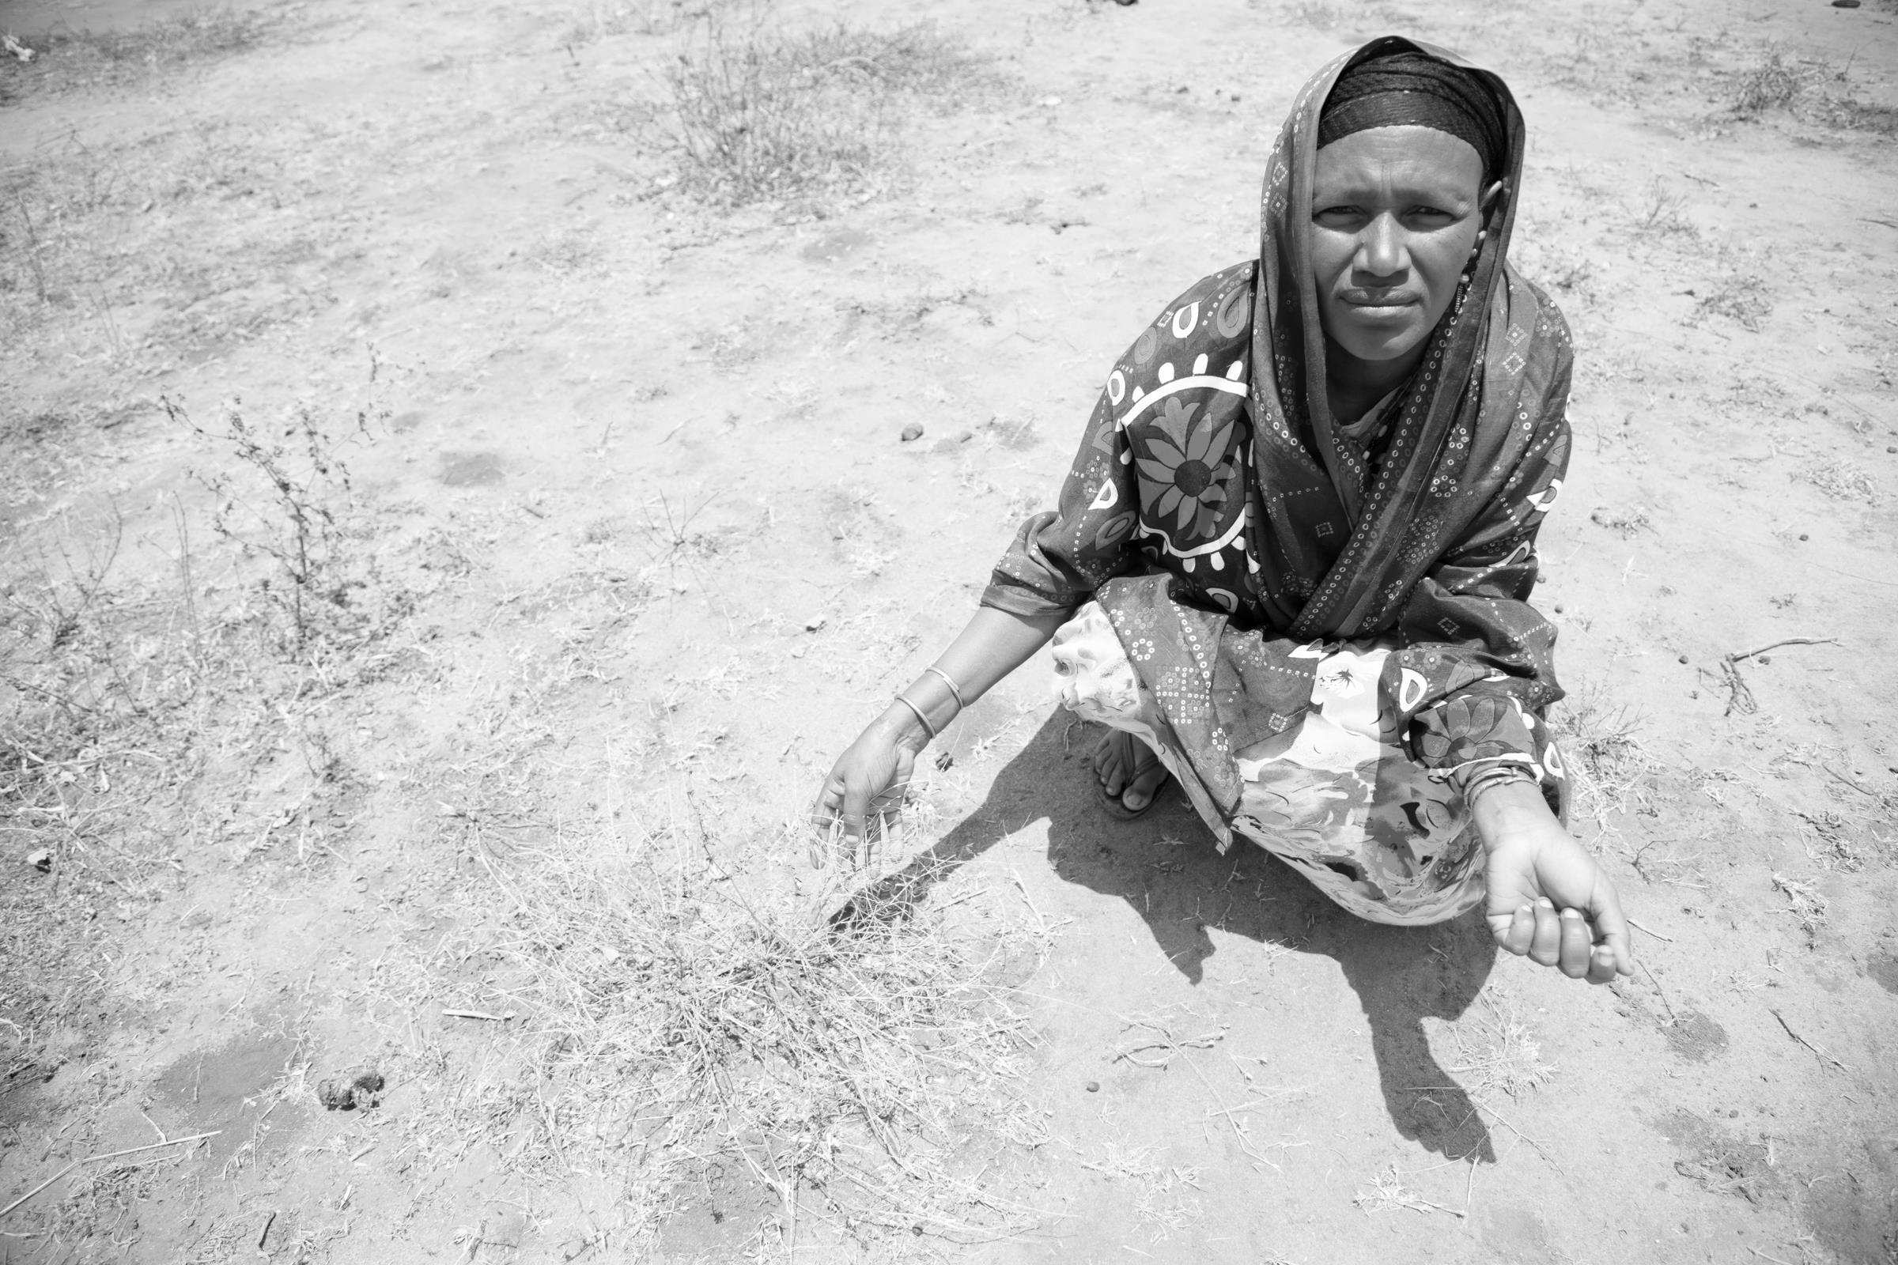
May God open the heavens and let His mercy rain down upon our fields and mountains.
Let us especially pray for those most impacted by water shortages and for the wisdom and charity to be good stewards of this precious gift.
May our political leaders seek the common good as we learn to care and share God's gift of water for the good of all.
In Jesus Name, Amen.

Slide 5


Thought/Prayer for the day
When you help the poor you are lending to the Lord--and he pays wonderful interest on your loan! Prov. 19:17

Slide 6
Thought/Prayer for the day
“From the heart of the Trinity, from the depths of the mystery of God, the great river of mercy wells up and overflows unceasingly. It is a spring that will never run dry, no matter how many people approach it.”
Misericordiae Vultus

Slide 7
Thought/Prayer for the day
“God’s mercy can make even the driest land become a garden, can restore life to dry bones (cf. Ez 37:1-14)... Let us be renewed by God’s mercy, let us be loved by Jesus, let us enable the power of his love to transform our lives too; and let us become agents of this mercy, channels through which God can water the earth, protect all creation and make justice and peace flourish.”
Pope Francis, Easter Urbi et Orbi message on March 31, 2013

Slide 8
Thought/Prayer for the day
If you pour yourself out for the hungry and satisfy the desire of the afflicted, then shall your light rise in the darkness and your gloom be as the noonday.
Isaiah 58:10

Slide 9
Thought/Prayer for the day
We love because he first loved us. If anyone says, “I love God,” and hates his brother, he is a liar; for he who does not love his brother whom he has seen cannot love God whom he has not seen. And this commandment we have from him: whoever loves God must also love his brother. 1 John 4:19-20

Slide 10
Thought/Prayer for the day
“I was hungry and you gave me food; I was thirsty and you gave me drink; I was a stranger and you made me welcome; naked and you clothed me, sick and you visited me, in prison and you came to see me… I tell you solemnly, in so far as you did this to one of the least of these brothers of mine, you did it to me.”
Matthew 25

Slide 11
Thought/Prayer for the day
The rich and the poor have this in common: the Lord is the maker of them all.
Proverbs 22:2

Slide 12

Scottish Catholic International Aid Fund is the official international aid and development agency of the Catholic Church in Scotland. We respond to emergencies around the world and work with poor people in Africa, Asia and Latin America. We also campaign for a more just world.
Photos: Sarah Hunter

