Slide 2
First Impressions
Have a look at the pictures around the room. What is your first impression of the person in the picture?
Write a word or phrase to describe your impressions of this person on a post it note and stick it around their picture. Think about:
what kind of person they might be
where they might live
what they might do as a job
what kind of family might they come from
what their hobbies might be

Slide 3
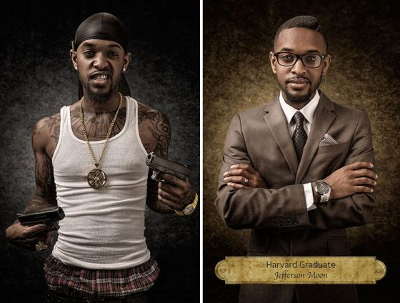
Were you right?

Slide 4
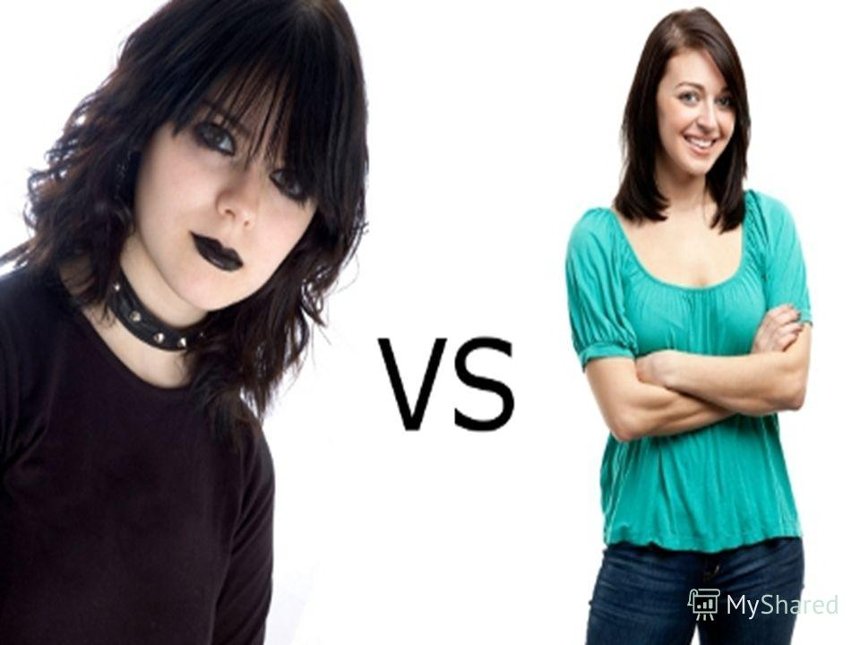
Were you right?

Slide 5
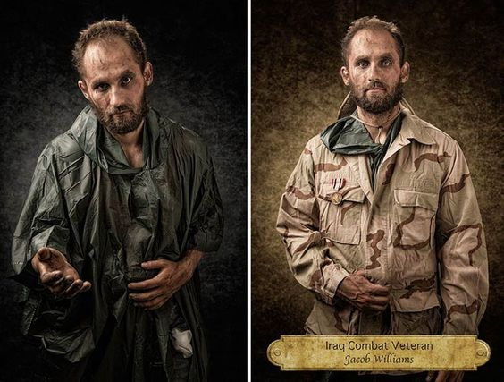
Were you right?

Slide 6
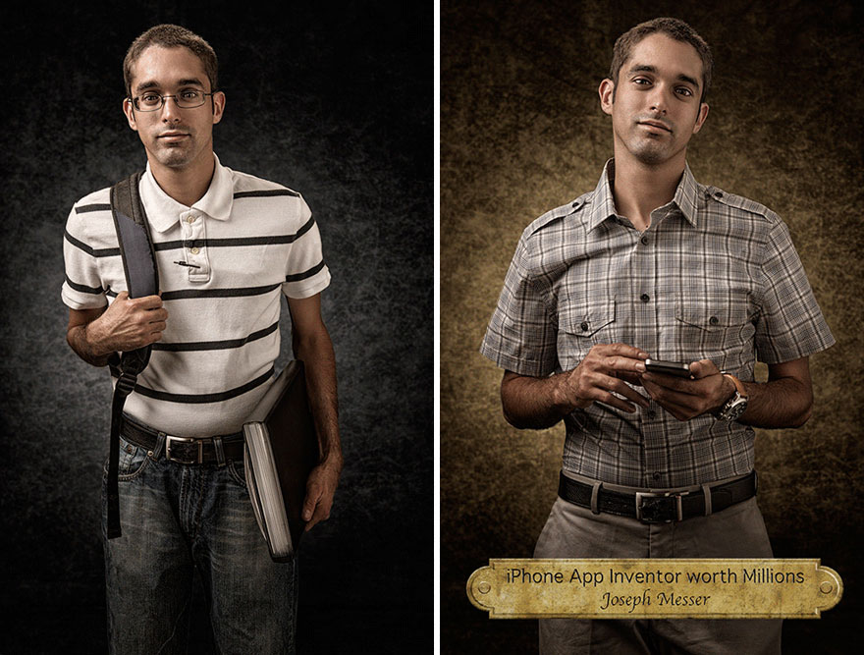
Were you right?

Slide 7
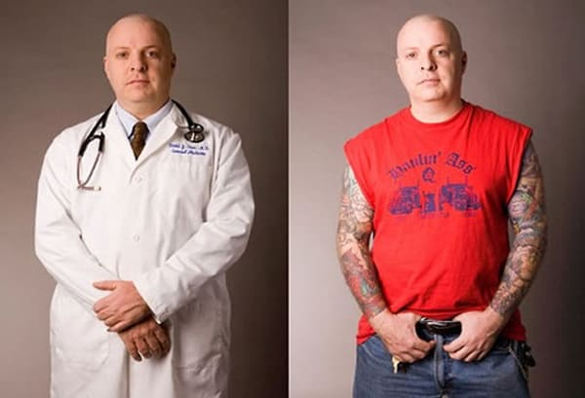
Were you right?

Slide 8
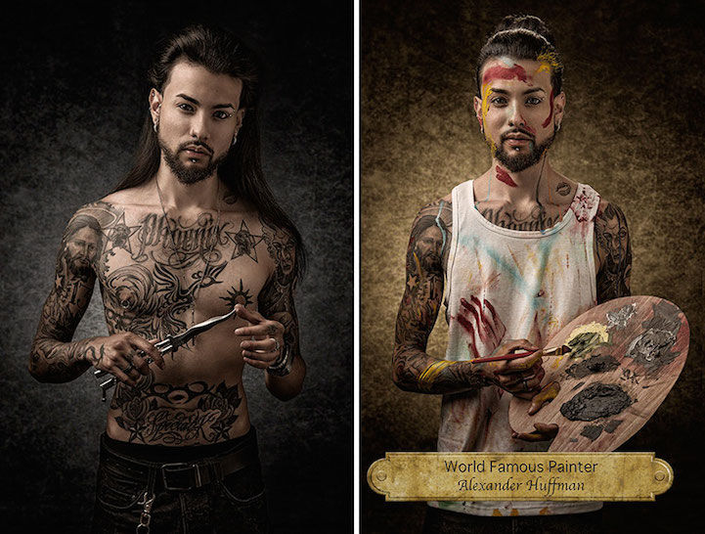
Were you right?

Slide 9
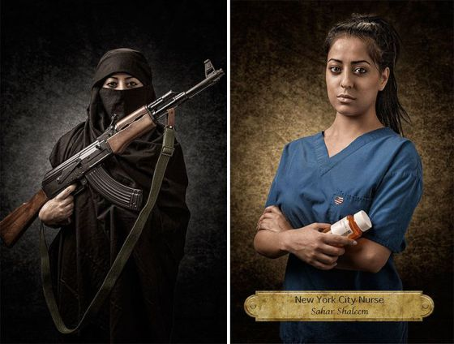
Were you right?

Slide 10
People are often described as being like onions.
Why?

Slide 11
Discussion Time
Following the activity let’s think about the answers to the following questions:
What decisions do you make when you see someone for the first time?
How can these decisions hurt or help others?
How do first impressions lead us to missed opportunities?
How can we change this?

Slide 12
What is a Stereotype?
A stereotype is an idea or belief many people have about a thing or group that is based upon how they look on the outside, which may be untrue or only partly true. Stereotyping people is a type of prejudice because what is on the outside is a small part of who a person is.

Slide 13
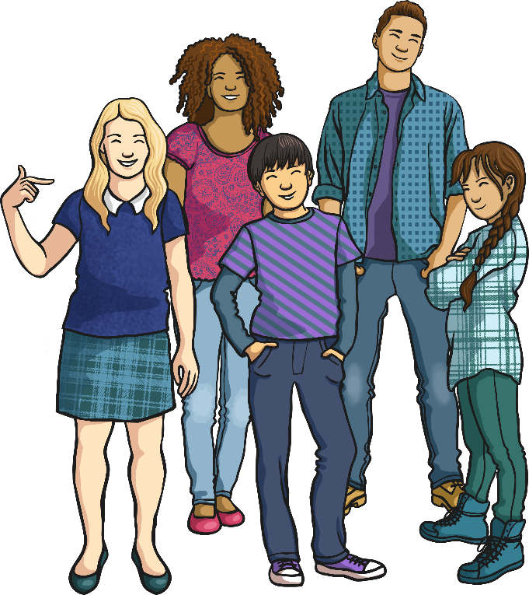
Challenging Stereotypes
We should never judge a person or a group just because of the way they look, their gender, the job they have, their age or their likes and dislikes.
Ideas that people have about
others are not always correct.

