Slide 1
I am Unique

Slide 2
Imagine how strange it would be if we all looked the same. Wouldn’t it be difficult to identify our family and our friends.

Slide 3
What if we all shared the same likes and dislikes?
What if everyone in the playground wanted to play football and everyone wanted to be in goals?
It just wouldn’t work.

Slide 4
Fortunately, each one of us is different. We may look a little like our parents or our brothers and sisters. We may have the same likes and dislikes as our friends but our own special mix makes us unique.

Slide 5
Did you know we all have a unique fingerprint? No two people in the world have the same fingerprint.

Slide 6
This is true everywhere we look!
Did you know that every snowflake has its own pattern?
Even though two snowflakes may form in the same cloud, their different journeys to the ground will affect their shape and size, giving each snowflake its own unique identity.

Slide 7
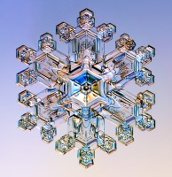
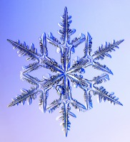
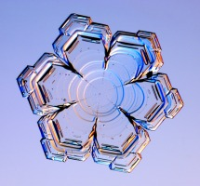
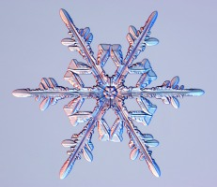
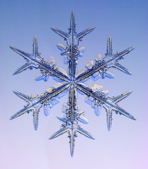
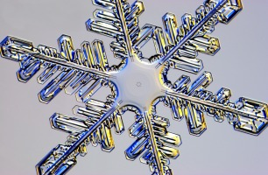
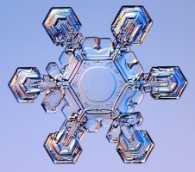
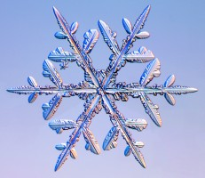
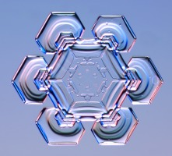
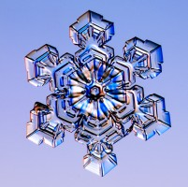
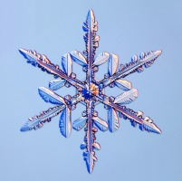

Slide 8
We may sometimes wish to be a little more like someone else; a bit taller, a bit less shy, more sporty, a better singer, more confident. But remember, many others might be striving to be a bit more like you.
We are who we are and we should celebrate this.

Slide 9
Quiet Reflectio
What makes you unique?

