Slide 1
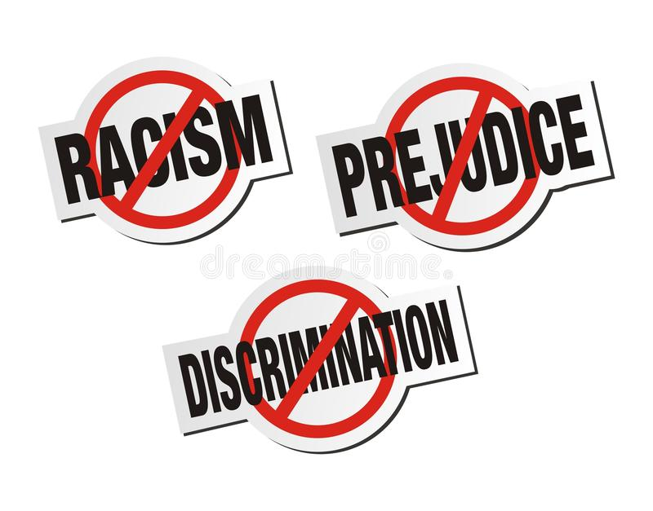
Prejudice and Discrimination

Slide 2
Definitions
Stereotype: An idea or belief about a certain group of people.
Prejudice: A feeling about a person based on their membership of a group.
Discrimination: An action that denies the rights of a person due to their membership of a group.

Slide 3
(idea)
“people with pink hair are mean”
(feeling)
“I don’t like people with pink hair”
(action)
“I’m not going to let anyone with pink hair sit next to me”

Slide 4
Prejudice or Discrimination?
Look at the cards in front of you and decide whether each scenario is an example of prejudice or discrimination. Sort the cards into two piles.

Slide 5
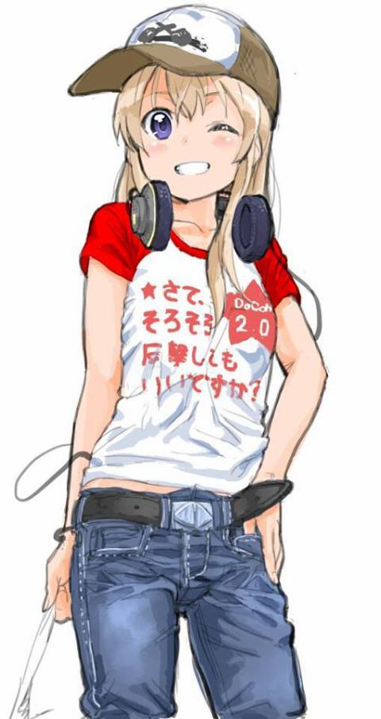
Sally’s Story
  Re read Sally’s story and as a class discuss:
  Has Sally done anything wrong?
  Why are people treating her badly?
  What is wrong with what they are saying to her?
  Why do you think that they are calling her gay?
  What is wrong with them using that word?
  How might Sally feel because of this?
  Should Sally change because of how she is being treated?
  What should other pupils who hear this name calling do?
  Should Sally tell anyone how this is making her feel? Who?
  What should happen to the people who are calling her names?
  How could restorative practice help Sally and the rest of the pupils?

Slide 6
Look at your bundle of scenario cards.
In pairs choose ONE that shows a form of prejudice and ONE that shows an act of discrimination
With your partner discuss
PREJUDICE Scenario: why the person showing the prejudice may feel that way? What impact might their prejudice have on the other person? How can their prejudice be changed?
DISCRIMINATION Scenario: why is the person acting badly? What impact might their discrimination have on the person they are doing it to? What prejudice are they showing? What could happen to them in terms of the law? How can their discrimination be stopped?

Slide 7
Universal Declaration of Human Rights
Article 2 states that:
Everyone is entitled to all the rights and freedoms set forth in this Declaration, without distinction of any kind, such as race, colour, sex, language, religion, political or other opinion, national or social origin, property, birth or other status. Furthermore, no distinction shall be made on the basis of the political, jurisdictional or international status of the country or territory to which a person belongs, whether it be independent, trust, non-self-governing or under any other limitation of sovereignty.

Slide 8
Unicef Rights of the Child
Article 2 states that:
All children have these rights, no matter who they are, where they live, what their parents do, what language they speak, what their religion is, whether they are a boy or girl, what their culture is, whether they have a disability, whether they are rich or poor. No child should be treated unfairly on any basis.

Slide 9
Equality Act 2010
Legally protects people from discrimination in the workplace and in wider society.
Makes the law easier to understand.
All groups have the same level of protection.

Slide 10
Protected Characteristics

