Slide 1

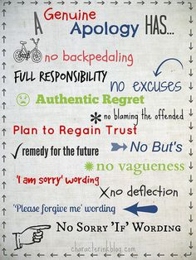

Slide 2
Restorative Practice

Slide 3
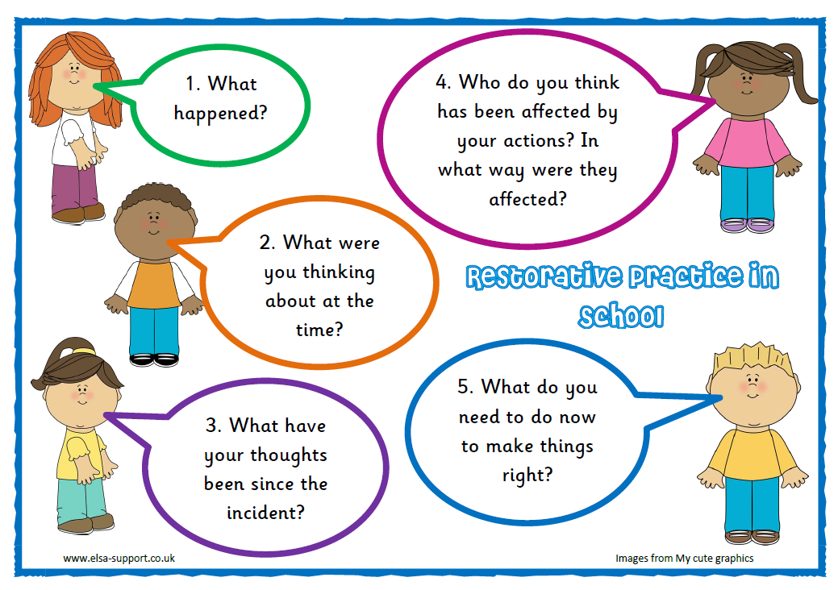

Slide 4
