Slide 1

Catholic Education Week 2021
Celebrating & Worshipping

Slide 2

Celebrating & Worshipping

Slide 3

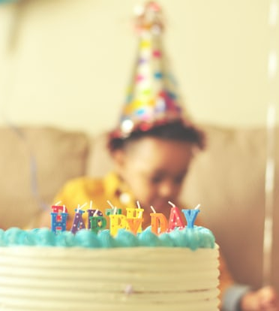

Celebrating & Worshipping
What images come to mind when you hear the word 'celebrating'?

Slide 4
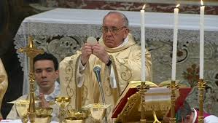
Mass
Did you remember to include celebrating Mass?

Slide 5

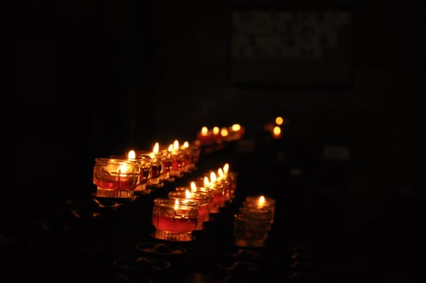
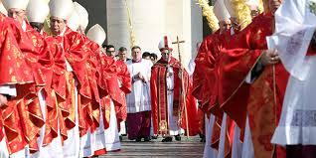
Celebrating & Worshipping
What images come to mind when you hear the word ‘worshipping’?

Slide 6
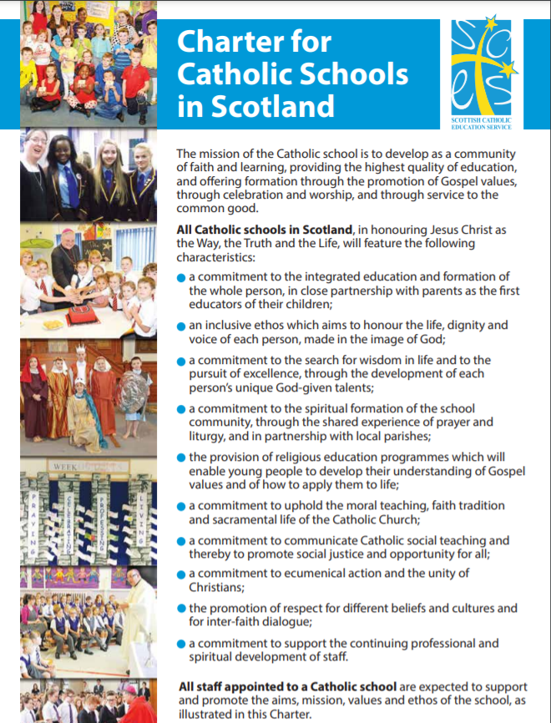
The Charter for Catholic Schools
In the Charter for Catholic Schools, it says the school should display:
a commitment to the spiritual formation of the school community, through the shared experience of prayer and liturgy, and in partnership with local parishes.
What does this mean to you in school today?

Slide 7
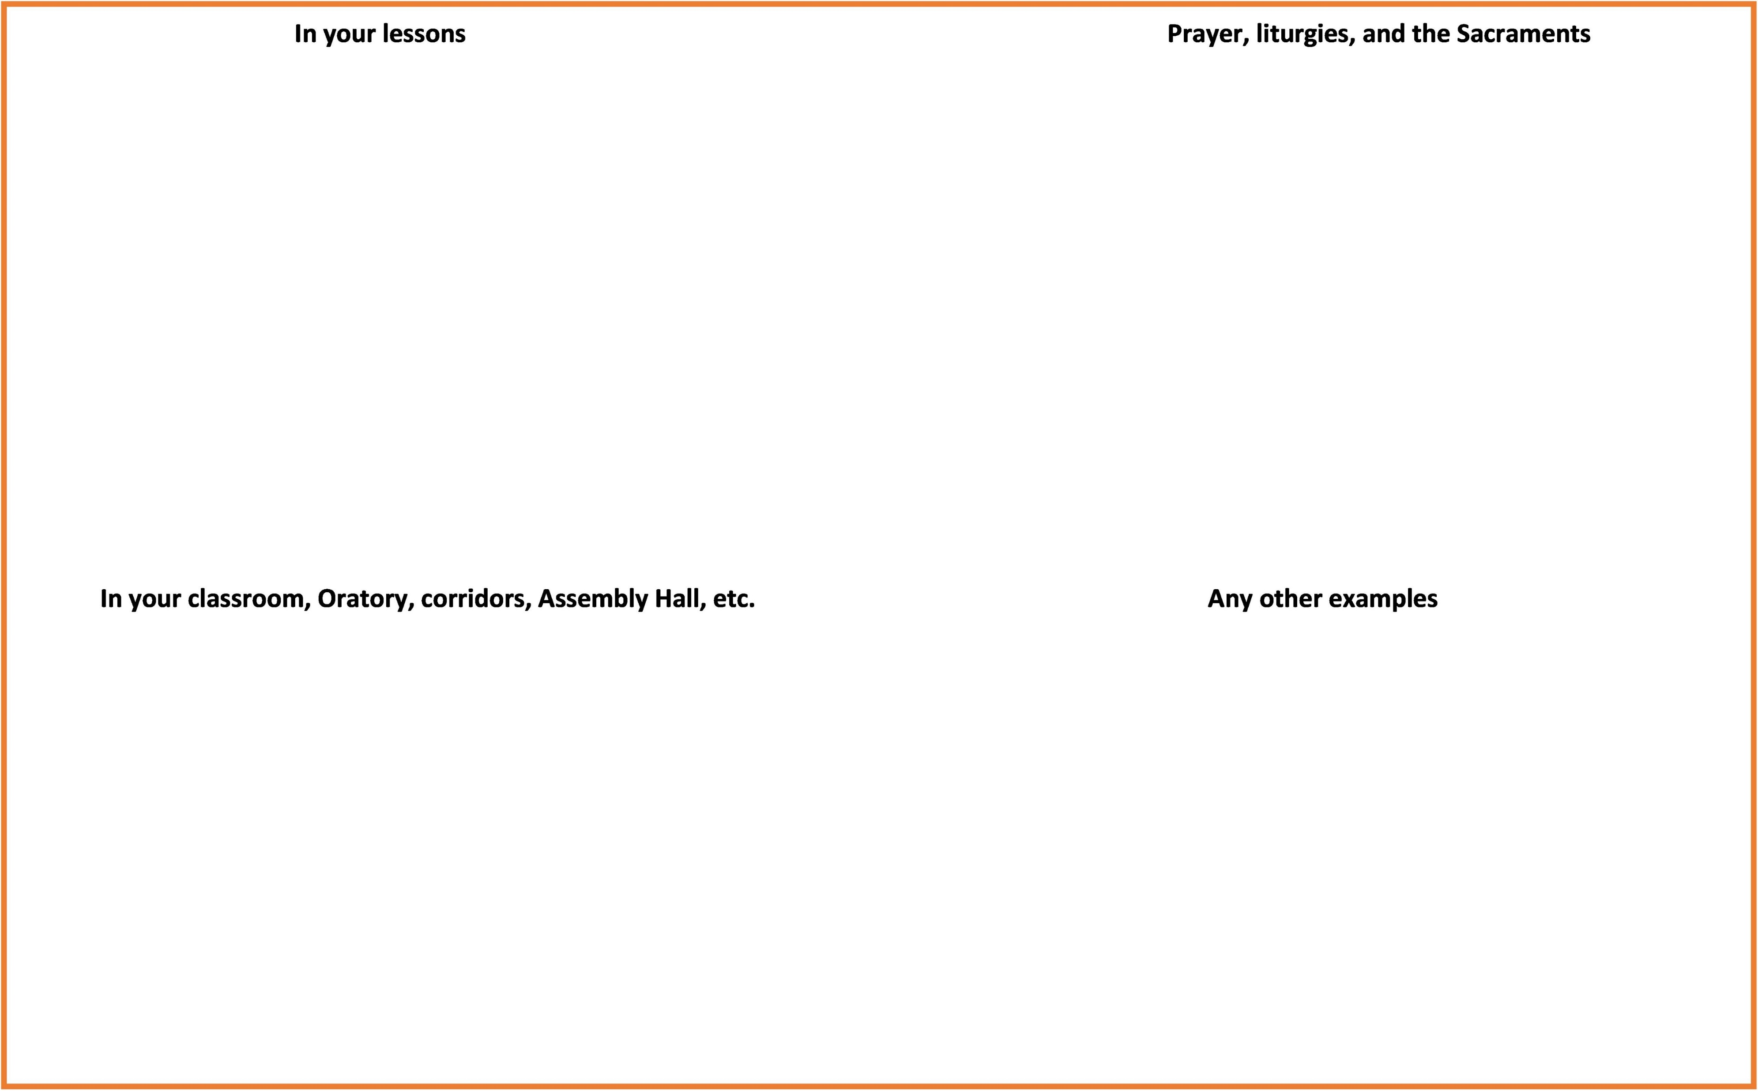
Activity 1: The Catholic School
Using the placemat note the ways that indicate you are part of a community of faith in a Catholic school.
Share your answers with the class.

Slide 8
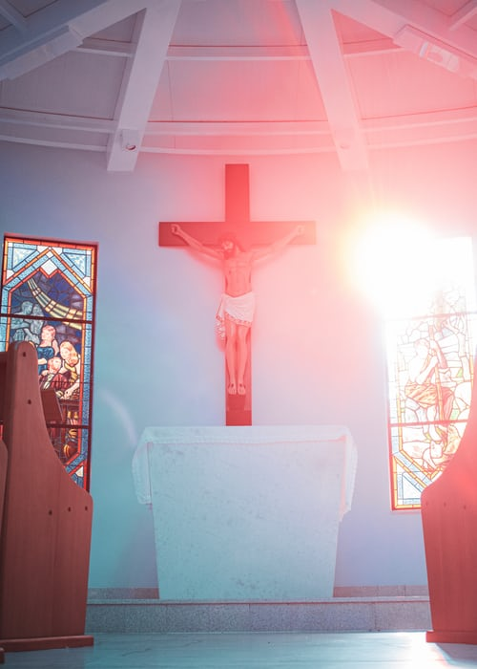
Prayer & Liturgy
The Catholic school is a believing community which celebrates faith in Jesus through prayer and liturgy.
The word ‘liturgy’ originally meant a ‘public work’ or ‘a service in the name of/on behalf of the people’. In Christian tradition it means the participation of the People of God in ‘the work of God’. Through the liturgy, Christ, our redeemer and high priest, continues the work of our redemption in, with, and through His Church. CCC 1069

Slide 9

The Youth Catechism says:
'Celebrating the Christian mysteries is about encountering Jesus Christ in time. Until the end of time he is present in his Church. The most profound encounter with him on earth is the liturgy (divine worship).'
'Liturgy becomes exciting when one senses that God himself is present under its sacred signs and its precious, often ancient prayers'.
What does this mean to you ?

Slide 10
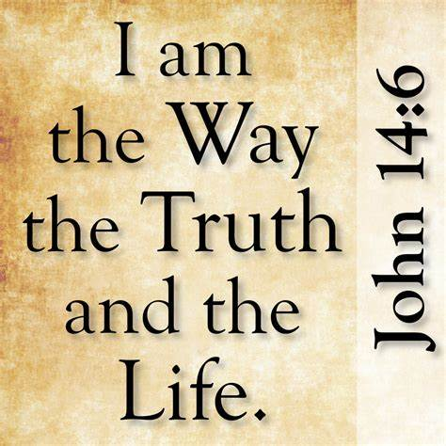
Liturgy
When we celebrate the liturgy, we are drawn into the love of God, healed and transformed. CCC 1076
The Youth Catechism explains this:
The sole purpose of all liturgies of the Church and all her Sacraments is that we might have life and have it abundantly... we encounter the One who said about himself, "I am the Way, the Truth and the Life".

Slide 11
What is Liturgy?
Liturgy, then, refers to the public prayers of the Church, with Christ as its head, using:
Signs and symbols
Music
Words
Images

Slide 12
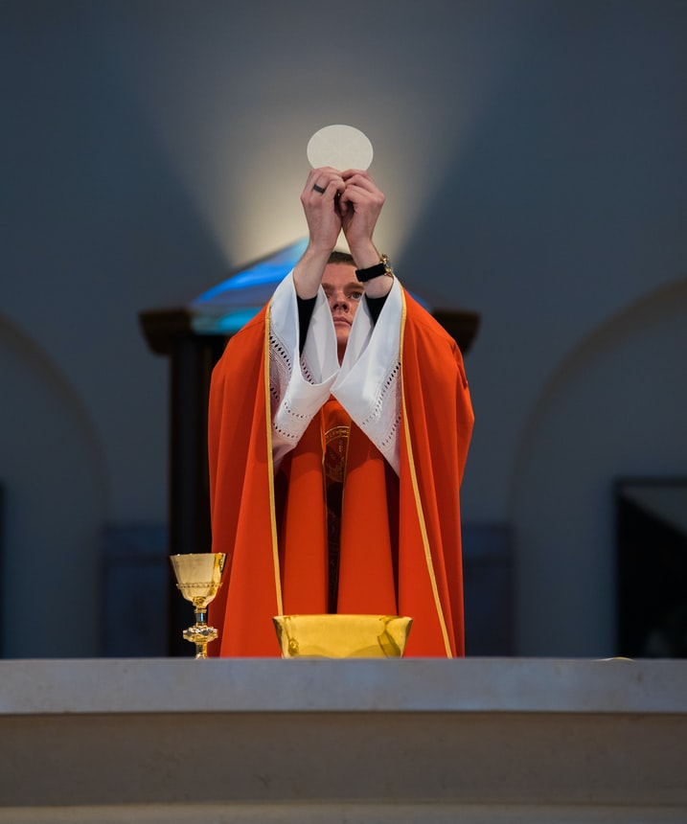
Liturgy is…
The ways in which we pray as a Church; the prayer we engage in as a community.
The focus in the liturgy is not on our personal experience of the great gifts of God; it is on our duty to give back and participate in the work of the Church in worshipping God in many ways that are beneficial to us.

Slide 13
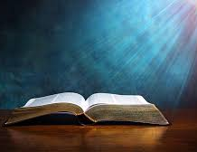
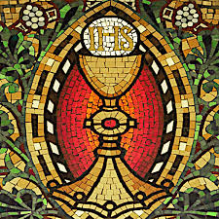
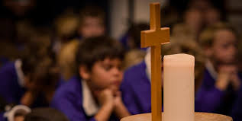
Forms of Liturgy
Liturgy of the Word
Liturgy of the Eucharist
Liturgy of the Hours
The Sacraments

Slide 14
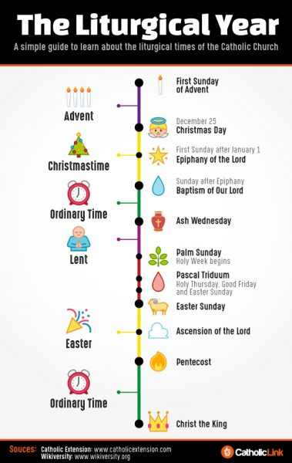
Activity 2 - Quick Quiz
With your shoulder partner answer the following questions:
When does the season of Advent begin?
What colour of vestments does the priest wear in Ordinary Time?
When would we wave palms in Church?
When does the season of Eastertide end?
5. When is All Saints Day celebrated?
How many did you get right?
These questions are all linked to the liturgical calendar.

Slide 15
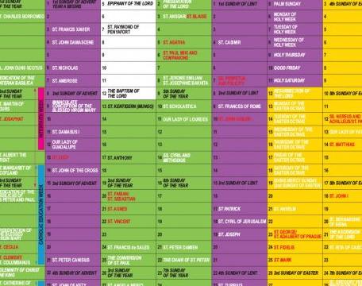
The Liturgical Calendar
The liturgical calendar helps us to focus each day on the person of Jesus.

Slide 16
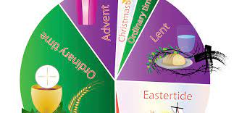
Activity 3 – The Liturgical Year
Look at a liturgical calendar. Your school will have a copy of the SCES liturgical calendar
Highlight the main liturgical seasons on the worksheet.
Why is the liturgical calendar important for a Catholic?
Invite your school chaplain to class to talk about the liturgical year. Ask your chaplain to explain why they wear different coloured vestments in specific liturgical seasons.

Slide 17
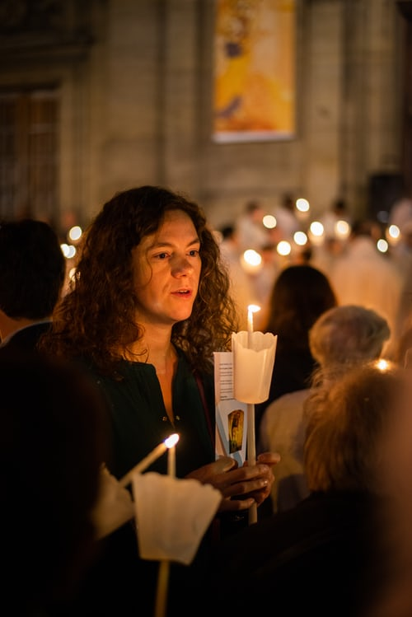
Worship
Worship describes the way that religious people praise and honour God in prayer and religious services.
Ritual refers to the use of symbolic objects, words and actions which allows religious people to express their beliefs about their relationship with God. When they gather in sacred places to praise and worship God, Christians will take part in rituals.
During Mass Catholics will take part in religious rituals which means that they are fully and actively involved in acts of worship with the gathered community.

Slide 18
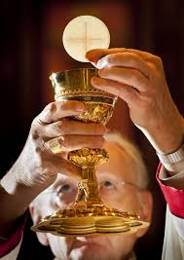
Activity 4 - Mass in School
You will have regularly attended Mass in School. On your show me board list when you have attended Mass.
Did you mention …?
The School Patron’s Day Morning/Lunchtime Mass
Feast Days Lent and Advent Masses
Year group Masses Catholic Education Week
School and Parish celebrations Class Masses
You will also have attended Mass in your associated parish as part of your school’s partnership with its local parishes. Some of you will be representing the school at your local parish as part of Catholic Education Week.

Slide 19
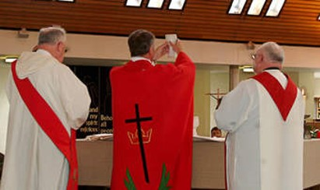
‘eucharistia’ is the Greek word meaning Thanksgiving.
In the early Church, Eucharist was at first the name for the prayer of thanksgiving that preceded the transformation of the bread and wine into the body and blood of Christ. Later, the term was applied to the whole celebration of Mass.
Father all-powerful and ever-living God, we do well always and everywhere to give you thanks. You have no need of our praise, yet our desire to thank you is itself your gift. Our prayer of thanksgiving adds nothing to your greatness, but makes us grow in your grace, through Jesus Christ our Lord.
Preface of Weekdays in Ordinary Time
During Catholic Education Week when we are focusing on the Eucharist, take the time to give thanks and praise to God in your worship

Slide 20
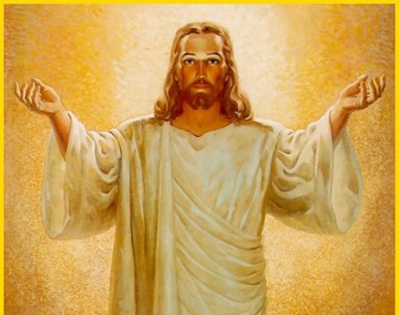
Catholics believe Jesus is truly present at Mass:
In the Word of God - the readings we hear at Mass from the Old and New Testaments are called the Liturgy of the Word. The Bible is God's revelation to us. He is present in his word.
In the bread and wine of the Eucharist. Catholics believe in transubstantiation - at the consecration, the bread and wine become the body and blood of Christ.

Slide 21
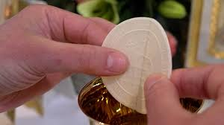
The Eucharist
To Catholics the Eucharist is not just a sign or symbol of Jesus.
The Eucharist is Jesus, truly present under the eucharistic symbols of bread and wine.

Slide 22
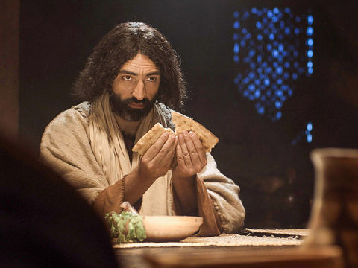
The Eucharist
The celebration of the Eucharist is 'the source and summit of the Christian life’ Second Vatican Council, Lumen Gentium,11
‘I am the bread of life’, Jesus told them. ‘Those who come to me will never be hungry; those who believe in me will never be thirsty’. John 6:35
‘This is my body, which is given for you. Do this in memory of me...This cup is God’s new covenant sealed with my blood, which is poured out for you.’ Luke 22: 19-20

Slide 23
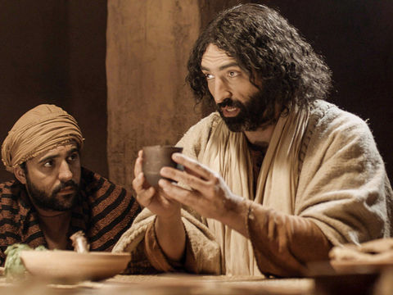
The Eucharist
Every celebration of the Eucharist is still the one supper that Christ celebrated with his disciples, and, at one and the same time, the anticipation of the banquet that the Lord will celebrate with the redeemed at the end of time.
In the celebration of the Eucharist the congregation does not celebrate itself; rather it discovers and celebrates again and again the presence of Christ's saving passage through suffering and death to life. (YOUCAT, 212)
'This means that every time you eat this bread and drink from this cup you proclaim the Lord's death until he comes.' 1 Corinthians 11:26

Slide 24
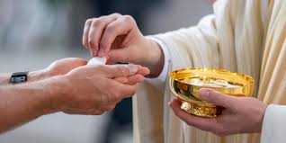
At Mass
Through reciting the Gloria, you have praised God
You have listened to God's word
You have learned about the teachings of Christ as the priest explains how the Gospel message can be applied in our daily life
You have reflected on the beliefs of Catholics about God and the Church by saying the Creed
You have prayed for those in need during the intercessions
You have been nourished and strengthened through receiving the Eucharist
You are ready to love and help others in the service of the Lord when you leave the Church
Activity 5. Write a detailed response beginning with:
Mass is central to the life of a Catholic because ….

Slide 25
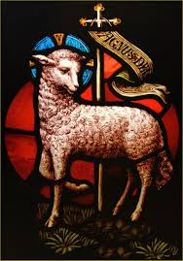
Receiving communion is very important to Catholics because:
Jesus is truly present in the host
God gives himself to each of us individually and wants to transform us
Once we are transformed, we are supposed to transform the world. This reflects the instruction we are given at the end of every Mass:
Go and announce the Gospel of the Lord OR
Go in peace, glorifying the Lord by your life.
We have received the body of Christ, so, we should now aim to love and serve the Lord through our ongoing words and actions.

Slide 26
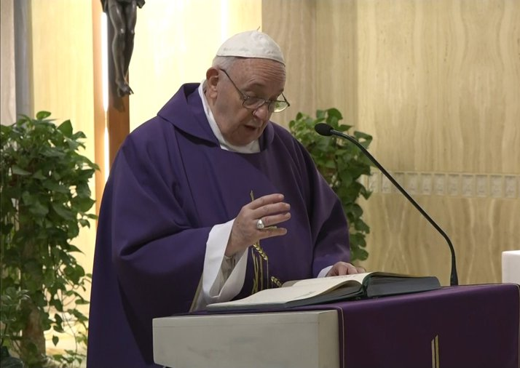
The Eucharist is not the reward of saints, no; it is the Bread of sinners. This is why he exhorts us: "Do not be afraid. Take and eat."
Pope Francis

Slide 27
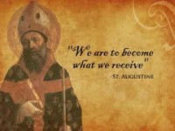
Activity 6
What is the connection between the Last Supper and the Eucharist?

Slide 28

The end of Mass is called the Dismissal.
This transformation and command to mission should be taken seriously. We love and serve God when we reach out and help others in need. So, we believe in the risen Christ and are asked to follow his commands to love and serve our neighbour. This should be a normal part of our daily lives and should be second nature to believers in Christ. We are strengthened in this mission by receiving the Eucharist at Mass.

Slide 29
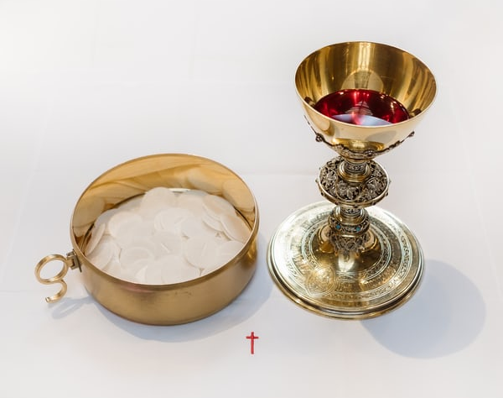
We cannot leave church with our own agenda, expecting to do things our own way. We serve our God and not ourselves. It must be God’s path we take, God’s words we speak, and God’s actions we perform. It must be God’s will that is done.
This is an extract from the book 'Living the Mass: How One Hour A Week Can Change Your Life' by Fr. Grassi and J Paprocki.

Slide 30
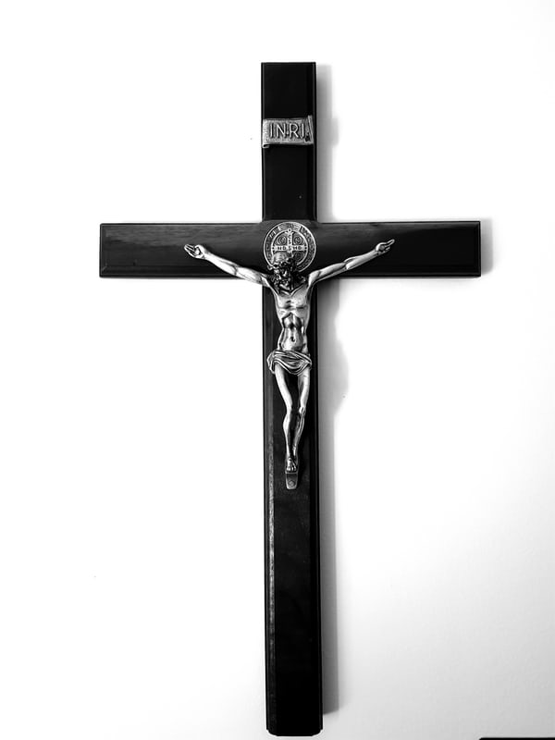
Activity 7
Ask yourself these questions then discuss your answers in pairs:
When you hear 'Go in peace, glorifying the Lord by your life' what do you think?
Is it just a phrase to you or do you take the call to mission seriously?
When you leave Mass do you intend to 'glorify the Lord' by your life?
What can you do to love and serve the Lord?

Slide 31
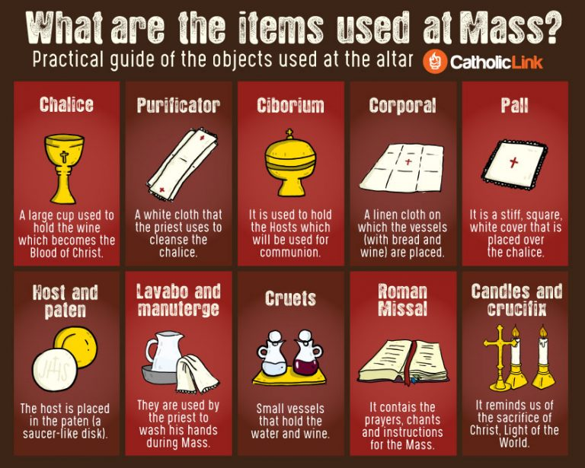
Celebrate a Class Mass
Each group should take responsibility for preparing for your class Mass. You need to:
Liaise with the School Chaplain
Choose the theme of the Mass
Choose the readings for Mass
Choose the hymns or music
Write the intercessions
Plan the Offertory Procession
Prepare the Oratory
Plan who will read, serve, etc.

Slide 32
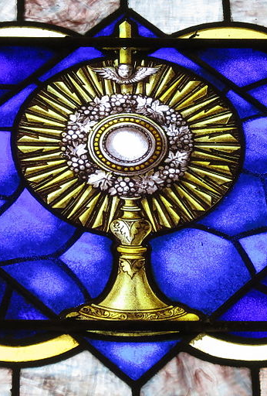
Eucharistic Adoration
Adoration of the Blessed Sacrament is a form of prayer that began centuries ago. The word adoration means “to pay honour or homage to someone or something.”
The same Jesus, whom we receive in the Eucharist at Mass is who we worship in Adoration. Adoration is a time to sit face to face with Jesus and deepen and strengthen your relationship with Him. Young Church Ministries

Slide 33
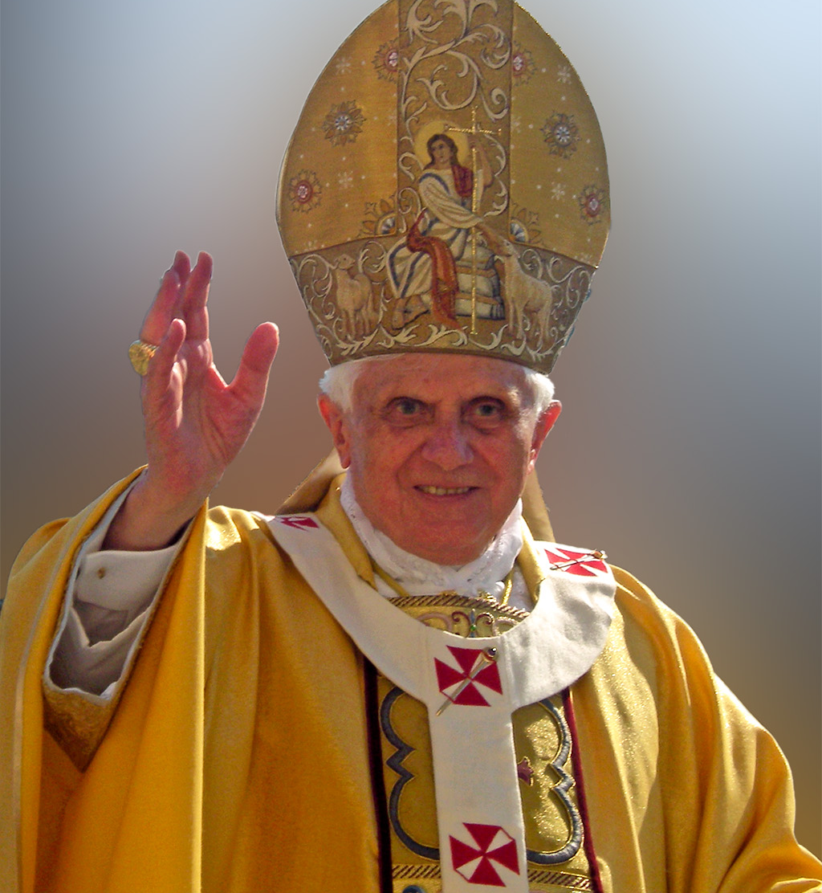
Adoration does not take the place of Mass. It should increase our desire to receive the Eucharist at Mass.
Adoration means entering the depths of our hearts in communion with the Lord, who makes himself bodily present in the Eucharist.
In the monstrance, he always entrusts himself to us and asks us to be united with His presence with His risen body.
Emeritus Pope Benedict XVI

Slide 34
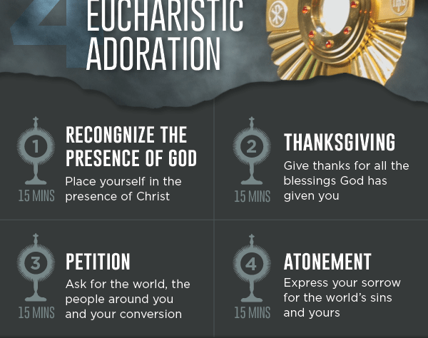
During Catholic Education Week go to the Oratory for Eucharistic Adoration.
Take the time to sit face to face with Jesus and deepen and strengthen your relationship with Him.
Take the time to pray and worship and ‘… be united with His presence with His risen body.’

Slide 35
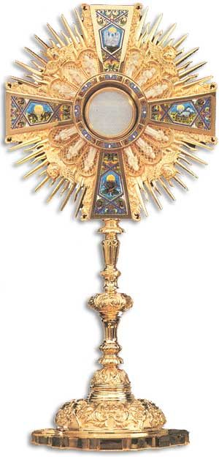
During Eucharistic Adoration you can:
Pray
Read the Bible
Ask for an intercession
Read a spiritual book
Meditate
Listen to music
Write in a prayer journal

Slide 36
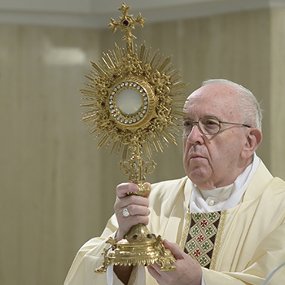
Take the opportunity to encounter Christ.
Be still
Be silent
Contemplate
Let Christ speak to your heart

Slide 37
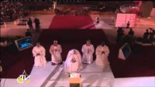
World Youth Day Adoration Vigil Rio 2013

Slide 38
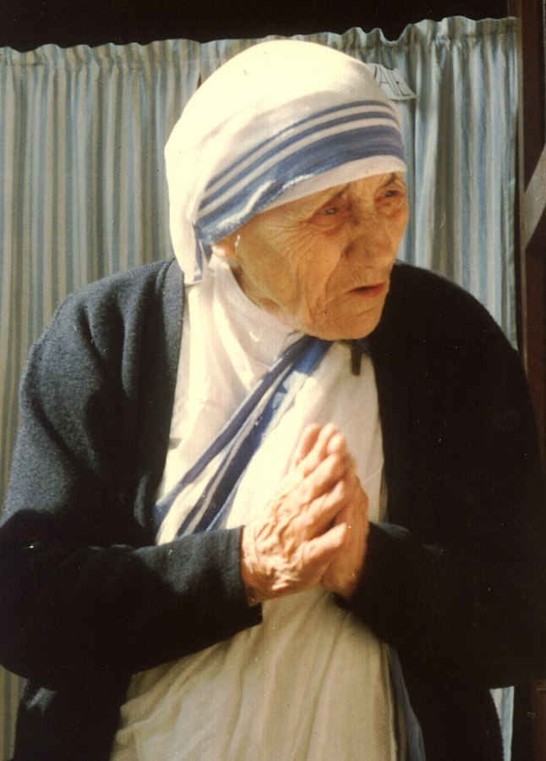
Prayer
The Catechism of the Catholic Church tells us that 'prayer is turning the heart towards God. When a person prays, he enters into a living relationship with God.’ (CCC 2558 - 2565)
My secret is quite simple; I pray.
And through my prayer I become one with the love of Christ and see that praying is loving him, that praying is living with him, and that means making his words come true...
For me, praying means being one with the will of Jesus twenty-four hours a day, living for him, through him, and with him. Saint Teresa of Calcutta

Slide 39
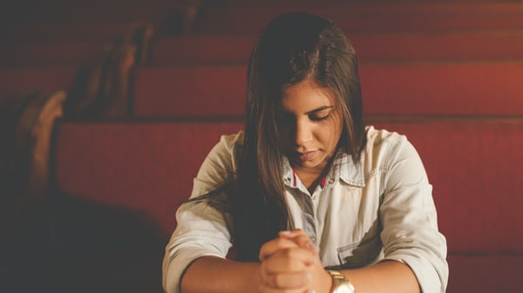
A new survey has found that young people in the UK are twice as likely as older people to pray regularly.
51% of 18 to 34-year-olds said they pray at least once a month, compared with 24% of those aged 55 and over.
It also found 49% of the younger age group attend a place of worship every month, compared with 16% of over-55s.
Polled by Savanta ComRes 2021
You can read about this poll here - Young more likely to pray than over-55s - survey - BBC News

Slide 40
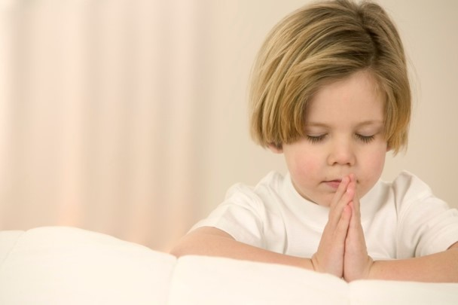
Through prayer, Catholics express and deepen their love of God, their hope in eternal life and their personal and communal faith.
It is through prayerful participation in the liturgy that the Church gives worship to God.
Prayer is about spending time with God and communicating as you would in any important relationship. Faithful people want to pray to help them keep in touch with God.
You might want to be alone to pray privately to God. You might want to gather with others in a church or other sacred space to pray as a group. This is most evident at Mass when you gather as a community of faith to praise and worship God.

Slide 41

We pray to:
Praise God for the beauty and wonders of all creation
Thank God for the blessings in our lives, our gifts and talents and when good things happen
Make a petition of God - ask God for guidance and to meet our personal needs or the needs of others
Say sorry - to be penitent and ask for God to forgive us
We can pray and praise God using the psalms in the Old Testament. The Catechism tells us that the Psalms are part of the Church's great treasury of prayers, and through them the praise of God is sung in an ageless way. We hear a psalm every time we go to Mass.

Slide 42
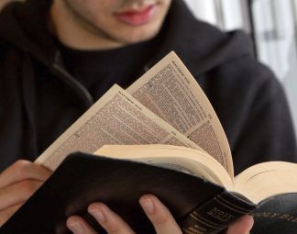
Psalm 95
Come, let us praise the Lord!
Let us sing for joy to God, who protects us!
Let us come before him with thanksgiving and sing joyful songs of praise.
For the Lord is a mighty God,
He rules over the whole earth, from the deepest caves to the highest hills.
He rules over the sea, which he made; the land also, which he himself formed.
Come let us bow down and worship him;
let us kneel before the Lord, our Maker!
Psalm 95:1 - 6

Slide 43
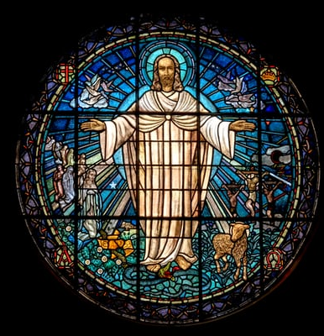
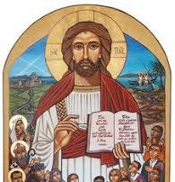
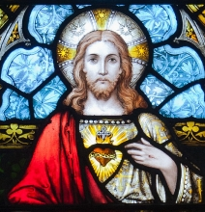
We can pray by reflecting on images and icons
Praying through art

Slide 44
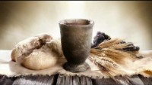
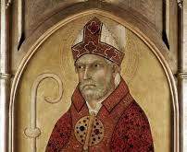
We can pray and praise God through hymns and song. There are many hymns about the eucharist.
'To sing is to pray twice’.
St. Augustine

Slide 45
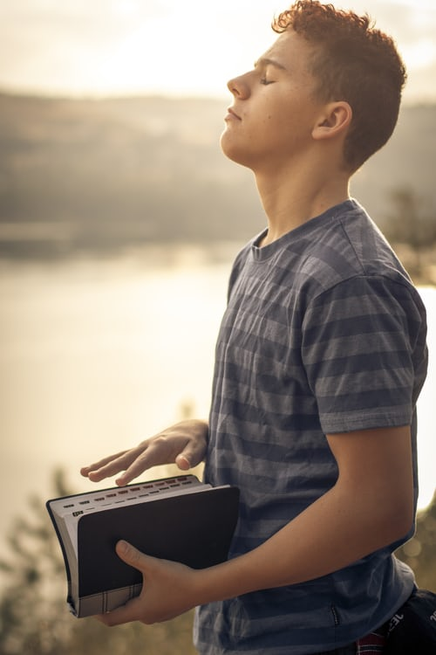
You can complete a guided meditation in the Oratory: Celebrating Eucharist Retreat (loyolapress.com) Gratitude Meditation | Busted Halo

Slide 46
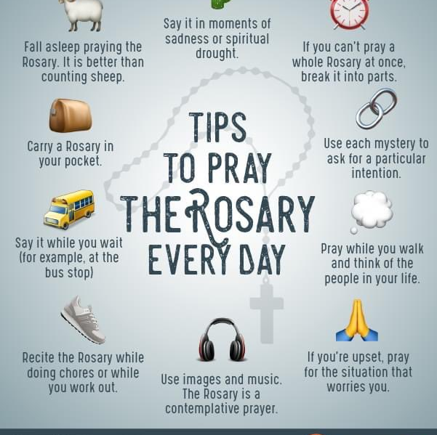
Throughout your time in school, you have been encouraged to pray as an individual and communally, as part of a group. Some examples are formal prayers, hymns, meditation and praying using scripture.
During the different liturgical seasons, you will have prayed using appropriate prayers, for example, the Stations of the Cross during Lent. You will have prayed on retreat days and in Assemblies. These are all ways of worshipping God.
Prayer helps you strengthen your relationship with God. Through prayer we are aware of the loving presence of God in our lives.

Slide 47
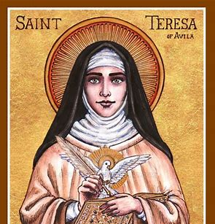
St. Teresa of Avila
Prayer in my opinion is nothing else than a close sharing between friends; it means taking time frequently to be alone with him who we know loves us.

Slide 48

Activity 8
Create a mind map displaying your learning. Outline ways you celebrate and worship in your school and your parish.

Slide 49
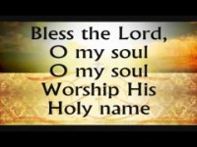
Prayer and Reflection:
Bless the Lord Oh my Soul
Remember Eucharistia means thanksgiving.
Give thanks as you listen …….
Reflect on what you are grateful for.
List the things you are grateful for.

