Slide 1
Catholic Social Teaching
Notes:
Pre-lesson starter activity:
Encourage students to talk about what it’s like living in the 21st century and to think about how things are different from the past (carrier pigeon onwards!)
Points to draw out:
Our world is very different from the past and the world is constantly changing.
Does this change mean we can treat people unjustly? No, only circumstances change, not how we treat of our neighbour.
How do we know how to treat the other? Catholic Social Teaching which is a firmly rooted in scripture and Church teaching.
Prayer to begin the lesson with:
Dear Lord,
During your life on earth you were often in the company of the poor, the outcasts, the working people, the lepers and the widows - those who had nothing to give you in a material sense.
Give us respect and compassion for those who struggle with material poverty.
Increase our awareness of those who are struggling in our communities and around the world.
Teach us to be generous and always ready to share what we have with others here at school, at home and in our communities. Amen.

Slide 2
Catholic Social Teaching
Notes:
Prior learning - ask students what they know about Catholic Social Teaching.
Clicking the image to play the video. Points to draw out from the video:
The kind of issues that Catholic Social Teaching addresses (poverty, injustice, migration, the environment etc.)
CST is drawn from lots of sources: scripture, papal encyclicals (letters), writings of saints etc.
That CST looks at the issues that affect us today in light of the scripture.
Any of the 7 themes of CST:
Life and dignity of the human person,
call to family, community and participation,
rights and responsibilities,
the dignity of work and the rights of workers
option for the poor and vulnerable
Solidarity
care for God’s creation.
Activity: What does Pope Francis say to young people about Catholic Social Teaching? Give out handout entitled: Pope Francis writes to young people about Catholic Social Teaching. This is a summarised version of the letter that appears at the beginning of the DOCAT (a book for young people about Catholic Social Teaching). Emphasise that he is speaking to each one of them. There is a speech bubble as part of each paragraph to allow students to summarise each part of the letter and enable them to give structured feedback at the end of the activity.

Slide 3
Catholic Social Teaching sums up the teachings of the Church on social justice issues.
It promotes a vision of a just society that is grounded in the Bible and in the wisdom gathered from experience by the Christian community as it has responded to social justice issues through history.
Notes:
After activity feedback:
The development of Catholic social teaching will always be ongoing because our development as a society is always ongoing.
Learning Intentions:
I understand the four main principals of Catholic Social Teaching

Slide 4
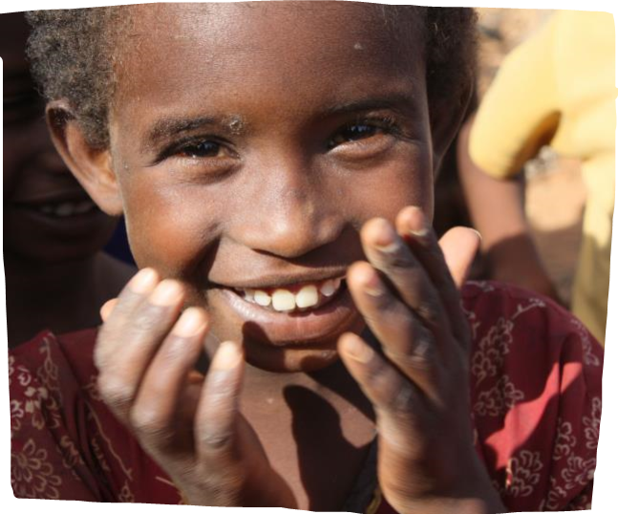
The four core principles of Catholic Social Teaching are:
The Dignity of the Human Person,
The Common Good,
Solidarity and
Subsidiarity.
Notes:
Prayer to begin lesson with:
Holy Spirit,
We praise and thank you!
You anoint us to
bring glad tidings to the poor
proclaim liberty to captives
recover sight for the blind
free the oppressed
and build communities in keeping
with God's vision of justice.
Show us how to be
light of the world
salt of the earth
seeds that sprout love
and leaven that infuses humanity
with the desire to promote
human dignity and solidarity.
Help us to listen so that
those in poverty can lead our efforts to
proclaim a more hopeful vision
liberate captives from injustice
heal the blindness of the powerful
free us all from self-centeredness
and build community to overcome poverty.
Amen.
Let’s go through the four principles that underpin Catholic Social Teaching.

Slide 5

Human Dignity
We believe that every person is made in God’s image.
We believe that every person has inherent dignity and every life is sacred.
The innate dignity of each person is the foundation and inspiration of our vision for a just and compassionate world.
Notes:
Ask students what we mean by “human dignity”. Alternatively, ask students to jot down a one sentence definition of the term and seek feedback.
Click to reveal three points about human dignity and a quote from the catechism.
Points to draw out:
That dignity belongs to every person, not because of anything we have done to deserve or earn it, but because we are made in the image and likeness of God. Dignity is a God-given gift.
Because of this dignity we are compelled as Christians to make sure everything we do as human beings respects our own dignity and the dignity of others.
The quote from the catechism makes the point that human beings are not objects, we are not things to be used and thrown away at will but instead are “someone” and as such, should be treated at all times in a just and compassionate way.

Slide 6
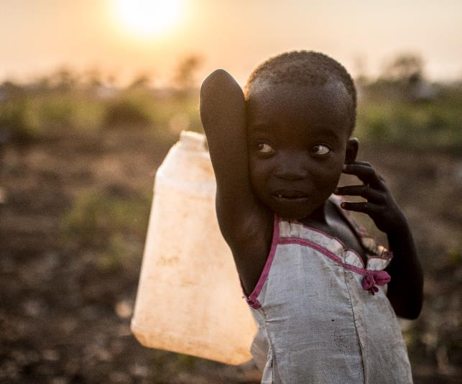
Human Dignity
We see the image of God in every person, no matter their circumstance.
The women, men and children most vulnerable to extreme poverty and injustice should not be hindered from living a life equal to their dignity.
Notes:
Ask students for examples either in our own lives, or in a worldwide context, of times when human dignity is ignored.
Examples might include: the way we conduct relationships, the conditions that some people work/live in, our attitude towards those who are different from us in any way.

Slide 7

The Common Good
We believe that humans are not only sacred but social and that we experience the fullness of life in our relationships with others.
Working towards the common good requires a commitment from each of us to respect the rights and responsibilities of all people.
Notes:
The next principle is: The Common Good. Ask students what we mean by “The Common Good”. Alternatively, ask students to jot down a one sentence definition of the term and seek feedback.
Click to reveal descriptions of the Common Good and a quote from an Encyclical (letter) written by Pope Benedict XVI to us.
Points to draw out:
The Common Good is different from utilitarianism. It does not mean what is best for most people. Instead it means working together for what is best for every single person.
We are social because we don’t exist in isolation. We all interact with someone at some level in our lives and this is what we call society.
The quote from Caritas in Veritate emphasises the need for us all to agree to respect each other and work towards a world that is good for everyone.

Slide 8
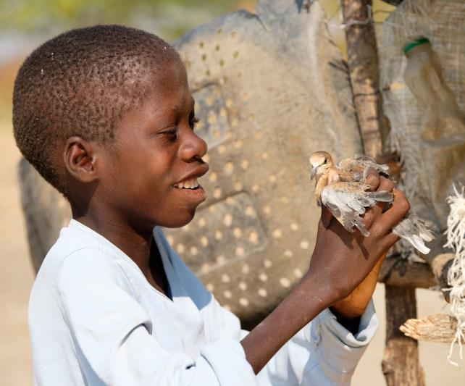
The Common Good
We believe every person is entitled to share in society’s resources. Every person is also responsible for sharing our society’s resources – the common good - with others.
This extends beyond our personal interests, and beyond national borders, to our one global human family.
Notes:
Ask students how we can work to achieve the Common Good, in our schools, families, parishes and globally? Ask them to note down three suggestions that demonstrate how they could do this.

Slide 9

Solidarity
Solidarity requires that we see another person as a neighbour, a fellow human who is equal in dignity.
Solidarity means recognising the responsibilities we have to each other, and taking an active role in helping others attain their full potential.
This is more than just a feeling. It drives us to action.
Notes:
The third principle is: Solidarity. Ask students what we mean by “solidarity” or contexts where they might have heard the term used. Alternatively, ask students to jot down a one sentence definition of the term and seek feedback.
Click to reveal three points about solidarity and a quote from an Encyclical (letter) written by Pope John Paul II to us.
Points to draw out:
We must see everyone as our neighbour and as our equal. No one person deserves better treatment than another.
It is not enough for us to feel empathy for those who are treated unjustly, solidarity requires action of us when we recognise unjust situations.

Slide 10
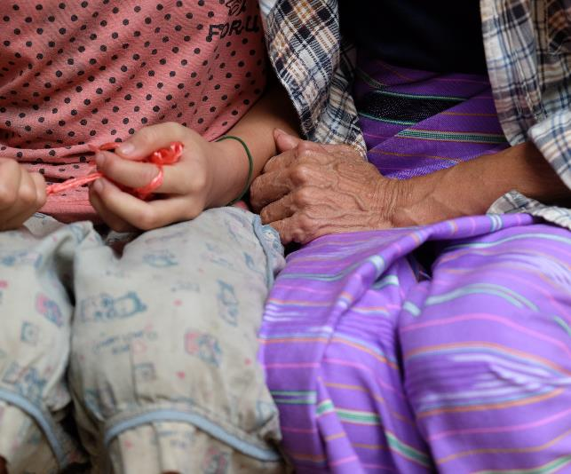
Solidarity
We are called by the principle of solidarity to take the parable of the Good Samaritan (Luke 10:29-37) to heart, and to express this understanding in how we live and interact with others, not as a matter of charity, but of justice.
Solidarity makes it impossible for us to look away from the injustices that our sisters and brothers experience.
Notes:
Ask students to reflect on and then discuss with the person nearest to them, times in their own lives when they have demonstrated the principle of solidarity.

Slide 11

Subsidiarity
Subsidiarity means that all people have the right to participate in decisions that affect their lives.
These decisions should be made at the appropriate level, by the people most affected by the decision.
Notes:
The final principle is: Subsidiarity. It is quite likely that students may not have come across this term
Click to reveal descriptions of subsidiarity and another quote from Pope Benedict XVI’s letter Caritas in Veritate.
Points to draw out:
If a decision will affect you then you have a right to part of the decision making.
Decisions should be made by those most affected by them.
An example might be a school football team. It would be inappropriate for the government to set down rules for your team about how many games they are allowed to play and what the strip should look like. These decisions should be left to the school, coaches and the members of the team to decide because you will be most affected by them.

Slide 12
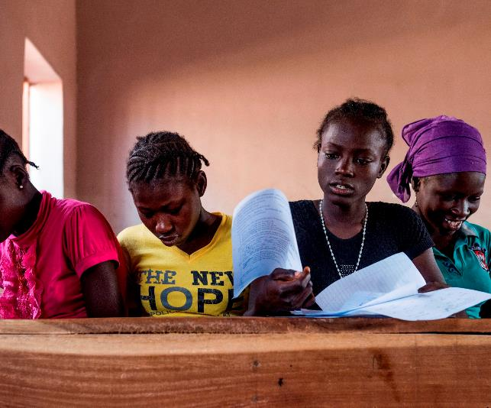
Subsidiarity
It also means that those in positions of authority have the responsibility to listen to everyone’s voice, and make decisions according to the common good.
Partnerships and collaboration amongst groups, including all levels of government and social institutions, are necessary to work toward a shared, unified vision for society.
Notes:
Think about either your own school, family, clubs or societies you belong to and, similarly to the example of the football team, explain how the principle of subsidiarity is at work in your example.
Ask for feedback on examples.
To summarise:
Ask students what the four principles of Catholic Social Teaching are (Human Dignity, The Common Good, Solidarity and Subsidiarity)
Emphasise that they work together and rely upon each other for social justice to become a reality in our world.
Each one of them has a responsibility to do as much as they can to bring this vision to life.

Slide 13
Catholic Social Teaching in Today’s World
Notes:
Prayer for peacemakers:
Spirit of God,
give us the openness, deep within us
to recognise, daily,
all people as made in your image and likeness.
Help us to learn from one another the ways of being fully alive,
at peace with ourselves and with those around us.
Give us the courage to transform
those parts of ourselves and our world
that separate and create enmity.
Help us to take steps to stop
the cycle of violence
in our homes, in our workplaces,
in our neighbourhoods, in our country,
in our world.
May we be open to our deepest yearning
for a world alive with your justice and truth,
to dream of a society
where all are treated with respect,
and, with the power of your Spirit,
to take steps to bring it about.
As an introduction, ask students to recap on previous learning about the four principles of Catholic Social Teaching are (Human Dignity, The Common Good, Solidarity and Subsidiarity)
Question to think about: What is the relationship between the Church’s Social Teaching and how the governments protects people from discrimination?

Slide 14

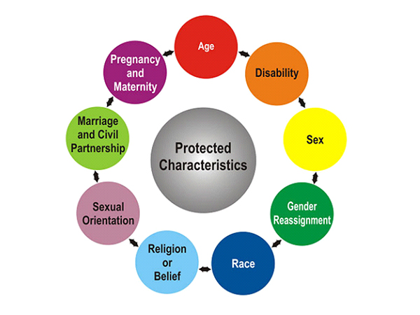
Notes:
Question to think about: What is the relationship between the Church’s Social Teaching and how the governments protects people from discrimination?
Equality Act 2010
In Scotland The Equality Act 2010 legally protects people from discrimination in the workplace and in wider society.
It replaced previous anti-discrimination laws with a single Act, making the law easier to understand and strengthening protection in some situations. It sets out the different ways in which it’s unlawful to treat someone.
The characteristics that are protected are:
Age
Disability
Gender reassignment
Pregnancy and maternity
Marriage and civil partnership
Race
Religion or belief
Sex
Sexual orientation

Slide 15

Case study 1
“I have just been accepted into this really good school. I am really happy except they said I am only allowed to attend if I hide that I am gay. They want me to pretend I am straight.”
1. What protected characteristic is potentially being discriminated against?
2. How does this oppose the principles of Catholic Social Teaching?
Notes:
Thinking about everything we have learned Catholic Social Teaching and the protected characteristics in the Equality Act, let’s apply these principles to real situations and think about how we should respond.
Give students the handout Equality ACT 2010 Quiz – Case Studies. You may also wish to make the handout Four Key Catholic Social Teaching Principles available for reference
Scenario 1 and 7 (the first and last) should be done as a whole class activity.
Points to draw out:
The protected characteristic being discriminated against is sexuality.
Human dignity belongs to every person because they are made in the image and likeness of God.
A person is not defined or judged based on their sexuality.
It is because of our dignity that we are compelled to make sure everything we do respects our own dignity and the dignity of others.
Allow students to work in pairs or smaller groups to work their way through scenarios 2-6

Slide 16

Case study 7
“At the moment I am undergoing gender reassignment. The school has been informed that I am undergoing reassignment but does not seem to be willing to accept this and keeps referring to me by my birth name rather than my new name.”
1. What protected characteristic is potentially being discriminated against?
2. How does this oppose the principles of Catholic Social Teaching?
Notes:
Points to draw out:
The protected characteristic being discriminated against is gender reassignment.
The principle of subsidiarity requires that if a decision affects you, you have a right to be part of the decision making process.
It also means that people in authority have the responsibility to listen to you.
Subsidiarity states that decisions should be made by those most affected by them.
You could also say that to ignore someone’s request is to ignore their dignity.

Slide 17

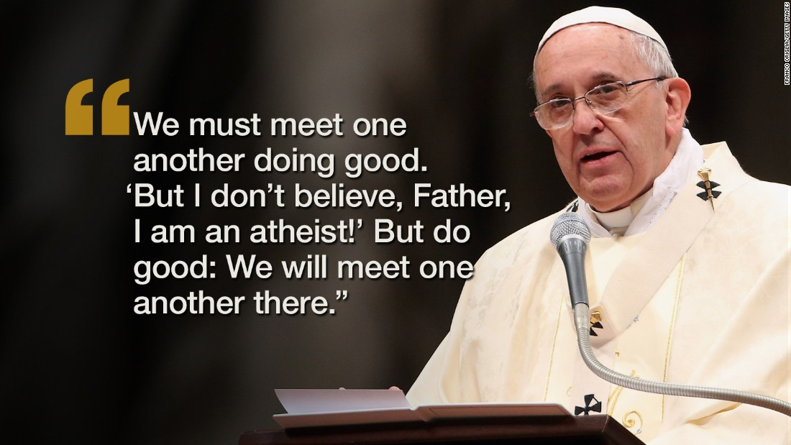
Notes:
Summary of this unit:
Over the last few lessons, we’ve learned about the principles of Catholic Social Teaching and about the protected characteristics of the Equality Act.
We’ve also learned about the relationship between these two things and how understanding and living Catholic Social Teaching means that we must never discriminate against another person and that we are all equal in dignity as children of God.
In summary, the final part of this section asks students to consider the difference between having different beliefs or opinions and discrimination.
Ask students to read both of the quotes and take some time to think about what each of them means. This should then lead into a whole class discussion.
Points to draw out:
That it is possible to hold different beliefs and opinions without this resulting in prejudice or discrimination
That each person’s beliefs must be respected.
That there can be common ground found in serving the common good.

