Slide 1

S4 Teaching As A Vocation
Catholic Education Week

Slide 2

Teaching As A Vocation
In third year, you considered what a typical day for a teacher is like and the qualities and skills that help make a teacher effective.
In fourth year, you will consider what teaching in a Catholic school is like.

Slide 3

Being a Teacher
As a teacher, you get the chance to inspire young people and use your skills and talents to give something back to society.
You are pivotal in making sure every pupil in your class has the same access to a good quality education and the opportunity to succeed.
It’s a career that offers so many unique benefits and allows you to inspire and enthuse students about the subject(s) you love.
Teaching allows you to put your faith into action as you encourage young people to learn about religion, values and morals.

Slide 4
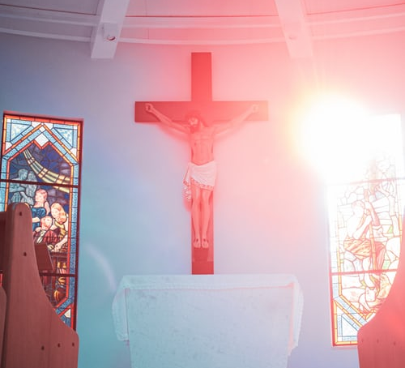
Activity
Using the placemat your group has been given indicate what makes a Catholic school distinctive.
Have a class discussion based on your answers.

Slide 5
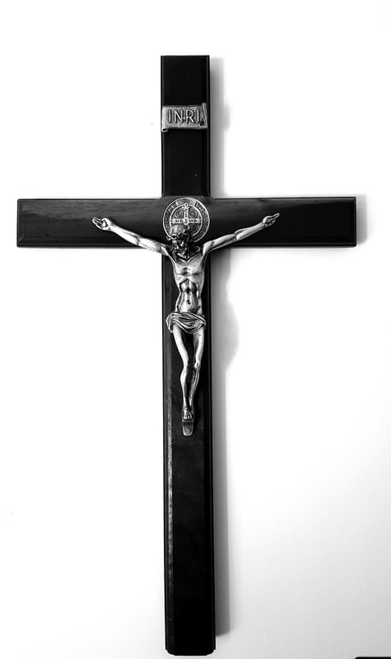
Teaching in a Catholic School
You have identified the things which are distinct in a Catholic school. This knowledge and understanding can help you if want to be a teacher in a Catholic school in the future.
In third year, you considered that teaching can be regarded as vocation.
Remember - Vocation means an occupation to which a person is especially drawn to or for which they are suited.

Slide 6




Vocation
As a teacher in a Catholic school, you want to commit to supporting the ethos and mission of the school and helping the young people in their journey of faith.
Discuss with your shoulder partner what that might involve – think back to your answers in the placemat activity.

Slide 7
What does this involve in the primary and secondary sectors?
Some answers have been provided for you.
The primary school
The secondary school
Sacramental preparation
Daily prayer
3.
4.
5.
Think of, at least, another three answers for each sector.
Teaching RE lessons
Leading morning prayer

Slide 8
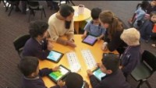
Watch this clip about teaching in a Catholic school.

Slide 9
The Charter for Catholic Schools
Schools in Scotland are guided by the Charter for Catholic Schools.
Ask your teacher for a copy.
The mission of the Catholic school is to develop as a community of faith and learning, providing the highest quality of education, and offering formation through the promotion of Gospel values, through celebration and worship, and through service to the common good.

Slide 10
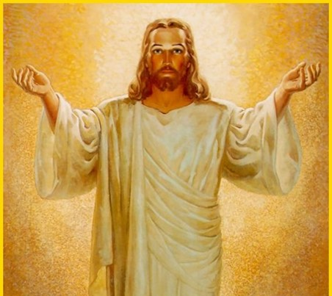
Task
Display your understanding of the distinctive nature of teaching in a Catholic school by completing this sentence.
As a teacher in a Catholic school, I could support the pupils in their journey of faith by…

Slide 11
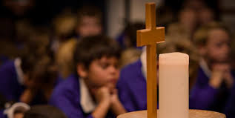
Pray together:
Loving God, you speak to us through all of life.
Help me to trust you and to trust that what you desire for me lies in the deepest part of my heart.
And, what you desire is that which allows me to grow and to be the person you created me to be - fully human and fully alive.
May I always centre my life on you and hear joyfully your call to be your companion.
Help me to follow my desire to live my life as best I can and to serve others with the special gifts you have given me.
Amen.

