Slide 1

S6 Teaching as a Vocation
Catholic Education Week

Slide 2

Being a Teacher

Slide 3

Teaching
In fifth year, you considered teaching as a vocation.
In sixth year, you will focus on teaching as a career and applying for teacher training.

Slide 4
Being a teacher is a unique career
As a teacher, you get the chance to inspire young people and use your skills and talents to give something back to society.
You are pivotal in making sure every pupil in your class has the same access to a good quality education and the opportunity to succeed.
It’s a career that offers so many unique benefits and allows you to inspire and enthuse students about the subject(s) you love.
Teaching allows you to put your faith into action as you encourage young people to learn about religion, values and morals.

Slide 5
Teaching as a Career
Your school will have teachers with a wide variety of titles.
This can reflect their subject, pastoral role or promoted position.
With your shoulder partner discuss the different job titles your teachers have and what responsibilities you think is involved in their post.

Slide 6

Activity
In your group create an infographic detailing the different posts and responsibilities that teachers have in both primary and secondary schools. You might want to ask your teacher about this or look in the school handbook for your primary and secondary school for information.
Remember to think about:
The Senior Leadership Team
Faculty or Department Heads
Pupil Support & Pastoral Care Teachers
Subject and Class Teachers

Slide 7
Present your infographic to the class.
What have you learned about career progression for a teacher?
There are a lot of opportunities for a teacher.
Whatever post you have in a school, you will take on extra responsibilities and give so much of yourself in terms of your knowledge, skills, qualities, time and talents to support the young people in your class.
This is because teaching is a vocation.

Slide 8

Activity
Create a banner saying, ‘Teaching as a Vocational Career’.
Reflect on what you have learned about being a teacher over the previous years.
Take a post-it note and write one or two points explaining why teaching is a vocational career.
Make a display under your banner.

Slide 9
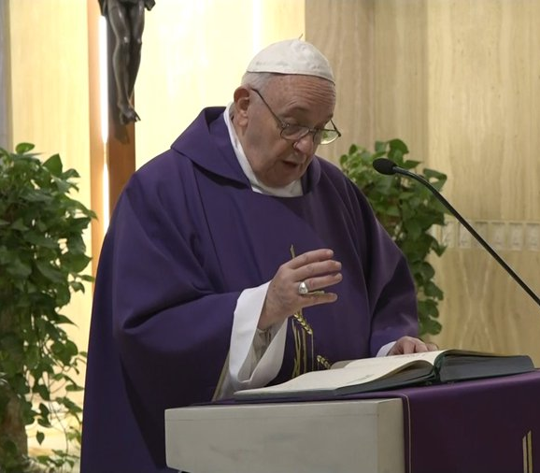
Pope Francis said:
Teaching is a beautiful job, as it allows you to see the growth day by day of people entrusted to your care. It is a little like being parents, at least spiritually. It is a great responsibility.
In what ways could these words of the Pope be inspirational to a teacher?

Slide 10

Take a new post-it note
Note down one or two points on why you would want to be a teacher.
Add these to your display.

Slide 11
What some teachers say:
“I see myself as a teacher that helps students and gives them a love for what they have to do.” Sandra, Head of RE
“In teaching, instead of working for a CEO, you’re working for the pupils.” Tarik, Teacher of Computing
“Being part of a learning community is a wholly worthwhile experience that cannot be measured in monetary terms or student achievement alone.” Gavin, Assistant Headteacher
“It’s the best job in the world in my opinion. It’s so varied; you are part of the pupil’s lives, part of their family’s lives and they’re part of your life – and I don’t think there are many other jobs that offer that.” Craig, P6 Teacher
These quotes are taken from ‘Get Into Teaching’.

Slide 12
Discussion
In your groups discuss the advantages of a career in teaching. Consider:
The very enjoyable aspects of being a teacher
The difference you can make in the life of a young person
The personal skills, qualities and talents you can bring to the job
The career progression
Note down some of the main points of your discussion and share these with the class.

Slide 13
So, are you called to teach?

Slide 14

Can you guide young people in their faith journey?

Slide 15


Becoming a Teacher
For very useful information on becoming a teacher go to:
https://sces.org.uk/becoming-a-teacher/
Or
APHTA Initial Teacher Education Support (rercglasgow.org)

Slide 16
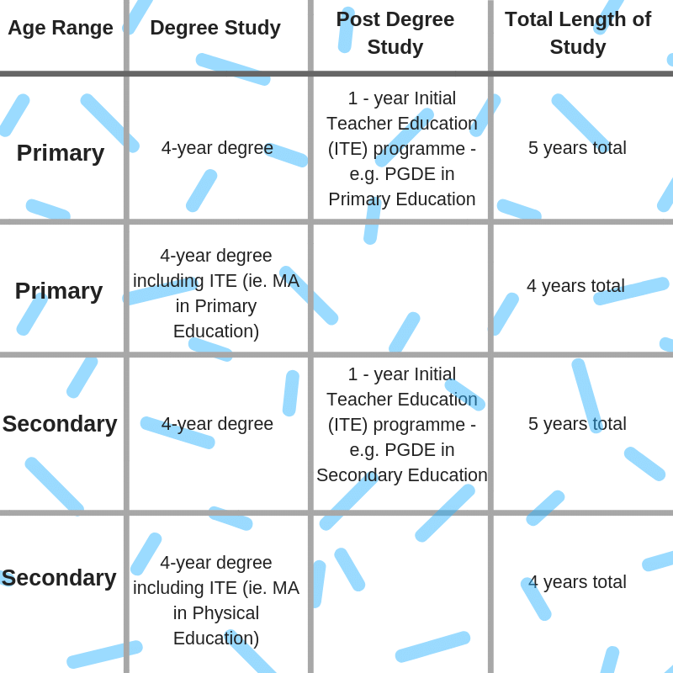
Becoming A Teacher
Traditional Pathways into Teaching
Graphic: Young Scot website

Slide 17

Teacher training courses
Edinburgh Napier University
Queen Margaret University
Royal Conservatoire of Scotland
University of Aberdeen
University of Dundee
University of Edinburgh
University of Glasgow
University of the Highlands and Islands
University of Stirling
University of Strathclyde
University of the West of Scotland

Slide 18
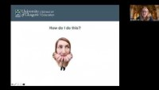
The Catholic Teacher Certificate(CTC)
In this clip Dr. Roisin Coll of Glasgow University gives information about the Catholic Teacher Certificate.

Slide 19
Preparing for a teaching course
What would help you get accepted on to a teacher training course?
A placement in one of your school’s associated primaries.
Being a class helper with younger students in a subject department.
Being a volunteer helper with extra-curricular clubs and activities.
Getting advice from a teacher in your own school about how to complete your personal statement.
Volunteering in your parish or local community with youth groups and events.

Slide 20


Good luck in your teaching career!

Slide 21

Pray together
Loving God, you speak to us through all of life.
Help me to trust you and to trust that what you desire for me lies in the deepest part of my heart.
And, what you desire is that which allows me to grow and to be the person you created me to be - fully human and fully alive.
May I always centre my life on you and hear joyfully your call to be your companion.
Help me to follow my desire to live my life as best I can and to serve others with the special gifts you have given me.
Amen.

