Slide 1

Becoming A Teacher
Information on Traditional and Alternative Routes into Teaching

Slide 2
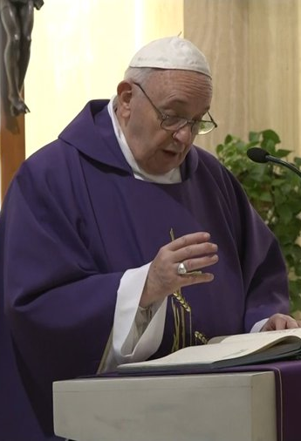
Pope Francis said:
Teaching is a beautiful job, as it allows you to see the growth day by day of people entrusted to your care. It is a little like being parents, at least spiritually. It is a great responsibility.

Slide 3

Teaching in Scotland
You can either work in a primary school teaching the compete curriculum or you could teach in a secondary school where you will teach one or more specialist subjects.

Slide 4

Teaching is A Unique Career
As a teacher, you get the chance to inspire young people and use your skills and talents to give something back to society.
You are pivotal in making sure every pupil in your class has the same access to a good quality education and the opportunity to succeed.
It’s a career that offers so many unique benefits and allows you to inspire and enthuse students about the subject(s) you love.
Teaching allows you to put your faith into action as you encourage young people to learn about religion, values and morals.

Slide 5

Becoming A Teacher
Traditional Pathways into Teaching
Graphic: Young Scot website

Slide 6

Teacher training courses
Edinburgh Napier University
Queen Margaret University
Royal Conservatoire of Scotland
University of Aberdeen
University of Dundee
University of Edinburgh
University of Glasgow
University of the Highlands and Islands
University of Stirling
University of Strathclyde
University of the West of Scotland

Slide 7
Alternative Routes into Teaching
In this report by the Scottish Government, they outline some partnerships they have supported with the General Teaching Council and different universities to attract and offer alternative routes into teaching for people either considering changing careers or considering their career options in light of their present qualifications:
Alternative routes into teaching: February 2020 - gov.scot
Individuals who have completed the Teach First programme that operates in England and Wales, gaining the appropriate qualifications, including a formal teaching qualification, for registration in Scotland can apply to the General Teaching Council in Scotland to become a teacher here.

Slide 8

Routes into teaching
https://teachinscotland.scot/
This website gives information about teaching in Scotland and varied routes into teaching.

Slide 9

Qualifications
If you initially don’t have the necessary qualifications to get a place on a teacher training course at University some pathways are:
https://www.strath.ac.uk/courses/undergraduate/educationcurricularstudieswithteachingqualification/
https://on.abdn.ac.uk/access/

Slide 10
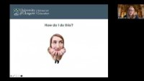
Catholic Teacher’s Certificate (CTC)
To teach in a Catholic School you will want to achieve your Catholic Teacher’s Certificate. In this clip Dr. Roisin Coll of Glasgow University gives information about the Catholic Teacher Certificate.

Slide 11

Catholic Teacher Certificate (CTC)
Ways you can also attain the CTC:
Complete the ‘Setting Out on the Road’ course which is taught at the University of Glasgow and is for qualified teachers who have not yet obtained their CTC. Find information at: University of Glasgow - Schools - School of Education - Continuing Professional Development - CPD For Teachers - Religious Education - Setting Out On The Road
Complete the online distance learning CREDL course, also offered by the University of Glasgow. Find information at: University of Glasgow - Postgraduate study - Taught degree programmes A‑Z - Religious Education by Distance Learning

Slide 12
Useful websites:
Education Scotland T. 0131 244 4330
E.enquiries@educationscotland.gsi.gov.uk www.education.gov.scot
General Teaching Council for Scotland T. 0131 314 6000
E. gtcs@gtcs.org.uk www.gtcs.org.uk
Scottish Catholic Education Service T. 0141 556 4727. E. mail@sces.org.uk https://sces.org.uk/becoming-a-teacher/
Scottish Credit and Qualifications Framework www.scqf.org.uk
Student Awards Agency for Scotland www.saas.gov.uk
Teach in Scotland T. 0845 345 4745 E. teachinscotland@gtcs.org.uk www.teachinscotland.scot
UCAS www.ucas.com

Slide 13

Prayer
Loving God, you speak to us through all of life.
Help me to trust you and to trust that what you desire for me lies in the deepest part of my heart.
And, what you desire is that which allows me to grow and to be the person you created me to be - fully human and fully alive.
May I always centre my life on you and hear joyfully your call to be your companion.
Help me to follow my desire to live my life as best I can and to serve others with the special gifts you have given me. Amen.

Slide 14

Good luck in your teaching career

