Slide 1
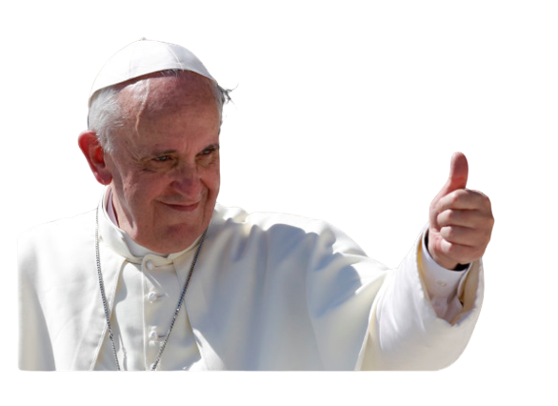
Pope Francis Faith Award
“Dear young people, do not bury your talents, the gifts that God has given you! Do not be afraid to dream of great things!”
26th April 2013
Learn Reflect Act
Notes:
Each Gathering Point for the Pope Francis Faith award has been designed to assist pupils as they complete their journey of faith in P6 & P7. Not all pupils in each school will be completing the Pope Francis Faith Award, but all pupils can participate in the GPs. They have been designed to be inclusive of all children. The teacher is free to decide which of the activities are used and which pupils complete them. It may be that the teacher decides to use the Learn and Reflect section with all pupils and then encourages certain pupils to complete the Act activities. Teachers can use the power point in whatever way suits their class. It may be that one teacher sets aside one point in the week and completes the GP as one learning experience. Another teacher may prefer to do small parts each day over the course of a week. Another teacher may decide that it is beneficial to complete a section each week so that each the content is covered over the course of a month. Staff are free to use the resource as best suits them. It is perhaps important to have a timeline of when each GP will be started/completed to ensure that all learning is completed in time for submission for the award.

Slide 2

Pope Francis Faith Award
Let us begin our time together
In the name of the Father
and of the Son
and of the Holy Spirit
Amen
Notes:
All of the Gathering points will begin with the Sign of the Cross. This is intended to indicate that this is not simply another R.E. Lesson, but that through our learning we are also praying and talking to God. Some schools may want to follow their daily prayer routine and light a candle in their sacred space, move away from tables and chairs and sit in a circle. You should feel free to do whatever is most suitable for your class. (Note – In the additional resources there are also links to the prayers and scripture passages from TIOF for each primary stage).

Slide 3
Pope Francis Faith Award
Lord Jesus,
You ask those who believe in you
To give your Good News to others.
We pray that, with the help of the Holy Spirit,
Our words, actions and prayers
Will help other people
To hear of You,
To believe in You,
And to find the joy of knowing You.
Amen

Slide 4
Pope Francis Faith Award
Learn
Focus on a Scripture to helps us understand, and put into practice, the Gifts of the Holy Spirit
Reflect
Think about the meaning of the Scripture passage. Visualise the Gifts at work in our life.
Act
Decide on an act of discipleship to teach others what we have learned.
Notes:
These first few slides are included so as to help explain to pupils what each Gathering Point will include. The routine of Learn-Reflect-Act is included in each GP so that pupils become familiar and comfortable with each part. This routine will also help them to expect times of silence, times of sharing and times of action. It is hoped that as they journey through the Gathering Points they will become more familiar with each step and may take a roll in leading the GPs.

Slide 5
Pope Francis Faith Award
Each Gathering Point (GP) works towards fulfilling the overall success criteria of the award so there are no specific Success Criteria (SC) for each GP. | What do I need to do? | What evidence will I need?
 | I will use the gifts of the Holy Spirit when showing my love of God and my love of others in my daily life. | I will record my actions in my Faith Journal.
 | With the support of others, I will reflect on how my actions have made an impact on my journey of faith. | I will include some reflections on these actions in my Faith Journal and my P7 Personal Profile.
Success Criteria
Notes:
Each Gathering Point (GP) works towards fulfilling the overall success criteria of the award so there are no specific Success Criteria (SC) for each GP.

Slide 6
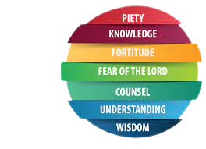
Pope Francis Faith Award
GP 1. The Gifts of the Holy Spirit
LI Explore the Gifts of the Holy Spirit.
Learn about the Gifts of the Holy Spirit.
Reflect on the times that we are aware of these gifts.
Act to show others what we know.

Slide 7
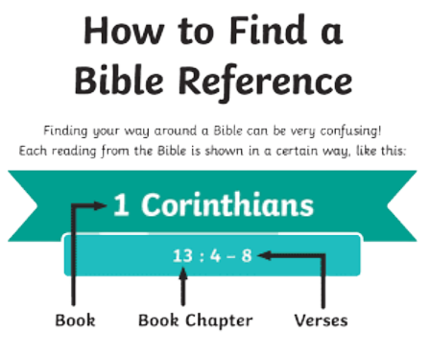
Pope Francis Faith Award
We will use our Bible to find a different Scripture passage for each gathering point.
We “read aloud from Sacred Scripture in such a way that I am proclaiming the Word of God”
RERC 2-12a.
Notes:
It may be useful to remind pupils that when we listen to Scripture passages we are listening to the inspired Word of God (RERC 2-12a) and that we “read aloud from Sacred Scripture in such a way that I am proclaiming the Word of God” (core learning P6. 2-12a). While the Scripture passages have been included in each power point, you may want to first use a Bible to read from to show the proclamation of the Word, and then display the slides that follow.

Slide 8

Pope Francis Faith Award
Young people do not take part in this award to measure their literacy skills. However, we need to learn new words and phrases to help develop our understanding of God.
Notes:
The translation used for all Scripture passages comes from the Jerusalem Bible. As you can see that sometimes means that there is a difference in words used to the terms we use today. You may want to speak to the children about why this might be. There is an activity to match the Gifts in the Scripture passages to the terms used today in the following slides.

Slide 9
Pope Francis Faith Award
Teacher note:
Teachers may use this power point in whatever way suits their class, and individual learners.
Time in which the gathering points are to be completed may be differentiated i.e., it may be of benefit to some learners to break each task into smaller activities.
It is important to have a timeline of when each GP will be started/completed to ensure that all learning and reflection is completed in time for verification in February P7.

Slide 10
The 7 Gifts of the Holy Spirit
Gathering Point 1

Slide 11


Pope Francis Faith Award
Listen as your teacher reads the Scripture passage on the next slide. Can you list the seven gifts of the Holy Spirit?

Slide 12
Pope Francis Faith Award
A Reading from the Prophet Isaiah
And the Spirit of the Lord shall rest upon Him,
the Spirit of wisdom, and of insight,
the Spirit of counsel, and of fortitude,
the Spirit of knowledge, and of piety.
And he shall be filled with the Spirit of the fear of the Lord.

Slide 13
Pope Francis Faith Award
Did you hear all 7?
Wisdom Insight Counsel Fortitude Knowledge Piety Fear of the Lord

Slide 14
Pope Francis Faith Award
Sometimes the Bible translates words in a different way to the words we use today. Look at the list below again. How many words do you know and understand?
Wisdom Insight Counsel Fortitude Knowledge Piety Fear of the Lord

Slide 15
Pope Francis Faith Award
Do you know what the other 5 mean? Look up the meaning of the rest of the words.
Wisdom Insight Counsel Fortitude Knowledge Piety Fear of the Lord
Notes:
Pupils may want to have a go at guessing what some of the words mean. If you have a wall display of the 7 Gifts you may want too direct them to looking at it to try to match them up. If attempts have been exhausted and pupils have not managed to match the Bible terms with the ones used today you may want to divide the pupils into groups to look up the meaning and share what they find with the rest of the class. If you do not have time for this exercise the answers are on the next slide.

Slide 16
Pope Francis Faith Award
When our research is complete, we may find that some of the Gifts of the Holy Spirit are often referred to with different names:
Insight Understanding
Piety Reverence
Fear of the Lord Wonder and Awe
Fortitude Courage
Notes:
Explain to pupils that it is ok if they are not sure the full meaning of some of the Gifts, that you will explore each one in depth over the next few Gathering Points. The important message from this Scripture passage is that it is the same Spirit of God that Isaiah speaks of in the Old Testament that was with the Apostles at Pentecost and is still with us today. The thing we have to think about is, when the Holy Spirit rests upon us what is he asking us to do and how does that make us feel? The pair and share activities that follow will help pupils to talk about this.

Slide 17
Pope Francis Faith Award
Over the next few months, we will explore the Gifts of the Holy Spirit and try to become aware of their presence in our lives:
Knowledge Understanding Wisdom Piety Fear of the Lord
Right Judgement Fortitude
Notes:
Explain to pupils that it is ok if they are not sure the full meaning of some of the Gifts, that you will explore each one in depth over the next few Gathering Points. The important message from this Scripture passage is that it is the same Spirit of God that Isaiah speaks of in the Old Testament that was with the Apostles at Pentecost and is still with us today. The thing we have to think about is, when the Holy Spirit rests upon us what is he asking us to do and how does that make us feel? The pair and share activities that follow will help pupils to talk about this.

Slide 18

Pope Francis Faith Award
A Reading from the Prophet Isaiah
And the Spirit of the Lord shall rest upon Him,
the Spirit of wisdom, and of insight,
the Spirit of counsel, and of fortitude,
the Spirit of knowledge, and of piety.
And he shall be filled with the Spirit of the fear of the Lord.

Slide 19
Pope Francis Faith Award
At the beginning of the reading, we heard these words:
“And the Spirit of the Lord
shall rest upon Him.”
Notes:
Use the slides to prompt the pupils to reflect on what they have heard and to think about what this may mean for their own faith journey.

Slide 20
Pope Francis Faith Award
Close your eyes. Listen to the words again.
‘And the Spirit of the Lord shall rest upon Him’
Imagine that the Spirit of the Lord is with you in your classroom.
What might he look like? What can you see and hear?What do you feel when he stops and rests upon you?
Listen to the Spirit. What is he asking you to do?
Notes:
If pupils are not used to reflecting or meditating it may be helpful to use some of the mediation technique notes beforehand. Each teacher can decide how this time of reflection will work best for their class. Some may dim the lights and use lit candles, others may use music, others again may prefer silence. However it is done, pupils should be given time to stop and think about the questions. During the first GPs this time may be short, however as the pupils become more comfortable with the activity you may be able to extend the reflection time. Pupils may find it helpful for you to quietly repeat the questions to keep them focussed.

Slide 21


Scripture Time
The following prompts could be used to support peer feedback.
Person 1 | Person 2
Could you imagine that the Holy Spirit was present? How did you feel? | What do you think might help us during reflection time to be able to get to know the Holy Spirit?
Can you remember how many gifts of the Hoy Spirit that there are? | Can you remember any of the names of these gifts?
Why do you think we learn about the gifts? | Which gift do you remember the most?
Do you think the award will be hard work? How could I help you to learn about the gifts of the Holy Spirit? | Do you think it will be hard to imagine the Holy Spirit outside of school? How will we do this?

Slide 22
Pope Francis Faith Award
Reflection
Examination of Conscience

Slide 23
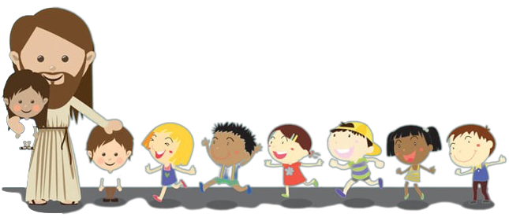
Pope Francis Faith Award
When we come together to learn about the gifts, we will have time to think about all the times that we have made good decisions, loved God and others, and done the right thing.
We will also think about the times when we made bad choices that we are not proud of.
We will think about how not to do that again in the future.
This is called examining your conscience. We do this each time we learn about a gift, so that we can reflect on where we are in discipleship, and how we need to act in the future to bring us closer to God.
Notes:
Each GP has an opportunity for an examination of conscience. This can be linked to RERC 2-23a 'I know that God has given me the freedom to make choices about the way I live my life. I have reflected on how my decisions affect my relationship with God and others', and specifically with core learning 'I am aware of the responsibility to inform my conscience when making choices about the way I live my life and I can do this by learning about and being faithful to the teaching of the Church and through daily prayer'.

Slide 24
Pope Francis Faith Award
Think about all the times that we have made good decisions, loved God and others and done the right thing.
Think about the times when we made bad choices that we are not proud of.
Think about how not to do that again in the future.

Slide 25
Faith Prayer
Lord Jesus,
You ask those who believe in you
to give your Good News to others.
We pray that, with the help of the Holy Spirit,
our words and actions
will help other people
to hear of You,
to believe in You
to find the joy of knowing You.
Amen

Slide 26
Extension activity
Reflection 1
Lord Jesus.
You ask those who believe in you
to give your Good News to others.
Read the part of our prayer above. Think about the questions below. Write your answer on the free pages of your journal.
1. How do I show others that I believe in Jesus?
2. How do I give the Good News to other people?

Slide 27
Extension activity
Reflection 2
We pray that, with the help
of the Holy Spirit,
our words and actions
Read the part of our prayer above. Think about the questions below. Write your answer on the free pages of your journal.
1. How do people meeting me know that what I say has been inspired by the Holy Spirit?
2. How do my actions show God in the world to other people?

Slide 28
Extension activity
Reflection 3
….and prayers will help other people
to believe in You
Read the part of our prayer above. Think about the questions below. Share your thoughts on the free pages of your journal.
Do other people know God because of me?
Do they hear of God from what I have learned?
Do they believe in him from how I share my knowledge?

Slide 29
Extension activity
Reflection 4
….and to find the joy of knowing You.
Read the part of our prayer above. Think about the questions below. Share your thoughts on the free pages of your journal.
How do I show others the beauty of God in the world?
How do I share the joy of having God as my friend?

Slide 30
Extension activity
Reflection 5
Examination of conscience
What could I do more of to share my knowledge?
How do I show my knowledge in school?
What could I do at home to share my knowledge?
What could I do in my parish to share my knowledge?

Slide 31
Pope Francis Faith Award
Can you remember all the learning and reflection from this gathering point on the gifts of the Holy Spirit?
Could you set yourself a target of one new way to show others that you have been given the 7 gifts of the Holy Spirit?
Could you use your gifts at home, school, and in the parish?
Could you tell someone outside of school what you have learned about the gifts of the Holy Spirit?

