Slide 1
Pope Francis Faith Award
Lord Jesus,
You ask those who believe in you
To give your Good News to others.
We pray that, with the help of the Holy Spirit,
Our words, actions and prayers
Will help other people
To hear of You,
To believe in You,
And to find the joy of knowing You.
Amen

Slide 2
Pope Francis Faith Award
Success Criteria
What do I need to do? | What evidence will I need?
I will use the gifts of the Holy Spirit when showing my love of God and my love of others in my daily life. | I will record my actions in my Faith Journal.
With the support of others, I will reflect on how my actions have made an impact on my journey of faith. | I will include some reflections on these actions in my Faith Journal and my P7 Personal Profile.

Slide 3







Pope Francis Faith Award

Slide 4
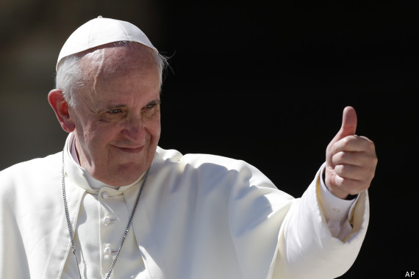
Pope Francis Faith Award
Gathering point 4 Understanding
“Dear young people, do not bury your talents, the gifts that God has given you! Do not be afraid to dream of great things!”

Slide 5
Pope Francis Faith Award
Teacher note:
Teachers may use this power point in whatever way suits their class, and individual learners.
Time in which the gathering points are to be completed may be differentiated i.e., it may be of benefit to some learners to break each task into smaller activities.
It is important to have a timeline of when each GP will be started/completed to ensure that all learning and reflection is completed in time for submission for the award.

Slide 6
Pope Francis Faith Award
Learning intention
Explore the meaning of the word ‘understanding’.
Listen to the Word of God, teaching us how ‘understanding’ can be used as a gift.
Challenge myself to an act of discipleship.
Learn
about the Gift of Understanding
Reflect
to reflect on what Understanding
means.
Act
to use Understanding

Slide 7

Pope Francis Faith Award
‘Make time for God by listening in silence and by praying with words each day.’
‘Contribute to charity with your time – for example by making something to sell at a School Fayre or speaking to your family about the work of your favourite charity and agreeing some way to offer support.’
‘Notice when someone in your family is sad, and respond in a kind way.’
‘Meditate quietly before a Church service.’
‘Be aware of those who may not have as much as you and discuss with your parents ways that you could be supportive and generous.’

Slide 8

Pope Francis Faith Award
Let us begin our time together
In the name of the Father
and of the Son
and of the Holy Spirit
Amen

Slide 9

Pope Francis Faith Award
Have you explored the ‘Knowledge’ Gathering Point yet?
If you have, you may remember our friends The Trackers, or Trackers of Faith! In the Knowledge Gathering Point, we learn that the gift of Knowledge is important because it helps us to know God, ourselves, and the world around us. The Trackers show us this in their video by telling us a story about one of St Paul’s letters to the Corinthians, the people of Corinth.

Slide 10
Pope Francis Faith Award
It is important that we understand why the Catholic Church believes what they do. Duke and Luke the barn brothers, Penny the tech savvy girl, Walker the mechanic, Jenny the biblical brains, and Milton the animal communicator explore how God wants us to use the Gifts of the Holy Spirit to help others to get to know His Son, Jesus.

Slide 11
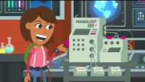


Pope Francis Faith Award
Can you explain what ‘Understanding’ means? What words do Trackers use to explain the gift of Understanding?

Slide 12
Pope Francis Faith Award
Can you explain what ‘Understanding’ means?
The Gift of Understanding energises us if we find it hard to love others when they and act in a certain way.
Understanding helps us to see what God wants us to do.
When we understand how to live and we show this to others, we also energise them, and give their faith journey new life.
The gift of Understanding is like fresh water that refreshes us on our faith journey.

Slide 13

Scripture Time
Listen carefully as your teacher
reads the words of Scripture.
Notes:
It may be useful to remind pupils that, when we listen to Scripture passages, we are listening to the inspired Word of God (RERC 2-12a) and that we “read aloud from Sacred Scripture in such a way that I am proclaiming the Word of God”. (core learning P6. 2-12a). While the Scripture passages have been included in each PowerPoint, you may want to first use a Bible to read from to show the proclamation of the Word, and then display the slides that follow.
God Gives What Is Good
1 The Lord says, “All you who are thirsty,
come and drink.
Those of you who do not have money,
come, buy and eat!
Come buy wine and milk.
You don’t need money; it will cost you nothing.
2 Why spend your money on something that is not real food?
Why work for something that doesn’t really satisfy you?
Listen closely to me, and you will eat what is good.
You will enjoy the food that satisfies your soul.
3 Come to me and listen.
Listen to me so you may live.
I will make an agreement with you that will last forever.
I will give you the blessings I promised to David.
4 I made David a witness of my power for all nations.
I made him a ruler and commander of many nations.
5 You will call for nations that you don’t yet know.
And these nations will run to you.
This will happen because of the Lord your God.
The Holy One of Israel honors you.”
6 So you should look for the Lord before it is too late.
You should call to him while he is near.
7 Evil people should stop being evil.
They should stop thinking bad thoughts.
They should return to the Lord, and he will have mercy on them.
They should come to our God, because he will freely forgive them.
8 The Lord says, “Your thoughts are not like my thoughts.
Your ways are not like my ways.
9 Just as the heavens are higher than the earth,
so are my ways higher than your ways.
And my thoughts are higher than your thoughts.
10 Rain and snow fall from the sky.
They don’t return without watering the ground.
They cause the plants to sprout and grow.
And the plants make seeds for the farmer.
And from these seeds people have bread to eat.
11 The words I say do the same thing.
They will not return to me empty.
They make the things happen that I want to happen.
They succeed in doing what I send them to do.

Slide 14
A Reading from the Prophet Isaiah
(55:1,3,10,11)
God gives what is good.
The Lord says ‘Come, everyone who is thirsty – here is water! Listen now, my people, and come to me and you will have life!
My Word is like the snow and the rain that come down from the sky to water the earth. They make crops grow and provide seed for sowing food to eat.’

Slide 15
Scripture Time
Your teacher will read the words of Scripture again. This time in silence.
Listen for the key words and messages from this passage.
Notes:
Your teacher will read the words of Scripture again.
What is the difference between knowledge and understanding?
How do instructions help us to understand?
What ‘instructions’ does God give us to help us on our faith journey?

Slide 16

Scripture Time
Person 1 | Person 2
We learned that the gift of understanding is like fresh water, what was the reason for this? | In the Gospel passage we hear the words 'You don’t need money; it will cost you nothing?' How do we repay God for the gifts He gives us?
Do you think that we need to use some of the other gifts of the Holy Spirit before we can use our gift of understanding? Why did you say this? | Why do you think that sometimes people don't use their gift of understanding?
In verse 10 we learn an important lesson about God's creation, can you help me understand this? | Can you list ways that people use their gift of understanding?
Can you think of a time when you found it difficult to show your gift of understanding. Would you like to share this with me? | In verse 11 we learn that 'The words I say do the same thing. They will not return to me empty'. What do you think this tells us about how we should use our words?

Slide 17
Pope Francis Faith Award
Listen to our Gospel passage again.
This time imagine you are David and you have been given a great responsibility.
Close our eyes and take time to reflect on our learning.
What do you say to God when He makes you a 'ruler and commander'?
How do you feel when you know that your people are looking to you for leadership?
How will you use your gifts to serve God's commandment?

Slide 18
Pope Francis Faith Award
Learning intention
Explore the meaning of the word ‘understanding’.
Listen to the Word of God, teaching us how Understanding can be used as a gift.
Challenge myself to an act of discipleship.
Learn
about the Gift of Understanding.
Reflect on what Understanding
means.
Act
to use Understanding.

Slide 19
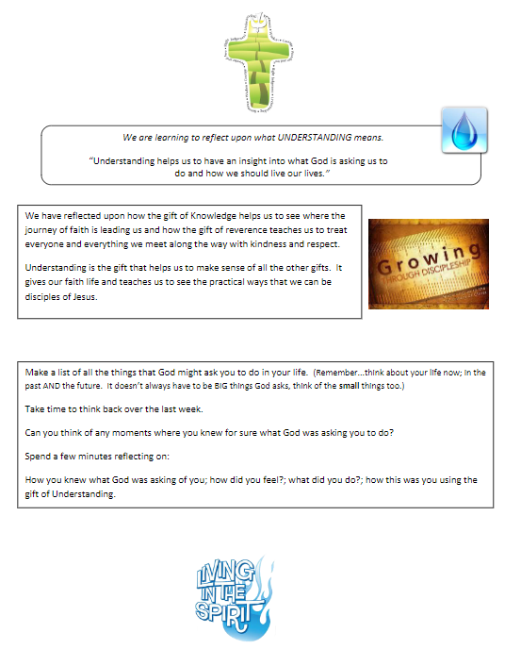
Pope Francis Faith Award
Think about all that you have learned about the gift of Understanding.
Use the Reflection Time activity for this gathering point to guide your thoughts.
Add any thoughts that come to mind to your journal.

Slide 20
Pope Francis Faith Award
The gift of Understanding helps us understand things 'as God understands them'.
Answer the following questions in your journal for school, home, and parish:
Can you think of a time you needed God’s help to show understanding?
Why was it important to use our gift of understanding?
How can we use the gift of understanding to serve others?

Slide 21
Pope Francis Faith Award
Reflection
Examination of Conscience

Slide 22
Pope Francis Faith Award
Think about all the times that we have made good decisions, loved God and others and done the right thing.
Think about the times when we made bad choices that we are not proud of.
Think about how not to do that again in the future.

Slide 23
Faith Prayer
Lord Jesus,
You ask those who believe in you
to give your Good News to others.
We pray that, with the help of the Holy Spirit,
our words and actions
will help other people
to hear of You,
to believe in You
to find the joy of knowing You.
Amen

Slide 24
Extension activity
Reflection
The following slides can be used to prompt children who are finished recording* their reflection on slide 19.
*Participants should evidence their learning in a method suited to their needs. Differentiated work should be presented for verification in the same manner.

Slide 25
Extension activity
Reflection 1
Lord Jesus.
You ask those who believe in you
to give your Good News to others.
Read the part of our prayer above. Think about the questions below. Write your answer on the free pages of your journal.
What do I believe about Jesus?
2. How do I give the Good News to other people?

Slide 26
Extension activity
Reflection 2
We pray that, with the help
of the Holy Spirit,
our words and actions
Read the part of our prayer above. Think about the questions below. Write your answer on the free pages of your journal.
1. How are the words I speak inspired by the Holy Spirit?
2. How do my actions show God in the world to other people?

Slide 27
Extension activity
Reflection 3
….and prayers will help other people
to believe in You
Read the part of our prayer above. Think about the questions below. Share your thoughts on the free pages of your journal.
Do other people know that I have received the Gifts of the Holy Spirit?
Do they see from my actions that I am a disciple?
Do they believe in him from what I do?

Slide 28
Extension activity
Reflection 4
….and to find the joy of knowing You.
Read the part of our prayer above. Think about the questions below. Share your thoughts on the free pages of your journal.
How do I use my gift of understanding to grow in love of God?
How do I share what I have learned about God as my friend?

Slide 29
Extension activity
Reflection 5
Examination of conscience
What could I do more of to share my faith?
How do I show my faith in school?
In what ways is my life at home filled with faith?
What do I do in my parish to show others I believe?

Slide 30
Pope Francis Faith Award
‘Make time for God by listening in silence and by praying with words each day.’
‘Contribute to charity with your time – for example by making something to sell at a School Fayre or speaking to your family about the work of your favourite charity and agreeing some way to offer support.’
‘Notice when someone in your family is sad, and respond in a kind way.’
‘Meditate quietly before a Church service.’
‘Be aware of those who may not have as much as you and discuss with your parents ways that you could be supportive and generous.’

