Slide 1
S2 & S3 - Lost

Slide 2
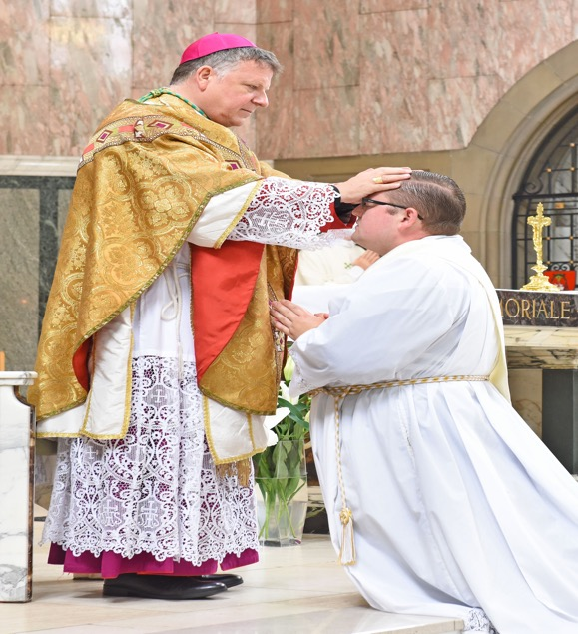
Starter Task
I See… I think… I wonder…

Slide 3
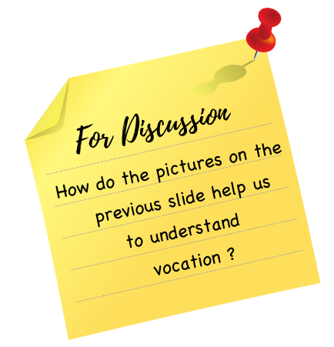

Introduction
This week the Catholic Church in Scotland celebrates Vocations Awareness Week.
During this time, we are asked to reflect on the ministry of Priests, Deacons and Religious Sisters in our communities. We are also asked to pray that men and women in our community and all over Scotland will offer their lives in the service of the Gospel.

Slide 4
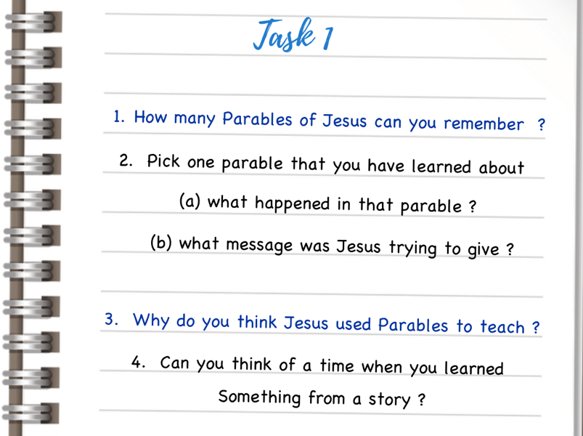
Introduction
This year, during Vocations Awareness Week, we are reflecting on theme of ‘parable’. Priests, Deacons and Religious Sisters are commissioned to tell the story of Jesus and that story comes to us, in a major part, by the stories, the ‘parables’ Jesus told about himself, about God and about the world.
The parables of Jesus work on many different levels. On the surface they can seem like simple stories but there is always something deeper at work in each and every one of them –
they draw us deeper into the mystery of Jesus and his message.
Parables, therefore, aren’t simply stories they’re more like riddles and puzzles – they stop and make us think and reflect.

Slide 5
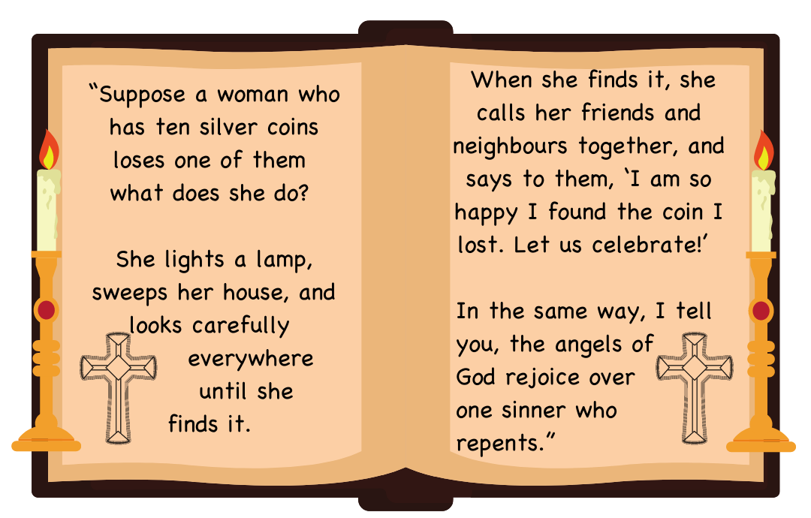
Parable of the Lost Coin

Slide 6
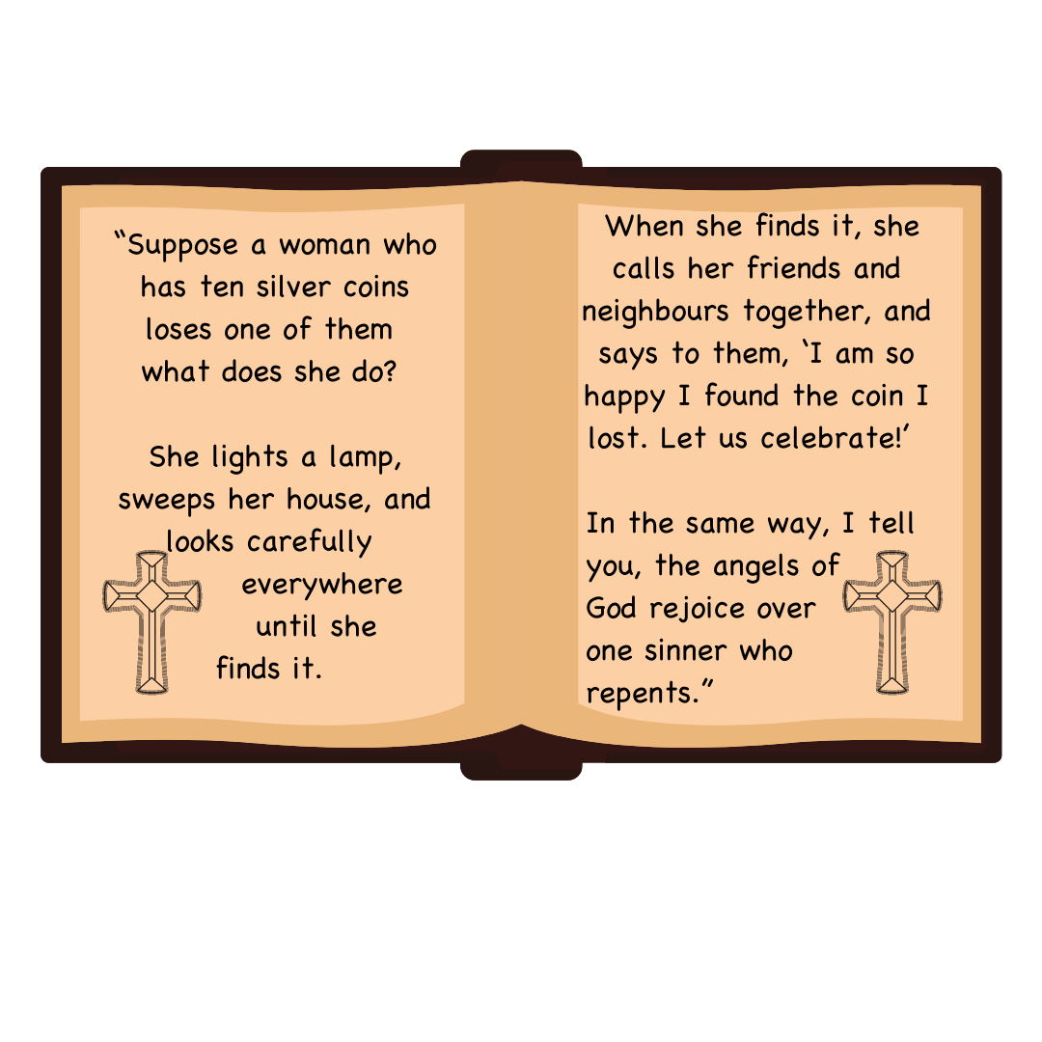

Parable of the Lost Coin

Slide 7
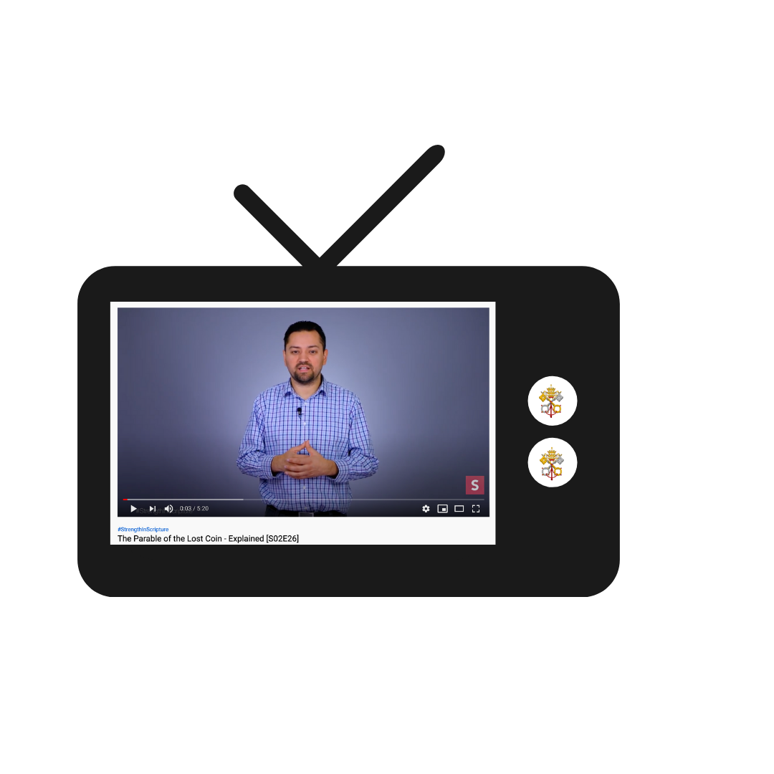
Parable of the Lost Coin
https://www.youtube.com/watch?v=e9i5_zXCNFs

Slide 8
Parable of the Lost Coin
Memory:
Jesus often told parables to convey his message but where did his ideas come from? In explaining God’s forgiveness, why did Jesus use the image of a woman looking for a coin. People who have studied this parable tell us that we tend to get ideas for stories from our memories and experience. They say it’s very likely that as a child Jesus saw Mary, his mother, frantically looking round the house for a lost coin. From that memory came the idea for this parable!

Slide 9
Parable of the Lost Coin
Lost and Found:
In the Gospel of Luke, Jesus tells many parables that revolve around the idea of things being lost and then found.
For Him it’s a key way of understanding
God’s love for us.
Whenever we are ‘lost’ – physically or emotionally or spiritually – He desires to ‘find’ us.

Slide 10
Parable of the Lost Coin
Repentance
At the end of the Gospel, Jesus speaks about ‘repenting’ but what does this mean.
We might think of ‘repenting’ in terms of ‘re-connecting’ – like getting back with a relative or an old friend after a long time apart.

Slide 11
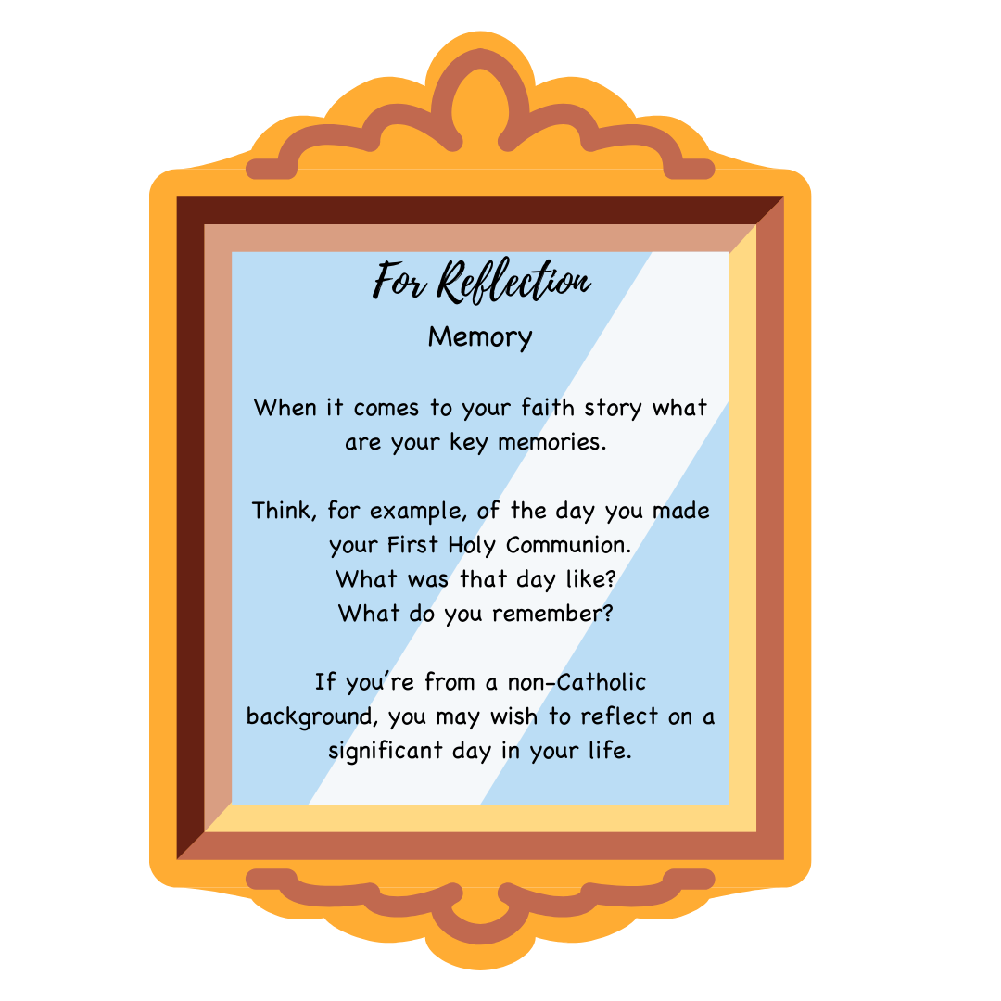

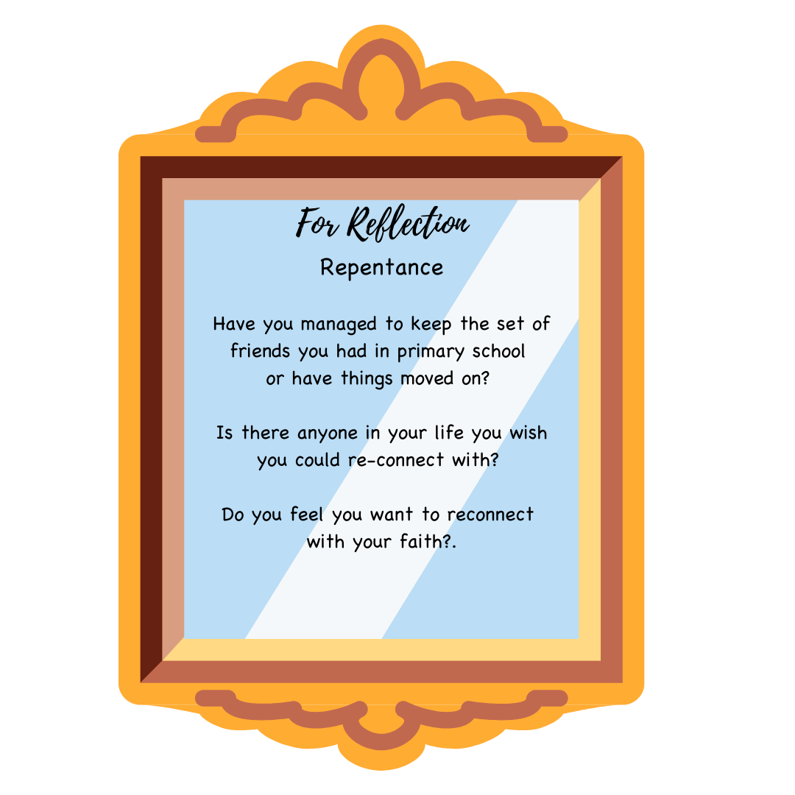

Slide 12
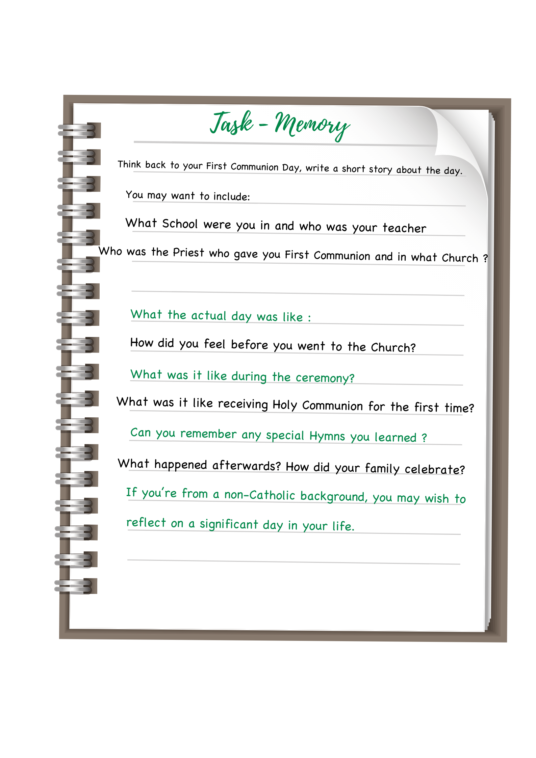

Slide 13
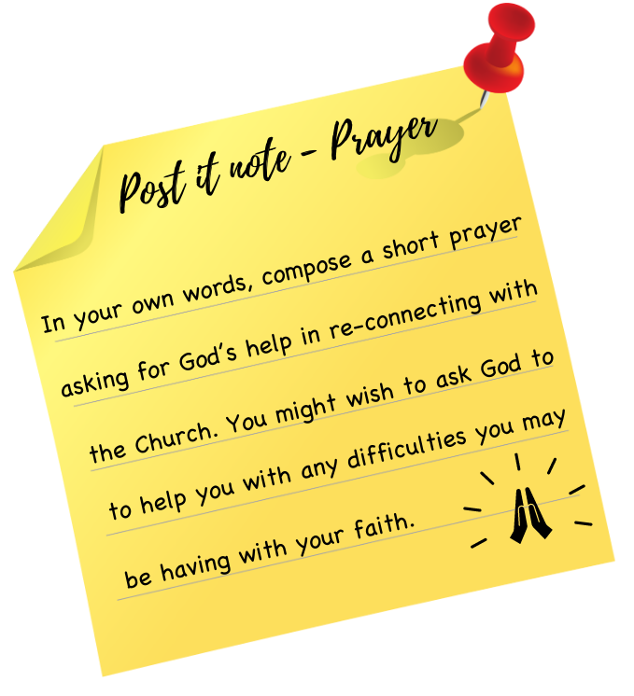
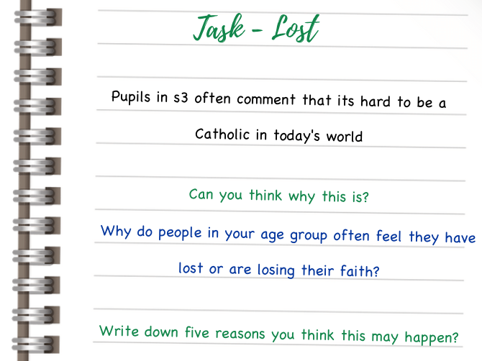

Slide 14

Vocation
“Jesus has a specific task in life for each and every one of us.
Each one of us is hand-picked, called by name by Jesus!
There is no one among us who does not have a divine vocation!”
Pope St John Paul II
on Vocation

Slide 15
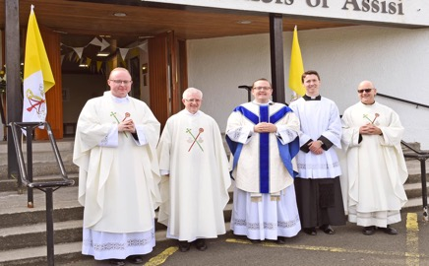
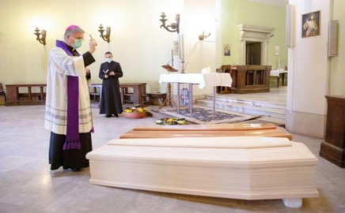
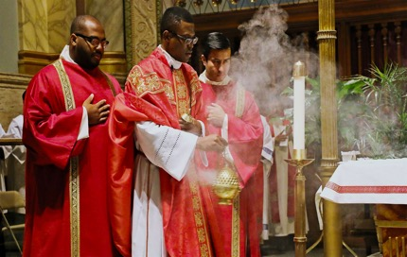
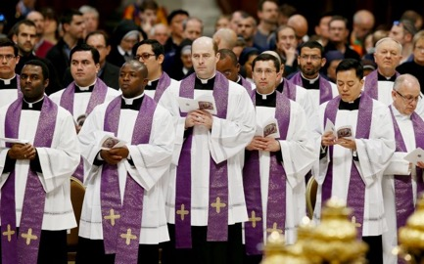
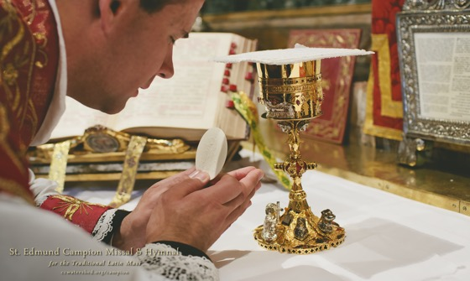
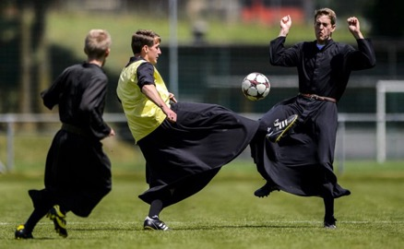
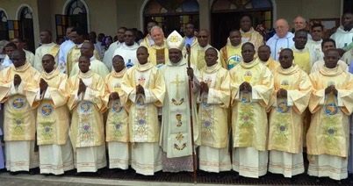
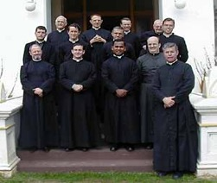
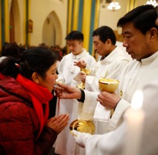
Vocation
The Parable of the Lost Coin is very helpful to help us understand the idea of Vocation.
In the Parable we learn about the Love of God and the our call to repentance..
In the Church Priests and Religious do this in the most obvious way.
Across the world today over 400,000 men are living out their vocation as Priests.

Slide 16
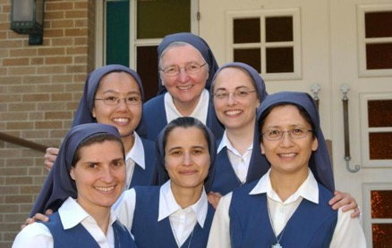
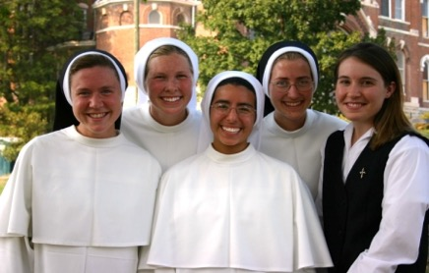
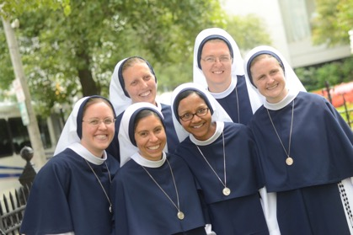
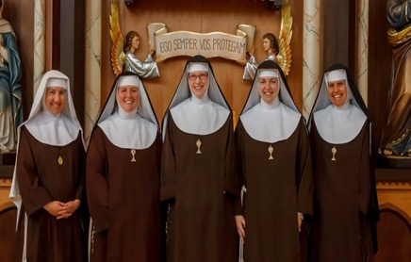
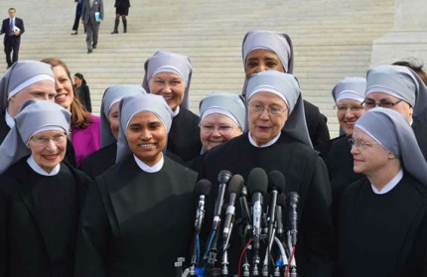
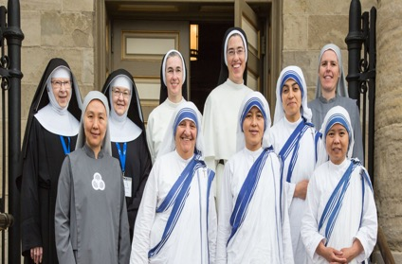
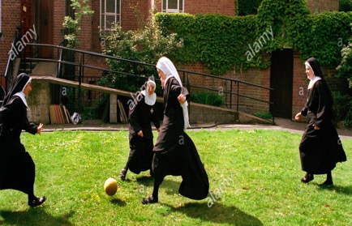
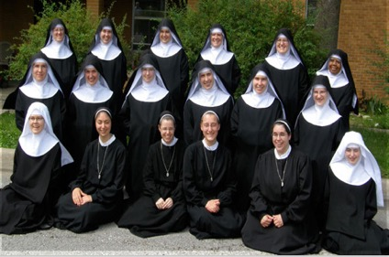
Vocation
The Parable of the Lost Coin is very helpful to help us understand the idea of Vocation.
In the Parable we learn about the Love of God and the our call to repentance..
In the Church Priests and Religious do this in the most obvious way.
Across the world today over 600,000 women are living out their vocation as as Religious Sisters (nuns)

Slide 17
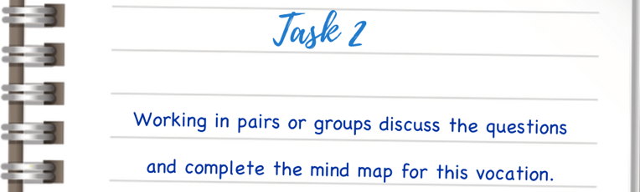
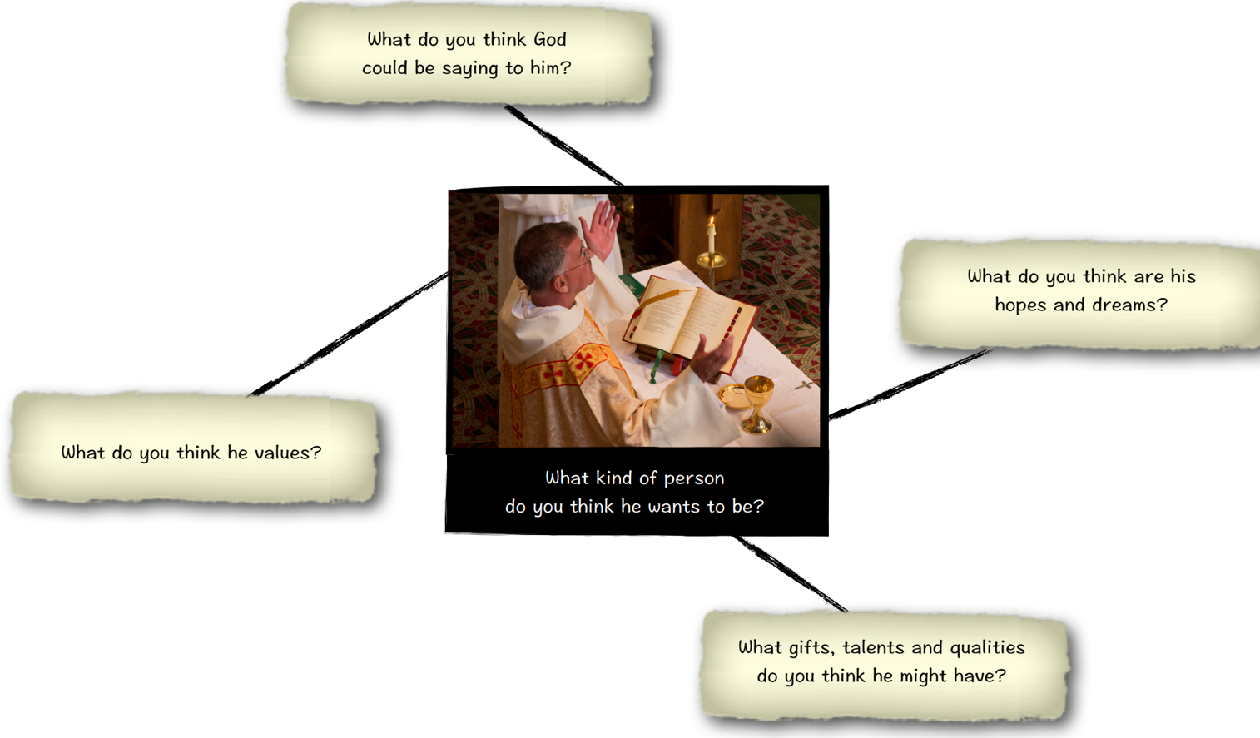

Slide 18
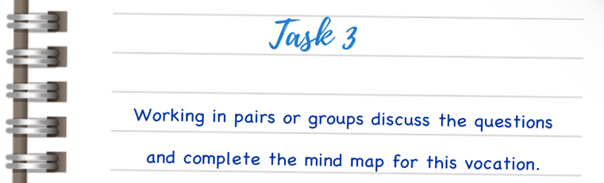
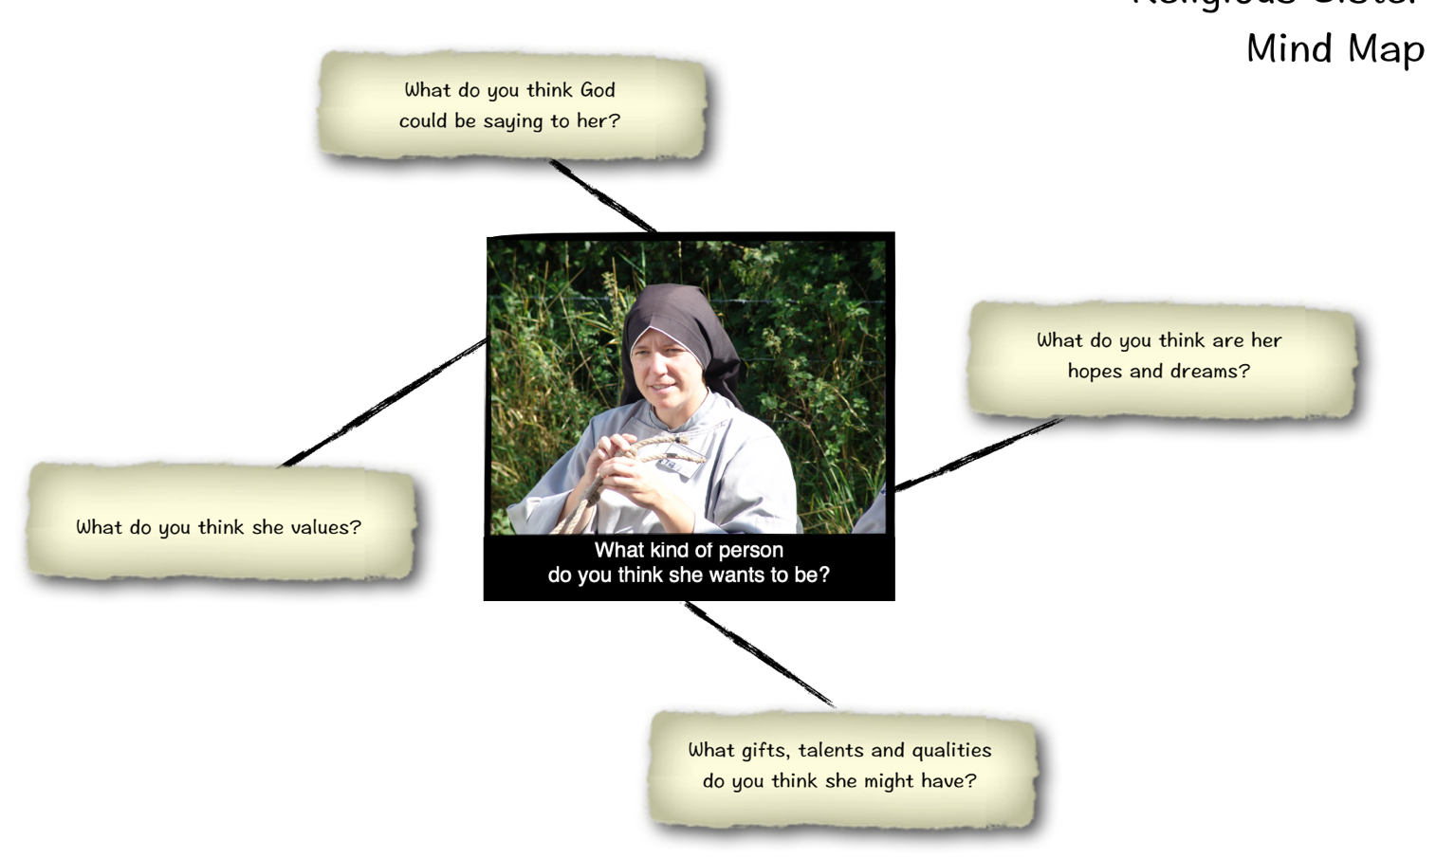

Slide 19
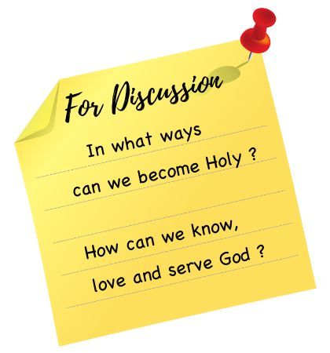
Our Vocation
Although we are focusing on Vocations to the Priesthood and Religious Life it is important to remember that each one of us has our own vocation in life.
Pope Francis reminds us that we all of us have the same basic vocation, that is we are called to be Holy, called to be Saints of the 21st Century.
The simplest and easiest way to live out his vocation is “to know God, to love God and to serve God with all our strength”
Catechism of the
Catholic Church

Slide 20

Our Vocation
https://youtu.be/ihnzFH2L818

Slide 21
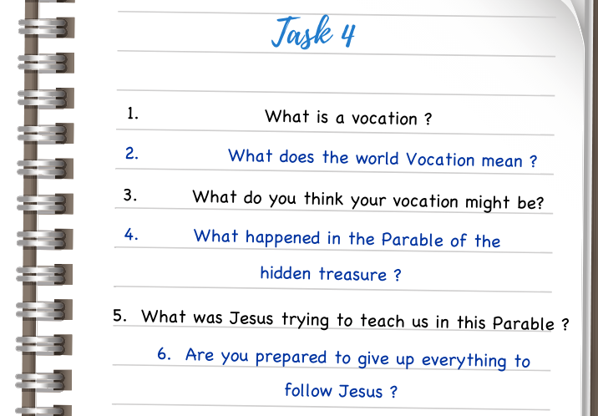
Check your understanding

Slide 22
Prayer Time
If possible, it may be desirable to encourage the class to prayerfully reflect on the parable in small groups
in the school oratory or another quiet location.
Ask participants to slowly reflect on the text. You may wish to have pupils read aloud the parable two or three times:
Ask the participants to reflect on the following four questions:
Leader: In the Name of the Father and of the Son and of the Holy Spirit
ALL : AMEN

Slide 23
Prayer Time
ALL: Our Father, Who art in heaven, hallowed be Thy name;
Thy kingdom come;
Thy will be done on earth as it is in heaven. Give us this day our daily bread;
and forgive us our trespasses as we forgive those who trespass against us;
and lead us not into temptation,
but deliver us from evil.

Slide 24
Prayer Time
What does the text say? Is there anything about the text I find surprising or unusual? Are there any words or phrases that strike me in a special way?

Slide 25
Prayer Time
What does the parable say to me? How does the parable connect with my life? What do I ‘treasure’? What is important to me? Can I see a connection between what I think is important and what my faith tells me is important?

Slide 26
Prayer Time
What do I want to say to God about the parable? Do I need God to make me aware of the the many ‘treasures’ in my life? Do I see the people around me as ‘treasures’? Do I need God’s help to recognize all the gifts that He has given me?

Slide 27
Prayer Time
Moving on: What is my ‘take-away’ from this time of prayer? Do I need to re-think what I value and what I think is important?

Slide 28
Prayer Time
ALL: Hail Mary, Full of Grace, The Lord is with thee. Blessed art thou among women, and blessed is the fruit of thy womb, Jesus. Holy Mary, Mother of God, pray for us sinners now, and at the hour of death. Glory Be to the Father, and to the Son, and to the Holy Spirit.

Slide 29
Prayer Time
ALL: Glory be to the Father, and to the Son, and to the Holy Spirit, as it was in the beginning, is now, and ever shall be, world without end.

