Slide 1
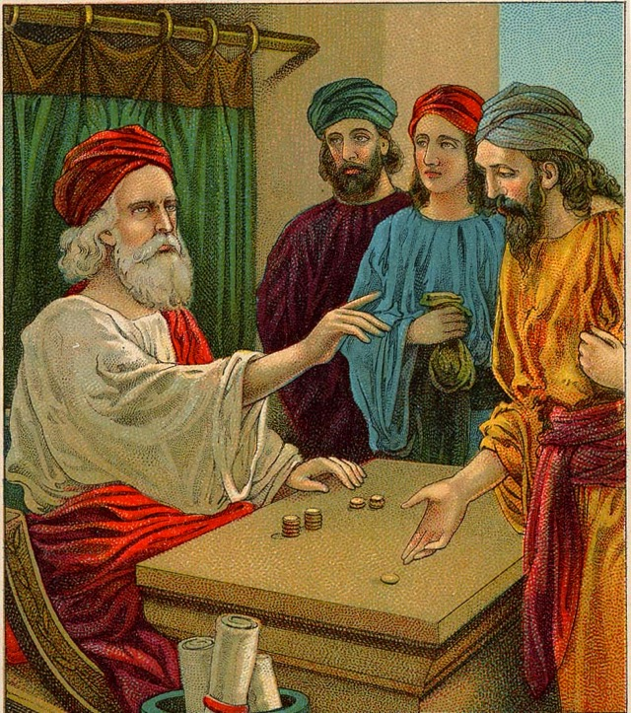
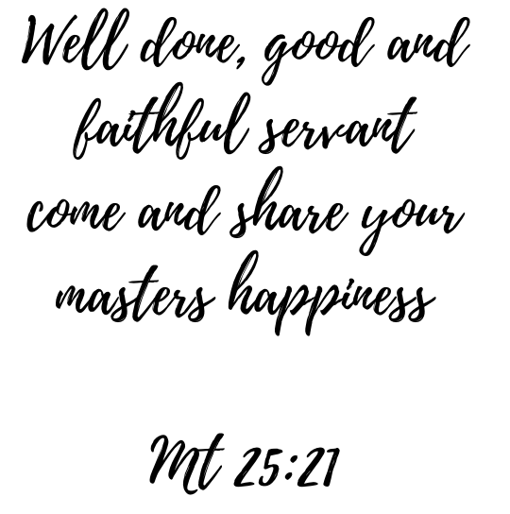
S5/6 - Talents

Slide 2
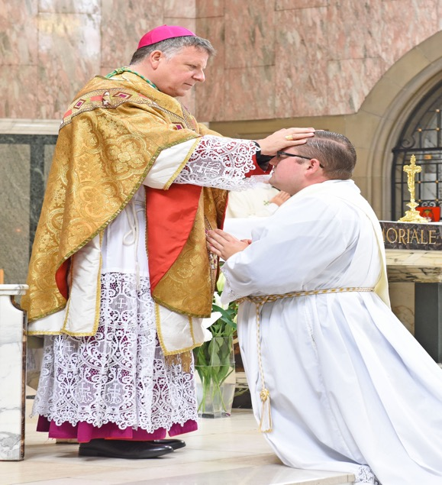
Starter Task
What is happening in each picture ?
What is the symbolism behind these actions ?

Slide 3


Introduction
This week the Catholic Church in Scotland celebrates Vocations Awareness Week.
During this time, we are asked to reflect on the ministry of Priests, Deacons and Religious Sisters in our communities. We are also asked to pray that men and women in our community and all over Scotland will offer their lives in the service of the Gospel.

Slide 4
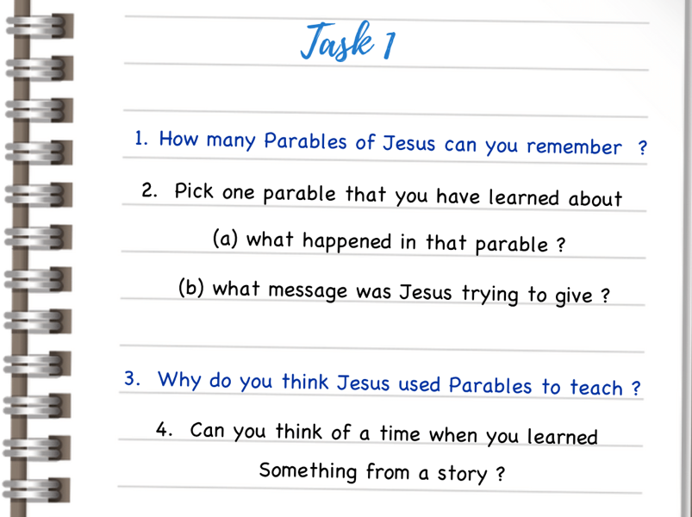
Introduction
This year, during Vocations Awareness Week, we are reflecting on theme of ‘parable’. Priests, Deacons and Religious Sisters are commissioned to tell the story of Jesus and that story comes to us, in a major part, by the stories, the ‘parables’ Jesus told about himself, about God and about the world.
The parables of Jesus work on many different levels. On the surface they can seem like simple stories but there is always something deeper at work in each and every one of them –
they draw us deeper into the mystery of Jesus and his message.
Parables, therefore, aren’t simply stories they’re more like riddles and puzzles – they stop and make us think and reflect.

Slide 5


Parable of the Talents
Once there was a man who was about to leave home on a trip; he called his servants and put them in charge of his property. He gave to each one according to his ability: to one he gave five talents, to another he gave two and to another he gave one. Then he left on his trip
The servant who had received five thousand coins went at once and invested his money and earned another five thousand.
In the same way the servant who had received
two thousand coins earned another two thousand.
But the servant who had received one
thousand coins went off, dug a hole in the ground, and hid his master's money.

Slide 6
Parable of the Talents
“After a long time the master of those servants came back and settled accounts with them. The servant who had received five thousand coins came in and handed over the other five thousand. ‘You gave me five thousand coins, sir,’ he said. ‘Look! Here are another five thousand that I have earned.’
‘Well done, you good and faithful servant!’ said his master. ‘You have been faithful in managing small amounts, so I will put you in charge of
large amounts. Come on in and share my happiness

Slide 7
Parable of the Talents
Then the servant who had been given two thousand coins came in and said, ‘You gave me two thousand coins, sir. Look! Here are another two thousand that I have earned.’
‘Well done, you good and faithful servant!’ said his master. ‘You have been faithful in managing small amounts, so I will put you in charge of large amounts. Come on in and share my happiness!

Slide 8
Parable of the Talents
Then the servant who had received one thousand coins came in and said,
‘Sir, I heard you were a hard man; you reap harvests where you did not plant, and you gather crops where you did not scatter seed.
I was afraid, so I went off and hid your money in the ground. Look! Here is what belongs to you.’ ‘You bad and lazy servant!’ his master said. ‘You heard, did you, that I reap harvests where I did not plant,
and gather crops where I did not scatter seed?

Slide 9
Parable of the Talents
Well, then, you should have deposited my money in the bank, and I would have received it all back with interest when I returned. Now, take the money away from him and give it to the one who has ten thousand coins.
For to every person who has something, even more will be given, and he will have more than enough; but the person who has nothing, even the little that he has will be taken away from him.
As for this useless servant—
throw him outside in the darkness’

Slide 10


Parable of the Talents

Slide 11

Parable of the Talents
https://www.youtube.com/watch?v=bXC_qB8xfYQ&t=236s

Slide 12
Parable of the Talents
We’re told that the Servants in the parable are given ‘talents’. We tend to think of ‘talents’ as gifts or aptitudes. In the parable, that is not quite the sense of the term.
In the ancient world a ‘talent’ was a unit of currency. Scholars tell us that five talents are roughly equal to £1.6 million in today’s money. Two’ talents’ would be worth about £640,000 and one talent worth about £160,000 – incredibly significant amounts of money!

Slide 13
Parable of the Talents
Location, location, location:
The parable occurs in Chapter 25 of Matthew’s Gospel. This is just before Jesus enters Jerusalem and is crucified by the Roman authorities. When people are approaching death, they tend to speak about the things that are most important to them.

Slide 14
Parable of the Talents
Location, location, location:
In this parable, Jesus is trying to get across some of the key ideas that he has been teaching for the last three years of His life. The teaching behind the parable is really important to Him and should be important to us!

Slide 15
Parable of the Talents
A Risky Business
A key figure in the parable is the mysterious Master. For most of the story he is far, far away. We’re just told that he gives to his servant’s enormous sums of cash with absolutely no directions on how to use it.
He simply gives them the money and goes, leaving no orders as to what is to be done with his considerable. He takes an enormous risk and places tremendous trust in these servants.

Slide 16
Parable of the Talents
Diving Deeper
For some people, the ‘parable’ is simply a cautionary tale on using your gifts.
If you’re a talented runner – run!
If you can paint – paint!
If you are a good listener – listen!
For them, the parable does not really have a deep religious significance its pure and simple common sense.

Slide 17
Parable of the Talents
Diving Deeper
For other people, the parable is just a description of the how the world works. People who are successful just seem to attract more success (the servant with the five talents) whereas those who are less talented tend to be less successful. Economists, looking at this parable, have even coined the term the ‘Matthew principle’ – whereby the rich always seem to get richer and the poor get poorer. Again, for these people, the parable is not really about God its more about how
the world works!

Slide 18
Parable of the Talents
Diving Deeper
People of faith tend to think there is something else at work in the parable. Jesus isn’t a self-help coach or an economist – He’s the Son of God and is using this parable to explain what his life and message are all about! We’ve got to think that’s He more than a self – help or an ancient economist!

Slide 19



Slide 20
Parable of the Talents
The Master:
The key to understanding this parable lies in understanding exactly what is going on with the Master. Christians have always understood the ‘Master’ as being God himself.
For most of the parable, the Master is absent. He appears at the beginning and end of the story.
We are told at the start of the story that he entrusts His servants with that which is most precious to Him.

Slide 21
Parable of the Talents
The Master
He doesn’t leave them tasks or directions or guidelines as to what do with these gifts – He simply gives and then leaves…His ‘giving’ of the talents is totally gratuitous, he doesn’t impose any conditions on the ‘gift’ that he is giving.
The Master’s annoyance isn’t really caused by the fact the servant doesn’t use his money particularly well. If you look carefully at the text, there is something deeper going on. The servant had heard the Master was a ‘hard man’ yet exactly where did this come from? Is there anything in the story that indicated that the Master was demanding or difficult or had unrealistic expectations of His servants?

Slide 22
Parable of the Talents
The Master
The only thing we hear about the Master is that he has given his given his servants wonderful gifts without price, without condition and without expectation.
Yet the servant sticks to his belief that the Master is a ‘hard man’. He has developed a false and ultimately unhelpful image of the Master that has damaged His relationship with Him.

Slide 23
Parable of the Talents
The Point!
Jesus, in this parable, is making the point that people often have unhelpful or even false images of God that damage their relationship with Him.
For Jesus, a key concern of his entire life has been to show people that God isn’t just another demanding boss, or harsh judge or cruel master but a Father who loves us and cares about every aspect of our lives.

Slide 24


Slide 25



Slide 26

Vocation
“Jesus has a specific task in life for each and every one of us.
Each one of us is hand-picked, called by name by Jesus!
There is no one among us who does not have a divine vocation!”
Pope St John Paul II
on Vocation

Slide 27
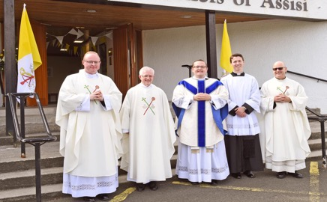
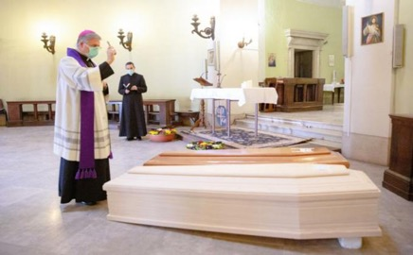
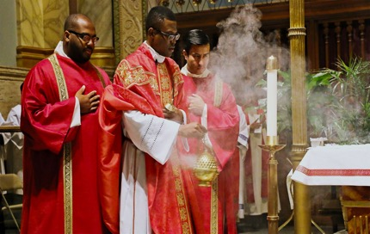
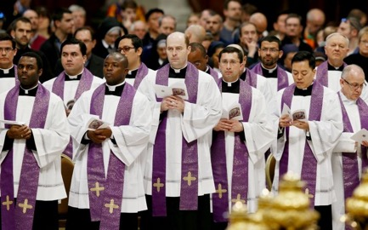
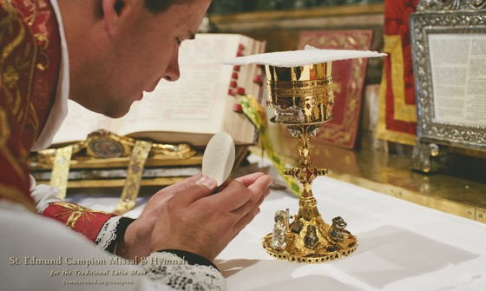
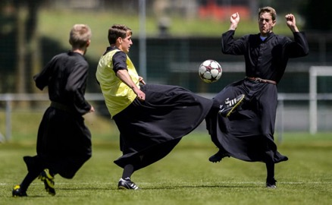
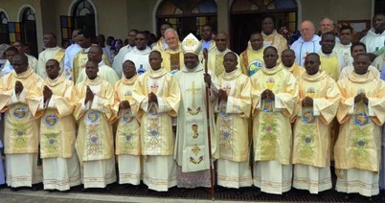
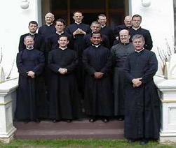
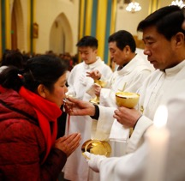
Vocation
The Parable of the Talents is very helpful to help us understand the idea of Vocation.
In the Parable God gives us all various talents which we need to use to their full potential.
In the Church Priests and Religious do this in the most obvious way.
Across the world today over 400,000 men are living out their vocation as Priests.

Slide 28
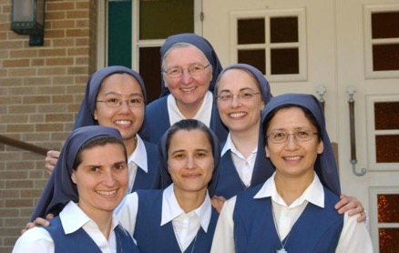
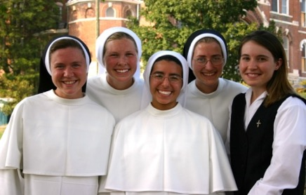
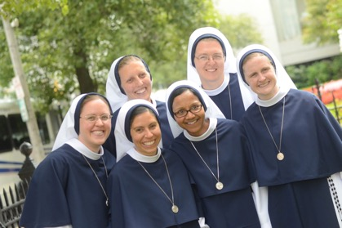
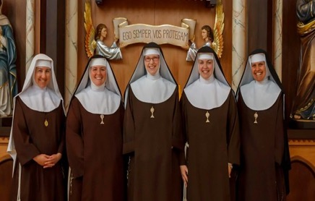
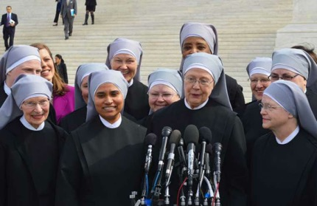
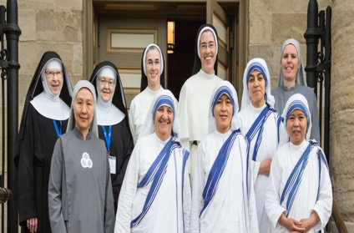
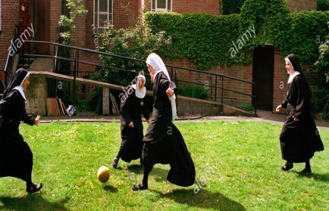
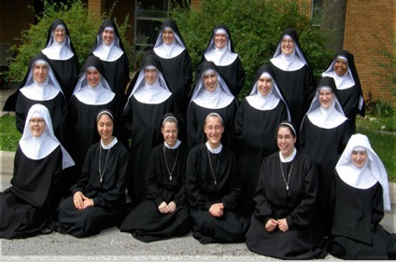
Vocation
The Parable of the Talents is very helpful to help us understand the idea of Vocation.
In the Parable God gives us all various talents which we need to use to their full potential.
In the Church Priests and Religious do this in the most obvious way.
Across the world today over 600,000 women are living out their vocation as as Religious Sisters (nuns)

Slide 29
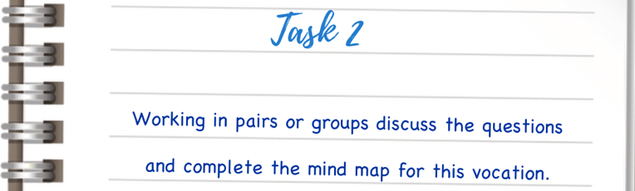
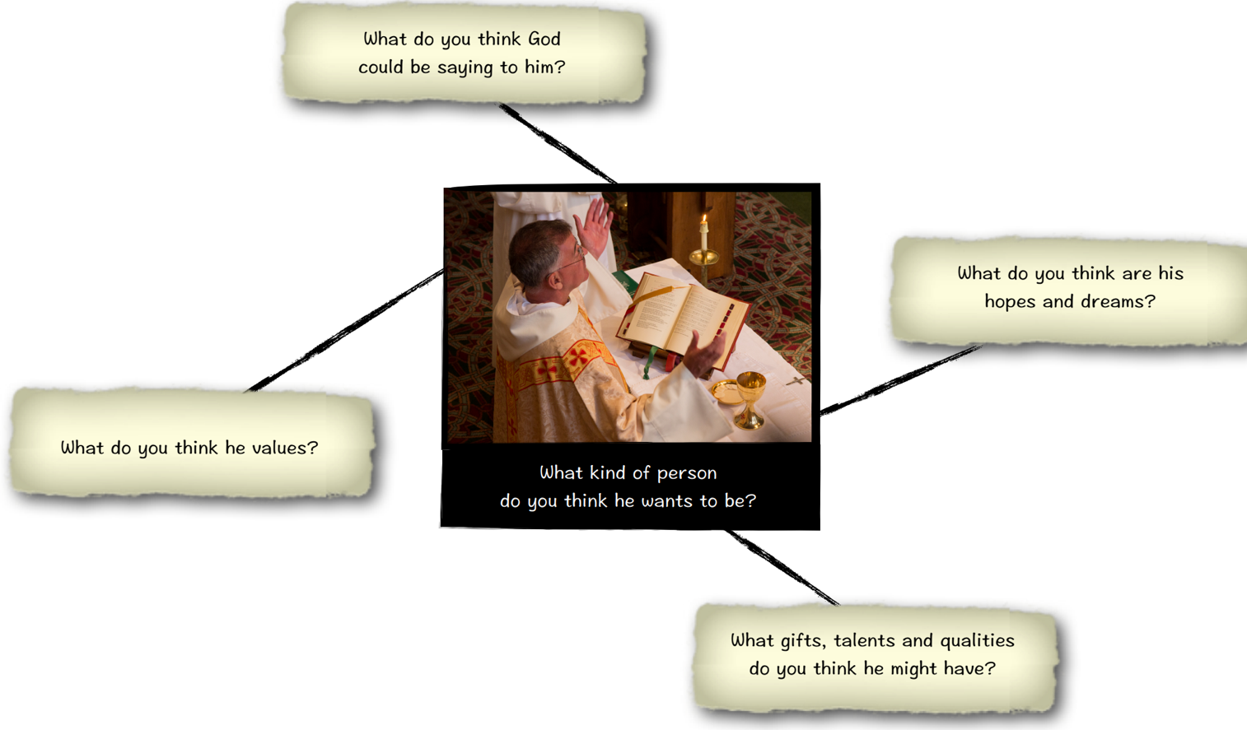

Slide 30
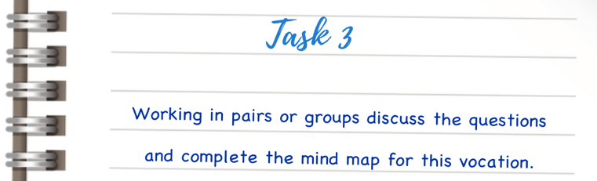
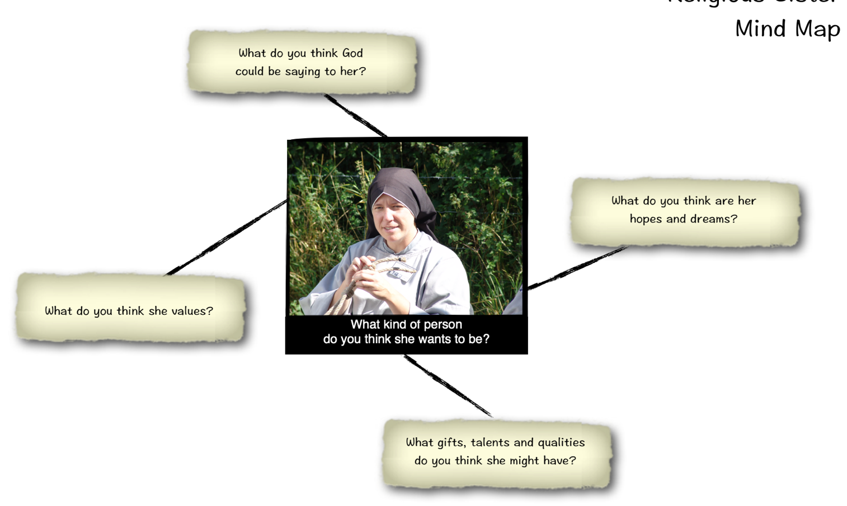

Slide 31

Our Vocation
Although we are focusing on Vocations to the Priesthood and Religious Life it is important to remember that each one of us has our own vocation in life.
Pope Francis reminds us that we all of us have the same basic vocation, that is we are called to be Holy, called to be Saints of the 21st Century.
The simplest and easiest way to live out his vocation is “to know God, to love God and to serve God with all our strength”
Catechism of the
Catholic Church

Slide 32

Our Vocation
https://youtu.be/ihnzFH2L818

Slide 33
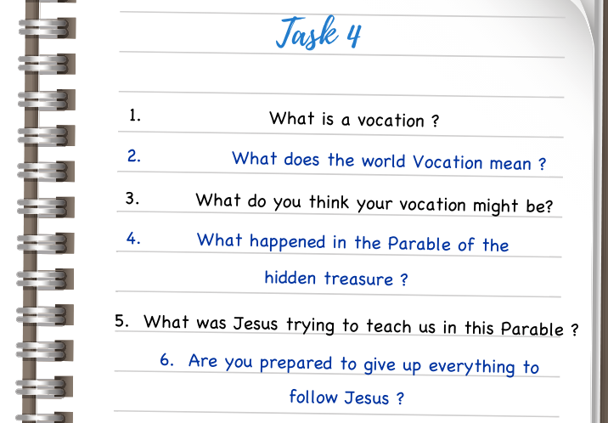
Check your understanding

Slide 34
Prayer Time
If possible, it may be desirable to encourage the class to prayerfully reflect on the parable in small groups
in the school oratory or another quiet location.
Ask participants to slowly reflect on the text. You may wish to have pupils read aloud the parable two or three times:
Ask the participants to reflect on the following four questions:
Leader: In the Name of the Father and of the Son and of the Holy Spirit
ALL : AMEN

Slide 35
Prayer Time
ALL: Our Father, Who art in heaven, hallowed be Thy name;
Thy kingdom come;
Thy will be done on earth as it is in heaven. Give us this day our daily bread;
and forgive us our trespasses as we forgive those who trespass against us;
and lead us not into temptation,
but deliver us from evil.

Slide 36
Prayer Time
What does the text say? Is there anything about the text I find surprising or unusual? Are there any words or phrases that strike me in a special way?

Slide 37
Prayer Time
What does the parable say to me? How does the parable connect with my life? What do I ‘treasure’? What is important to me? Can I see a connection between what I think is important and what my faith tells me is important?

Slide 38
Prayer Time
What do I want to say to God about the parable? Do I need God to make me aware of the the many ‘treasures’ in my life? Do I see the people around me as ‘treasures’? Do I need God’s help to recognize all the gifts that He has given me?

Slide 39
Prayer Time
Moving on: What is my ‘take-away’ from this time of prayer? Do I need to re-think what I value and what I think is important?

Slide 40
Prayer Time
ALL: Hail Mary, Full of Grace, The Lord is with thee. Blessed art thou among women, and blessed is the fruit of thy womb, Jesus. Holy Mary, Mother of God, pray for us sinners now, and at the hour of death. Glory Be to the Father, and to the Son, and to the Holy Spirit.

Slide 41
Prayer Time
ALL: Glory be to the Father, and to the Son, and to the Holy Spirit, as it was in the beginning, is now, and ever shall be, world without end.

