Slide 1


Catholic Education Week 2021
Celebrating and Worshipping

Slide 2
Celebrating and Worshipping
“The Catholic school is a believing community which celebrates faith in Jesus through prayer and liturgy, inviting all to participate appropriately and to develop their spiritual capacities.”
believing
We are a community of faith and learning, with Jesus at its centre. We believe that God – Father, Son and Spirit – is active here.
Notes:
The theme for this year’s catholic Education Week is “Celebrating and Worshipping”.
In the document “The Catholic School: Developing in Faith”, we find this description of Catholic school:
CLICK 1(quote from DiF) and read out quote
We’re going to break this down a bit and unpack what this means for us.
First of all, we are
CLICK 2
a believing school.
We are a community where learning is central to what we do and how we do it. However, we are also a community that is built on and a nourished by faith. We believe that Jesus Christ and his teaching is at the centre not only of what we do and how we do it; he is also at the centre of why we do what we do. And because we believe in belief; because we have faith in the power of faith itself, we are strengthened and motivated by our belief that God is here with us. We believe in God and his love for us; we believe in the power of prayer to strengthen us and to guide us, and we believe that each of us is the result of the work of God.
CLICK 3 (next slide)

Slide 3
Celebrating and Worshipping
“The Catholic school is a believing community which celebrates faith in Jesus through prayer and liturgy, inviting all to participate appropriately and to develop their spiritual capacities.”
celebrates
Our faith doesn’t just live in our heads – it is something we do, and something we share.
Notes:
Next, we are a school community that celebrates our faith.
Think about the use of that word.
When we think of the word “celebrate” we do not think of a quiet, private event! While there are times when our faith can be a very private and personal thing, as a community we are proud of our faith, and it is a huge part of how we function as a school. It is clear in the name of our school; in its crest and its symbols; in the way we shape our year; in the artwork and artefacts in our classrooms and corridors; in the way in which we support those who need our help; in the way we mark important events in the life of our school and the lives of those who are a part of it; in the vision, values and aims of our community.
Our faith is not just a set of beliefs in our minds. God has created us body and soul; our faith is as much a part of us as our own bodies are. In living as a community of faith and learning, we remember the words of St Teresa of Avila:
Christ has no body but yours,
No hands, no feet on earth but yours,
Yours are the eyes with which He looks
Compassion on this world,
Yours are the feet with which He walks to do good,
Yours are the hands, with which He blesses all the world.
Yours are the hands, yours are the feet,
Yours are the eyes, you are His body.
Christ has no body now but yours,
No hands, no feet on earth but yours,
Yours are the eyes with which he looks
compassion on this world.
Christ has no body now on earth but yours.
Our faith is active, it is loving, and it is to be celebrated.
CLICK TO NEXT SLIDE

Slide 4
Celebrating and Worshipping
“The Catholic school is a believing community which celebrates faith in Jesus through prayer and liturgy, inviting all to participate appropriately and to develop their spiritual capacities.”
prayer
and
liturgy
Our tradition helps us to do this in ways that can be both private and public; in ways that join us with one another and with the wider Church. These include sacramental celebrations.
Notes:
Our tradition provides us with the ways and the words to celebrate our faith. We can come together in various ways to mark the ways in which our faith supports us.
These might be different types of prayer, like sharing a rosary or having services of remembrance in November. It may be that we gather for special prayers during Advent or Lent.
Our most important events we usually mark with a mass, where we come together in the celebration of the Eucharist. We know that Jesus is with us at all times: he told us that wherever two or three are gathered together in his name, he is there with them. However, we also know that in the Eucharist Jesus is truly present with us: body, blood, soul and divinity.
CLICK TO NEXT SLIDE

Slide 5
Celebrating and Worshipping
“The Catholic school is a believing community which celebrates faith in Jesus through prayer and liturgy, inviting all to participate appropriately and to develop their spiritual capacities.”
all to participate appropriately
Although not everyone in our community is a Catholic, we are still a Catholic school, and invite everyone in our community to join with us as we celebrate our faith.
Notes:
There is a difference between being a Catholic school, and being a school for Catholics. Or community is a Catholic school in that we operate in accordance with the values of the Gospels and the teachings of the Church. Faith is at the centre of how we operate for everyone, and everyone benefits from this ethos, whether they themselves are Catholic or not. It is in the nature of our school to care for everyone, to help everyone to the fullest use of the gifts they have been given, and to be involved with everyone in the community.
CLICK TO NEXT SLIDE

Slide 6
Celebrating and Worshipping
“The Catholic school is a believing community which celebrates faith in Jesus through prayer and liturgy, inviting all to participate appropriately and to develop their spiritual capacities.”
spiritual capacities
We believe that every person – of any faith or none – is made by God and is both body and soul. We try to help the whole person to grow.
Notes:
It is a part of our faith that every single person is created in the image and likeness of God, and therefore has their own dignity and value.
We remember this in our dealings with others, and in remembering our own dignity and value.
We also believe that every person is created body and soul and is invited into a special and unique relationship with God. There may be times in our lives where we forget this or where, for some reason, our relationship with God is not as strong as it might be. As with any relationship, our relationship with God is helped by good communication; by speaking and listening to God through prayer; by sharing our feelings with him; by letting him know how important he is in our lives. We do this through celebrating and worshipping together.
CLICK TO NEXT SLIDE

Slide 7
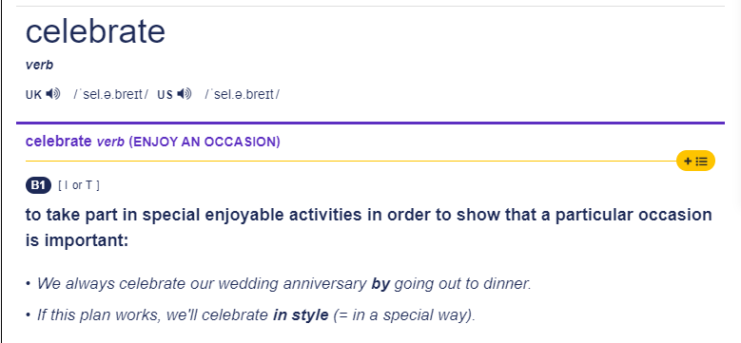
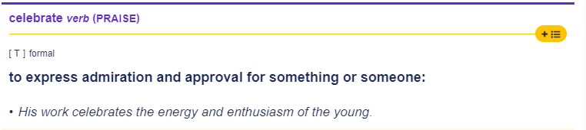
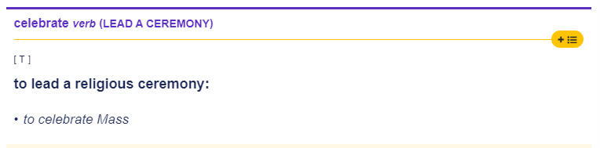
Celebrate
Notes:
So what do we mean by the word “celebrate”? What do we think of?
We tend to think of celebration in this way (CLICK 1), meaning marking an important occasion by doing something we enjoy and usually something we do with others. It might be Christmas dinner; going out for a meal to mark a birthday; a christening party; going out with friends who have just passed an exam or a driving test . . . We mark all sorts of things in all sorts of ways.
However, the word can be used in different ways. We can use it (CLICK 2) to mean to praise or to express admiration for something. So, for example, we might say that our Prizegiving ceremony celebrates achievement and all the good things that happen in our school.
When talking about our school, and about our faith, however, there is one very particular use of the word “celebrate”, (CLICK 3)
We talk about the Mass as something that is celebrated. It’s not just that we go to Mass, or attend Mass, as if just turning up and sitting there is enough. Rather, we are joining a celebration.
Within the Mass, we celebrate the Eucharist, where we meet Jesus in the Blessed Sacrament.
CLICK TO NEXT SLIDE

Slide 8
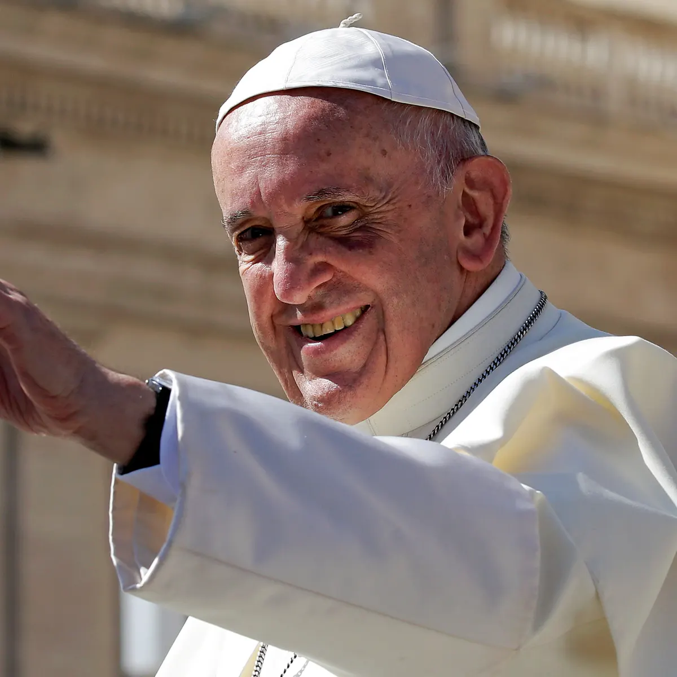
Worship
"When we do not worship God, we end up worshipping ourselves . . . Worship means concentrating on what is essential. In worship, we learn to reject what should not be worshipped: the god of money, the god of consumerism, the god of pleasure, the god of success, the god of self. Worship means putting the Lord at the centre, not ourselves. ”
Pope Francis, Homily of 6th January 2020, St. Peter’s Basilica
Notes:
What do we mean by the word “worship”?
Pope Francis tells us (CLICK 1 – quote from Pope Francis – it may be worthwhile to have someone read it aloud)
Pope Francis tells us that worship is about turning our focus and attention to God; to his great love for us and the many gifts he gives us.
It helps us to make sense of our lives through, as Pope Francis says, “concentrating on what is essential”, and what is not. Spending time with God helps us to understand his plan for us and with us, which allows us to put aside the temporary and empty pleasures that society tells us to want.
(CLICK TO NEXT SLIDE)

Slide 9
Worship
Worship means realising that you and God belong together to one another. It means being able to speak to him freely and intimately. It is means giving things their rightful place, and giving the first place to God. In worship, we allow Jesus to heal and change us … to kindle light amid our darkness, to grant us strength in weakness and courage amid trials.
Pope Francis, Homily of 6th January 2020, St. Peter’s Basilica
Notes:
READ QUOTE FROM SLIDE
Worship allows us to build our relationship with God and gives him a place to work in our lives
(CLICK TO NEXT SLIDE)

Slide 10
Worship
Worship means bending low before the Most High and to discover in his presence that life's greatness does not consist in having, but in loving."
Pope Francis, Homily of 6th January 2020, St. Peter’s Basilica
Notes:
God made us to know him, to love him and to serve him, and worship gives us a way and a space to do that. It helps us towards an understanding of our purpose, and that helps us, as Pope Francis says in this quote, when we bring ourselves into the presence of God we see that “life’s greatness does not consist in having, but in loving.”
CLICK TO NEXT SLIDE

Slide 11
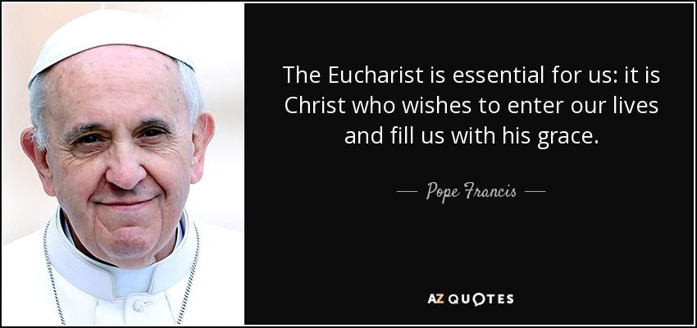
“Worship means concentrating on what is essential.”
Notes:
We can see then that celebrating and worshipping belong together in any Catholic community. They are the ways in which we mark and nourish our relationship with God and with one another.
We saw in an earlier slide that Pope Francis said “Worship means concentrating on what is essential.”
What does that mean? What is “essential” for us as a community?
CLICK
Pope Francis is very clear on this.

Slide 12
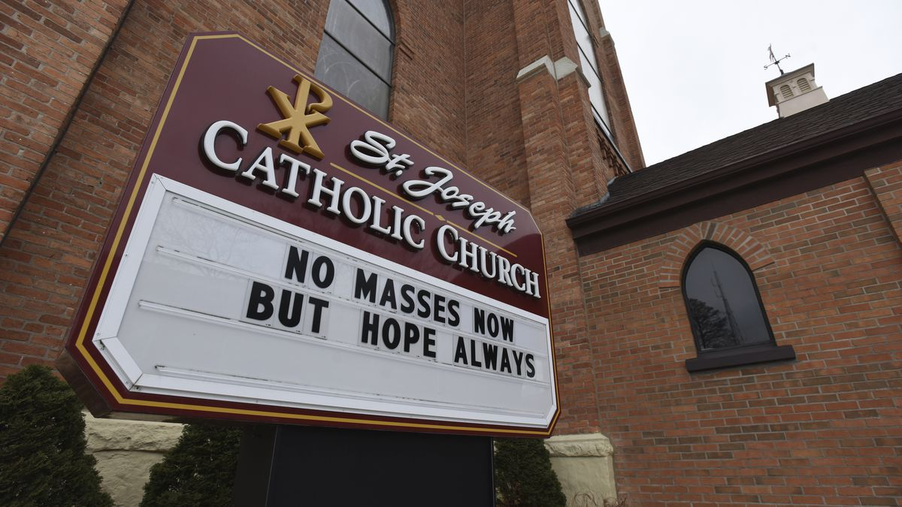
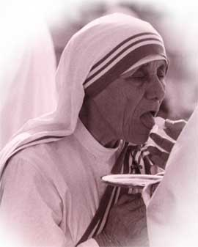
“If I can give you any advice, I beg you to get closer to the Eucharist and to Jesus…”
St. Teresa of calcutta
Notes:
When we look at the lives of the saints, over and over again we see that receiving the Blessed Sacrament and Eucharistic Adoration was central to everything they did. The eucharist is the perfect blend of celebration and worship.
Over lockdown, when our churches were closed or restrictions meant very few of us could get to mass,
CLICK
many Catholics were unable to receive the Blessed Sacrament. As often happens, it is not until something is removed from us that we realise how much we need it. And while we were still able to attend mass online, and we could pray at any time, being distanced from the Eucharist was a trial for many. We gain such strength and grace from receiving communion, or from spending time in adoration of the Holy Eucharist. Every relationship benefits from time spent together, and our relationship with God is no different. When we are in the presence of the Eucharist, we are in the presence of Jesus and he is truly present with us. The Eucharist is not a symbol or a representation of Jesus; rather, it is Jesus himself.
CLICK TO NEXT SLIDE

Slide 13
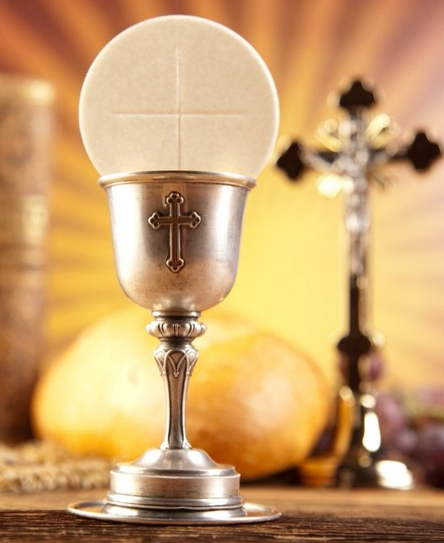
“The Eucharist is a fire which inflames us.” st. john damascene
Notes:
As we try to return to a more normal way of living after the restrictions, we should never forget what it was like not to be able to go to our celebrations and our acts of worship.
We should try to be an active community of celebration and worship.
We should be a community that recognises and welcomes Jesus at its heart, and that is inspired to follow him.
CLICK TO NEXT SLIDE

Slide 14
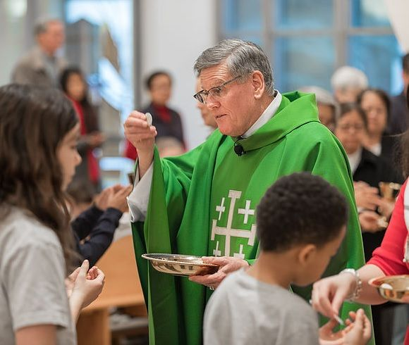
“Not to go to communion is like someone dying of thirst beside a spring.”
St. John Vianney
Notes:
Let us remember the life-giving power of the Eucharist, and how we can be transformed through the grace it brings us.
CLICK TO NEXT SLIDE

Slide 15
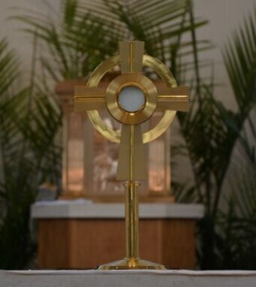
“Jesus in the Blessed Sacrament is the Living Heart of each of our parishes.” St. Paul VI
Notes:
Let us take every opportunity to celebrate and worship in our school and in our parishes
CLICK TO NEXT SLIDE

Slide 16

Lord,
In this Catholic Education Week, we thank you for our school community.
We thank you for all that you give us, and for the many ways in which you show your love to us.
Help us to be a community of celebration and of worship.
May we never tire of praising you, and always find joy in prayer and worship.
Help us to grow closer to you in devotion and adoration,
And closer to each other through love and service.
Amen.
Notes:
Let us pray together.

