Slide 1
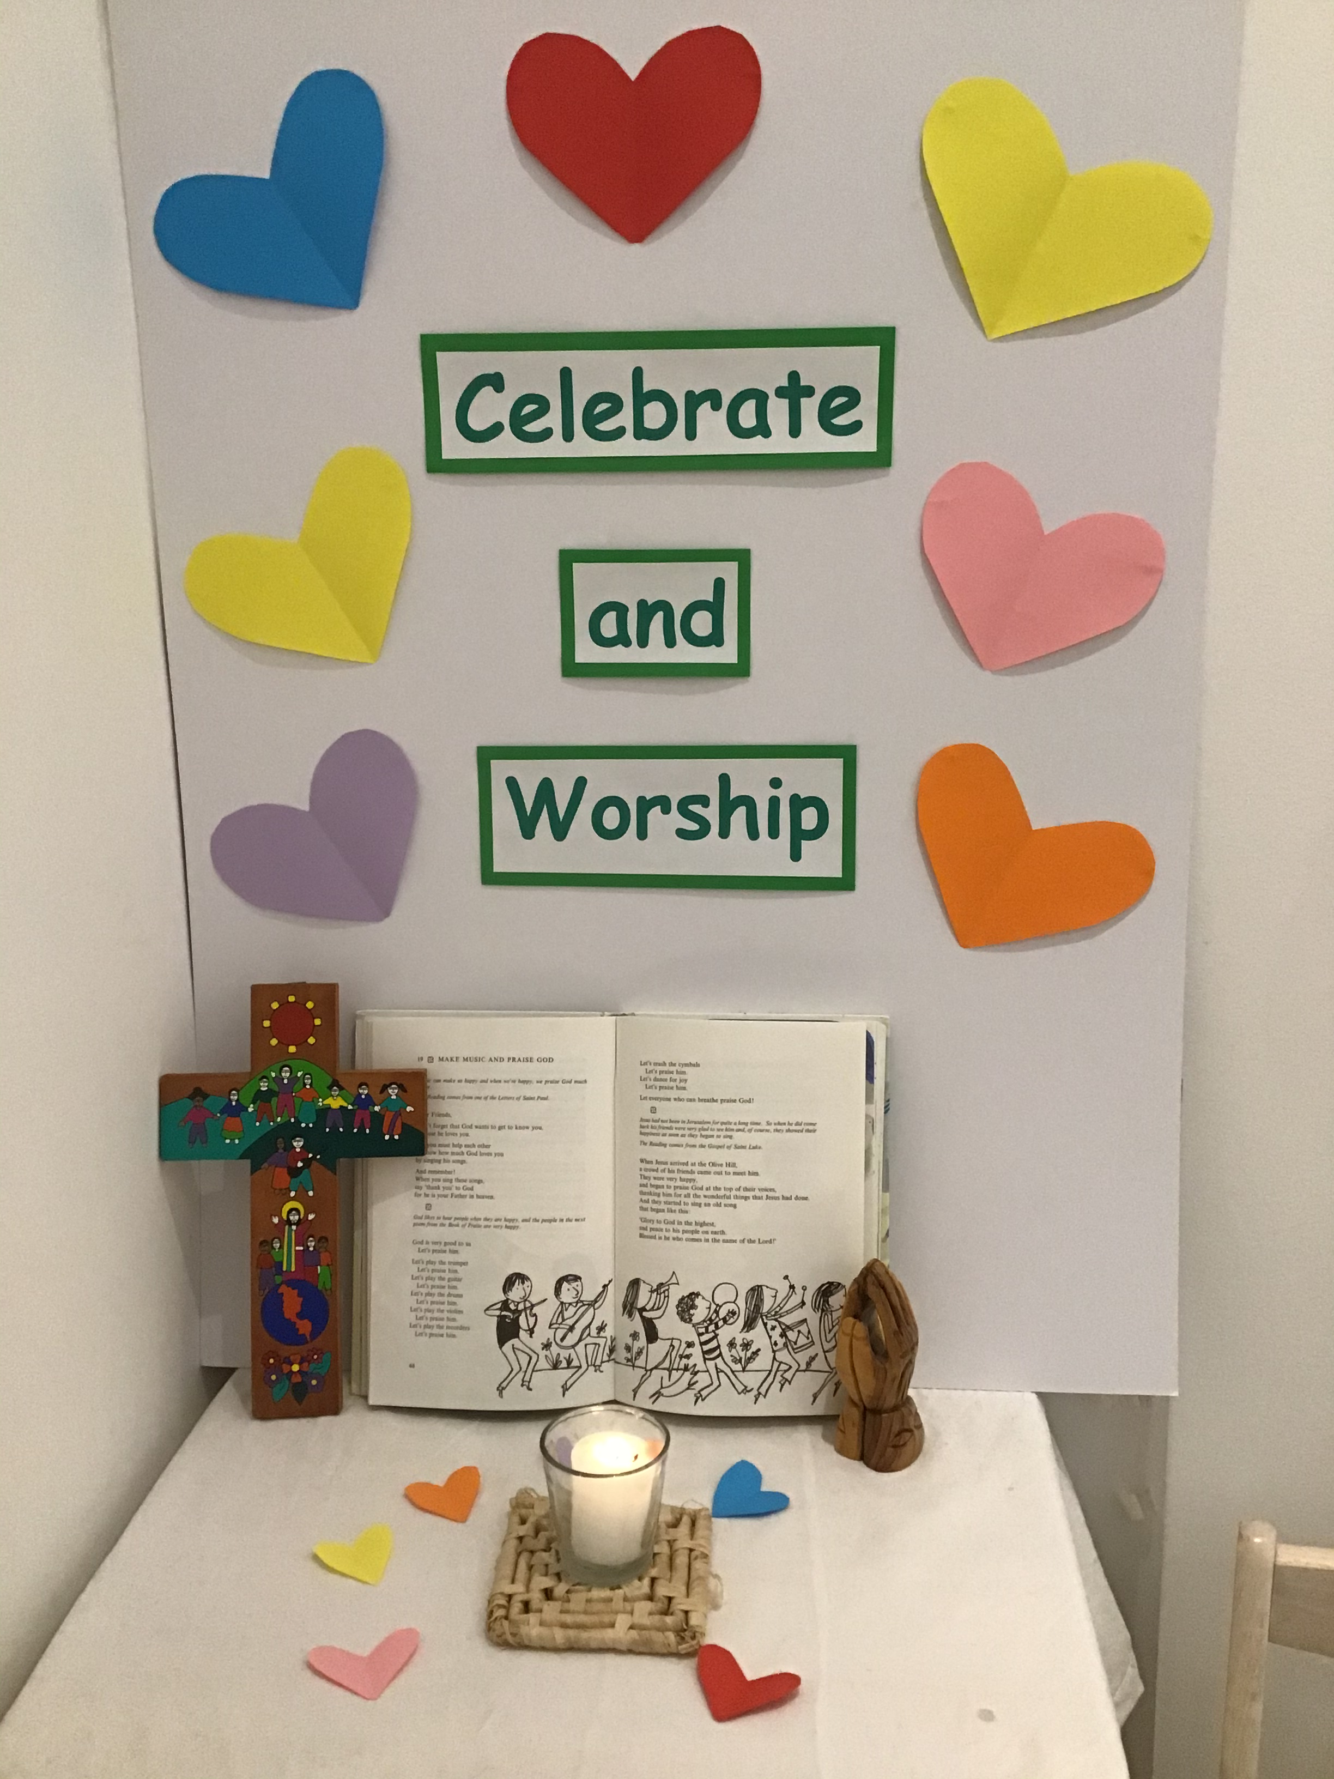
Catholic Education Week 2021
Children’s Liturgy

Slide 2
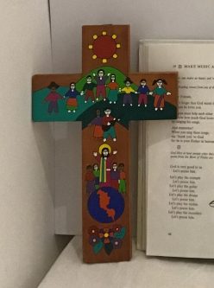
In the name of the Father
and of the Son,
and of the Holy Spirit
Amen

Slide 3
Let’s reflect
What do you think of when you think of the word ‘celebrate?’
Who do we worship?
How can we celebrate and worship God together?

Slide 4
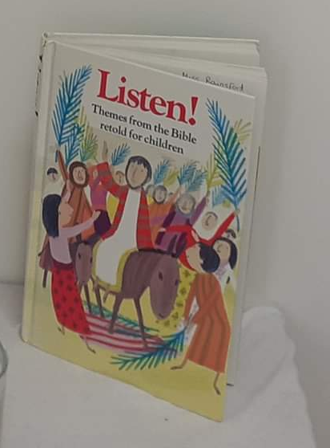
Psalm 150 from the ‘Listen’ Book
Let’s play the violin
Let’s praise Him!
Let’s play the recorder
Let’s praise Him!
Let’s crash the cymbols
Let’s praise Him!
Let’s dance for joy
Let’s praise Him!
Let everyone who can breath
Praise God!
God is very good to us
Let’s praise Him!
Let’s play the trumpet
Let’s praise Him!
Let’s play the guitar
Let’s praise Him!
Let’s play the drums
Let’s praise Him!

Slide 5
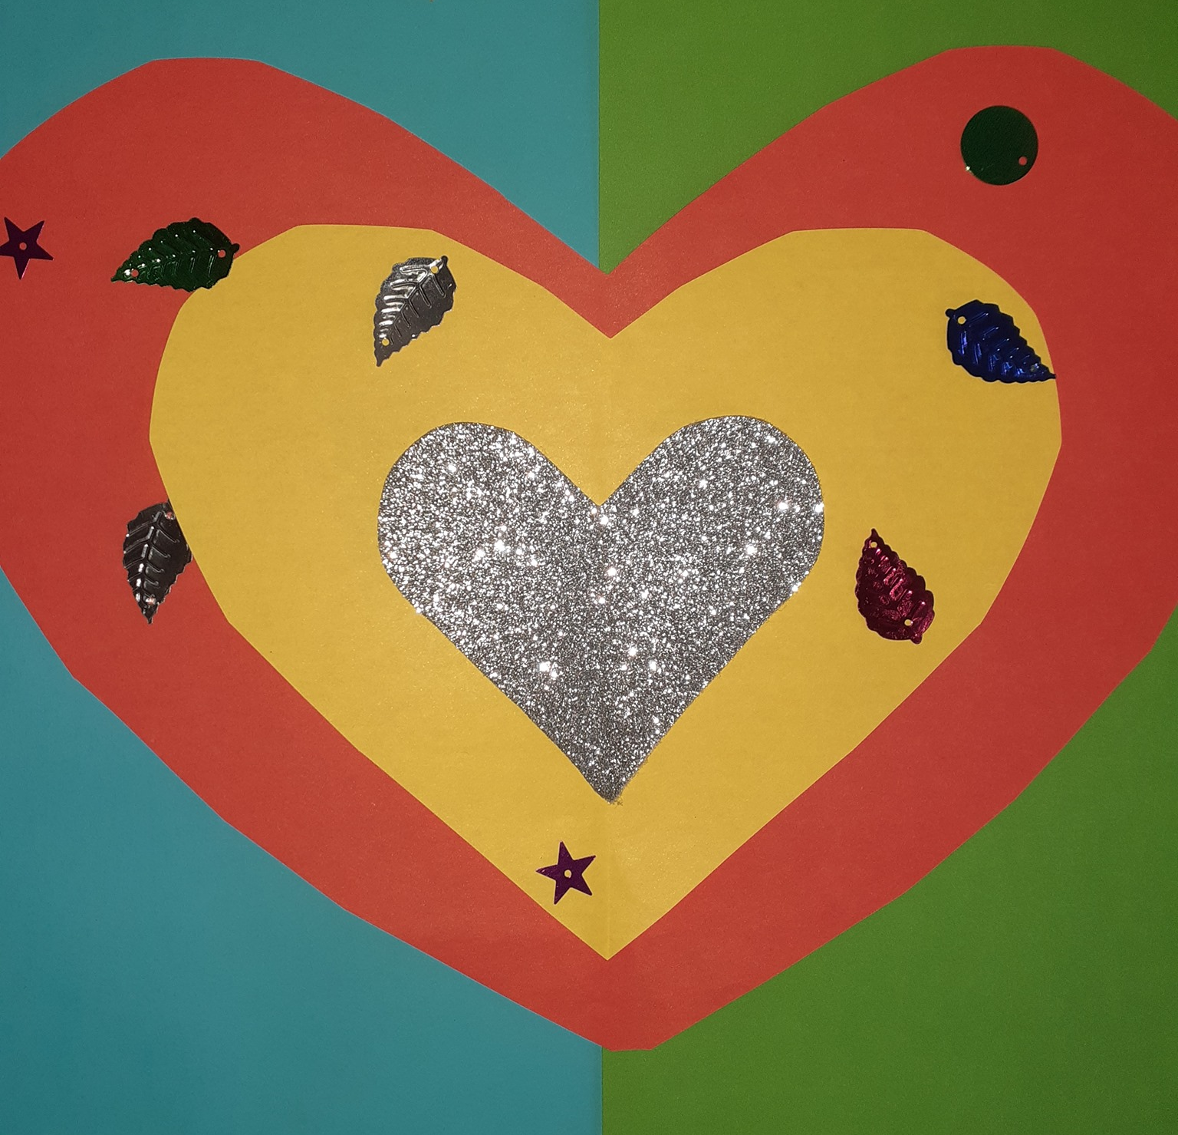
What different things do the people in the psalm do to celebrate their love for God?
What do you really enjoy doing? Can you celebrate God with this?

Slide 6
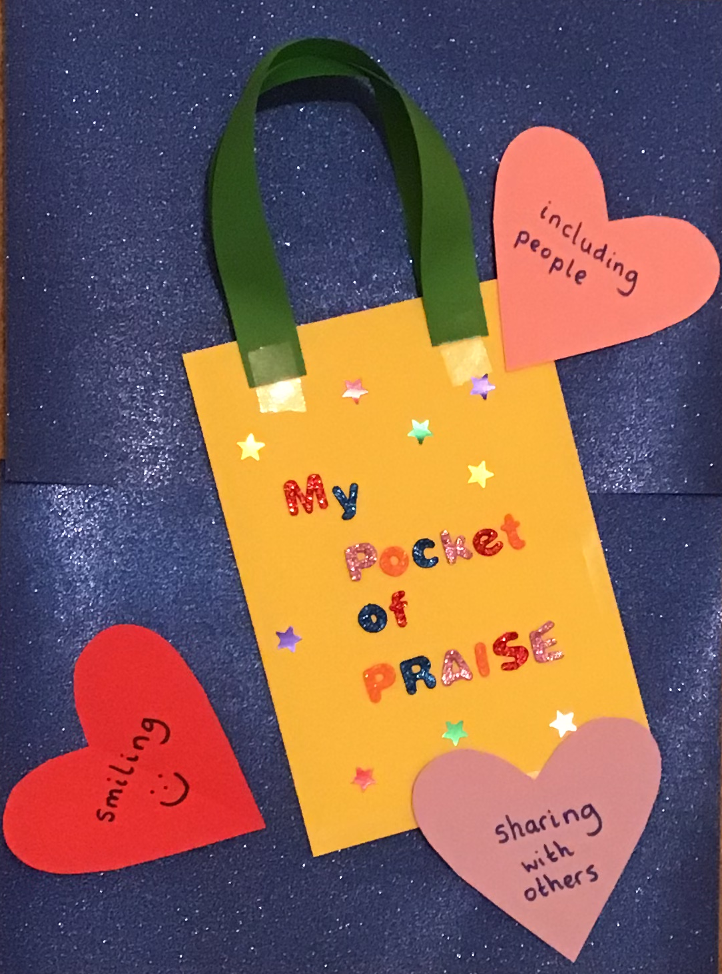
Let’s Create!
Make your very own ‘Pocket of Praise!’
- To help remind you to celebrate God every day this week!
Write ways to praise on hearts and pop them into your pocket!
To make your pocket, simply fold an A4 piece of paper in half and tape the sides and bottom together. Then attach 2 strips of paper to use as handles! Finally, decorate it! ☺

Slide 7
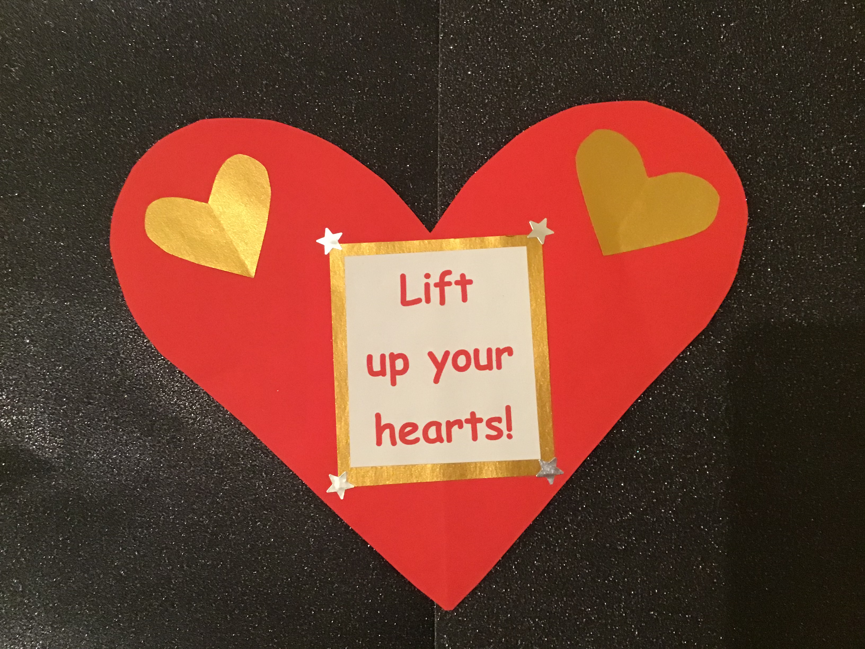
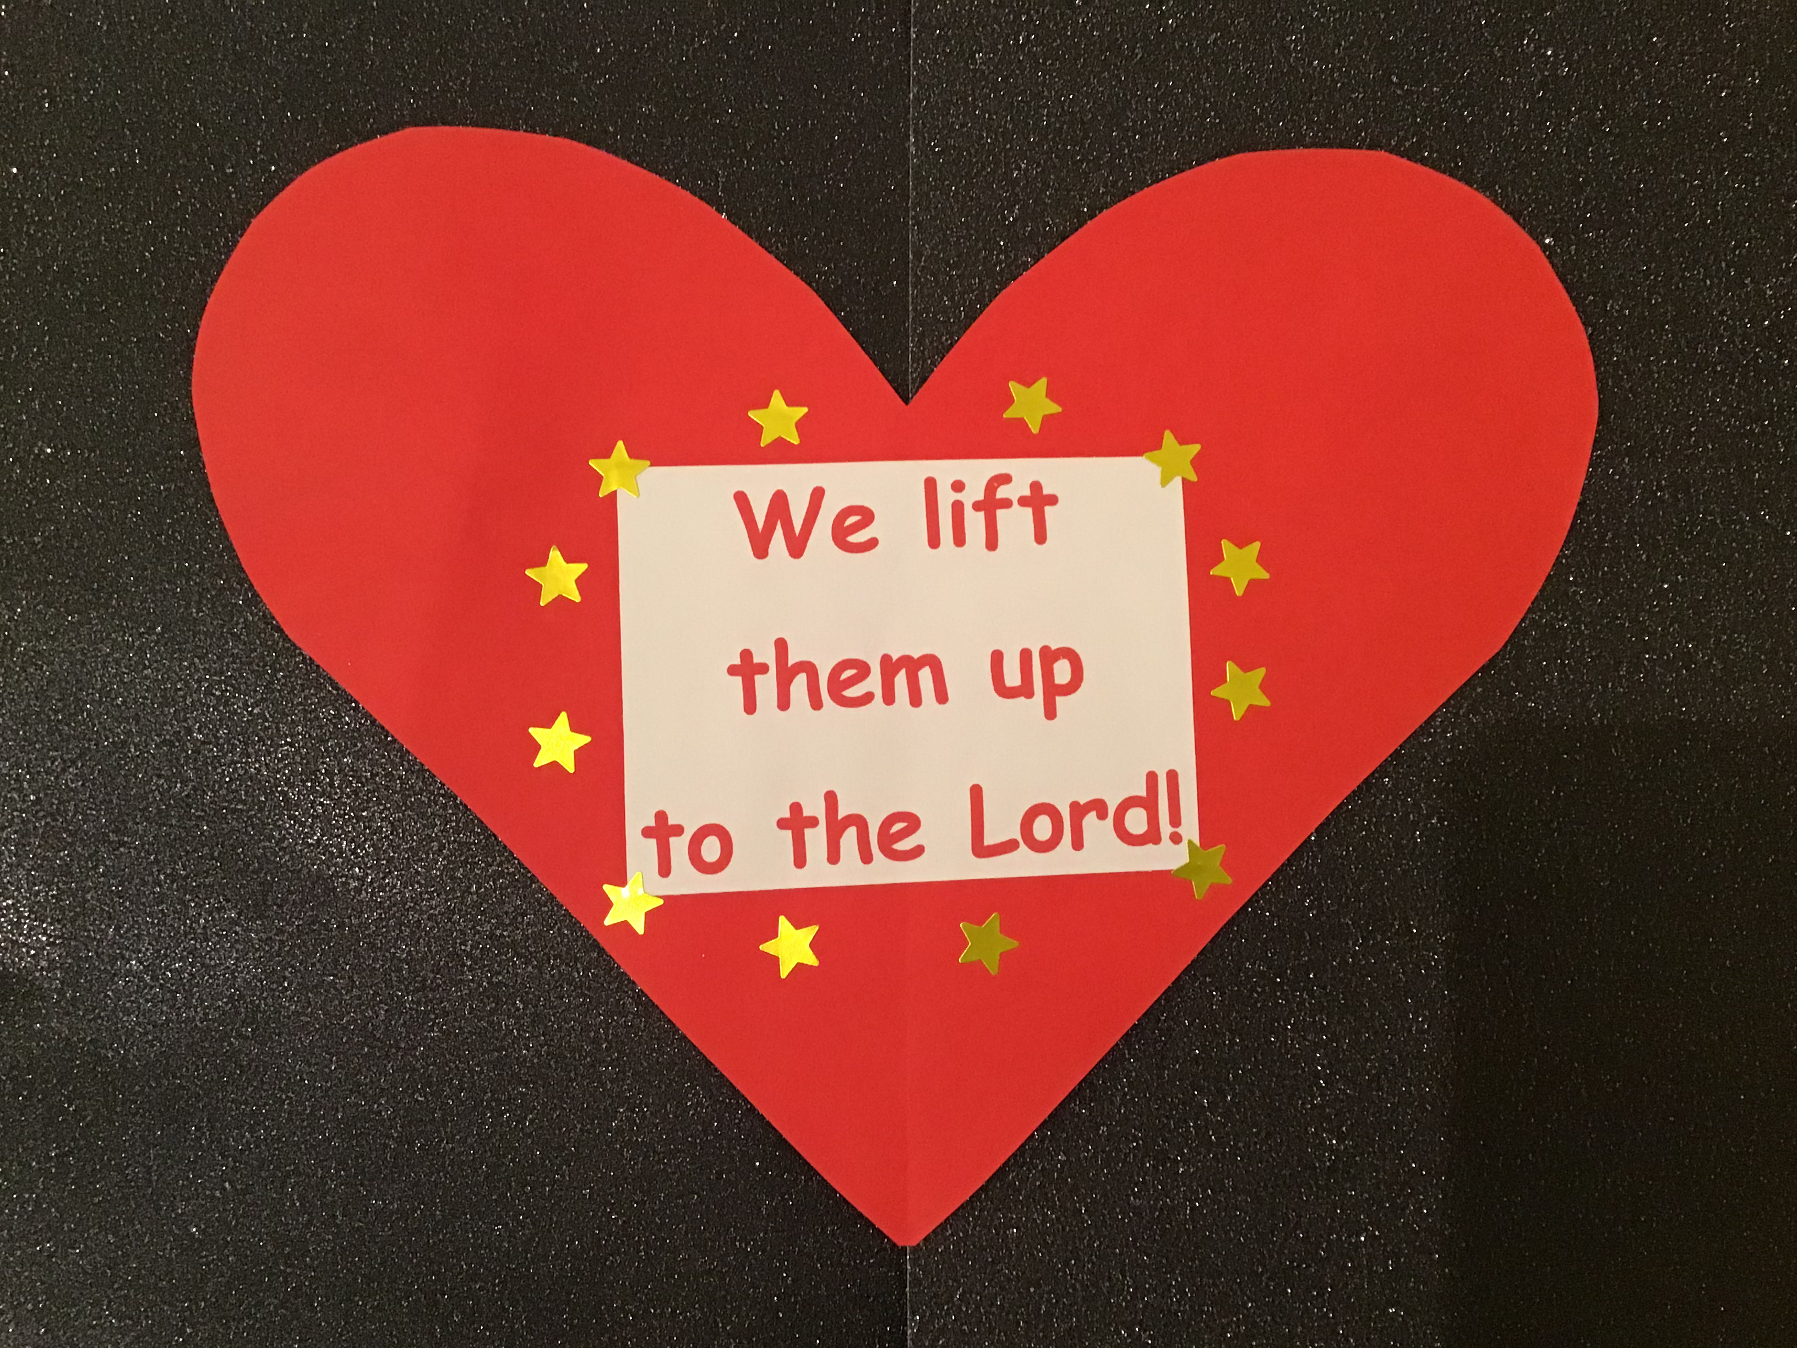
Make a heart to remind you that when we celebrate and worship together at Mass, we lift our hearts up to the Lord, who is the most high!
Tip: If you have any wooden lolly sticks in your craft box, attach it to your heart so you can lift it even higher!

Slide 8

Let’s Sing!
(To the tune of Tommy Thumbs Are Up)
Praise Him with your heart
Praise Him with your mind
Praise Him when you’re smiling
Praise Him when you’re kind
Celebrate and worship
Gather now in prayer
In the name of Jesus
He is always there

Slide 9
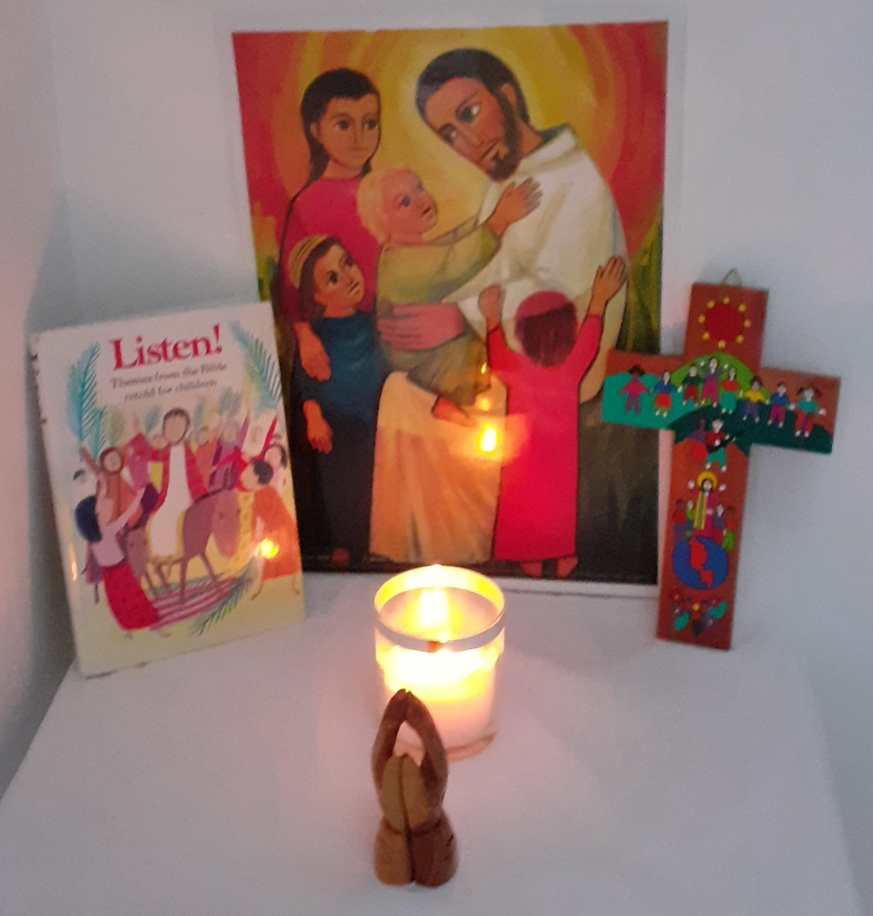
Let’s Pray!
Lord Jesus,
As we gather together in your name
to celebrate and worship,
may we remember that you are right here with us
in a very special way.
Amen

Slide 10
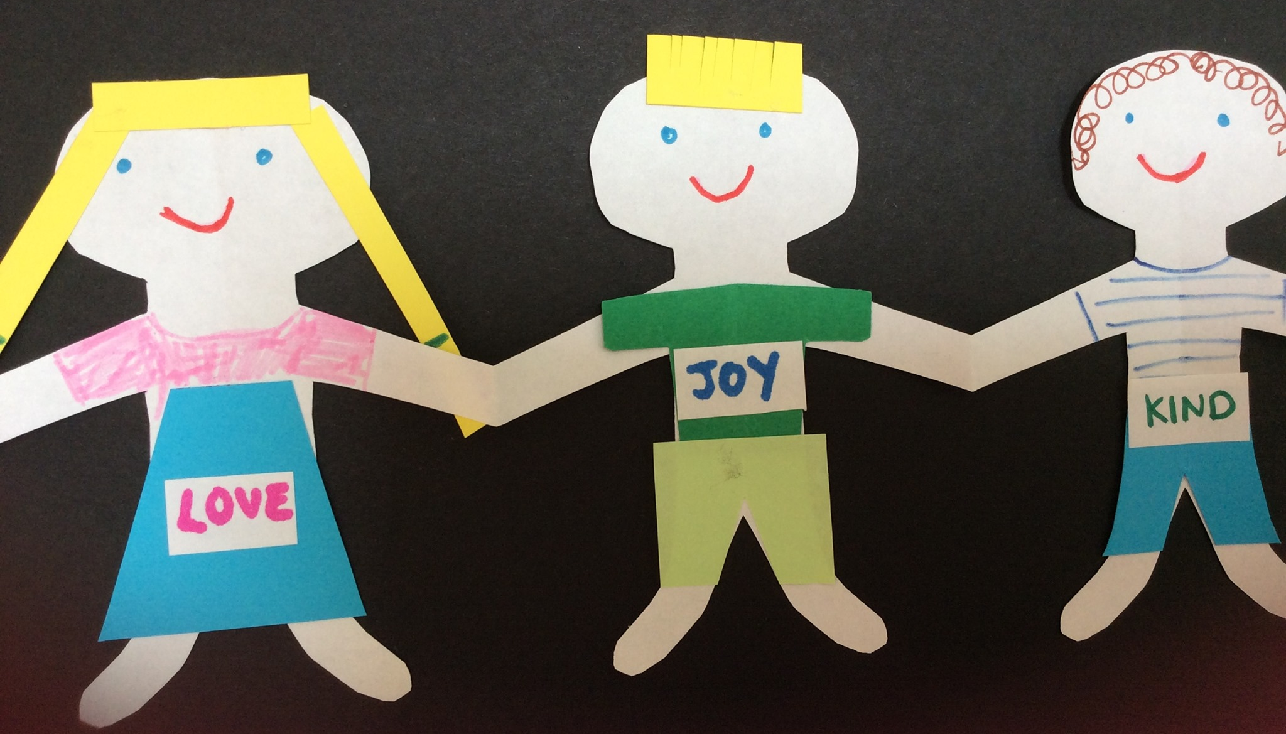
We gather together to worship!
Jesus says, “When two or three gather together in my name, I am there with you!”
As a your Children’s Liturgy Group/Class/School, each child can make a paper version of themselves. Put them all up on the wall so that they all hold hands together, as a reminder that we gather together to worship and that when we do this, Jesus is with us in a very special way!

