Slide 1
Pope Francis Faith Award
Lord Jesus,
You ask those who believe in you
To give your Good News to others.
We pray that, with the help of the Holy Spirit,
Our words, actions and prayers
Will help other people
To hear of You,
To believe in You,
And to find the joy of knowing You.
Amen

Slide 2
Pope Francis Faith Award
Success Criteria
What do I need to do? | What evidence will I need?
I will use the gifts of the Holy Spirit when showing my love of God and my love of others in my daily life. | I will record my actions in my Faith Journal.
With the support of others, I will reflect on how my actions have made an impact on my journey of faith. | I will include some reflections on these actions in my Faith Journal and my P7 Personal Profile.

Slide 3







Pope Francis Faith Award

Slide 4
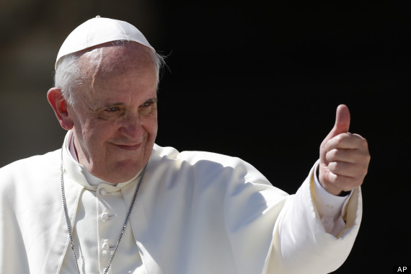
Pope Francis Faith Award
Gathering point 7 Wisdom
“Dear young people, do not bury your talents, the gifts that God has given you! Do not be afraid to dream of great things!”

Slide 5
Pope Francis Faith Award
Teacher note:
Teachers may use this power point in whatever way suits their class, and individual learners.
Time in which the gathering points are to be completed may be differentiated i.e., it may be of benefit to some learners to break each task into smaller activities.
It is important to have a timeline of when each GP will be started/completed to ensure that all learning and reflection is completed in time for submission for the award.

Slide 6
Pope Francis Faith Award
Learning intention
Explore the meaning of the term ‘wonder and awe’.
Listen to the Word of God, teaching us how ‘wonder and awe’ can be used as a gift.
Challenge myself to an act of discipleship.
Learn
about the Gift of ‘wisdom’.
Reflect
to reflect on what ‘wisdom’
means.
Act
to use wisdom.

Slide 7

Pope Francis Faith Award
‘Spend some time speaking to someone older in order to learn from their wisdom e.g., visit an elderly relative.’
‘Help someone younger with their homework.’
‘Write a newsletter to an elderly relative.’
‘Attend prayer services help in the parish for special purposes e.g., Peace, Missionary workers, etc.’
‘Notice at home when someone could use a helping hand and offer yours gardening/housework/looking after younger children.’

Slide 8

Pope Francis Faith Award
Let us begin our time together
In the name of the Father
and of the Son
and of the Holy Spirit
Amen

Slide 9

Pope Francis Faith Award
Work in a team to see how many points you can score before the starter ends.
1 Mark | 2 Marks | 3 Marks
Name all the gifts of the Holy Spirit. | Name two Old Testament prophets. | Name the last gathering point we completed as a class.
Name two communities that received letters from St Paul. | Where could you go to visit elderly people in your community? Name one place. | Can you share a complete bible reference including book, chapter, and verse?
Which sacrament helps us restore our relationship with God? | Name two parables in the New Testament. | Share one example of using the gift of understanding.

Slide 10
Pope Francis Faith Award
Work in a team to see how many points you can score before the starter ends.
1 Mark | 2 Marks | 3 Marks
Knowledge, Understanding, Wisdom, Reverence, Wonder and Awe, Right Judgement, Courage. | Isaiah, Moses, Abraham, Ezekiel, Elijah, Zechariah, Job etc. (Any two). | Name the last gathering point we completed as a class.
Romans, Corinthians, Galatians, Ephesians, Philippians, Colossians, Thessalonians. (Any two) | Where could you go to visit elderly people in your community? Name one place. | Matthew 5:1-12
Reconciliation | The lost sheep, the lost coin, the wise and the foolish servant, the mustard seed etc. (Any two). | Share one example of using the gift of understanding.

Slide 11
Pope Francis Faith Award
Wisdom is the gift of the Holy Spirit that helps us to love God and spiritual things more than material things.
It shines a light on God’s plan in our lives and in the world. ‘Wisdom’ helps us to say, ‘I understand how to love.’

Slide 12
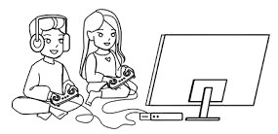
Pope Francis Faith Award
The TV/console is something we use, an item that we can see or hold, it is material.
The friendship is something we cannot see, we cannot hold it, but we can feel it’s presence, it is spiritual.

Slide 13
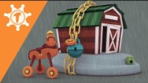


Pope Francis Faith Award
Listen to the video as Tomkin and Blaise learn about the Gift of Wisdom. List some of the key words to share with the class.
Notes:
youtu.be/dAx96FDRvx4

Slide 14
Pope Francis Faith Award
Can you explain the ‘Gift of Wisdom’?
Wisdom is the gift of the Holy Spirit that helps us to love God and spiritual things more than material things. ‘Wisdom’ helps us to say, ‘I understand how to love.’

Slide 15

Scripture Time
Listen carefully as your teacher
reads the words of Scripture.
Notes:
It may be useful to remind pupils that, when we listen to Scripture passages, we are listening to the inspired Word of God (RERC 2-12a) and that we “read aloud from Sacred Scripture in such a way that I am proclaiming the Word of God”. (core learning P6. 2-12a). While the Scripture passages have been included in each PowerPoint, you may want to first use a Bible to read from to show the proclamation of the Word, and then display the slides that follow.

Slide 16
A Reading from the book of Proverbs (9:9-12)
Anything you say to the wise will make them wiser. Whatever you tell the righteous will add to their knowledge. To be wise you must first have reverence for the Lord. If you know the Holy One, you will have understanding. Wisdom will add years to your life. You are the one who will profit if you have wisdom, and if you reject it, you are the one who will suffer.

Slide 17
Scripture Time
Your teacher will read the words of Scripture again. This time in silence.
Listen for the key words and messages from this passage.
Notes:
Re-read the passage to pupils. At the end of reading the passage give pupils some thinking time and then ask them to share the key words and messages. This can be done using ‘show me’ boards or a ‘hands-down’ question time where the teacher selects pupils to answer (rather than them volunteering a response). Both methodologies should encourage all pupils to listen carefully as they will have to share a response.

Slide 18

Scripture Time
Person 1 | Person 2
We read that ‘knowledge of the Holy One is understanding’, can you put this into your own words? | What have we learned about God that we could share with others?
We hear about lots of different ‘gifts’ in this passage. Why do you think this is? | We read that ‘Whatever you tell the righteous will add to their knowledge.’ Who do you think are the righteous in our society?
Why do you think we are told, ‘To be wise you must first have reverence for the Lord’. | Now that we have learned about wisdom, do you think it changes how you will use the other gifts that you already know?

Slide 19
Pope Francis Faith Award
Listen to our Gospel passage again.
In the Knowledge gathering point, we imagined that we were one of King Solomons followers. This time imagine you are the writer himself, King Solomon. You learn that your people are offending God and so decide to write a book to teach them right from wrong.
What are some of the offences people have been committing.
How will you speak to them in your book; the book of Proverbs?
How do you know what God wants you to do?

Slide 20
Pope Francis Faith Award
Learning intention
Explore the meaning of the word ‘Wisdom’.
Listen to the Word of God, teaching us how wisdom can be used as a gift.
Challenge myself to an act of discipleship.
Learn
about the Gift of Wisdom.
Reflect on what Wisdom
means.
Act
to use Wisdom.

Slide 21
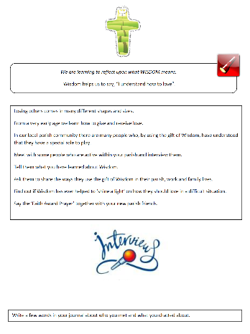
Pope Francis Faith Award
We have all been called by God to be disciples, this means that we should ‘go out’ and share our learning about Him.
Meet with some people who are active within your parish and interview them.
Share what you have learned about Wisdom with them. Ask them to share the ways they use the gift of Wisdom in their parish, work and family lives.

Slide 22
Pope Francis Faith Award
The Gift of Wisdom helps us to say, “I understand how to love”.
Answer the following questions in your journal for school, home, and parish:
What are some words and examples that I can use to explain the gift of Wisdom?
Do you think the more you use the gift of wisdom, the more you will benefit from it? Explain your answer in a few sentences.
How can we use the gift of wisdom to help others know Jesus?

Slide 23
Pope Francis Faith Award
Reflection
Examination of Conscience

Slide 24
Pope Francis Faith Award
Think about all the times that we have made good decisions, loved God and others and done the right thing.
Think about the times when we made bad choices that we are not proud of.
Think about how not to do that again in the future.

Slide 25
Faith Prayer
Lord Jesus,
You ask those who believe in you
to give your Good News to others.
We pray that, with the help of the Holy Spirit,
our words and actions
will help other people
to hear of You,
to believe in You
to find the joy of knowing You.
Amen

Slide 26
Pope Francis Faith Award
‘Spend some time speaking to someone older in order to learn from their wisdom e.g., visit an elderly relative.’
‘Help someone younger with their homework.’
‘Write a newsletter to an elderly relative.’
‘Attend prayer services help in the parish for special purposes e.g., Peace, Missionary workers, etc.’
‘Notice at home when someone could use a helping hand and offer yours gardening/housework/looking after younger children.’

Slide 27
Extension activity
Reflection
The following slides can be used to prompt children who are finished recording their findings from their meeting on slide 21.

Slide 28
Extension activity
Reflection 1
Lord Jesus.
You ask those who believe in you
to give your Good News to others.
Read the part of our prayer above. Think about the questions below. Write your answer on the free pages of your journal.
What do I know about the Wisdom of Jesus?
2. When have I used the gift of Wisdom in my life?

Slide 29
Extension activity
Reflection 2
We pray that, with the help
of the Holy Spirit,
our words and actions
Read the part of our prayer above. Think about the questions below. Write your answer on the free pages of your journal.
1. What words can I use to explain why it is important to use our gift of wisdom?
2. What actions could I take to show my wisdom to others?

Slide 30
Extension activity
Reflection 3
….and prayers will help other people
to believe in You
Read the part of our prayer above. Think about the questions below. Share your thoughts on the free pages of your journal.
Do other people know that I recognise the value of wisdom because of my faith?
How can I use wisdom to help others believe in Jesus?

Slide 31
Extension activity
Reflection 4
….and to find the joy of knowing You.
Read the part of our prayer above. Think about the questions below. Share your thoughts on the free pages of your journal.
How do I use my gift of wisdom to grow in love of God?
2. How do I share what I have learned about God from the book of Proverbs?

Slide 32
Extension activity
Reflection 5
Examination of conscience
What could I do more of to share my faith?
How do I show my faith in school?
In what ways is my life at home filled with faith?
What do I do in my parish to show others I believe?

