Slide 1
Pope Francis Faith Award
Lord Jesus,
You ask those who believe in you
To give your Good News to others.
We pray that, with the help of the Holy Spirit,
Our words, actions and prayers
Will help other people
To hear of You,
To believe in You,
And to find the joy of knowing You.
Amen

Slide 2
Pope Francis Faith Award
Success Criteria
What do I need to do? | What evidence will I need?
I will use the gifts of the Holy Spirit when showing my love of God and my love of others in my daily life. | I will record my actions in my Faith Journal.
With the support of others, I will reflect on how my actions have made an impact on my journey of faith. | I will include some reflections on these actions in my Faith Journal and my P7 Personal Profile.

Slide 3







Pope Francis Faith Award

Slide 4
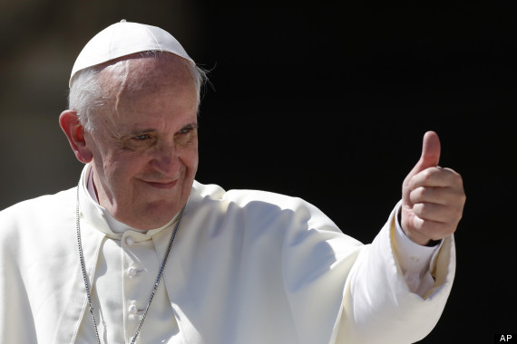
Pope Francis Faith Award
Gathering point 6 Wonder and Awe
“Dear young people, do not bury your talents, the gifts that God has given you! Do not be afraid to dream of great things!”

Slide 5
Pope Francis Faith Award
Teacher note:
Teachers may use this power point in whatever way suits their class, and individual learners.
Time in which the gathering points are to be completed may be differentiated i.e., it may be of benefit to some learners to break each task into smaller activities.
It is important to have a timeline of when each GP will be started/completed to ensure that all learning and reflection is completed in time for submission for the award.

Slide 6
Pope Francis Faith Award
Learning intention
Explore the meaning of the term ‘wonder and awe’.
Listen to the Word of God, teaching us how ‘wonder and awe’ can be used as a gift.
Challenge myself to an act of discipleship.
Learn
about the Gift of ‘wonder and awe’.
Reflect
to reflect on what ‘wonder and awe’
means.
Act
to use Wonder and Awe.

Slide 7

Pope Francis Faith Award
‘Go for a walk and really look carefully around you, appreciating what you see.’
‘Write a prayer to thank God for something beautiful that you have seen.’
‘Help to keep the garden of your home/school/church looking beautiful.’
‘Write a poem about being amazed by the wonders of the universe.’
‘Create a poster advertising something wondrous or awesome that is part of God’s creation.’

Slide 8

Pope Francis Faith Award
Let us begin our time together
In the name of the Father
and of the Son
and of the Holy Spirit
Amen

Slide 9

Pope Francis Faith Award
Work in a team to see how many points you can score before the starter ends.
1 Mark | 2 Marks | 3 Marks
Name all the gifts of the Holy Spirit. | Who wrote to the letter to the people of Corinth? | Name the last gathering point we completed as a class.
Name two Gospel writers. | How many gifts of the Holy Spirit are there? | Can you share a complete bible reference including book, chapter, and verse?
Reverence is another word for piety, true/false? | Name two bible stories where we experience wonder and awe. | Which gift provides us with the spirit of fortitude?

Slide 10
Pope Francis Faith Award
Work in a team to see how many points you can score before the starter ends.
1 Mark | 2 Marks | 3 Marks
Knowledge, Understanding, Wisdom, Reverence, Wonder and Awe, Right Judgement, Courage. | St Paul i.e., St Paul’s Letter to the Corinthians. | Name the last gathering point we completed as a class.
Matthew, Mark, Luke, John (any two). | 7 | e.g., Book of Proverbs 2:1-6
True | e.g., David and Goliath, Battle of Jericho, Creation etc. | Courage

Slide 11
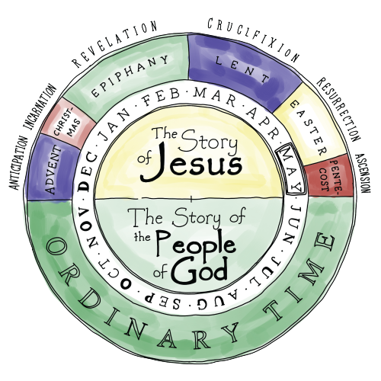
Pope Francis Faith Award
It is important that we allow ourselves to experience wonder and awe because this is the seed that helps our faith grow.
We know that we are becoming closer to God when we can recognise the mystery of our faith.

Slide 12
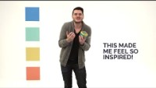


Pope Francis Faith Award
Listen to the presenter explain ‘Wonder and Awe’. Who do you think is the something bigger trying to get through?

Slide 13
Pope Francis Faith Award
Can you explain what ‘Wonder and Awe’ means?
Wonder and awe is the gift of the Holy Spirit that helps us become aware of the glory and majesty of God; it is the beginning of Wisdom because it helps us see that God is the Father Almighty, Creator of Heaven and Earth.

Slide 14
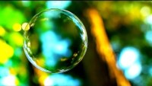
Scripture Time
Listen carefully as your teacher
reads the words of Scripture.
Notes:
It may be useful to remind pupils that, when we listen to Scripture passages, we are listening to the inspired Word of God (RERC 2-12a) and that we “read aloud from Sacred Scripture in such a way that I am proclaiming the Word of God”. (core learning P6. 2-12a). While the Scripture passages have been included in each PowerPoint, you may want to first use a Bible to read from to show the proclamation of the Word, and then display the slides that follow.
A Reading from St. Paul’s letter to the Philippians(4:8&9)
In conclusion, my brothers and sisters, fill your minds with those things that are good and that deserve praise: things that are true, noble, right, pure, lovely, and honourable. Put into practice what you have learnt and received from me, both from my words and from my actions. And the God who gives us peace will be with you.

Slide 15
A Reading from St. Paul’s letter to the Philippians
(4:8&9)
In conclusion, my brothers and sisters, fill your minds with those things that are good and that deserve praise: things that are true, noble, right, pure lovely, and honourable. Put into practice what you have learnt and received from me, both from my words and from my actions. And the God who gives us peace will be with you.

Slide 16
Scripture Time
Your teacher will read the words of Scripture again. This time in silence.
Listen for the key words and messages from this passage.
Notes:
Re-read the passage to pupils. At the end of reading the passage give pupils some thinking time and then ask them to share the key words and messages. This can be done using ‘show me’ boards or a ‘hands-down’ question time where the teacher selects pupils to answer (rather than them volunteering a response). Both methodologies should encourage all pupils to listen carefully as they will have to share a response.

Slide 17

Scripture Time
Person 1 | Person 2
What things in the world do you think are good, and deserve praise? Try to think about amazing, clever, natural things as well as technology, people, landscapes etc. | What things in the world do you think are good, and deserve praise? Try to think about amazing, clever, natural things as well as technology, people, landscapes etc.
Think about the words that St. Paul uses to describe things that deserve praise: True, Noble, Right, Pure, Lovely, Noble. Do these words help you to add any more items to your list of ‘good’ things. | The gift of Wonder and Awe challenges us to see the goodness and beauty in all of God’s creation – in all that is true, noble, right, pure, lovely and honourable. Can you think of a time that you have seen or put into action some or all of these things?
St. Paul says that we should put into practice what he has taught us. How is his life wonderful and awe inspiring? | How can we learn from St Paul, and be inspiring to others.

Slide 18
Pope Francis Faith Award
Listen to our Gospel passage again.
This time imagine you are the Philippians.
Close our eyes and take time to reflect on our learning.
How do you feel when you hear Pauls voice? Remember he is not yet a Saint.
How do you understand what he is telling you?
Why do you think he is telling you to learn form both his words and actions ?

Slide 19
Pope Francis Faith Award
Learning intention
Explore the meaning of the term ‘wonder and awe’.
Listen to the Word of God, teaching us how wonder and awe can be used as a gift.
Challenge myself to an act of discipleship.
Learn
about the Gift of Wonder and awe.
Reflect on what Wonder and awe
means.
Act
to use Wonder and awe.

Slide 20
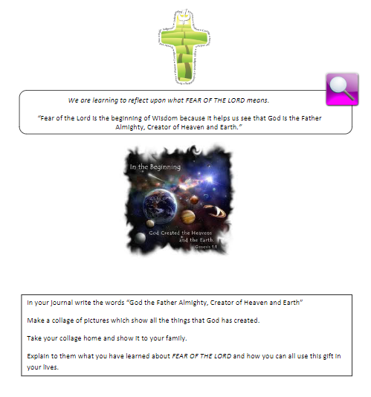
Pope Francis Faith Award
Think about all that you have learned about the gift of Wonder and awe.
Why do you think this gift is also known as ‘Fear of the Lord’?
Create a collage using ICT/paper to show some examples you have learned about which represent Wonder and awe.
As an extra challenge – can you present your findings to the class?

Slide 21
Pope Francis Faith Award
The gift of Wonder and awe is an invitation to get to know God.
Answer the following questions in your journal for school, home, and parish:
Sometimes we forget to use the Gifts that we have. What can we do to remember them better?
Do you think the more you use the gift of wonder and awe, the more you will benefit from it?
How can we use the gift of wonder and awe to help others know Jesus?

Slide 22
Pope Francis Faith Award
Reflection
Examination of Conscience

Slide 23
Pope Francis Faith Award
Think about all the times that we have made good decisions, loved God and others and done the right thing.
Think about the times when we made bad choices that we are not proud of.
Think about how not to do that again in the future.

Slide 24
Faith Prayer
Lord Jesus,
You ask those who believe in you
to give your Good News to others.
We pray that, with the help of the Holy Spirit,
our words and actions
will help other people
to hear of You,
to believe in You
to find the joy of knowing You.
Amen

Slide 25
Pope Francis Faith Award
‘Go for a walk and really look carefully around you, appreciating what you see.’
‘Write a prayer to thank God for something beautiful that you have seen.’
‘Help to keep the garden of your home/school/church looking beautiful.’
‘Write a poem about being amazed by the wonders of the universe.’
‘Create a poster advertising something wondrous or awesome that is part of God’s creation.’

Slide 26
Extension activity
Reflection
The following slides can be used to prompt children who are finished creating their collage on slide 20.

Slide 27
Extension activity
Reflection 1
Lord Jesus.
You ask those who believe in you
to give your Good News to others.
Read the part of our prayer above. Think about the questions below. Write your answer on the free pages of your journal.
What do I know about the wonder and awe of Jesus?
2. How can I share my learning so that others may experience the wonder and awe of Him?

Slide 28
Extension activity
Reflection 2
We pray that, with the help
of the Holy Spirit,
our words and actions
Read the part of our prayer above. Think about the questions below. Write your answer on the free pages of your journal.
1. What words can I use to emphasise the wonder and awe of my faith?
2. What actions should I demonstrate to share my care love of the wonder and awe of God’s creation?

Slide 29
Extension activity
Reflection 3
….and prayers will help other people
to believe in You
Read the part of our prayer above. Think about the questions below. Share your thoughts on the free pages of your journal.
Do other people know that I recognise wonder and awe because of my faith?
How can I use wonder and awe to help others believe in Jesus?

Slide 30
Extension activity
Reflection 4
….and to find the joy of knowing You.
Read the part of our prayer above. Think about the questions below. Share your thoughts on the free pages of your journal.
How do I use my gift of wonder and awe to grow in love of God?
2. How do I share what I have learned about God as the creater of all things wonderous and awesome?

Slide 31
Extension activity
Reflection 5
Examination of conscience
What could I do more of to share my faith?
How do I show my faith in school?
In what ways is my life at home filled with faith?
What do I do in my parish to show others I believe?

