Slide 1
Putting Laudato Si’ into Practice
Ben Wilson - SCIAF

Slide 2
Overview
Session 1 – Practicing Laudato Si’ – 0945 - 1045
Introduction to Laudato Si’
Laduato Si’ & Global Climate Policy
Using Laudato Si’ to create change
Thinking Coffee Break – 1045
Session 2 – Living Laudato Si’ – 1115 - 1200
Personal Faith
Parish Life
Living Laudato Si at SCIAF…

Slide 4
Catholic Social Teaching

Slide 5
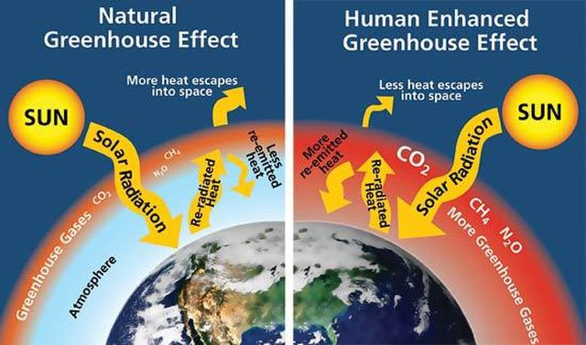

Slide 6
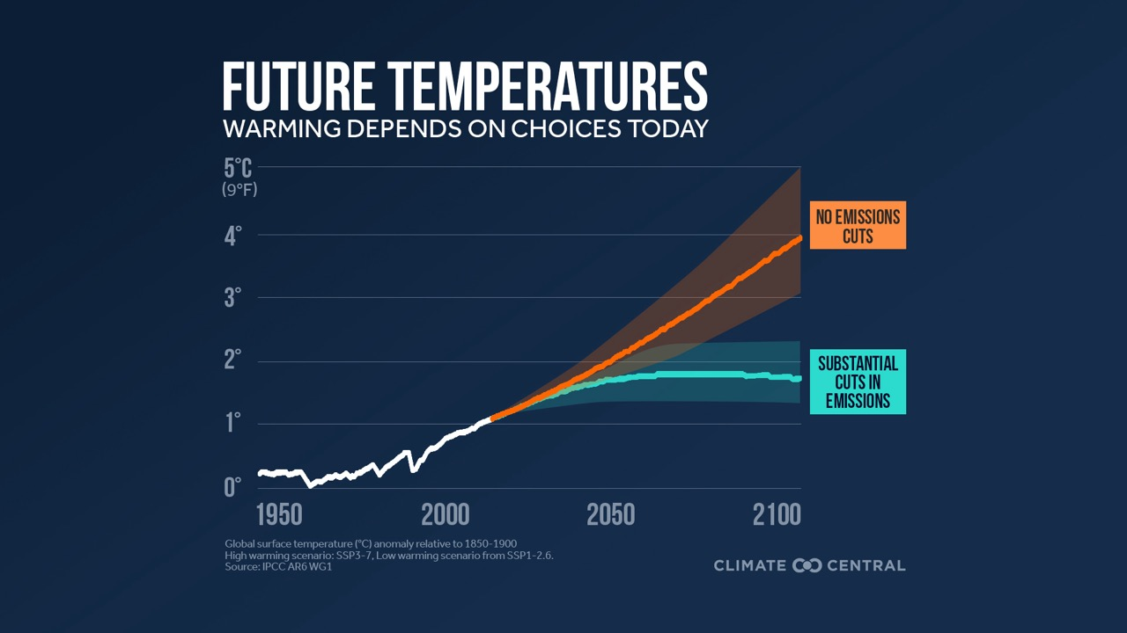

Slide 7
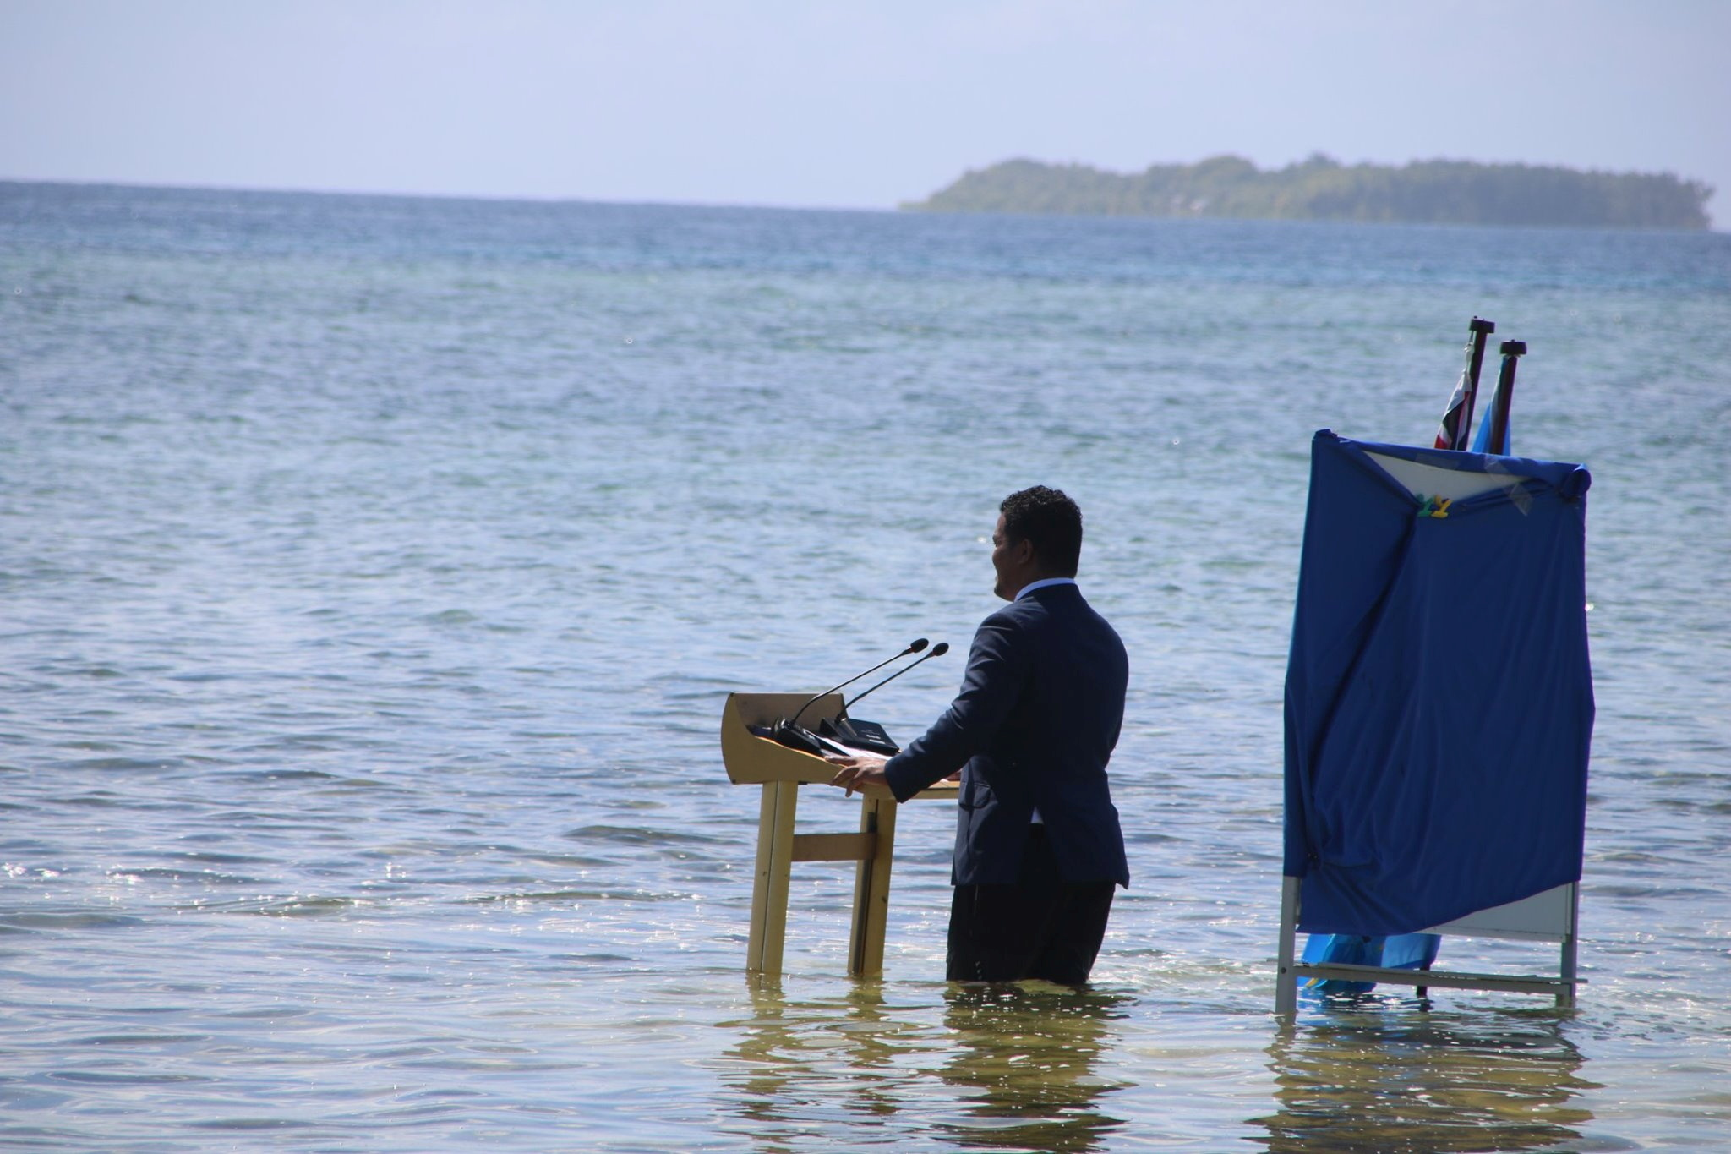
Sea-Level Rise

Slide 8
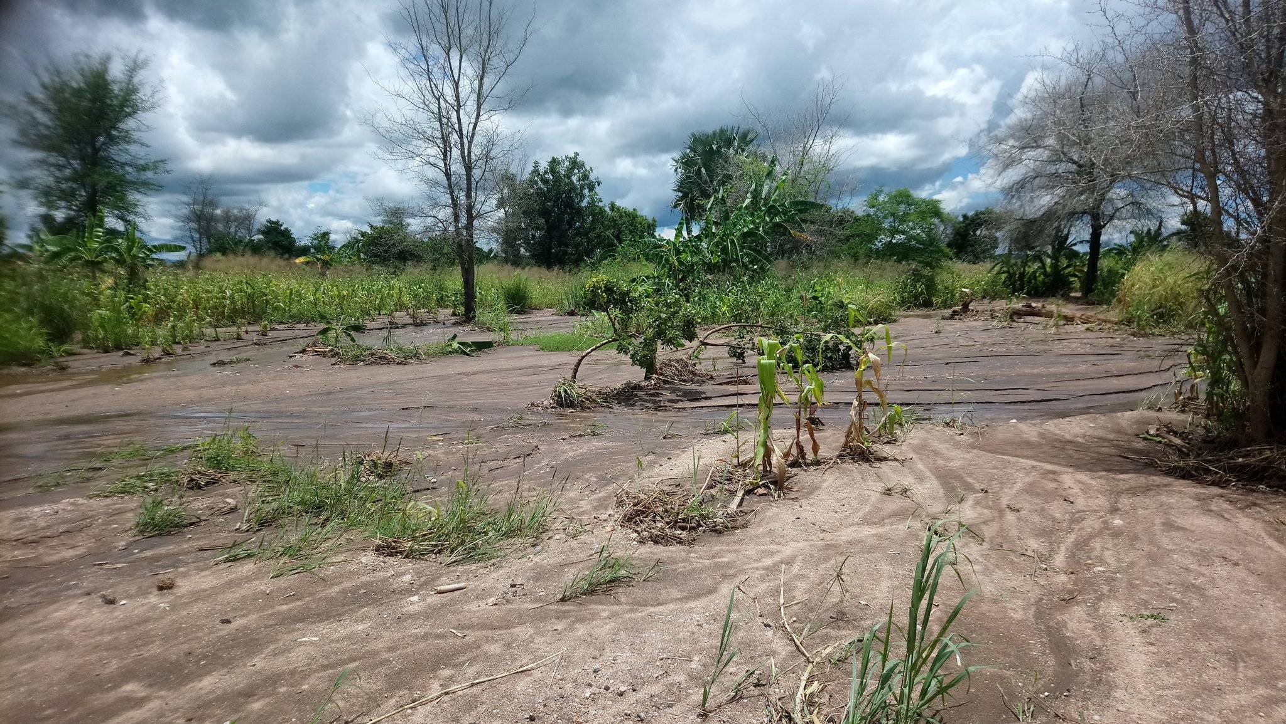
Changing Weather

Slide 9
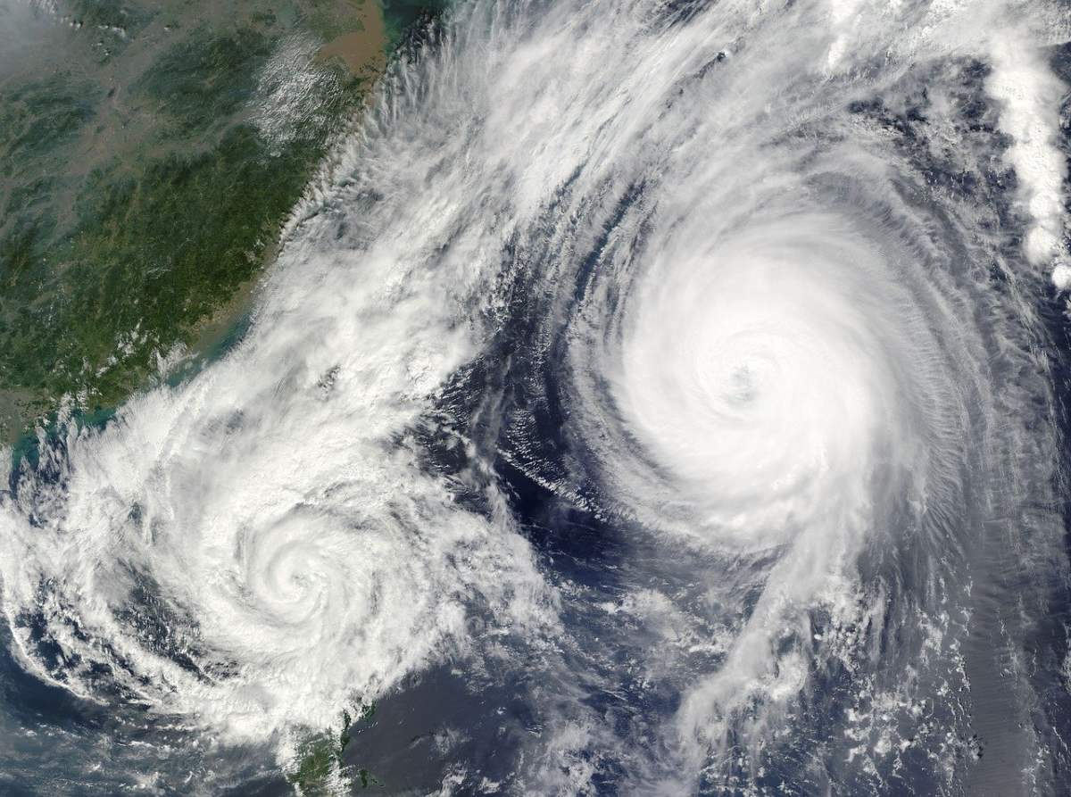
Extreme Weather

Slide 10
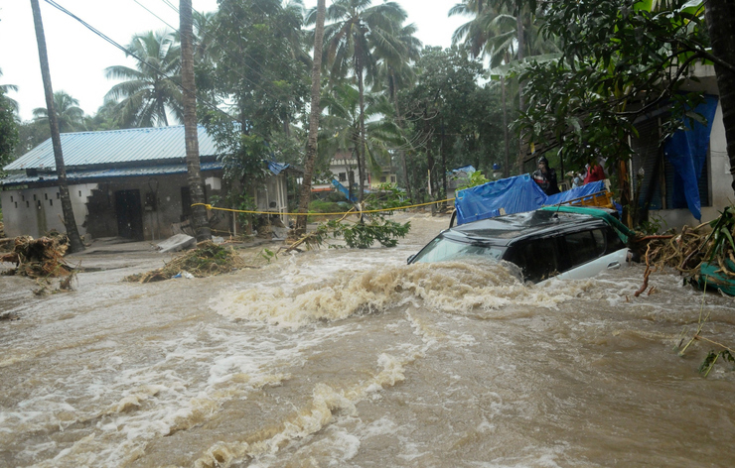
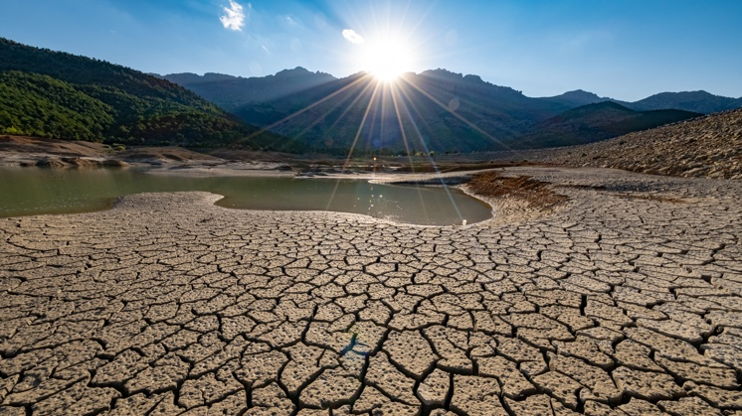
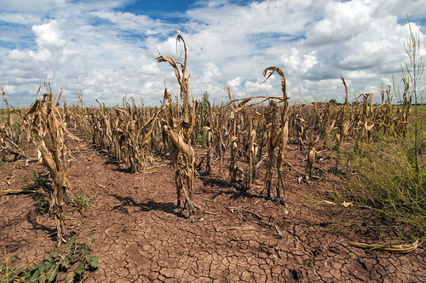
LOSS & DAMAGE

Slide 11
Laudato Si’

Slide 12
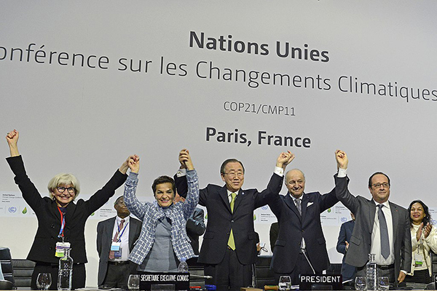
Paris Agreement

Slide 13
How does climate action relate to tackling global poverty?
Is our ambition for the climate crisis enough?
Do our climate plans consider the environment as a whole?
Are we being participatory, democratic and synodal?
Are we delivering a just transition?
Are we addressing the personal and spiritual dimensions of addressing climate change?

Slide 16
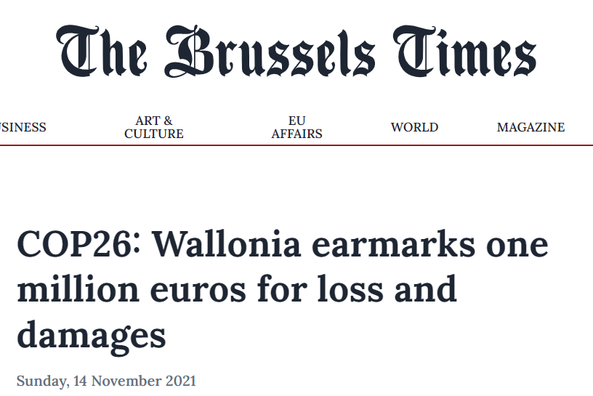
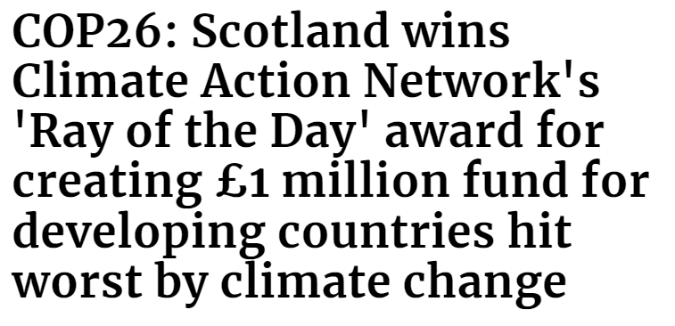
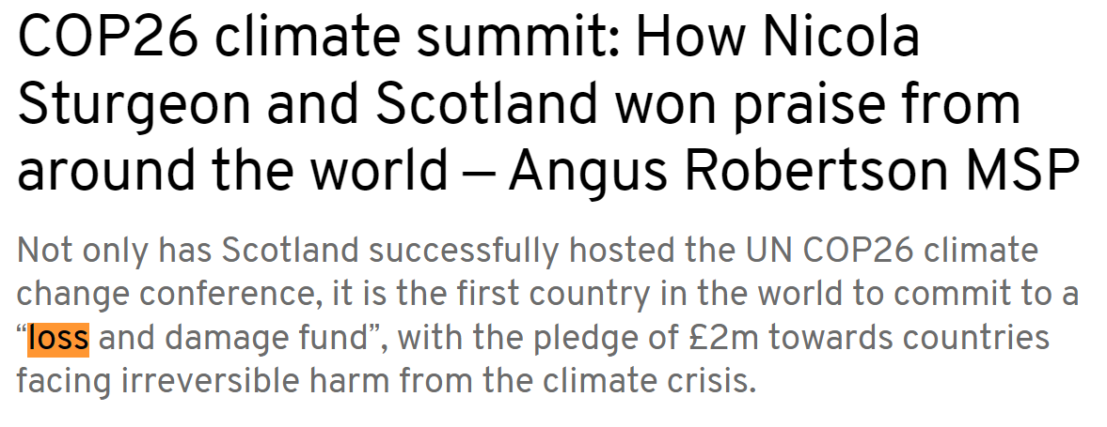
COP26

Slide 19
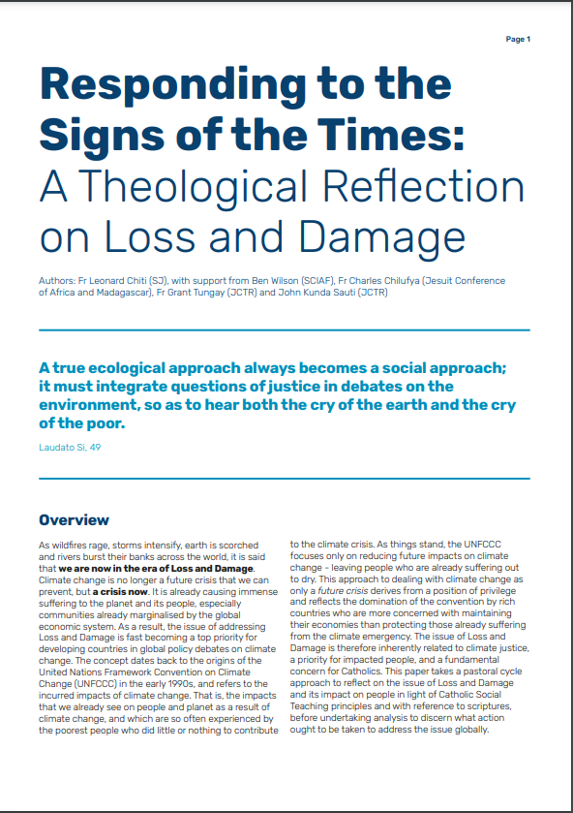
The common good
Solidarity
The preferential option for the poor
A science of loss
Restorative justice
Prophetic vision

Slide 20
The Veil of Ignorance

Slide 21
Thank You! Break starts at 1045 Any question in the meantime?

Slide 22
How has faith motivated your commitment to Laudato Si?

Slide 24
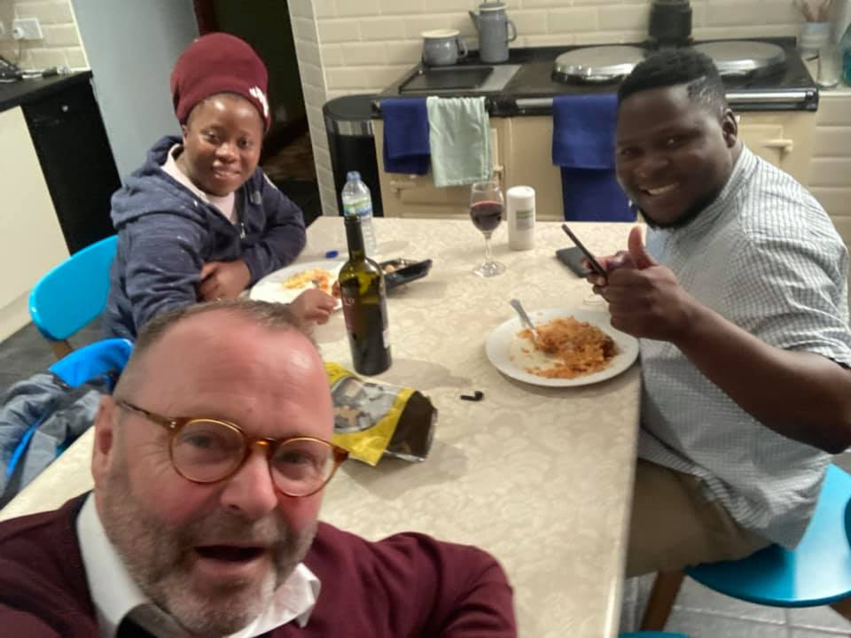

Slide 25
Communities of Practice

Slide 26
1) Critical Pedagogy
Notes:
The goal of dialogue is social not individual change
Discernment and encounter
Education takes place where there are two learners who occupy somewhat different spaces in an ongoing dialogue. First when we learn from each other sknowledge. Second when we learn from reflection on the self.

Slide 27
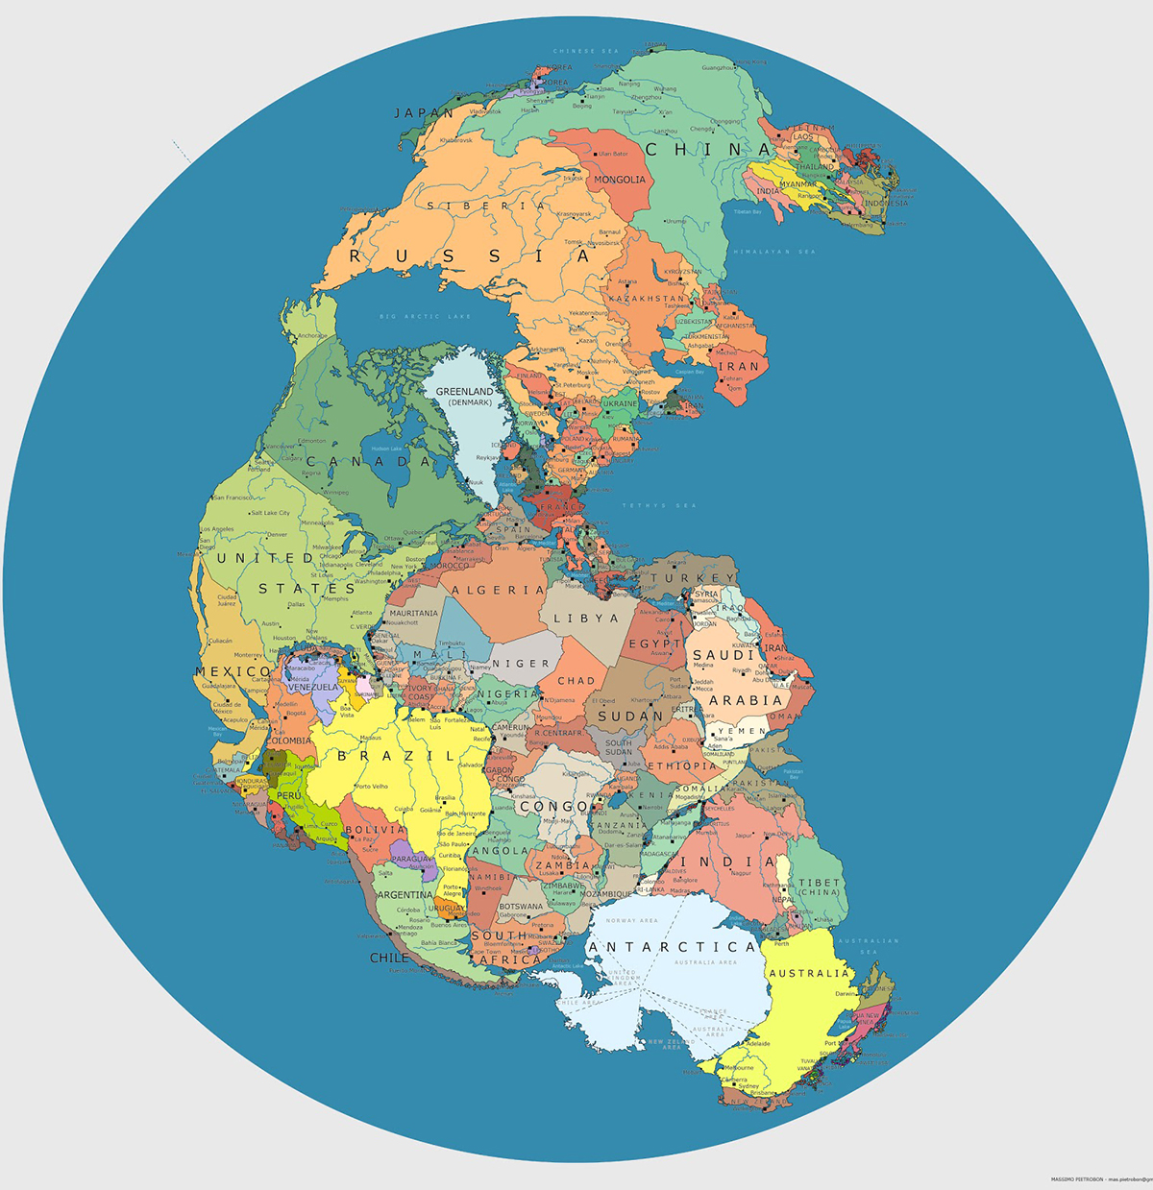
2) From Local to Global
Notes:
Human nature – Marx, then Havel
Political Ontologies – real politick of values based
Different sides of the debate – CISONECC and climate finance
Moving with the times – no one solution

Slide 28
3) Building Power
Notes:
How do we build power? What is the role of anger and reaction in our responses to injustice?
Reflection is only real when it sends us back to the situation in which we act – Satre
Not just feeding the poor buy asking why the poor have no food
Best focus group in Malawi – the point is not just to interpret the world, the point is to change it
Not capacity building. That is too often used in a uni direction way – rightly or wrongly. This is about building power together, across countries and with different political realities.

Slide 29
How can you support this kind of work?

Slide 30
Pray

Slide 31
March

Slide 32
Donate

Slide 33
Petition

Slide 34
Social Media

Slide 35
What do you think of the methods of action I have shared? What is the most important?
How do you practice Laudato Si’ in your role as educators? What else could you do?

Slide 36
bwilson@sciaf.org.uk
Thank you!

